Slide 1
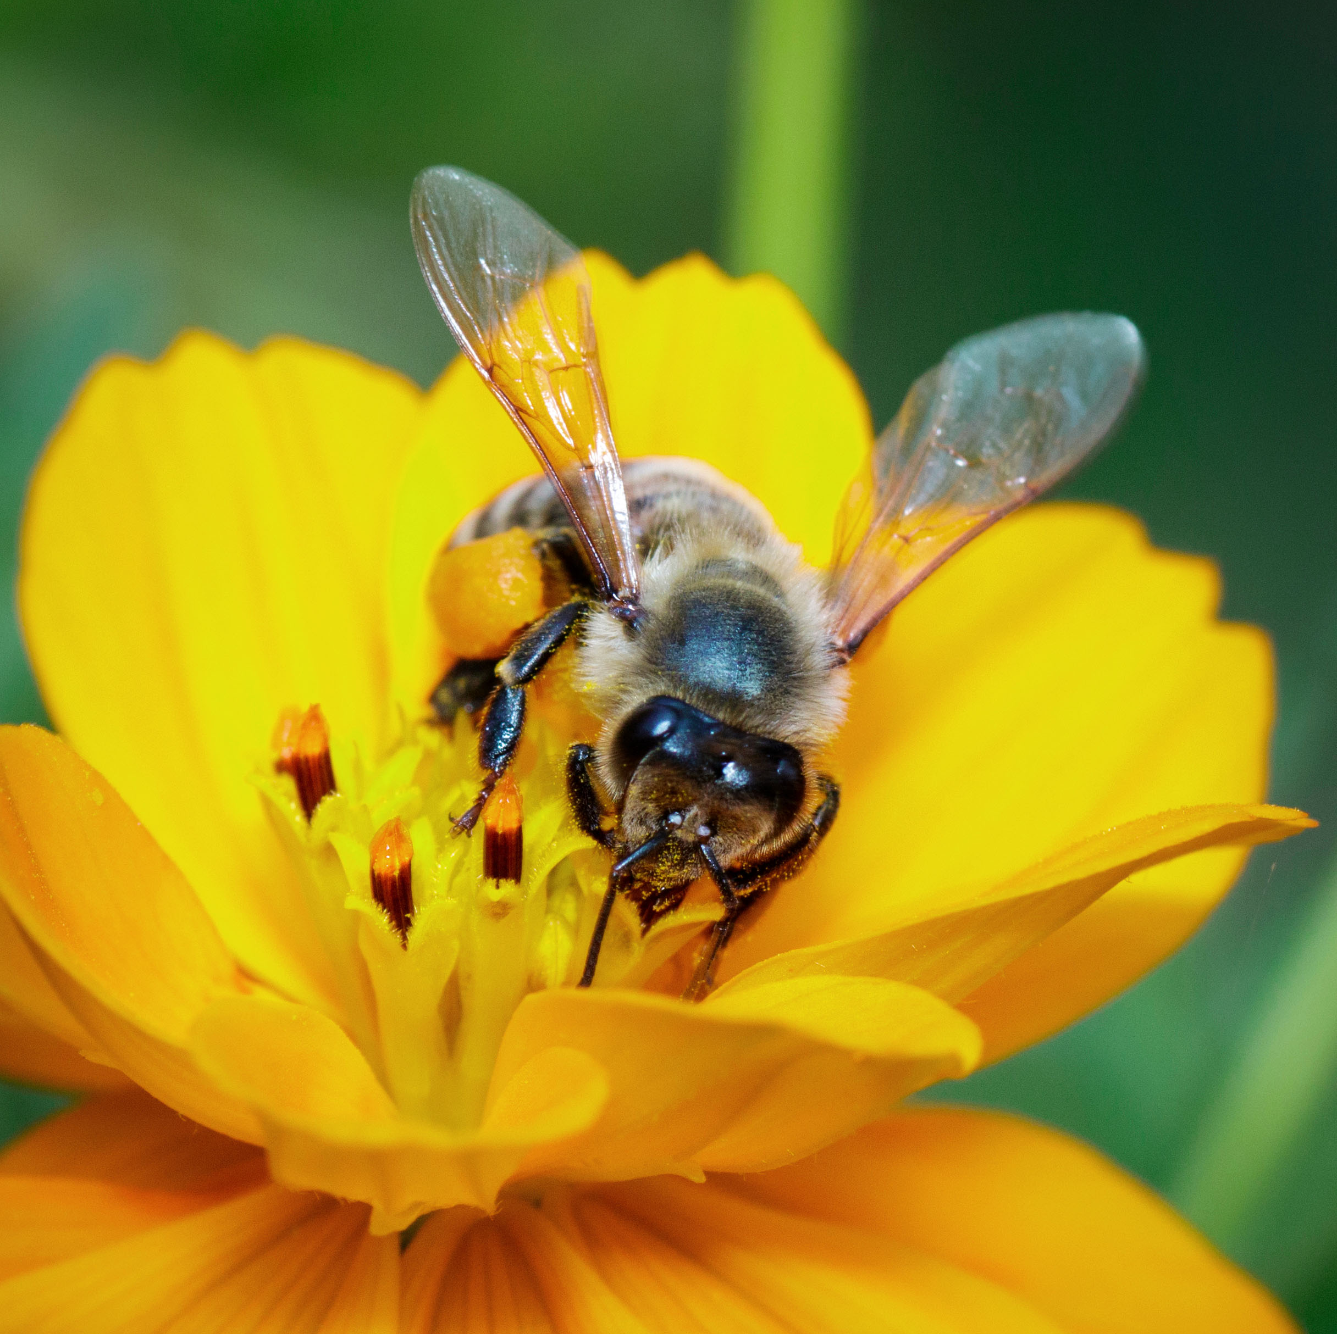
Forssan yhteislyseo
Est. 1899

Slide 2
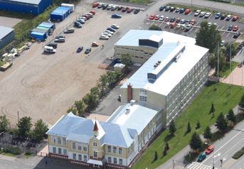
Finnish High Schools – an overview

Slide 3
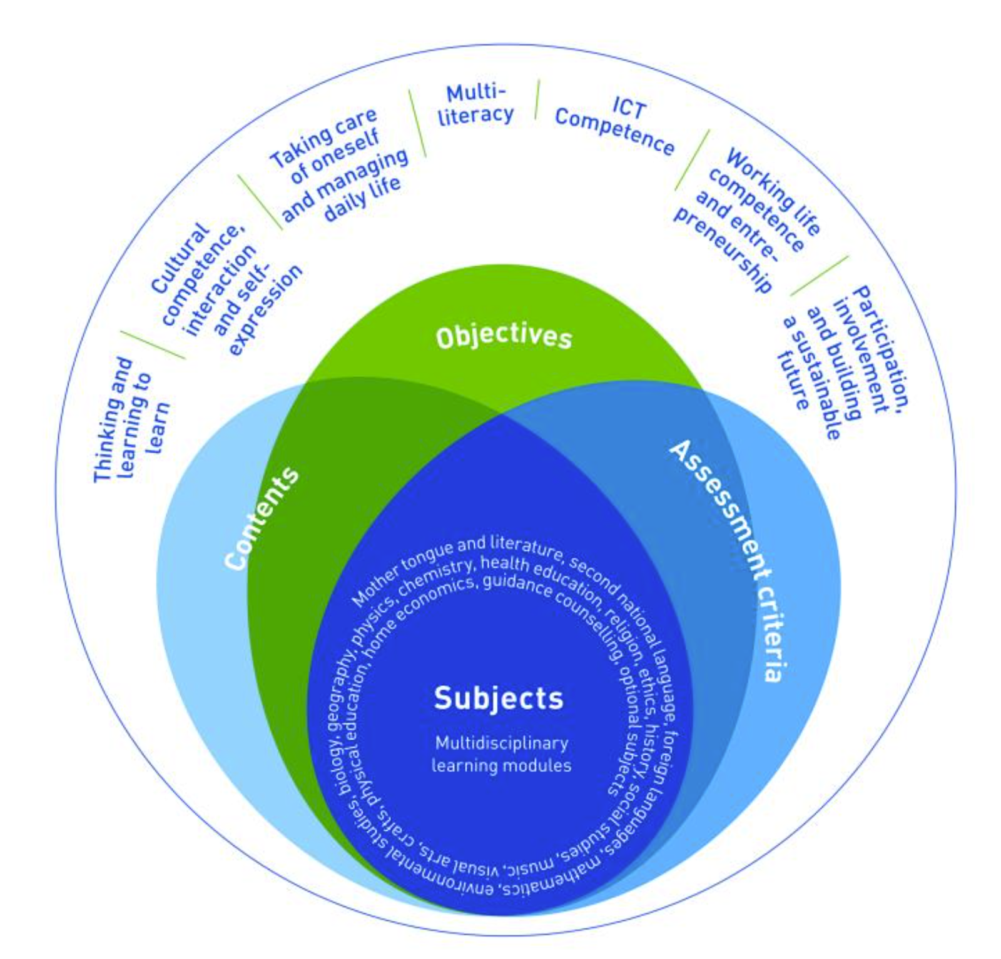
The Finnish curriculum
The Finnish educational institution's curriculum has produced good results.
In particular, Finnish schools produce young people who have the opportunity to live a happy and balanced life in a changing world.
Teachers are coaches whose task is to support the student.

Slide 4
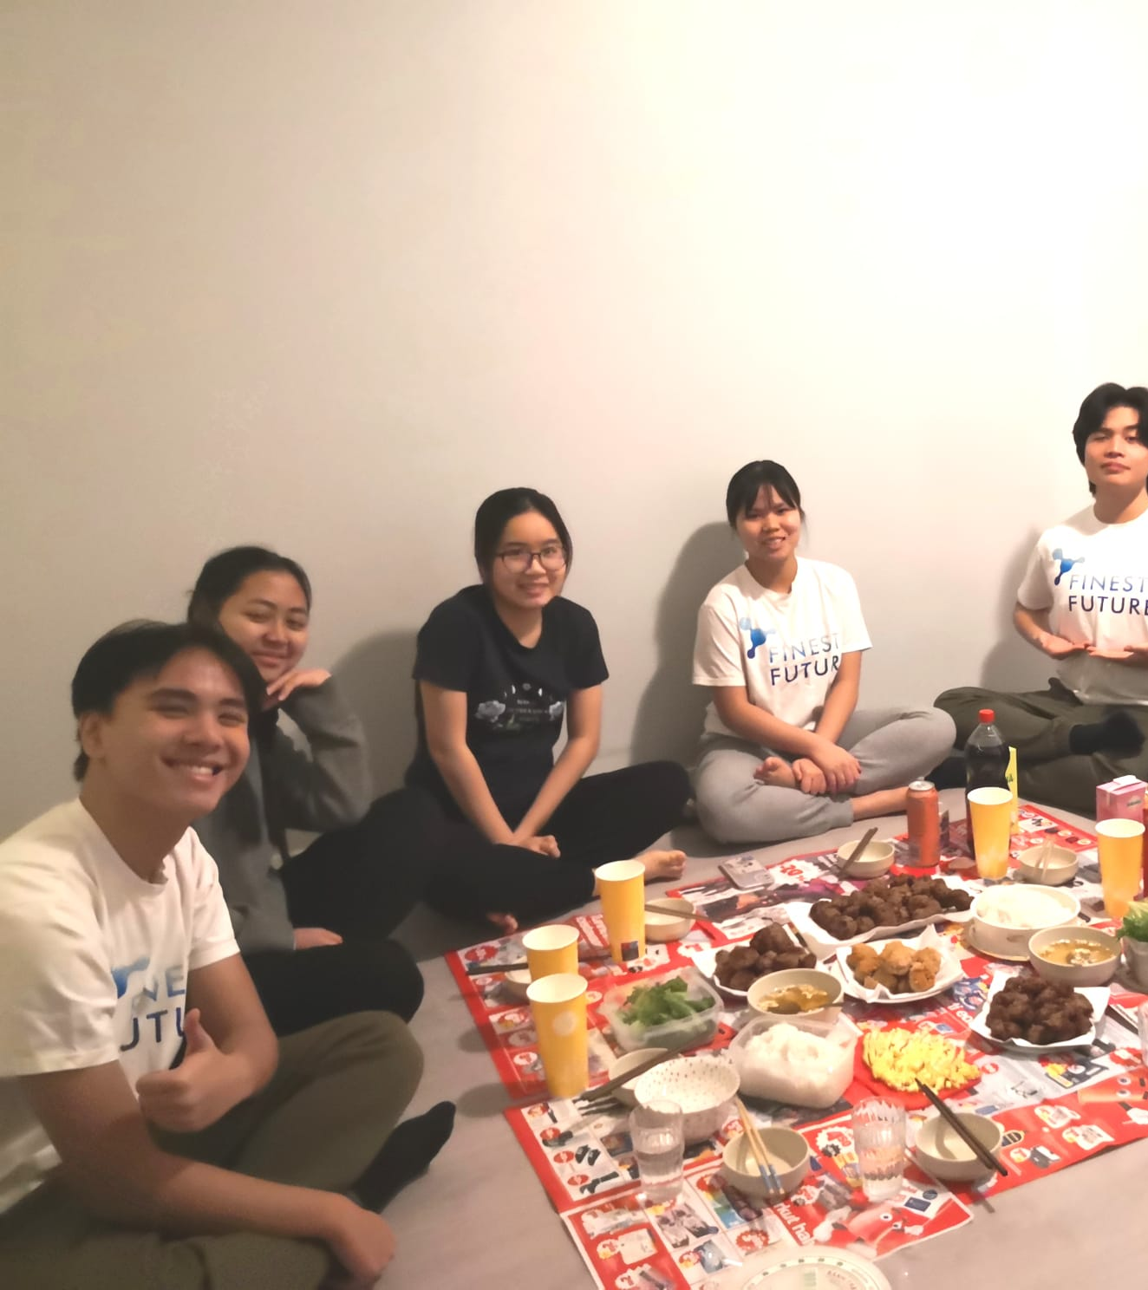
Finnish high schools offer
High-quality teaching and counselling
Individual study paths

Slide 5
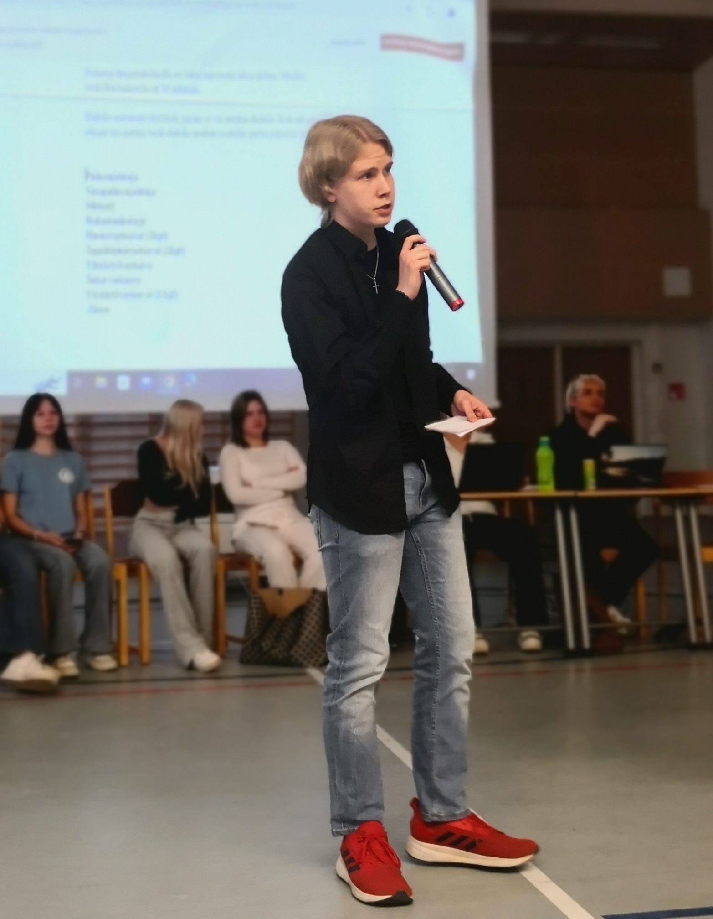
Studies in Finnish High School
3-4 year studies
To study is free (incl. laptop, e-books, lunch)

Slide 6

Compulsory subjects
Math 12-20 credits (general or advanced)
Physics, Chemistry, Biology, Geography, total 10 credits
History and social studies, philosophy etc. Total 26 credits
Music, art, P.E. 8 credits
Study councelling 4 credits
TOTAL 94-102 (compulsory credits) + optional courses 56-48: sum 150 credits

Slide 7
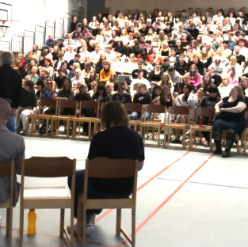
Studies in Finnish High School
Students get to choose the subjects and even teachers.

Slide 8

Study year
Five study periods
  School days from 8 to 16 (it varies a lot)
  2 credits course: 3*75 min in seven weeks
  7 d test ”weeks”, one test / day

Slide 9
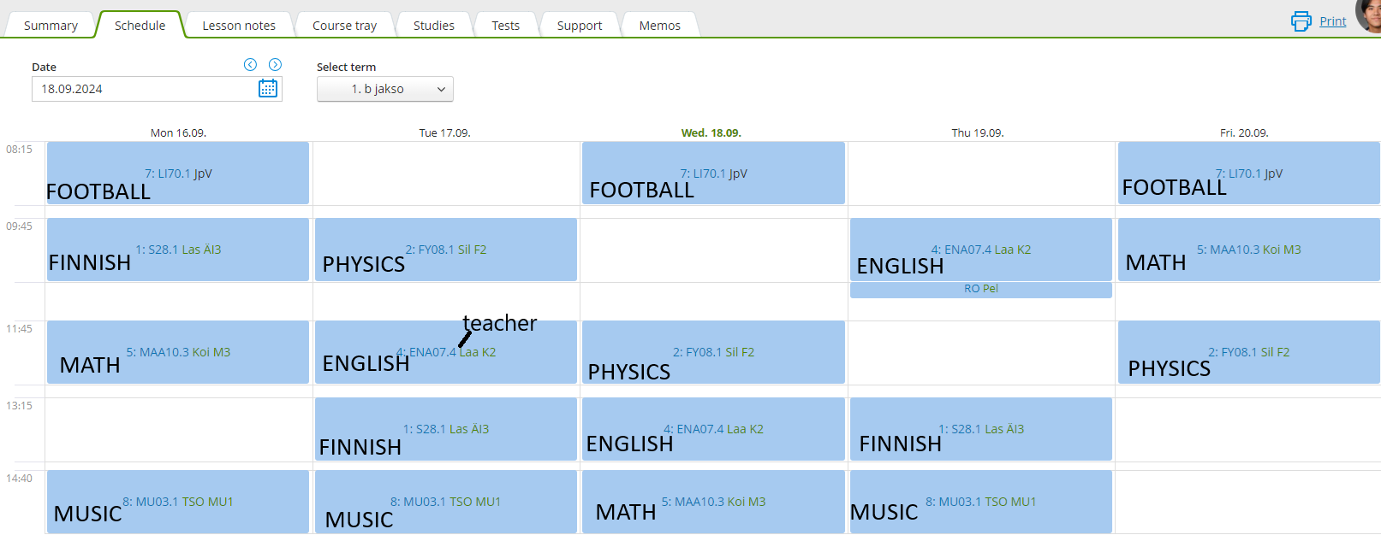

Slide 10
Forssan yhteislyseo – an overview

Slide 11
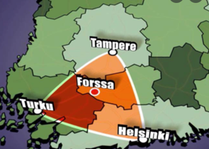
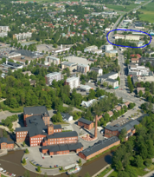
The city of Forssa
Southern Finland
around 17 000 inhabitants
the Loimijoki River
plenty of greenery
Notes:
Kaunis, turvallinen kaupunki. Kävelymatkan päässä toisistaan kirjasto, uimahalli, jäähalli, lukio, linja-autoasema…

Slide 12
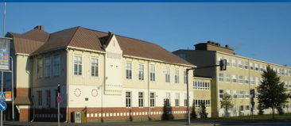

Forssa High School, Forssan yhteislyseo
– 125 years old
- 450 students
Notes:
Iso rakennus, paljon tilaa opiskella mm. itsenäisesti

Slide 13

Academic areas of focus in Forssa
Plenty of studies available in all subjects
Wide selection of foreign languages
Erasmus accreditation: numerous cooperative high schools in Europe
Special programs:
  Sport Academy
  Arts and design line
  Music line

Slide 14
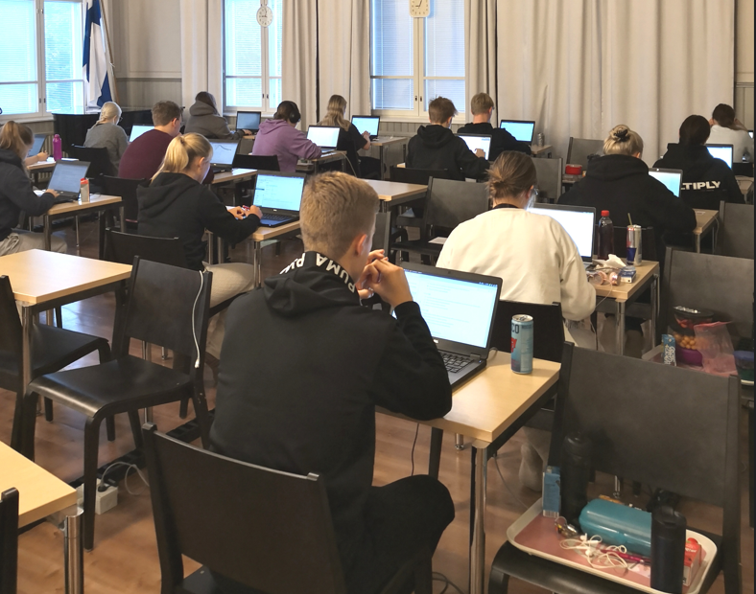
Matriculation exams

Slide 15
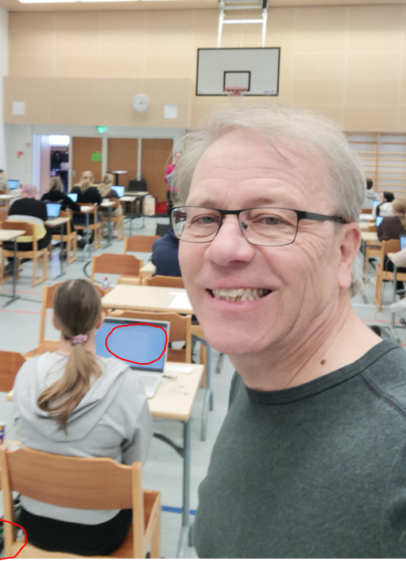
The aim of the studies
Digital matriculation exams
  Finnish
  Math
  English
  Two other subjects (e.g. Physics and Chemistry)

Slide 16
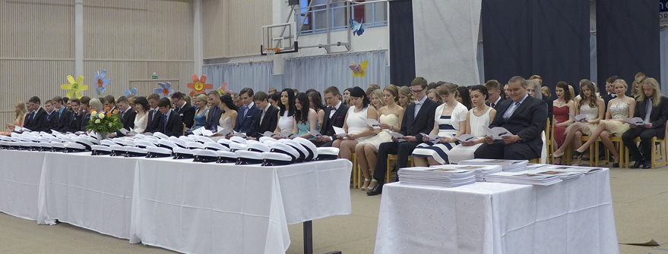
Where to go after high school?
Universities and polytechnics (applied universities)

Slide 17
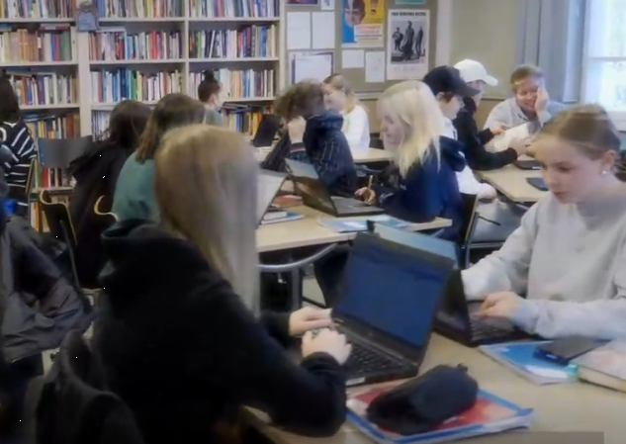
From the parents’ point of view
A safe country and high-quality schools
Good chances of getting into universities
Accomodation etc.: no worries
In Forssa: 22 Finest Future students: Everything is going well

Slide 18
Admission requirements
B1.1 Finnish
Forssa has a short application period in March
Interview
Everyone can apply, but Principal has to be sure of the student's other support (e.g. Finest Future)

Slide 19
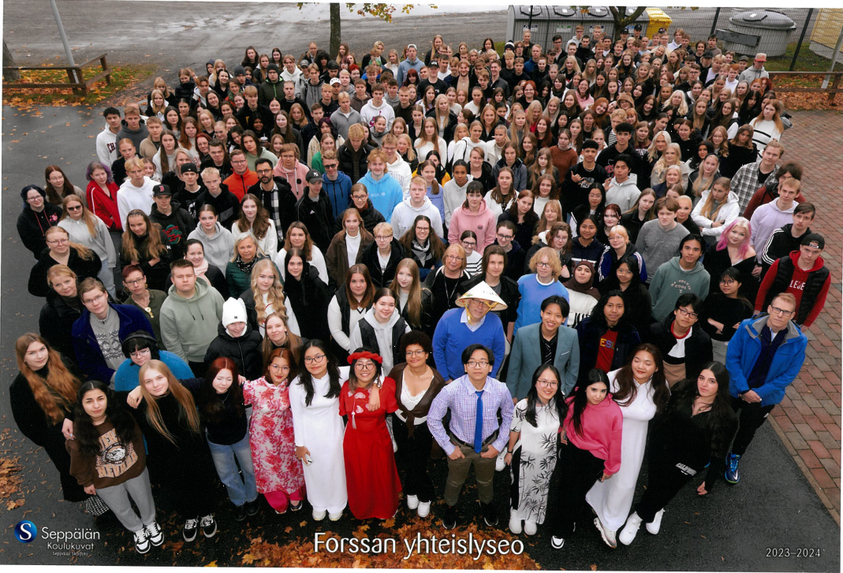

Slide 20
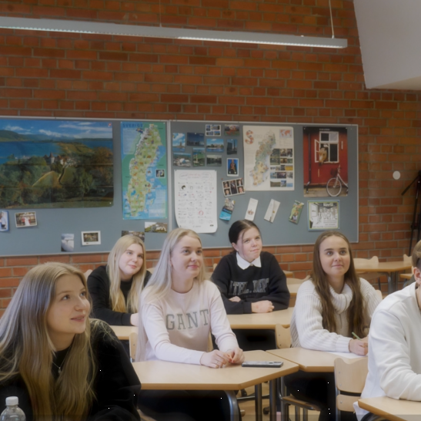

Welcome to Finland and Forssa

