Slide 1
Evaluate the effect of the Cold war on Vietnam
1945-1975

Slide 2
Doctrines
”Everything depends on the Americans. If they want to make war for 20 years then we shall make war for 20 years. If they want to make peace, we shall make peace and invite them to tea afterwards."
North Vietnamese leader Ho Chi Minh, December 1966
Domino Theory & Containment Policy

Slide 3
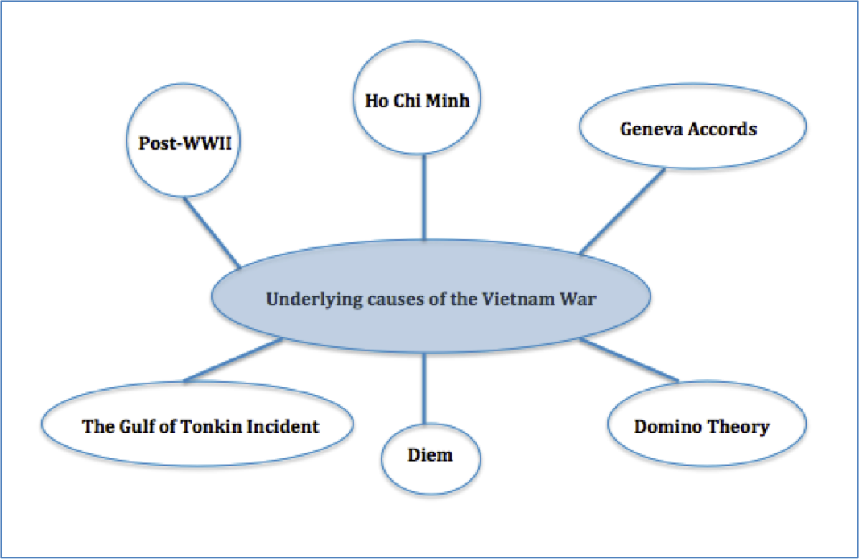
Causation

Slide 4
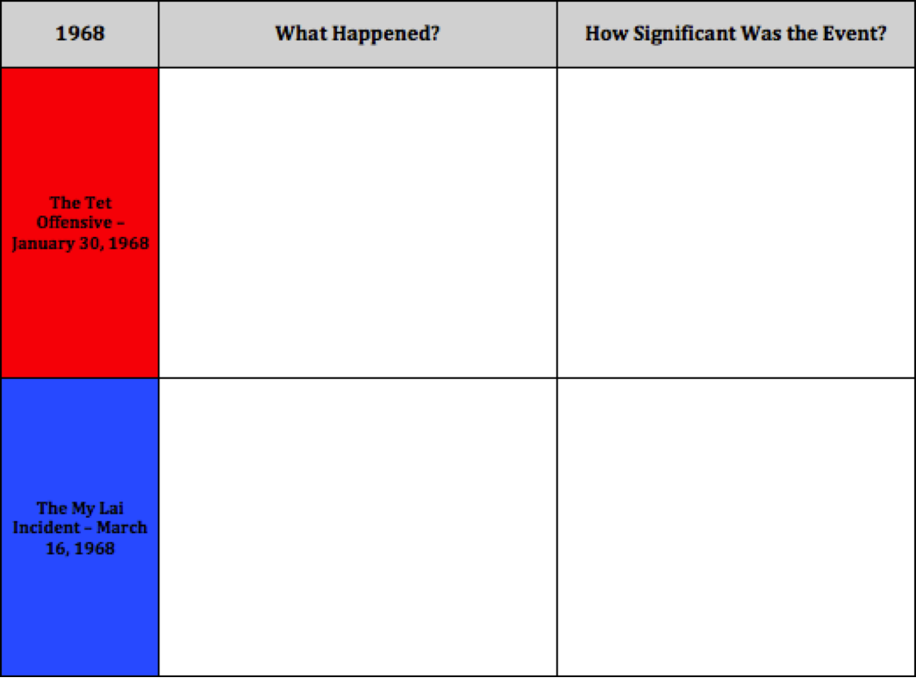
The War

Slide 5
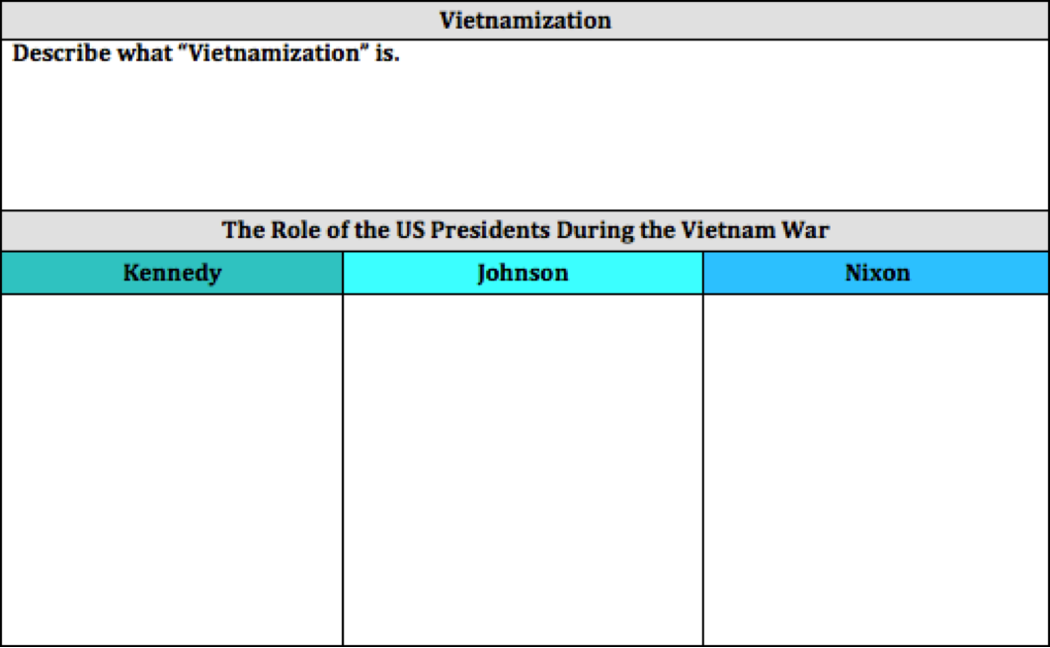
The Role of the US presidents

Slide 6
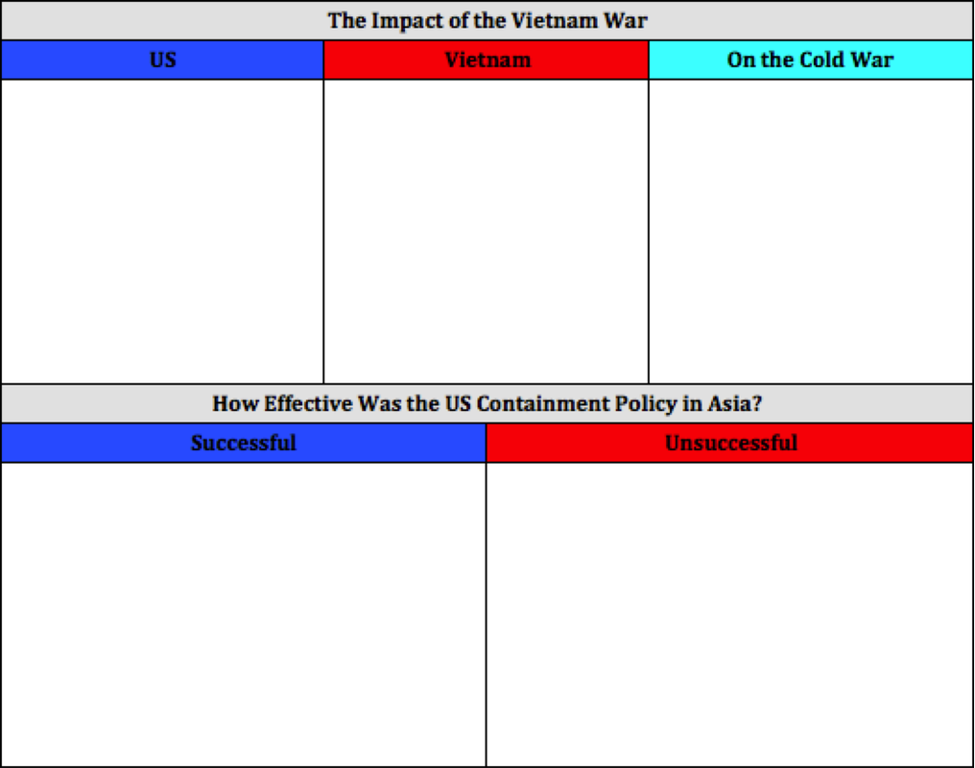

Slide 7
To what extent can you justify the claims?
The Socialist Republic of Vietnam was established as a result of the cold war
United Vietnam´s political, social and economic system was comparable to that of the USSR
Vietnam's foreign policy succeeded in acting independently under the pressure of East and West during the Cold War

