Slide 1
Here you write the name of the animal

Slide 2
Appearance
Here you insert the picture of the animal
Here you describe the appearance of the animal: size, colour, type of limbs, a tail?

Slide 3
Here you insert the picture of the habitat the animal lives in

Slide 4
Food
Here you insert the picture of the food the animal eats
Here you write what kind of food the animal eats

Slide 5
Here you write about the breeding: what time of the year it happens and how many young are born?
Here you insert a picture of a young member of the species

Slide 6
Wintering
Here you write how the animal spends the wintertime.

Slide 7
Adaptation to aquatic environment
Here you write how the animal is adapted to the aquatic environment (see the picture in e-book)

Slide 8
Distribution
You can copy the pinmark and paste it to areas your animal lives in.

Slide 9
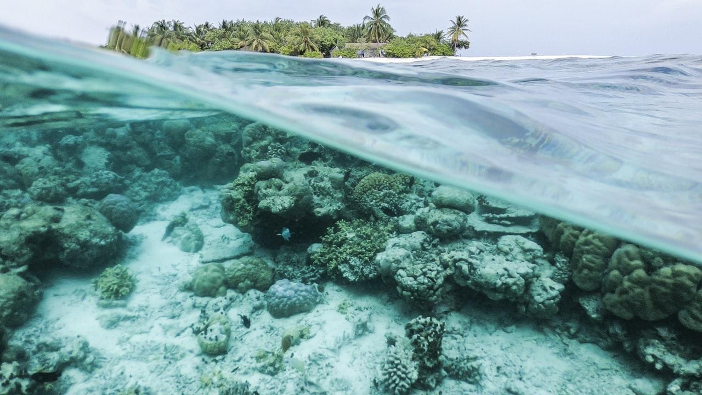
Something interesting you found out about the animal?

Slide 10
ONLY FOR PAIRS! Comparison in between my aquatic mammal and the seal

Slide 11
😉
👉 Made by

