Slide 1

What is eTwinning?

Slide 2
Content of the presentation
  eTwinning
  eTwinning projects in general
  Twinspace as a project platform
  and some talk about other possible platforms

Slide 3
eTwinning
“eTwinning offers a platform for staff (teachers, head teachers, librarians, etc.), working in a school in one of the European countries involved, to communicate, collaborate, develop projects, share and, in short, feel and be part of the most exciting learning community in Europe.”

Slide 4
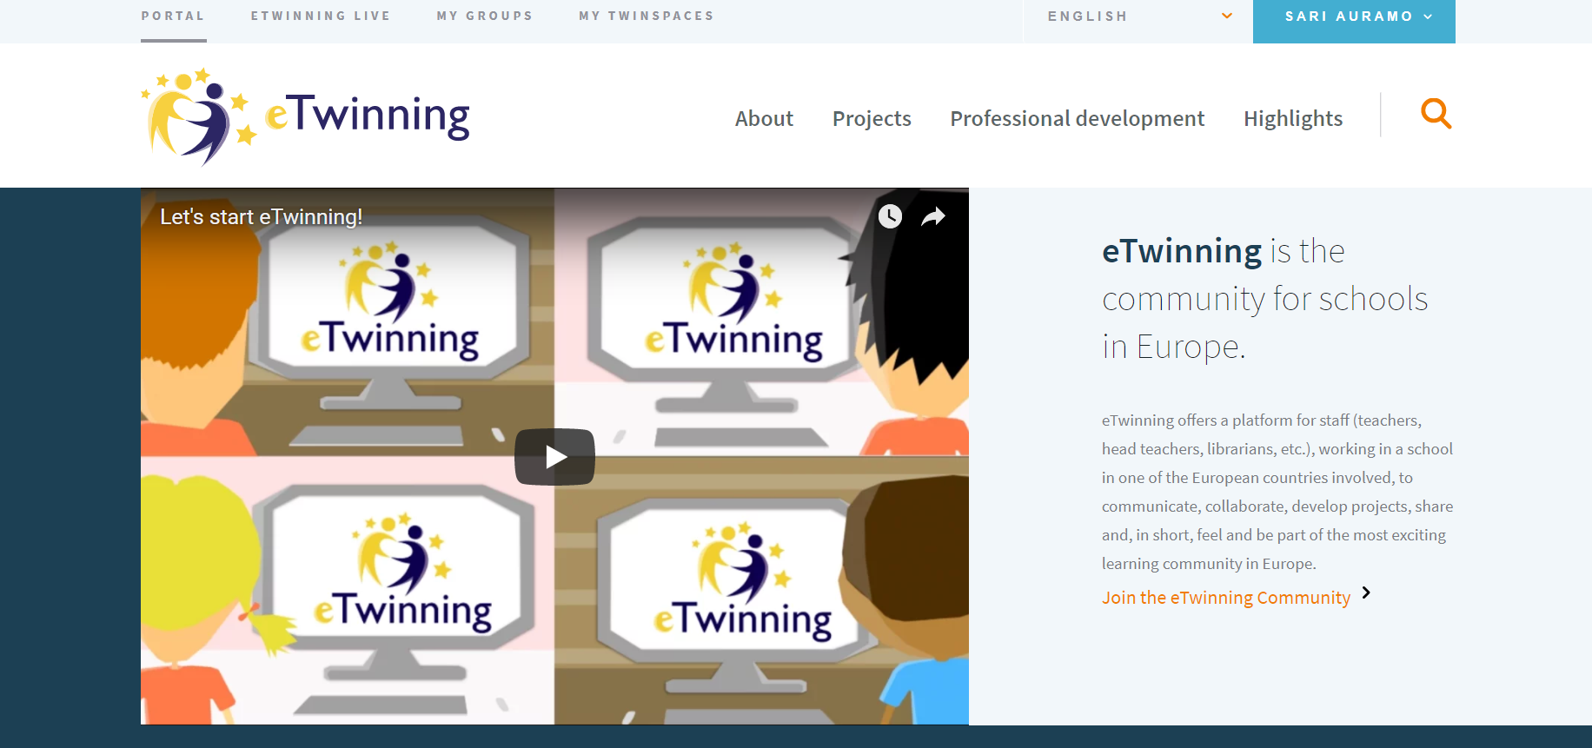
eTwinning

Slide 5
Different levels
Portal
eTwinning Live
Groups
Twinspace
www.etwinning.net

Slide 6
eTwinning projects
They can be any kind!
2-100 partners
1 hour – 5 years
simple – challenging
fun – serious
Think, what your pupils need to learn and invent the project!

Slide 7
How does the project work?
1) Find your partner(s)
  - you have the idea and choose your partners or
  - some else has the idea and chooses you
  2) Plan the project (involve the pupils as early as possible!)
  3) Register the project in eTwinning
  4) Do the project! Have fun! Learn new things! Get new friends!
  5) Evaluate
  6) Get ready for the next project!

Slide 8
Some examples

Slide 9
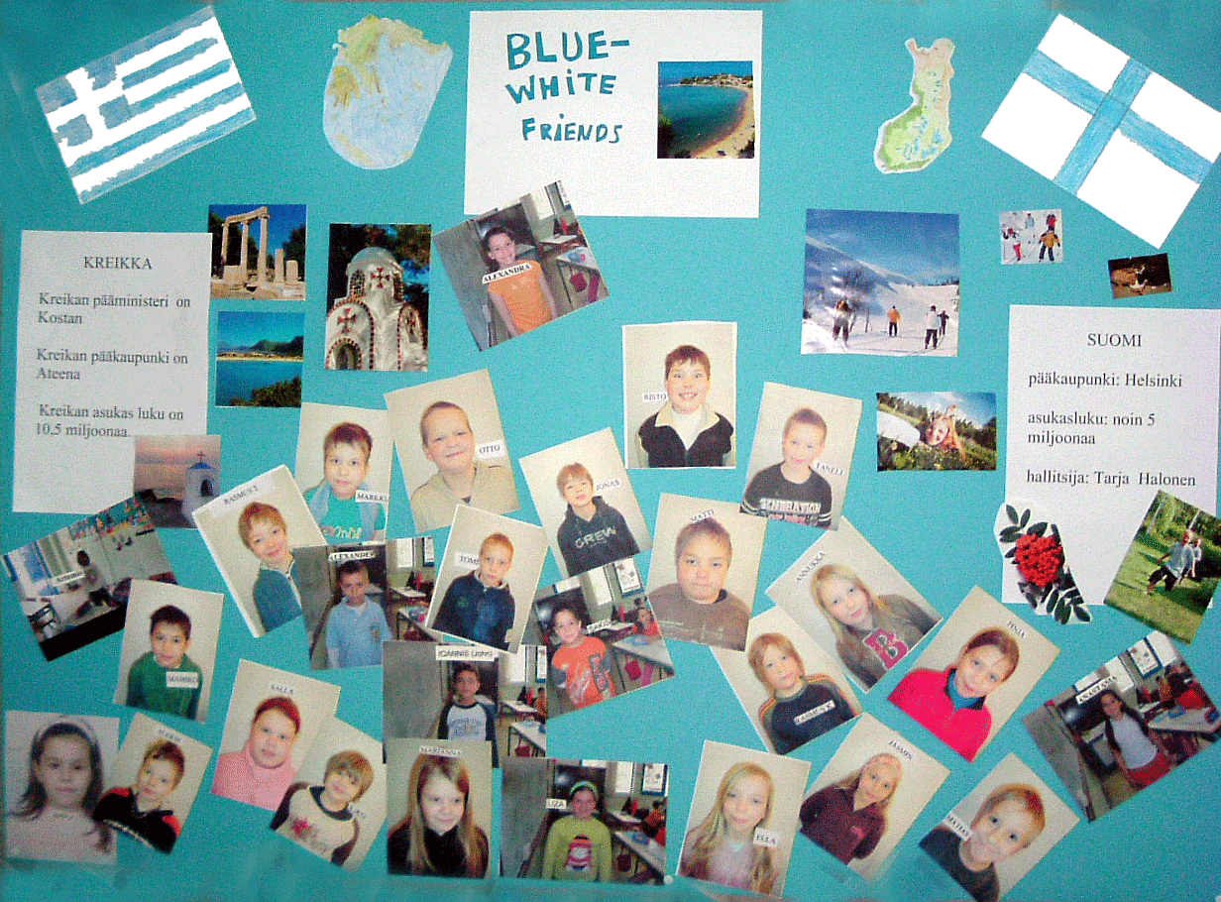
The Blue-White friends
2 classes, Finland and Greece
children 7-8 years old
my very first project!
different topic each month
we looked at the material and talked about it
pictures important
”we did something here, you did there”

Slide 10
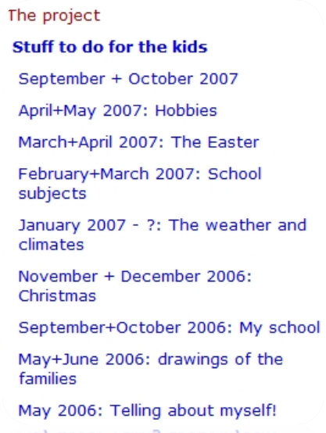

Slide 11
Speaking English right away!
two classes, Finland and France
children 8-9 years old
just started to study English
a Skype call once a week
everyone talked, taking turns
others listened, doing something quiet
always something interactive

Slide 12
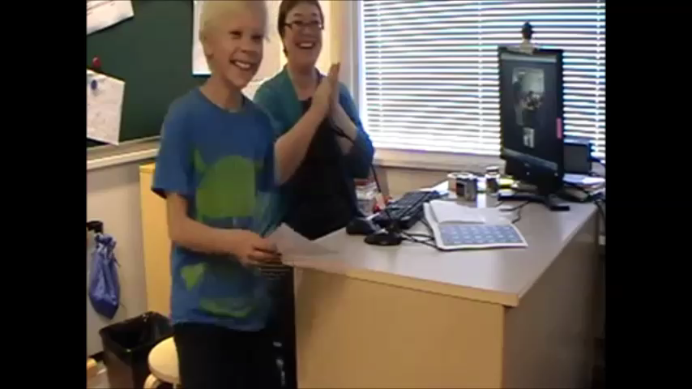
Mikael talking… How many?

Slide 13
The results
exellent results with learning English
  everyone heard the same sentances many times
real use for a foreign language right away
  you need to speak English to be understood
motivation to learn
  makes more sense to introduce youself to a stranger than you own classmate
courage
  the children are not afraid of using the language in other situations

Slide 14
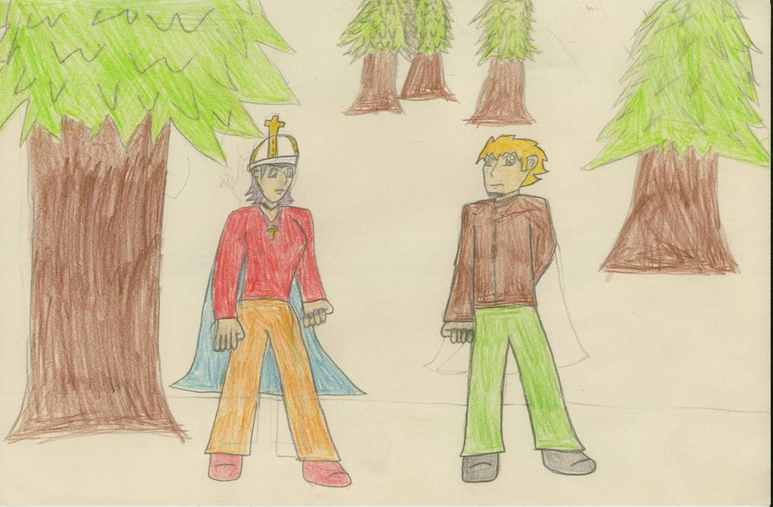
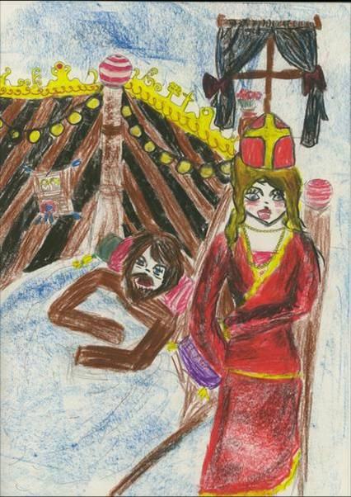
Fingerm – the Fish
two classes, Finland and Germany
children 9-12 years old
a story, Fisherman’s wife, was divided half
the Germans draw pictures to the other half, the Finns the other
the story was recorded both in German and in Finnish to the PowerPoint presentation
”we worked separately, but towards the same presentation”

Slide 15
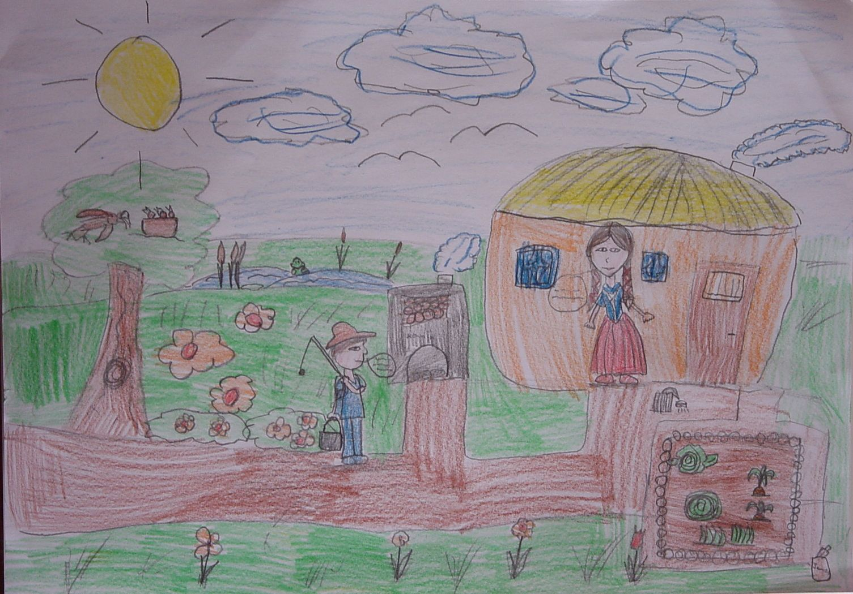




Notes:
When the man went home, his wife was no longer in the stye, but instead of it there stood a hut, and she was sitting on a bench before the door. Then she took him by the hand and said to him, "Just come inside. Look, now isn't this a great deal better?"
Da ging der Mann hin, und seine Frau saß nicht mehr in einem Topfe, aber eine kleine Hütte stand da, und seine Frau saß vor der Tür auf einer Bank. Da nahm ihn seine Frau bei der Hand und sagte zu ihm: "Komm nur herein, sieh, nun ist's doch viel besser."
Silloin mies meni kotiin, eikä hänen vaimonsa enää ollutkaan pahaisessa potassa, vaan sen tilalla oli pieni mökki, ja vaimo istui penkillä oven edustalla. Vaimo tarttui miestä kädestä ja sanoi: ”Tule sisään, kyllä nyt on kaikki paljon paremmin.”

Slide 16
We sing, you sing
6 classes from different countries
children 8-12 years old
we chose songs which have lyrics in all the languages of us
the songs were recorded in your own language for the others to learn
same songs were recorded again, when we used the foreign languages

Slide 17
And now, would you be kind enought to stand up?

Slide 18


Slide 19
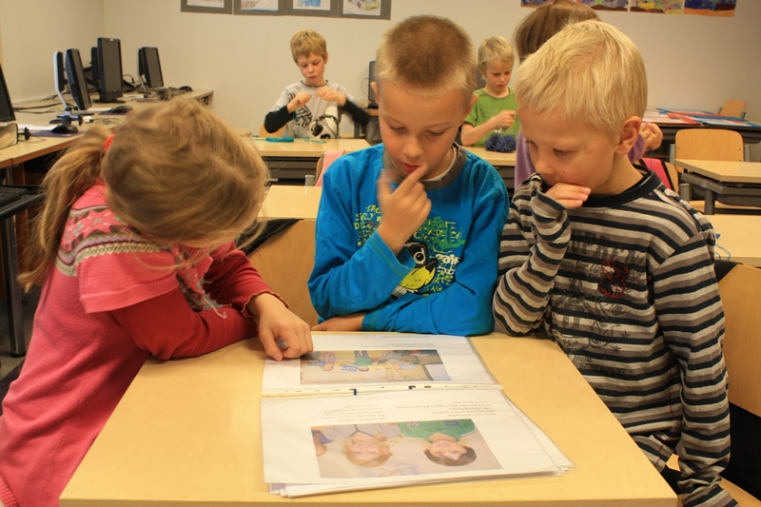
You + Me = Fun!
2 classes, Finland and The Netherlands
children 8 years old
children looked around and created math problems from their surroundings
teachers translated them into English
children at the other country tried to solve the problems sent by the other ones
”We made something for you and you made for us”

Slide 20
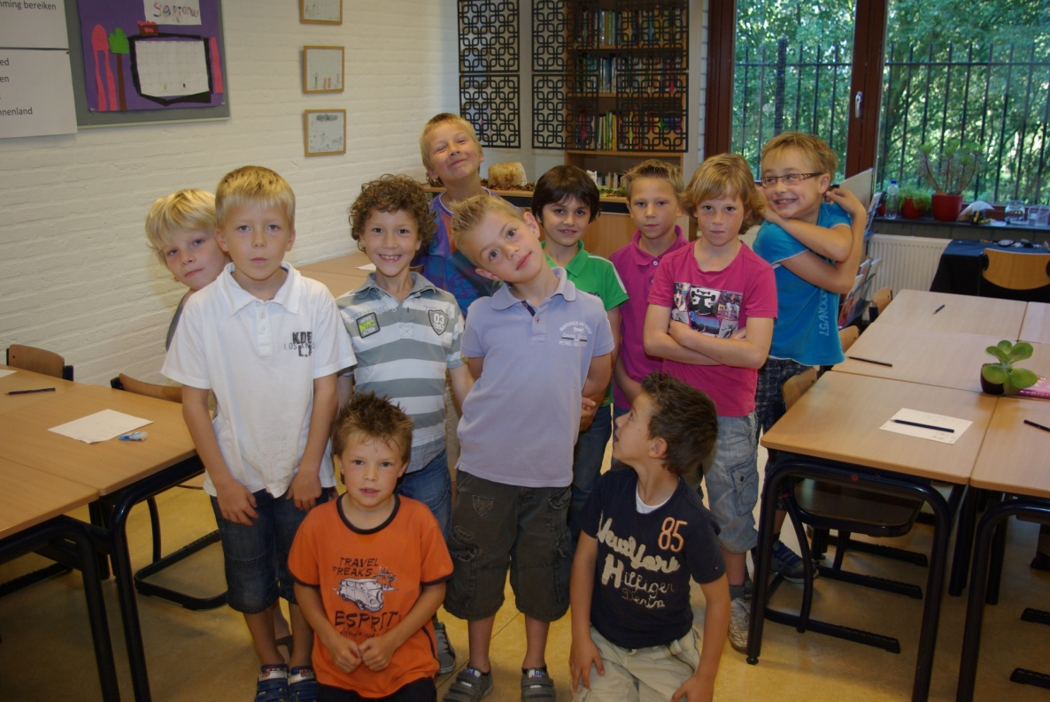
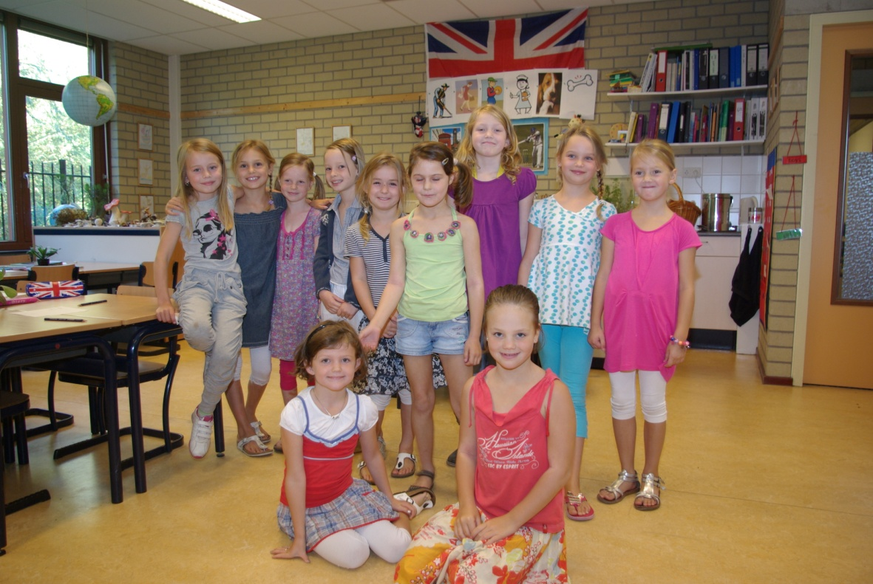
How many boys are in our class?
How many girls are in our class?
How many children in total?
Love from Sylvie and Sem

Slide 21
Applications and tools
- you can use what ever applications or tools you have available
  anything you would use in your class anyway
  new tools or applications
- share the results in internet
- The project platform can be
  Twinspace in eTwinning
  your school’s web page
  some blog

Slide 22
Twinspace as a project platform
- When you register your project in eTwinning, you automaticly get the project platform called Twinspace
- Good for sharing different documents
- The teachers have different roles (admistrator, teacher, visitor)
- You can also invite you pupils there
www.etwinning.net

