Slide 1
Safety and Health in Craft and Technology Education

Slide 2
What governs the regulations
Legislation (law of safety at work 738/2002)
National Framework Curriculum for Basic Education 2014
National board of education (Safety regulations in craft education, 2011)

Slide 3
To be considered in the TE classroom
Safe environment
Orientation to safe behavior, attitudes
Safe tools and equipment
Learning group and atmosphere
Machines with safety devices/protectors
Personal safety equipment

Slide 4
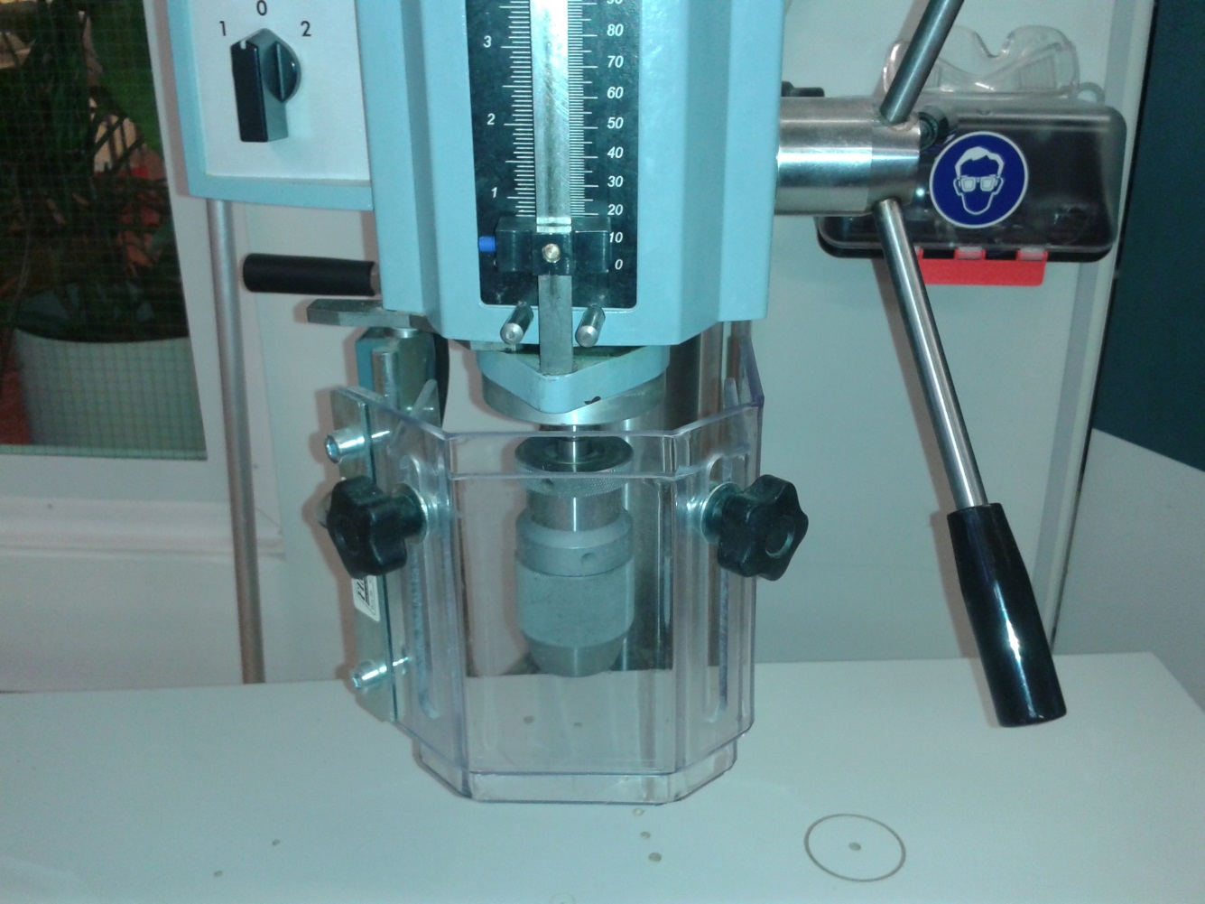
Examples of the safety devices

Slide 5
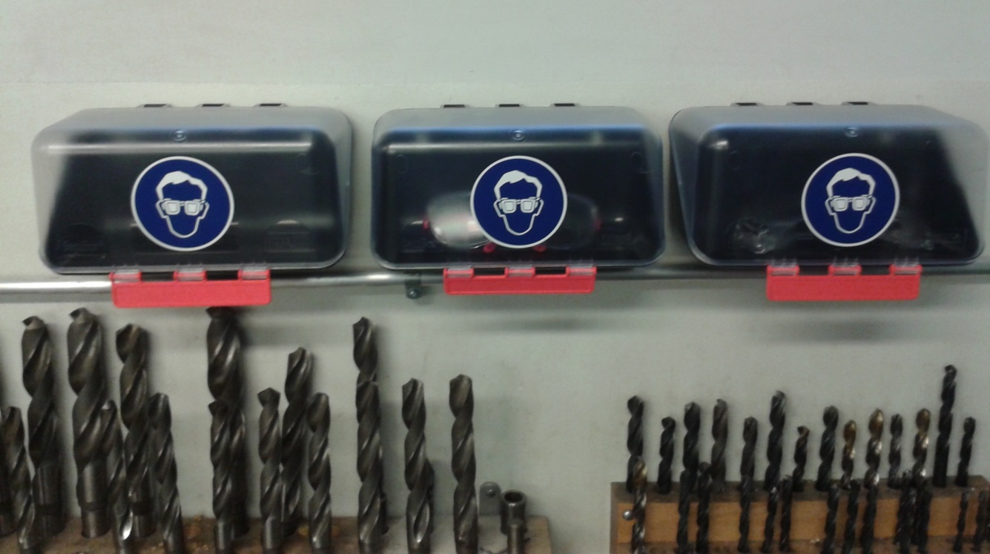

Slide 6
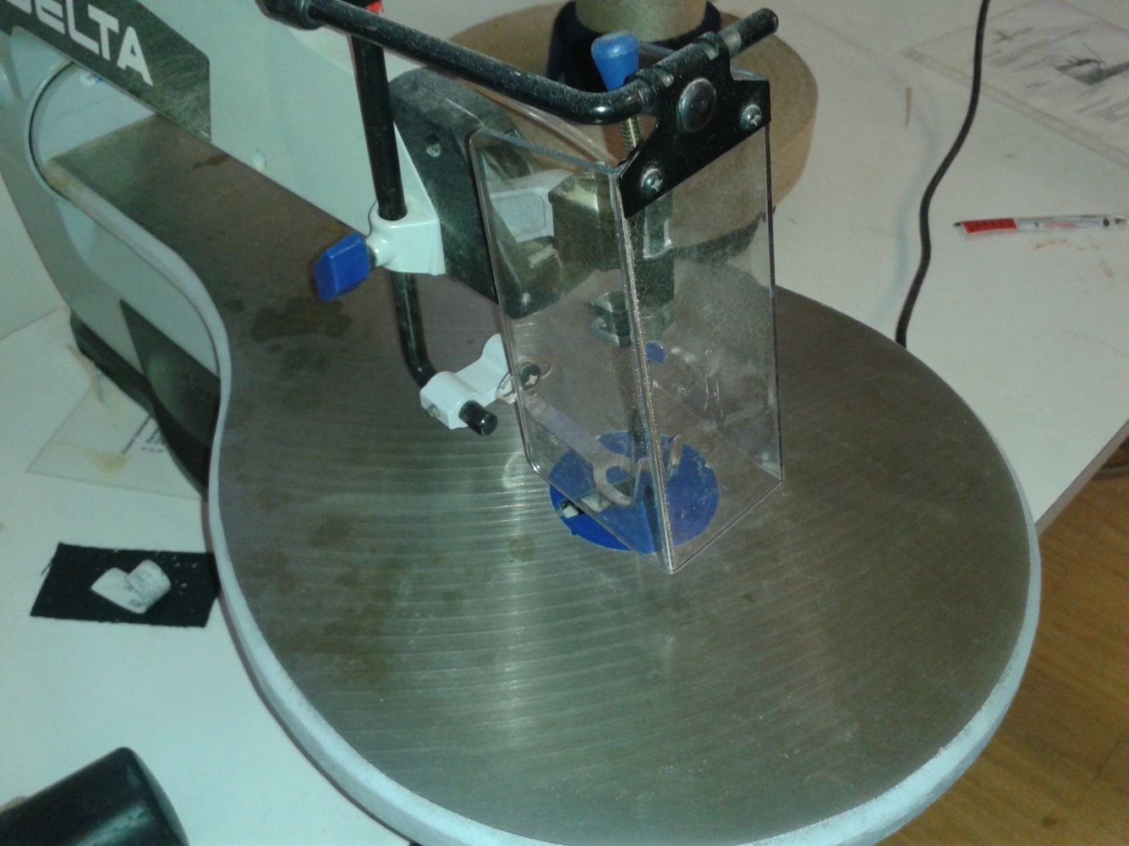

Slide 7
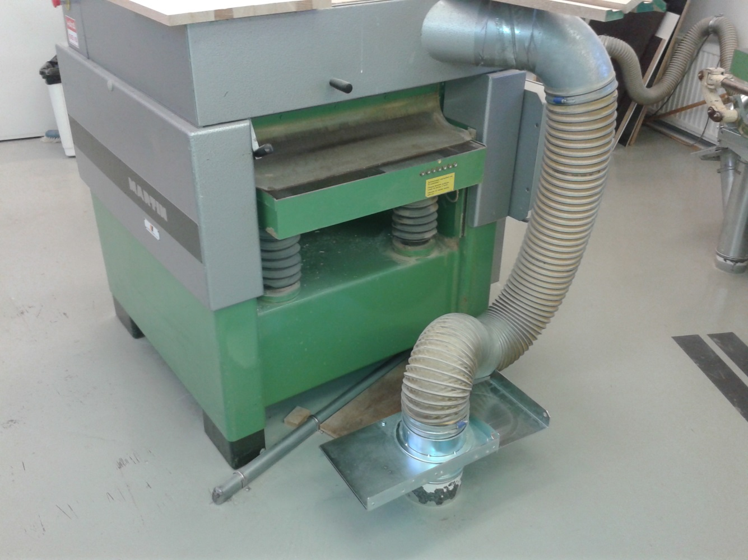

Slide 8
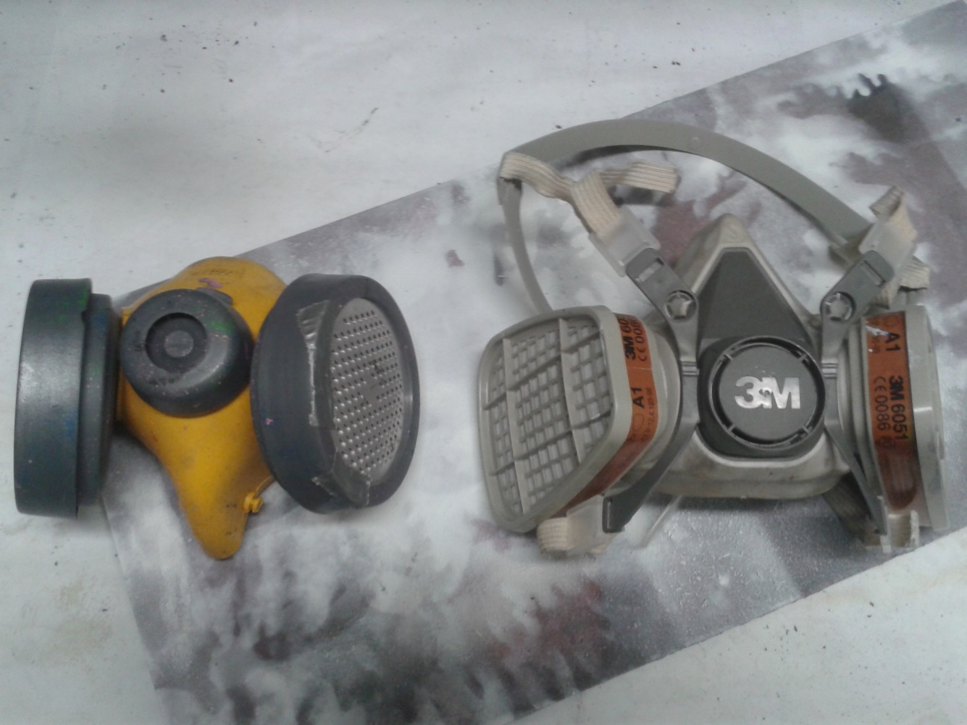

Slide 9
