Slide 1
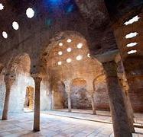
Arab Baths in Granada
Veijo, Saana

Slide 2
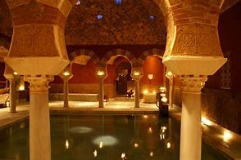
Arab Baths
Arab baths are ancient buildings from 12th century. They are one of the most important historical aspects in Granada. Also known as Hammam.
The baths were built by the muslims because they believed thet water was symbol of purity.
Source

Slide 3
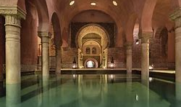
Use of the Arab bath
The most important use of the arab baths, was business. And the most important business was weddings.
Arabs used the baths to relax and for hygiene
Source

Slide 4
Rooms in the baths
The architecture was evolved from Roman and Greek baths.
There was an undressing room (Apodyterium) where you could store your belongings while bathing. While the citizens we're bathing, slaves looked over the belongings.
There was a cold room (Frigidarium) that was one of the main bathing chambers. It was a pool with cold water where you would go after bathing and washing yourself.
Warm room (Tepidarium) was the bathroom of the Roman baths. They we're heated by a hypocaust.
There was a hot room (Caldarium). It was a very hot and steamy room heated by a hypocaust. The Arabs would use olive oil to cleanse their bodies. The temperature is estimated to be around 50-55C.
Source

Slide 5
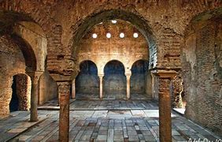
Heating
There were furnaces under the pool to heat up the water and rooms.
Source

