Slide 1
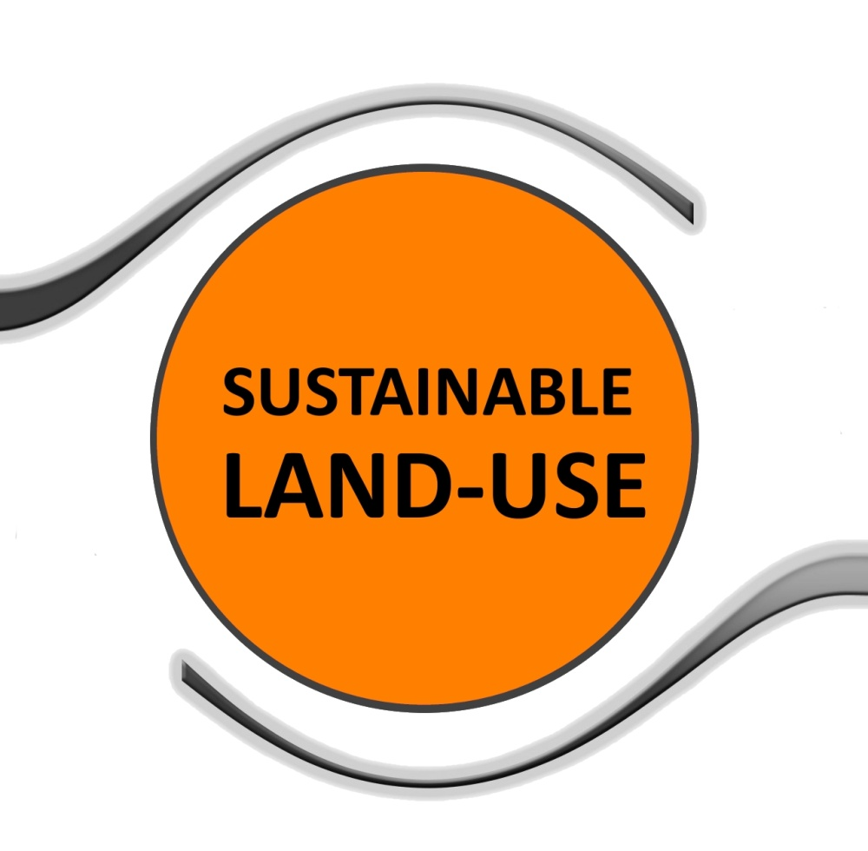
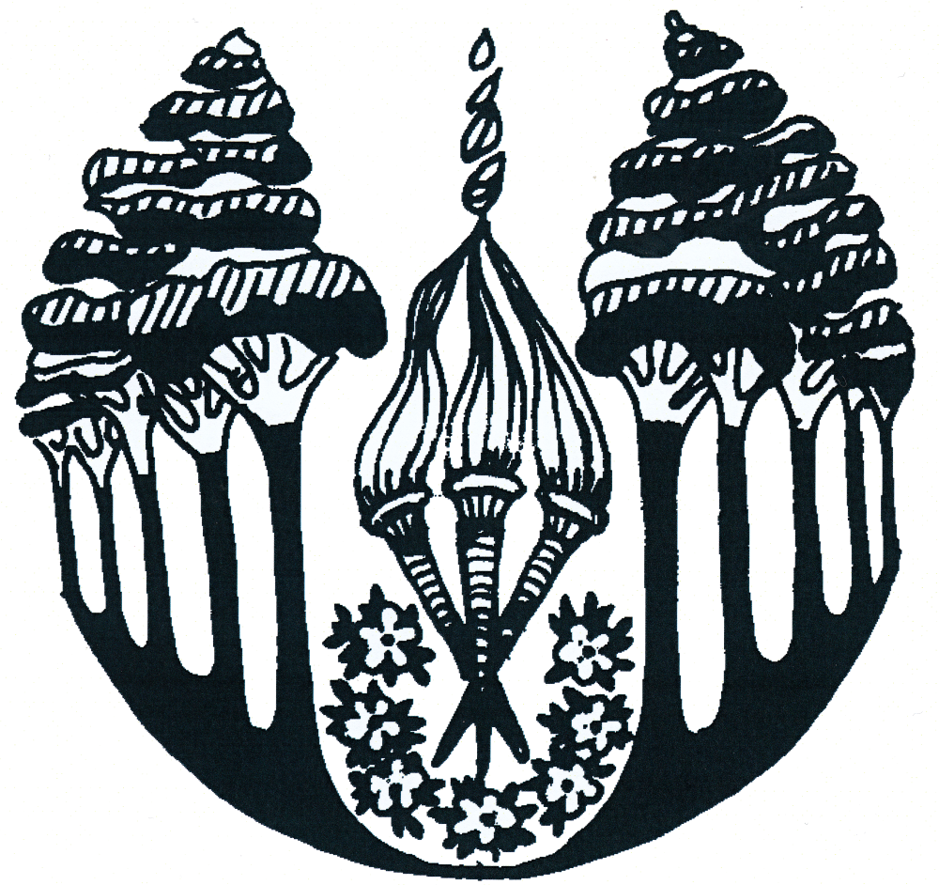

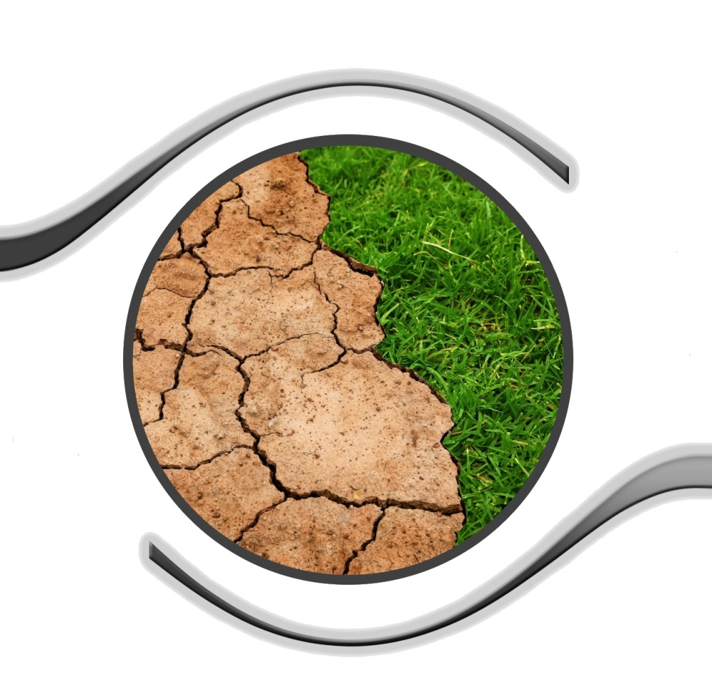

Czech Seminar, Land Use
Källhagens skola, Finland
ITTC It’s Time to Care

Slide 2
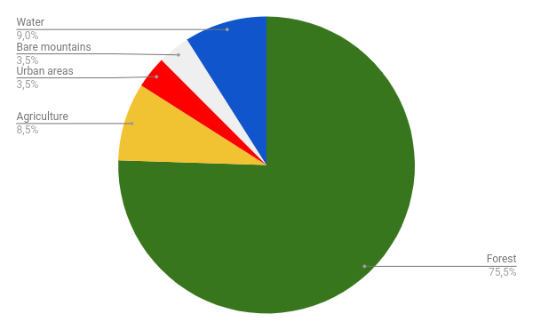
The land in Finland
Are there any changes in use of the land fund?
Because the forests are planted again after they’ve been chopped down there aren’t any big changes.
The mires/swamps and agriculture don’t change that much either.
Do these changes benefit the ecology or the environment?
Yes, we plant more trees than we chop down in Finland. The forest works as a carbon sink.
What can we do to preserve land?
We have 39 national parks in Finland, in which the goal is to preserve the most valuable nature.
The national parks are open for the public.
The parks combined have an area on approximately 1 million hectares.
http://www.ym.fi/sv-FI/Natur/Naturens_mangfald/Naturskyddsomraden/Nationalparker_och_naturreservat
How is the land used in your country?

Slide 3
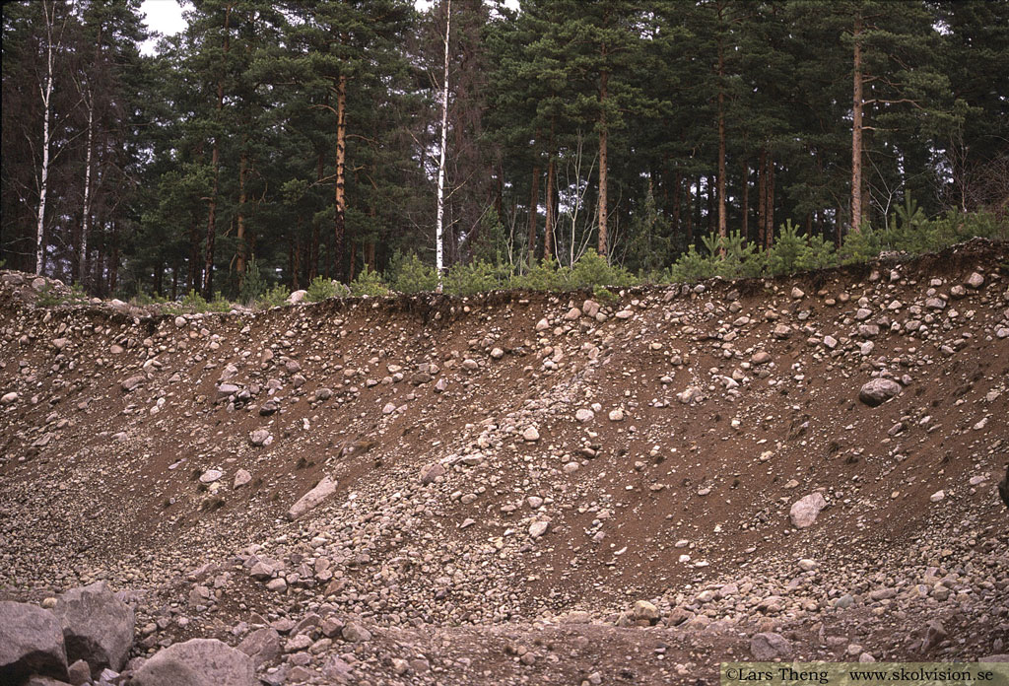
2. The soil in Finland
What types of soil are there in your country?
The most common soil type in Finland is moraine, which can be found a little bit under the surface. Its a mixture of sand, rocks of different sizes formed during the last ice age.
Is the soil used in the right way?
There is one controversial thing with the soil use in Finland which is the cultivation of peatland. Peatland is great to cultivate on, but the cultivation of peatland causes harmful greenhouse gases.
Is the soil type suitable for the crop planted there?
Yes, otherwise the crop wouldn’t be able to survive there.
33-Dia-2004-04-Isalv.jpg

Slide 4
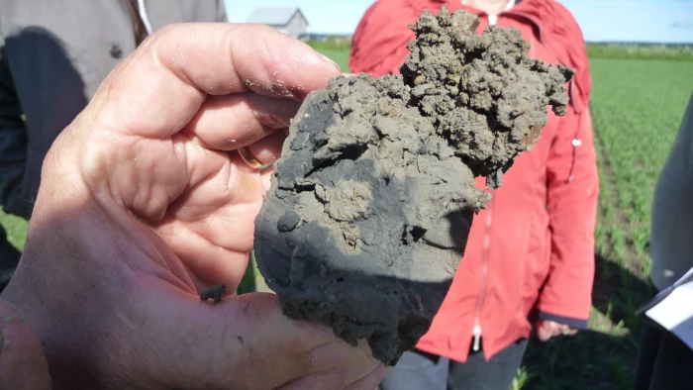
3. What does the soil in your country suffer from?
The soil doesn’t suffer from drought, it usually suffers from the complete opposite. That there is too much water in the soil. When that happens you have to employ drainage and subsoil drainage (an artificial ditch not visible on the surface) to get rid of the excess water.
Finland has a big shortage of selenium in the soil. Selenium is an important element for living organisms. A lack of selenium in your diet can lead to many diseases.
Another big problem is the acidic sulfate soils. The soil gets oxidised and the pH value becomes very low. In Larsmo lake fish have died because of the acidic sulfate soils.
Due to climate change, last summer was extremely hot and dry, which affected the crops negatively.
How can this problem be remedied?
The shortcoming of the selenium can partly be fixed with adding it to the fertilizer.
Finland is also a part of an international research project on finding a solution for the oxidising.
The researchers have found interest in solving the issue with the help of bacteria which already exist in the soil and reduce the oxidising process.
https://svenska.yle.fi/artikel/2018/08/23/forskare-fran-vasa-soker-losning-pa-globalt-problem-osterbottniska-sura

Slide 5
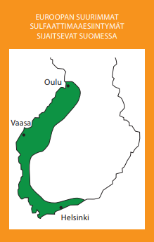
https://www.maaseutu.fi/globalassets/esitteet-ja-oppaat/happamat_sulfaattimaat_b5_low.pdf
https://svenska.yle.fi/artikel/2017/06/30/laget-med-sura-sulfatjordar-ar-varst-i-osterbotten
https://svenska.yle.fi/artikel/2018/08/23/forskare-fran-vasa-soker-losning-pa-globalt-problem-osterbottniska-sura

Slide 6
4. Is the land in your country endangered by water, wind or frost erosion?
We do not have problem with erosion in Finland. There is no erosion because our ground is too flat except minor erosion on the coast.

Slide 7

5. Do you have a seed plant bank in your country? Do you use seeds from the seed plant bank to grow your own vegetables and are you able to product and use your own seeds?
Nordiska genbanken is a Nordic seed bank located in Svalbard. The Nordic countries have cooperated over 30 years. The seeds come from all over the world. The seeds are not used for farming, but are preserved for future needs.
You can use your own seeds, but you need to pay a small fee.

Slide 8
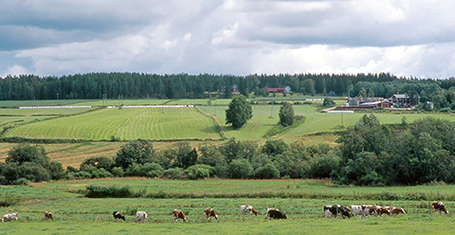
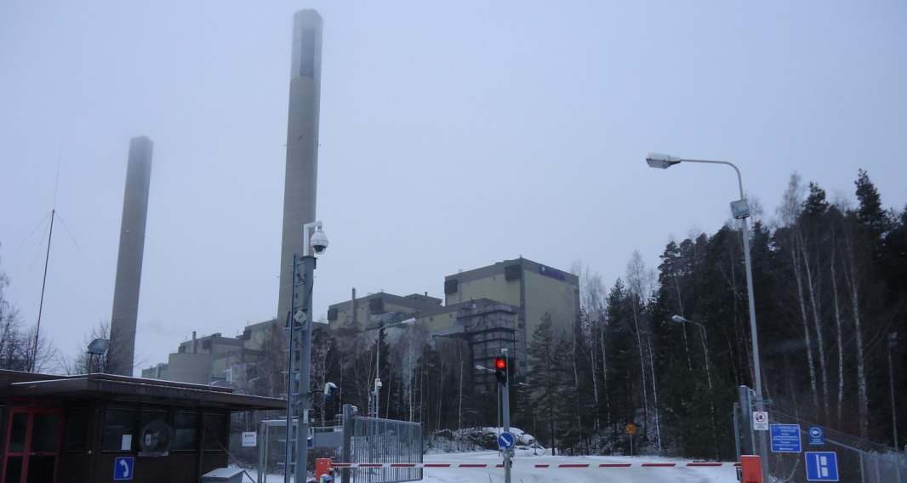
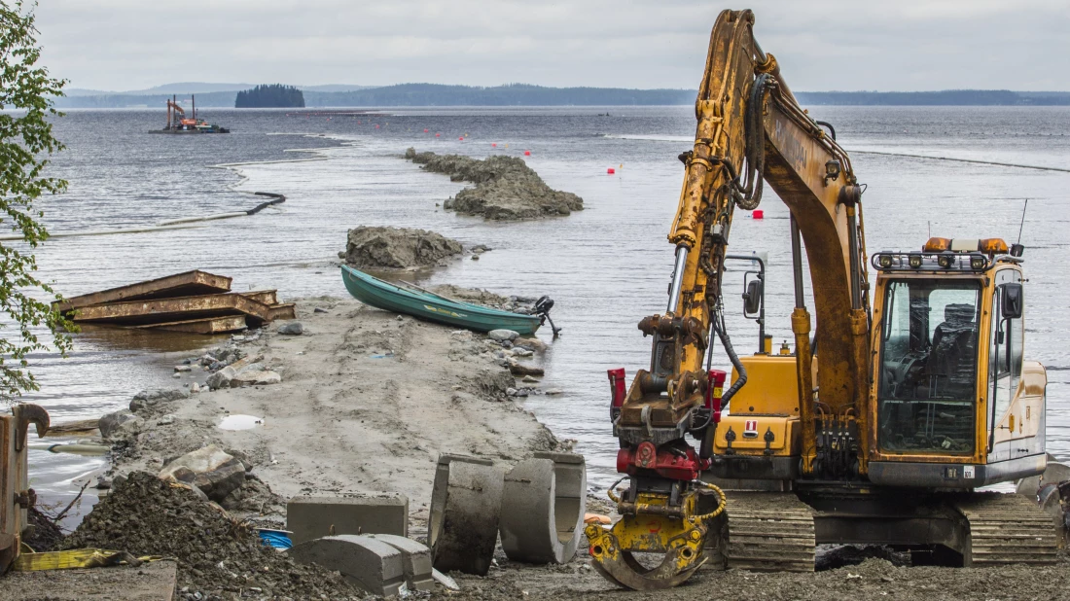
6. How many percent of the area covers cultural landscape, disturbed and degraded landscape?
8,5% of the land in Finland is used for agriculture.
Talvivaara mine is an environmental problem locally, the forests near the mine are dead and the water is toxic.
The coal plant in Inkoo is being torn down because it is not in use anymore.
It is close to our school, approximately 25 km.

Slide 9
7. How many percent of your country is used for conventional farming and how many percent of land are used for organic farming?
11,4 % (almost 260 000 hectare) of land is used for ecological farming. That means that no artificial nutrients or pesticides are used. The goal in Finland is that 20% of the land should be farmed ecologically.
Is the nature-friendly agriculture supported by subsidy?
Yes, those who are farming ecologically, or readjusting their farm to be ecological, can ask for economical support. The support is 160€ / hectare. The reason why they get economical support is that we want to stop the strain on the nature and increase ecological products.

Slide 10
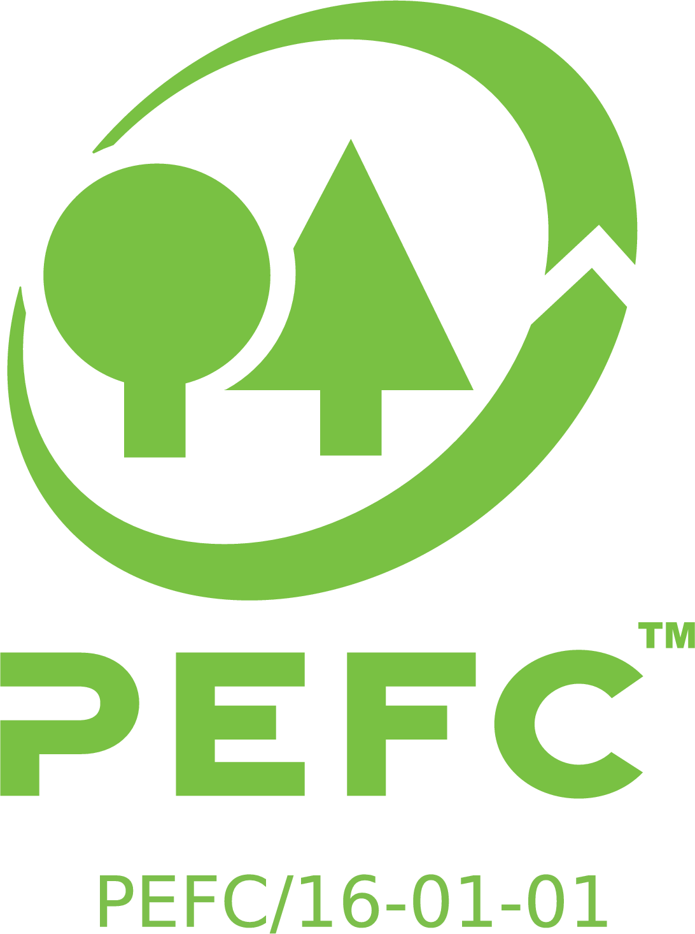
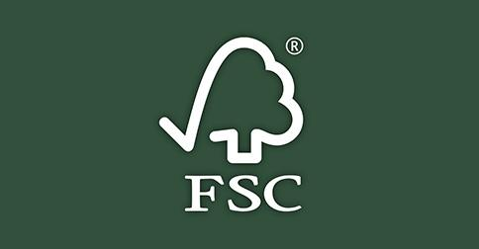
8. Does your country keep the forests sustainably?
Yes, if you cut down forest in Finland, you have to plant new trees (Metsälaki, Forest law). However there are places where you can’t cut trees at all. This system secures the sustainability of the forests. 85% of the forests in Finland are certified. That means that they are used sustainably.
The chop of forest is supervised by the organisations PEFC and FSC. They ensure the sustainability of the forests and the wood that comes from these forests are labeled with a stamp so that the consumer can be sure that the forest has not been damaged while they chopped the trees.

Slide 11
9. How the loss of biodiversity can be stopped?
The nature is monitored by the Environment Ministry. Their agenda is to secure the environment and stop the loss of biodiversity. They legislate, make up nature conservation programs and found conservation areas to secure the diversity of nature. The Environment Ministry monitors nature and environment in Finland and ensures that the laws are followed.
Are the politicians interested in the situation?
It varies from one politician to another. Some of them think that it is a serious problem that should be rectified while others don’t care about it.

Slide 12
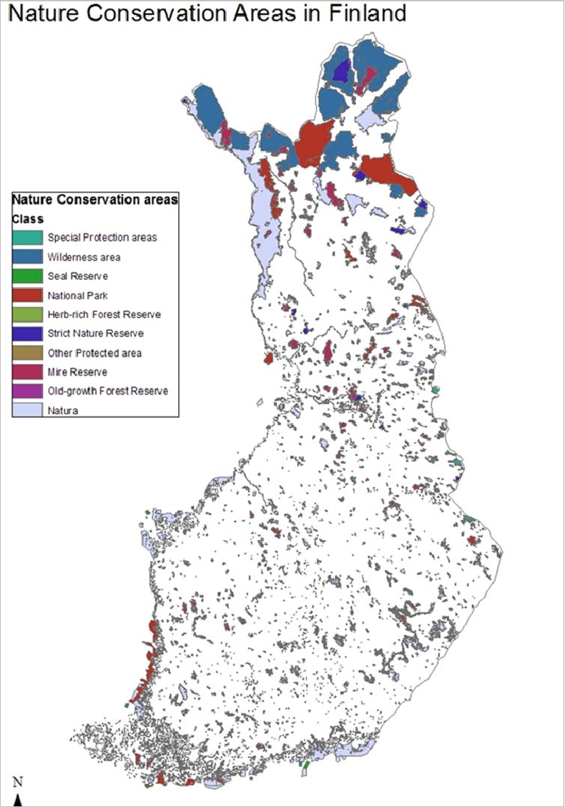
10. Environment and Natural Resources
The water and terrestrial ecosystems are protected in Finland by law. 11% of Finland’s area is protected.
In the Baltic sea the cod and the salmon and other fish species are protected by law.
Every mans right is a right that everyone in Finland has by law. You can walk in forests, pick berries and mushrooms for free. But you cannot camp or hunt without permission from the land owner.

Slide 13
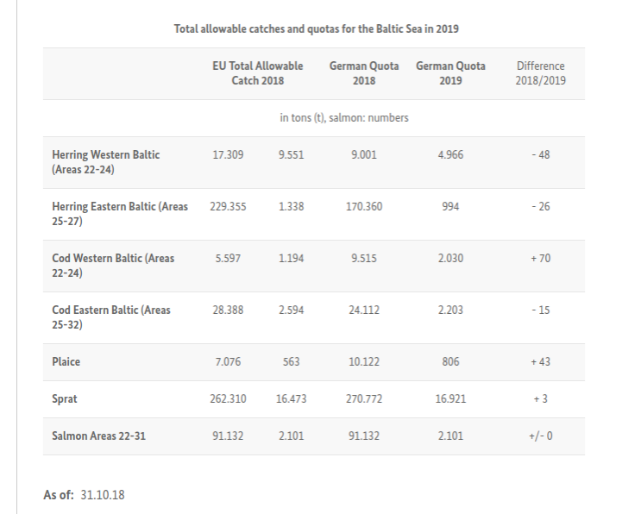

Slide 14
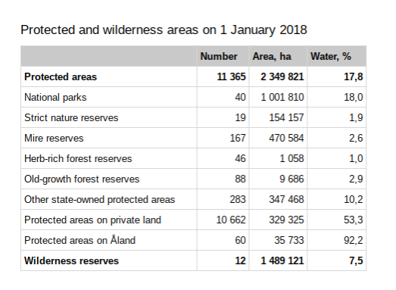

Slide 15
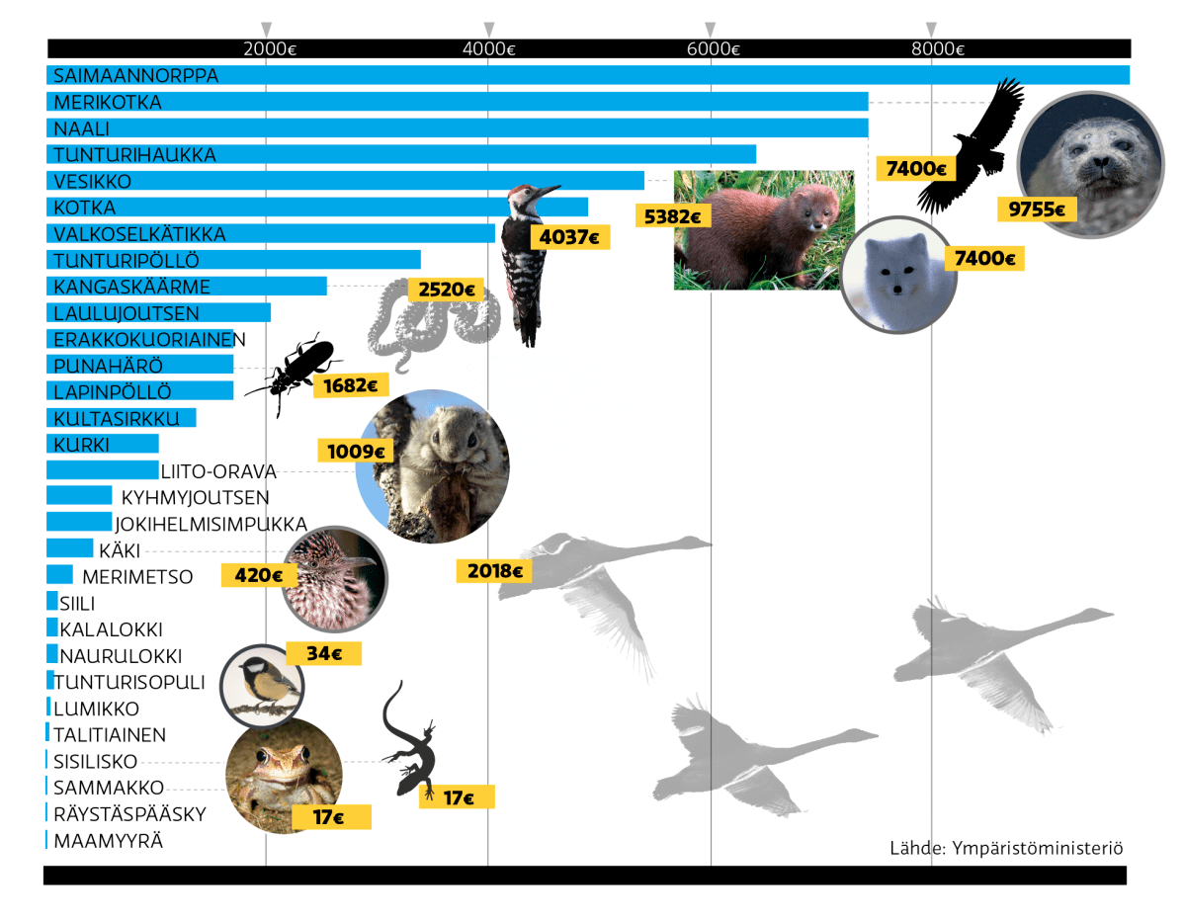
11. Protected animals in Finland
In Finland we have endangered animals which are protected by law. The authorities have made up a list which clearly states exactly how much you will have to pay as a fee if you kill an endangered animal.
More than one third of bird species are classed as threatened. This is due to legal or illegal hunt. Nature crimes in Finland have reduced the past ten years because the fee has increased.
Nature crimes in Finland are difficult to detect due to vast unpopulated areas. These problems could be solved with modern technology.

Slide 16
Thank You!
Ina Albrecht, Rebecka Malmberg, Rebecca Siro, Annika Pöllänen
Anna Idman, Ina Hildeen, Anders Johansson, Monica Lemberg

Slide 17
Länkar:
https://yle.fi/uutiset/3-6573086
https://fi.fsc.org/fi-fi/pa-svenska
https://pefc.fi/svenska/
http://www.ymparisto.fi/download/noname/%7BDF85F600-55E5-429E-B14B-DAD54330D34E%7D/128414
http://www.ymparisto.fi/fi-FI/Kartat_ja_tilastot/Ympariston_tilan_indikaattorit/Vihrea_talous/Luomutuotanto_kaantyi_kasvuun(28657)
http://www.seedquest.com/index.php
https://www.nordgen.org/skand/nordgen-deponerar-egna-fron-globala-frovalvet-pa-svalbard/
https://www.nordgen.org/skand/
https://www.stat.fi/tup/suoluk/suoluk_alue_en.html
https://www.researchgate.net/profile/Heli_Fitzgerald/publication/299535811/figure/fig1/AS:345967414005760@1459496467264/Map-of-nature-conservation-areas-in-Finland-Source-Author.png

Slide 18
http://picmeeting2017.femac.org/wp-content/uploads/2017/04/nordgen2-1.jpg
http://www.nationalparks.fi/hikinginfinland/rightsandregulations
https://www.bmel.de/EN/Forests-Fisheries/Fisheries/_Texte/Fangquoten-Ostsee-2019.html
https://svenska.yle.fi/artikel/2016/01/15/farre-daggdjur-hotas-av-utrotning-1
https://svenska.yle.fi/artikel/2016/01/15/mer-var-tredje-fagelart-klassas-som-hotad
https://www.mtk.fi/maatalous/maatalous_suomessa/luomutuotanto/fi_FI/luomutilat/
http://www.mavi.fi/sv/guider-och-anvisningar/odlare/Documents/Milj%C3%B6st%C3%B6dets%20specialst%C3%B6ds%20brochyr%202012/SV_YE%20esite%20Ekologisk%20produktion%20%202012.pdf
http://www.metsa.fi/web/sv/skogscertifiering
https://fi.fsc.org/fi-fi/pa-svenska
http://www.ym.fi/sv-FI/Natur/Naturens_mangfald

