Slide 1

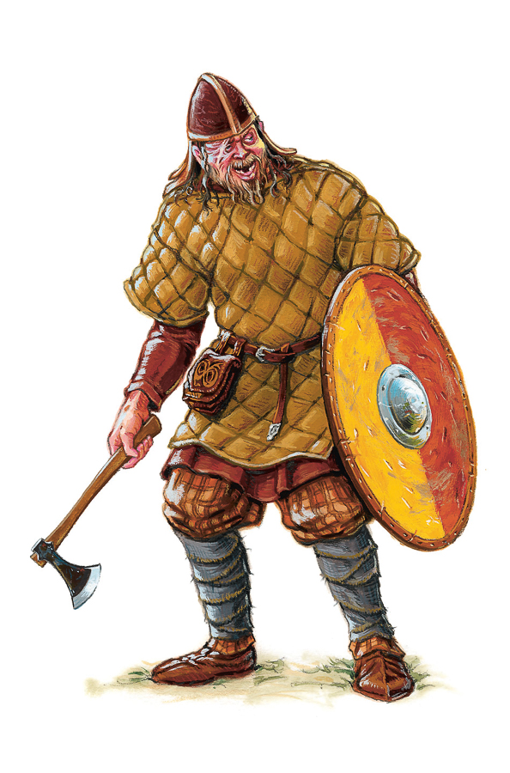
The Viking Age

Slide 2
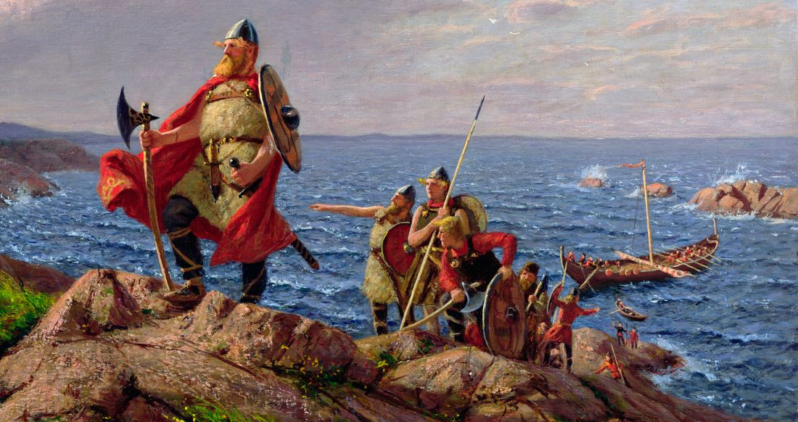
The Viking Age
The time between the years 800-1050 is probably the most famous period in Scandinavian prehistory; The Viking Age.
The stories about the Viking raids with ships are famous, like those about the plunder and trade of the Vikings.

Slide 3
The Viking Age
Even peaceful traveling families like colonizers and farmers, has been called Vikings
Vikings were actually a small group who went out "viking" and engaged in trade and robbery (plunderage)
Notes:
In our modern times, the entire population during the period, both peaceful traveling families like colonizers and farmers, has been called Vikings, although the word actually only described the small group who went out "viking" and engaged in trade and robbery (plunderage).
For most Scandinavians the farm was the center of life.
The Viking era was nevertheless a period of transition and the contact with the outside world fundamentally changed the whole society.

Slide 4
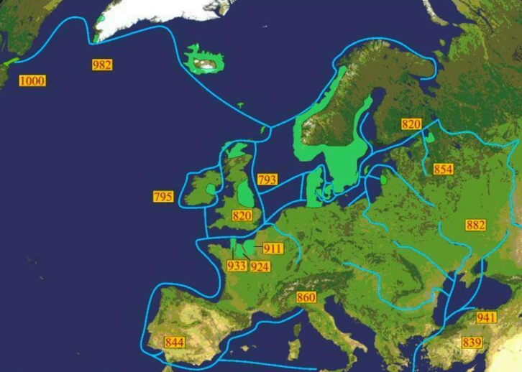
The Viking Age
The Viking era was a period of transition and the contact with the outside world fundamentally changed the whole society
The first invasion of Vikings in England took place at Dorch- ester sometime between the years 786 and 796
Years and routes for some
important Viking trips

Slide 5
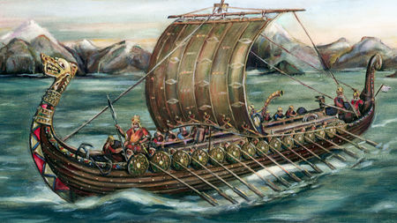
The Viking ships
The Vikings were very good at building and navigating ships. The ships were sleek, fast and safe.
They were also very good at navigation. They used the positions of the celestial bodies in the sky and the movement patterns of the waves and the winds.
Notes:
The Viking ships were sleek, fast and safe. The construction enabled them to withstand long sea voyages while being suitable as landing vessels because of they could sail on very shallow waters.
Even as navigators, the Vikings were skilled. They were able to carry out long journeys on the open sea, for instance by studying the positions of the stars and celestial bodies in the sky as well as the movement patterns of the waves and the winds.

Slide 6
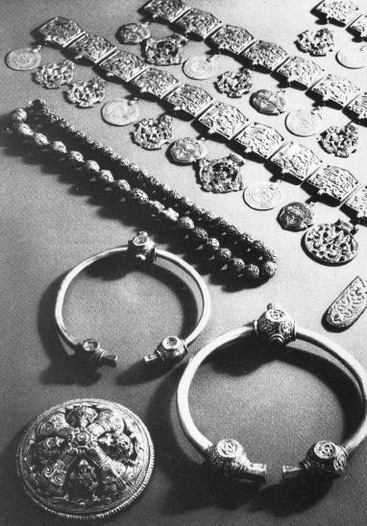
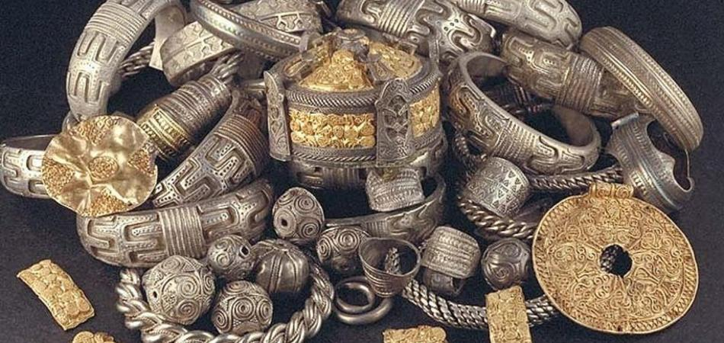
The Viking trades and treasures
Trading accelerated, great treasure finds like the one from Vårby shows that. The treasure contained jewelry and costumes from both Russia and the Muslim Empire, the Caliphate.
Treasures from Vårby, Huddinge, Södermanland

Slide 7
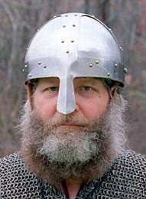
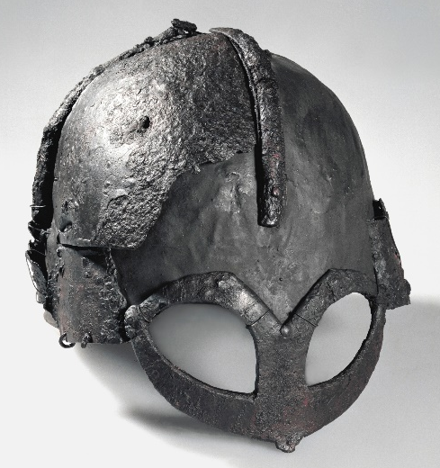
The Viking helmets
The Viking helmets were typically fairly simple: a bowl with a prom- inent nose guard
There is little evidence that the Vikings wore helmets with horns
Only 1 complete Viking helmet has turned up. Discovered in 1943 in Norway.
Notes:
The Viking helmets were typically fairly simple: a bowl with a prominent nose guard. Contrary to popular belief, there is little evidence that Viking-age helmets had horns. The only ones were probably worn by fierce warriors or for display and cultural purposes.
Despite years of searching, archaeologists have yet to uncover a Viking-era helmet embellished with horns. In fact, only one complete helmet that can definitively be called “Viking” has turned up. Discovered in 1943 on Gjermundbu farm in Norway, the 10th-century artifact has a rounded iron cap, a guard around the eyes and nose, and no horns to speak of.

