Slide 1
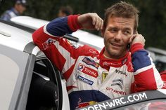
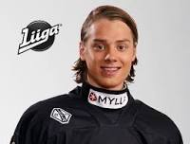
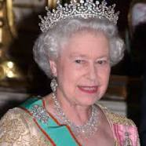
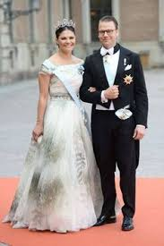
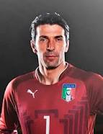
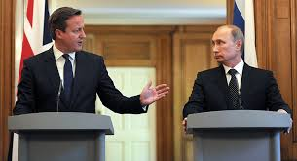
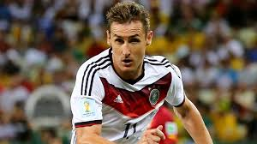
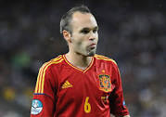
Where do you come from? – I come from… Where does he/she come from? – He/She comes from…
Sebastian Loeb
France
Sebastian Aho
Finland
Elisabeth II
England
Princess Victoria and Prince Daniel
Sweden
Gianluigi Buffon
Italy
Prime Minister Cameron
Great Britain
President Putin
Russia
Miroslav Klose
Germany
Andres Iniesta
Spain

