Slide 1
Premier league

Slide 2
Basic information
-Premier league is the highest level of the English football league system.
-There are 20 teams in the premier League
-Manchester United has the most championships(13)
-The current champion is Manchester city
-Premier League is the most watched sport league in the world

Slide 3
History
The Premier League was founded in 1992 to replace the First division.
Premier League was founded to get extra income and compete with teams across Europe
It composed of 22 clubs but later it was reduced to 20
Manchester United won the first season of premier league

Slide 4
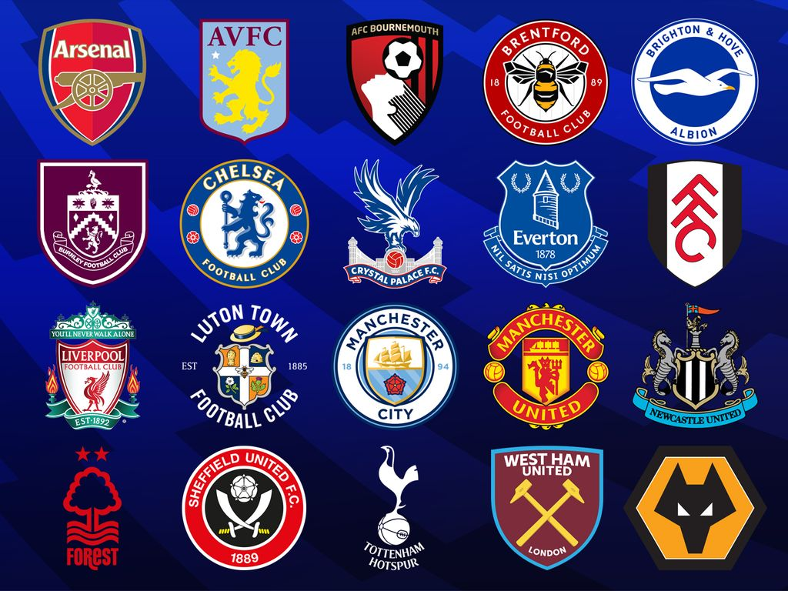

Slide 5
How the Premier League works
The premier league consists of 20 teams
Each team playes 38 matches during the course of the entire season
Win 3 points
Draw 1 point
Loss 0 points
Who has the most point at the end of the season wins.

Slide 6
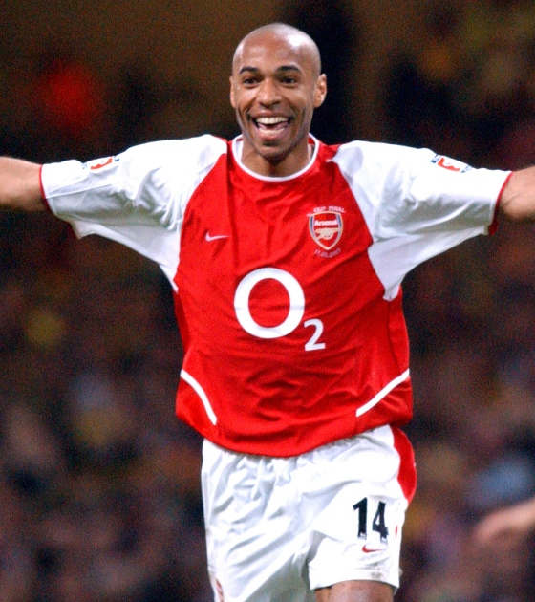
Thierry Henry
Thierry henry is French footballer who is considered one of the best strikers ever and one of the greatest players in premier league history.
He played in Arsenal from 1999 to 2007
He did 228 goals during his time in Arsenal and he has been named by arsenal as the clubs greatest player.

Slide 7
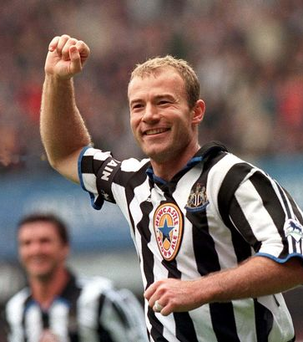
Alan Shearer
Alan shearer is professional English football player and he is also regarded as one of the greatest players in premier league history.
He is the premier leagues record goalscorer with 260 goals.
He played his entire career in Premier League and he was one of the first two players inducted into the premier league Hall of Fame.

Slide 8
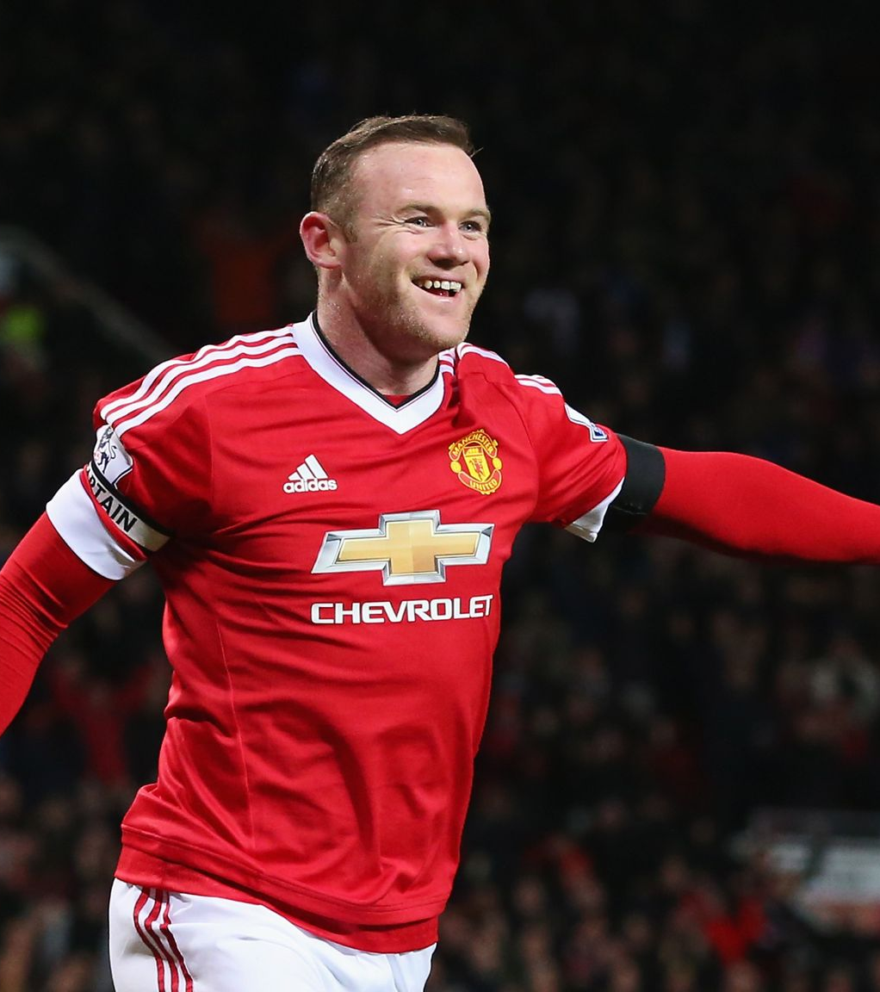
Wayne Rooney
Wayne Rooney is professional English football player who is widely considered one of the best players of his generation
He made his professional debut at the age of 16
He played two years in Everton before moving to Manchester United were he played thirteen years
He is the record goalscorer for Manchester United.

Slide 9
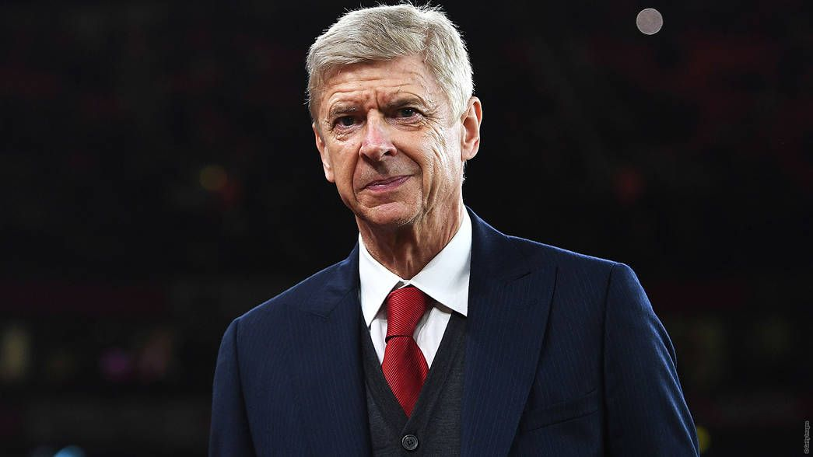
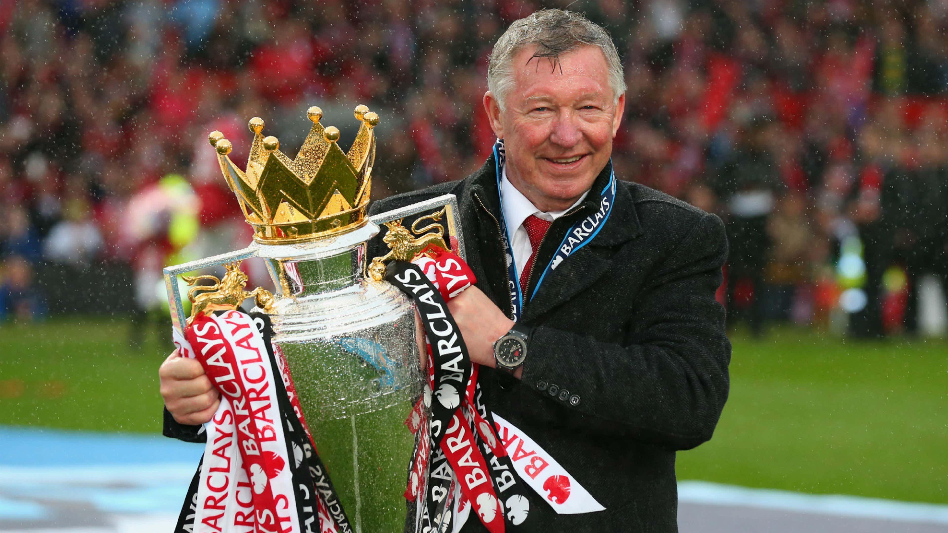
Best coaches
Arsene Wenger
Arsene Wenger is former football manager and player
He was the manager of Arsenal from 1996 to 2018
He is currently serving as FIFAs chief of global football development
Alex Ferguson
Alex Ferguson is former Scottish Football manager and player
He is best known for managing Manchester United from 1986 to 2013
He is widely regarded as one of the greatest managers of all time and has won more trophies than any other manager

Slide 10
sources
https://en.wikipedia.org/wiki/Premier_League
https://www.premierleague.com/history/dashboard
https://www.givemesport.com/premier-league-players-history/

