Slide 1
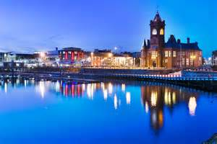
Whitchurch, Cardiff and Wales

Slide 2


Slide 3
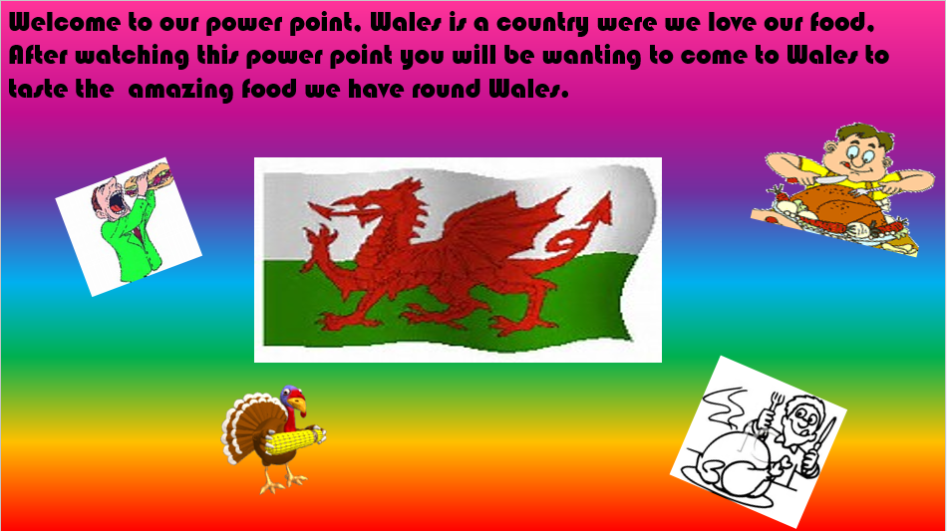

Slide 4
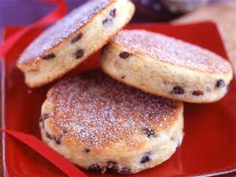
FAMOUS WELSH FOODS ARE
Welsh Cakes
Bara Brith
Welsh Rarebit
Cockles
Welsh lamb
Glamorgan sausages

Slide 5
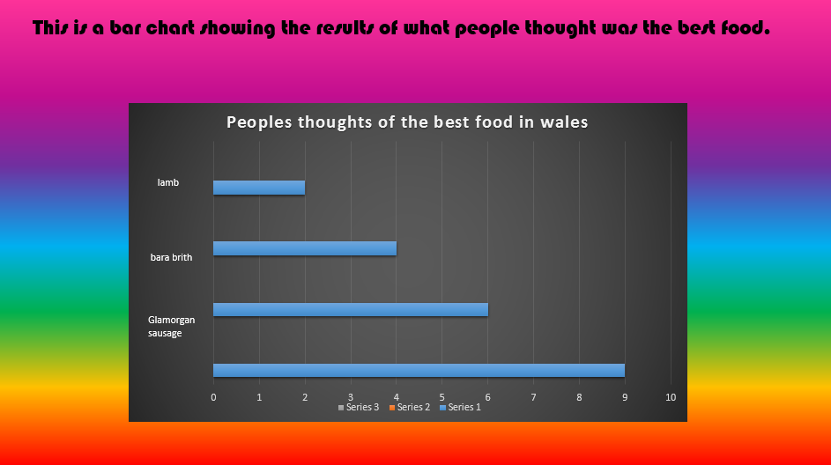

Slide 6

CHURCHES IN WHITCHURCH

Slide 7
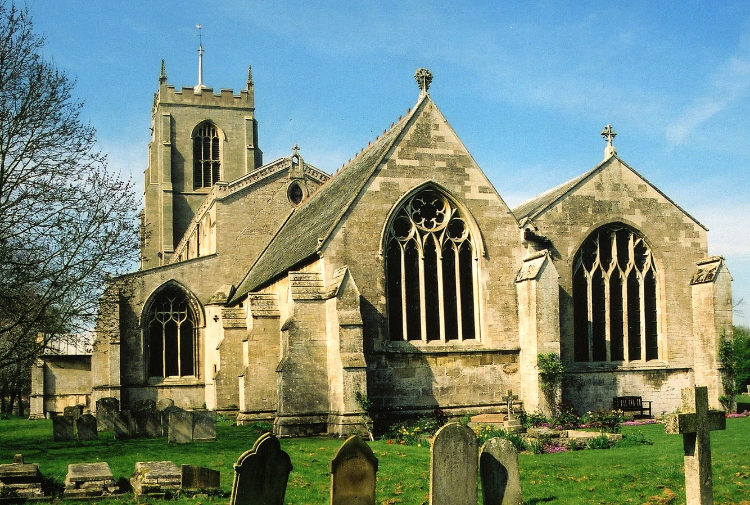
St Mary's church
It was built in 1884. St Mary's church is next to Whitchurch high school in the village

Slide 8
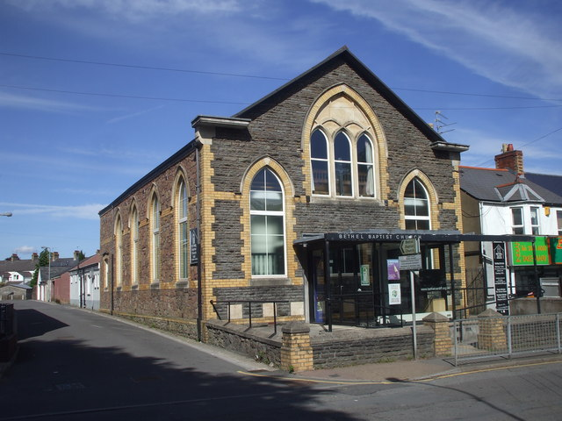
Bethel Baptist
Bethel Baptist church was built in 2007. It has fun clubs, singing & art. Wow!

Slide 9
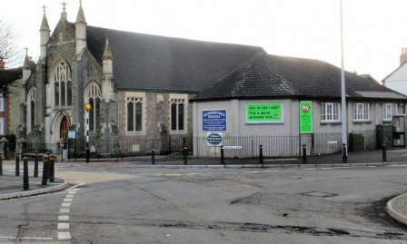
Methodist church
This church was built in 1829 and is
one of the oldest churches in Whitchurch.

Slide 10
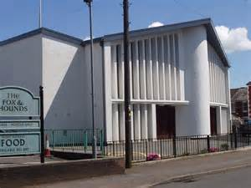
St Teilos
Catholic church
We have held our Christmas concerts here

Slide 11
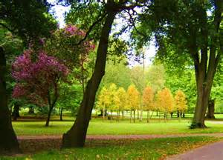
PARKS IN CARDIFF

Slide 12
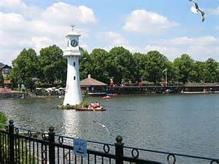
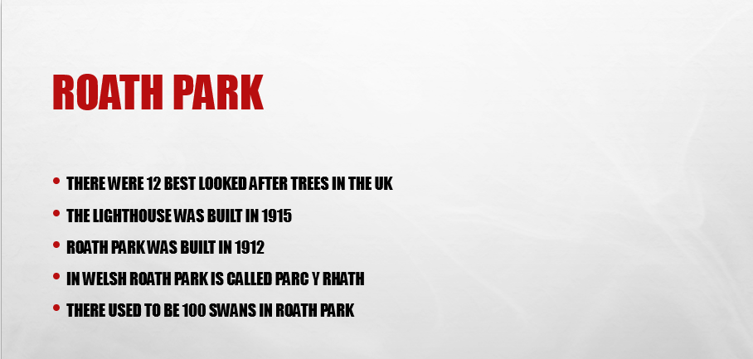

Slide 13
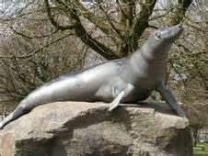
VICTORIA PARK is in an area of Cardiff called Canton. It has a swimming pool and a famous statue of a seal called Billy!

Slide 14
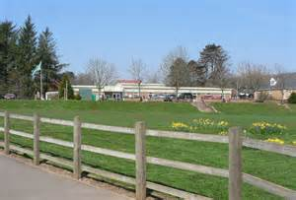
Schools in Whitchurch

Slide 15

Coryton primary is one of the best schools in Whitchurch. This is our school

Slide 16
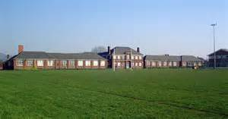

Whitchurch High School is one of the biggest schools in the country. It’s a secondary school, we go down there for lessons every 2 weeks.

Slide 17

Famous Whitchurch People
This is Gareth Bale. He is the worlds most expensive football player. He currently plays for Real Madrid and the Welsh national football team. Gareth grew up attending Eglwys Newydd school in Whitchurch. After his primary school years Gareth moved up to Whitchurch high school where he continued to excel in his sports. Gareth was always playing football at Whitchurch high (he also played hockey and rugby), after growing up and moving from Southampton to Tottenham Gareth opened a five a side astro-turf football centre just outside Whitchurch high school. He is now 26 and having very good season.

Slide 18
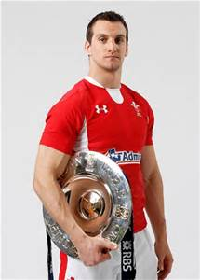
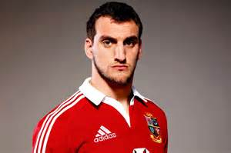
Sam Kennedy-Warburton is a Welsh international rugby union player. He plays regional rugby for the Cardiff Blues and was first capped for Wales in 2009. In June 2011 he was named as Wales captain versus the Barbarians and subsequently in August 2011 he was named as the Wales captain for the 2011 Rugby World Cup.
Sam grew up in Whitchurch and went to Whitchurch High School aw well.
He came to raise our Eco flag a few years ago!

Slide 19
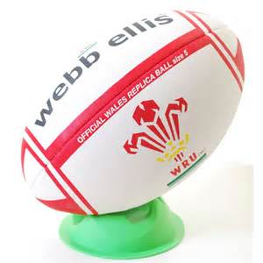





Sports in Whitchurch

Slide 20

Whitchurch rugby club is located just behind Llandaff north playing fields also known as Hailey park. They have the exact same kit as the proud welsh team - my country. Most ages can play tag rugby or proper rugby. They also play against teams in different places, like Penarth, Taff swell, Barry and lots more. Rugby is the most popular sport in Wales!!!!!!

Slide 21
Taekwondo
Taekwondo is one of the many known martial arts. The inventor is president Chio Hong Ha. It is one of the most dangerous self defences. As you speed through the belts, the first weapons you get is a darbon (rope attached to a stick) Khatana (Large knife) and a jahn bong ( Massive stick.) Taekwondo training also includes a comprehensive system of blocks, Punches, open-handed strikes, various take-down or sweeps, throws, and some joined locks like Brazilian Jiu Jitsu.

Slide 22
Football is the worlds most watched and played sport. Football was originated in China, the maximum number of goals scored in a match was 16 scored by Stephan Stanis (France) playing for the racing club de lens in December 1942!

Slide 23

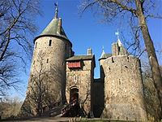
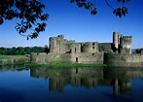
CASTLES
Cardiff has a variety of castles, some are huge some are small, here is some information on some of the castles in Cardiff.
Cardiff Castle is an immense castle in the heart of town, you can go there for lots of things like ice-cream, junior sports events and a peaceful walk around the castle grounds.
Caerphilly castle is a castle near Cardiff which has a wide moat around which was used in the olden days to protect them from enemies.
Castle Coch is welsh for red castle and it is a lovely family day out, it also has a lovely wood around it with colossal oak trees in it.

Slide 24

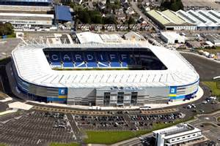
Stadiums
Millennium stadium is the heart of welsh rugby, it always has an electric atmosphere on match day and always has an accumulation of passion and enjoyment, it also offers a place to eat and a cinema.
This is the Cardiff City stadium, its capacity is 33,280 so on match day the stadium is bursting with pride, there is also a giant megastore that offers everything to do with Cardiff city football clubs. It is located in Leckwith.

Slide 25

ATTRACTIONS IN Cardiff
In this power point we will show you all of our eminent attractions here in Cardiff, we hope you have a pleasant time going to some of these places, we’ll show you that Cardiff is a amusing place to live.
Cardiff has lots of wonderful shops, Sports shops, food shops, outdoor shops, jewellery shops and lots more. Cardiff has three main shopping centres these are Saint David's one, Saint David's two and capital. Here are the most visited shops in Cardiff

Slide 26

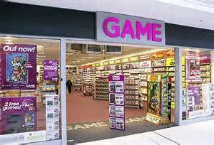

Shops
Hollister is a unisex clothing's shop which has over 500,000 visitors since 2014 .
Asda is a colossal supermarket located in north Cardiff which sells almost everything.
Game is a shop which sells computer games and consoles, game is favoured by older kids and teenagers.

Slide 27
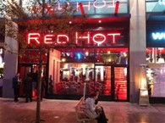
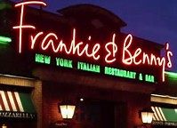

Restaurants
Pizza Express is a pleasant restaurant in lots of places in Cardiff. It offers perfect pizza and pleasant pasta, it also has very well mannered waiters and waitresses.
Red Hot is located in town, this restaurant is a popular attraction for people who love their food, their moto is ‘all you can eat’
Frankie & Benny’s is an Italian restaurant that you can book parties in. It has great food and drink and is enjoyable for all ages

