Slide 1
A trip into the unknown: Modern Education
School environment in our countries

Slide 2
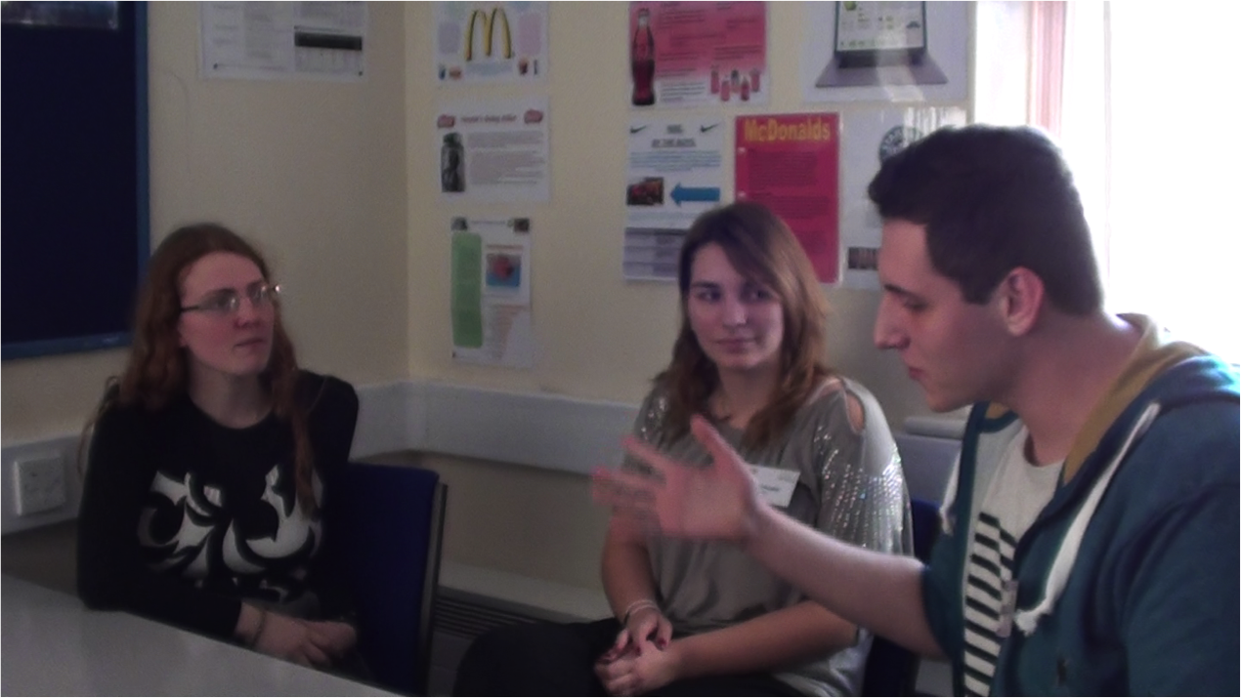
Interview with a passionate teacher ☺

Slide 3
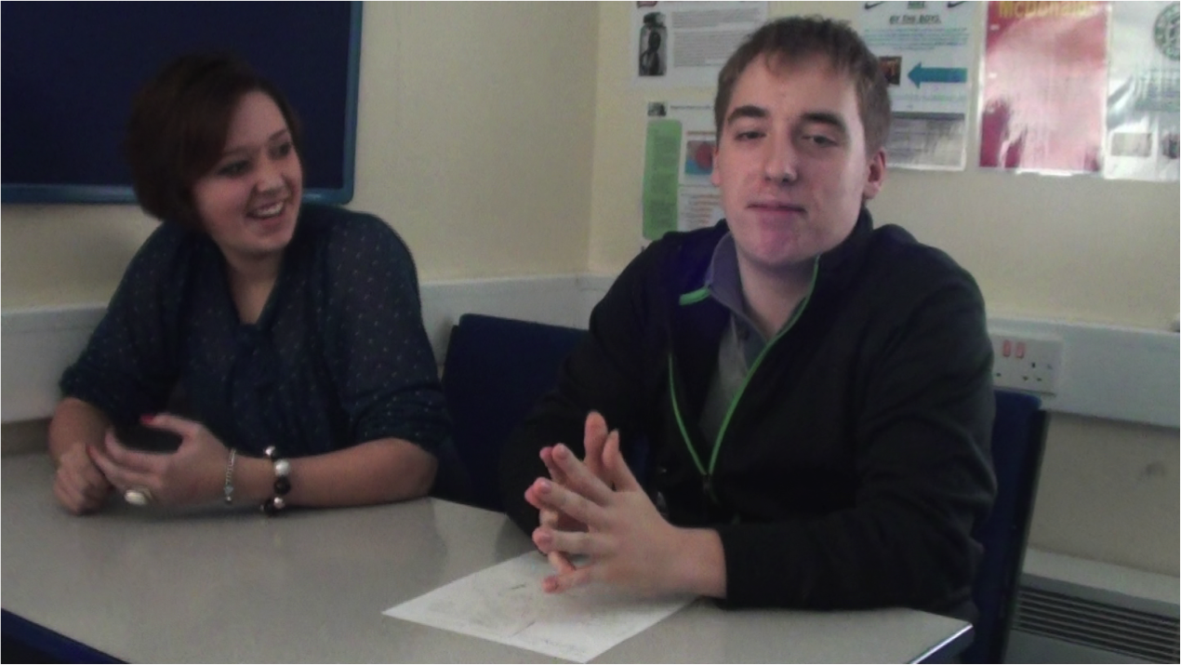
Interview on British System of Education

Slide 4
Our brilliant students and gorgeous TEACHERS <3

Slide 5
COMENIUS makes strong
bonds ☺

