Slide 1
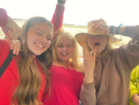
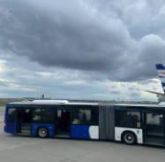
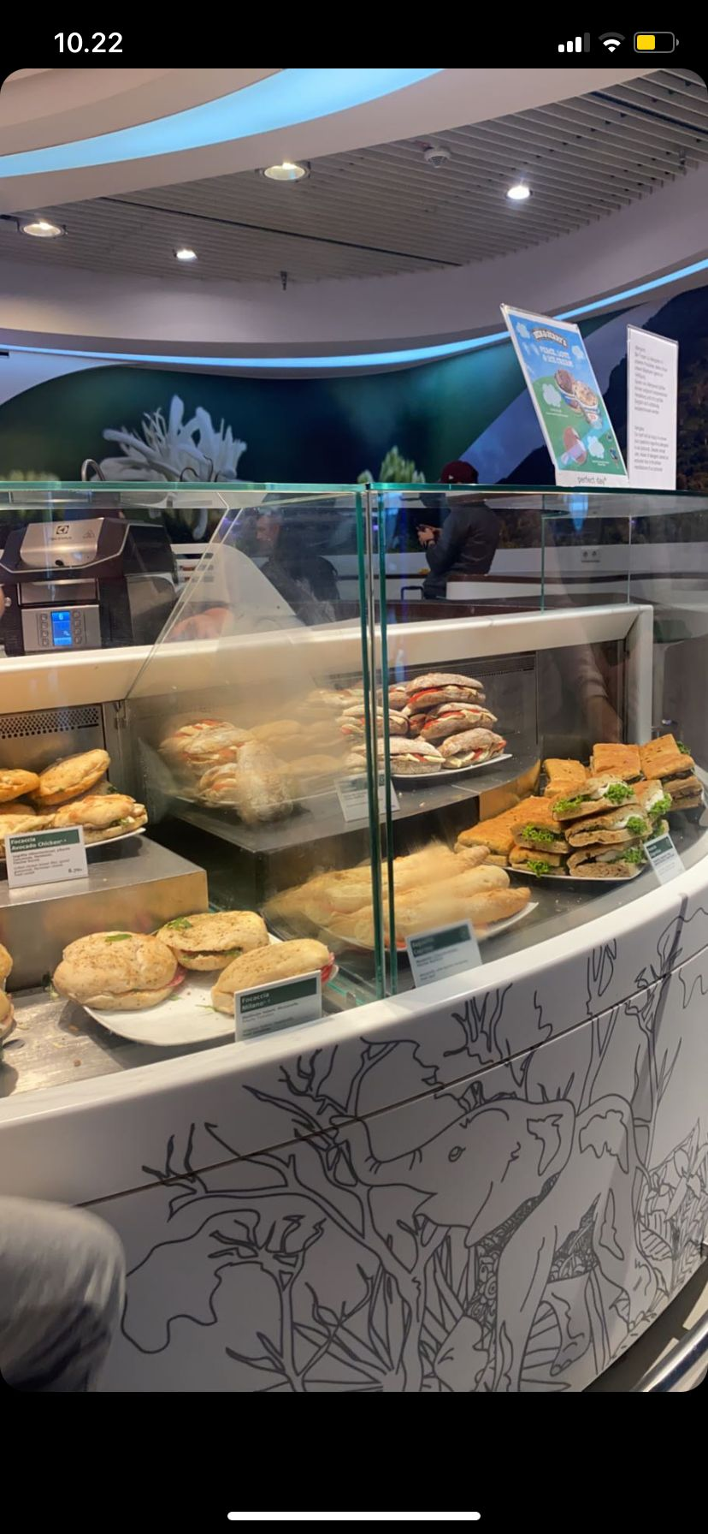
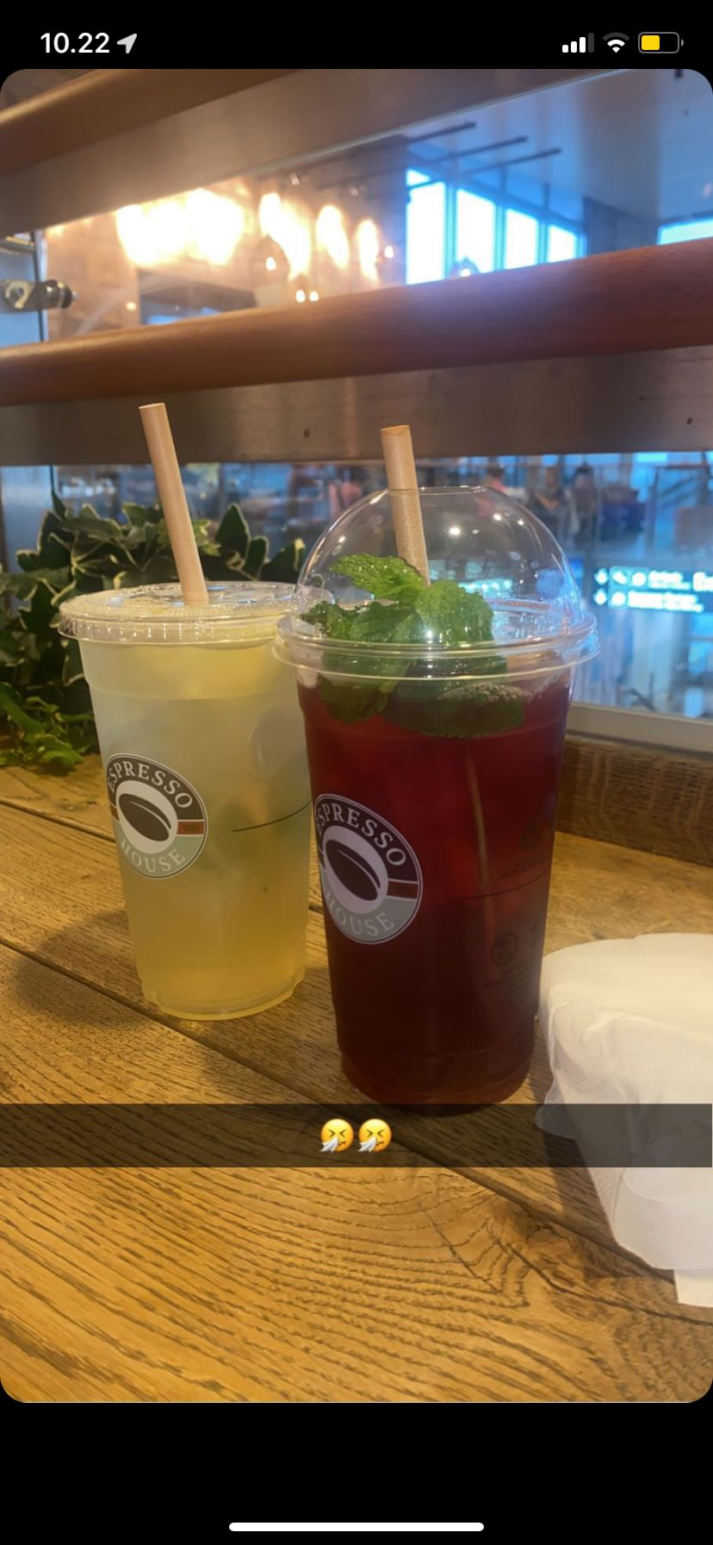
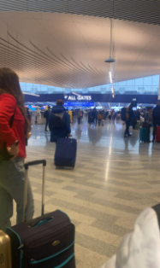
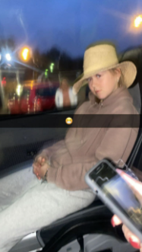
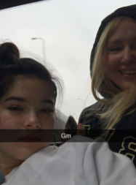
Sunday 16.10.
We had to be at our school yard at 7.45 o’clock because our minibus left at eight. We were all really tired but still so excited that no one slept during our way to Helsinki-Vantaa’s airport. We arrived there around eleven and had about two hours of free time there. We ate and shopped until our flight left at one o’clock. After three hours of flying we arrived to Frankfurt and had some time there too, three hours passed by and we were flying to Greece. After three hours of flying again we finally met our hosts. Because it was already eleven o’clock, we went straight home, showered, ate and went to bed.

Slide 2
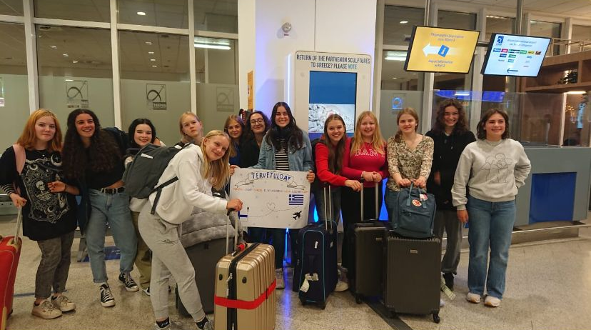
Here we met our hosts

Slide 3
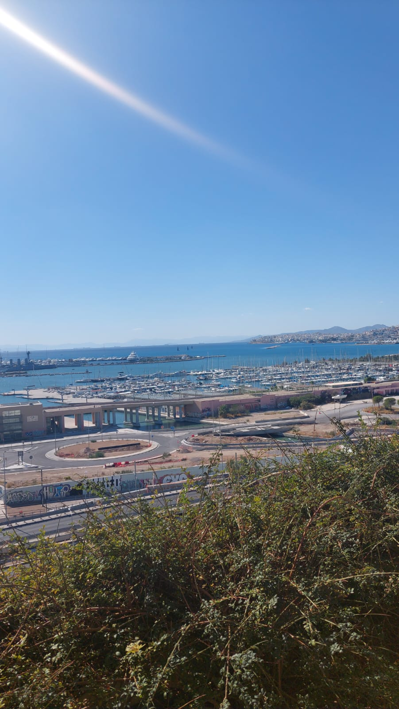
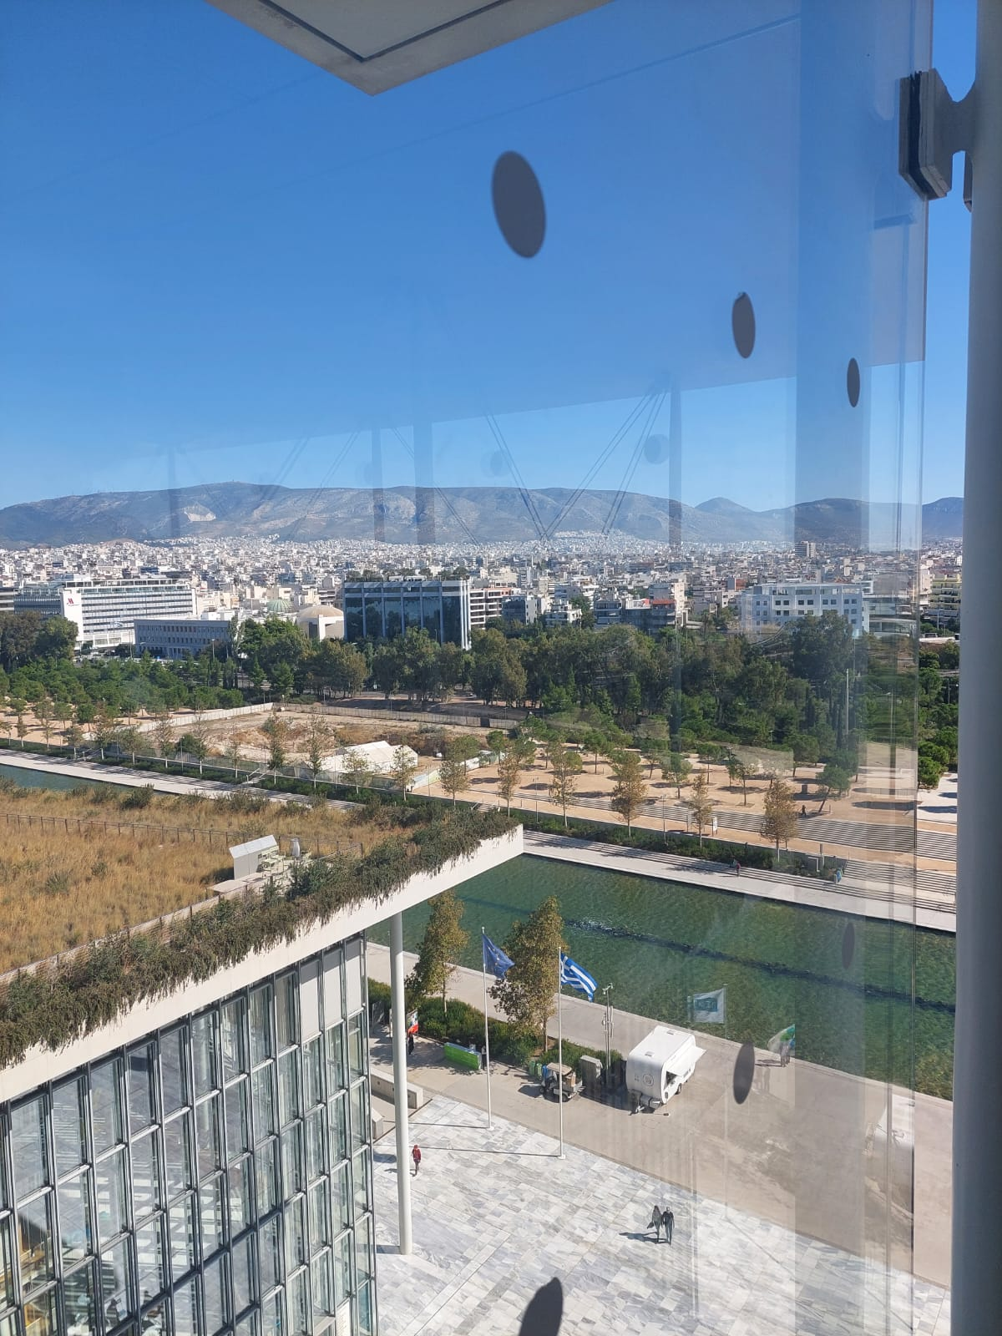
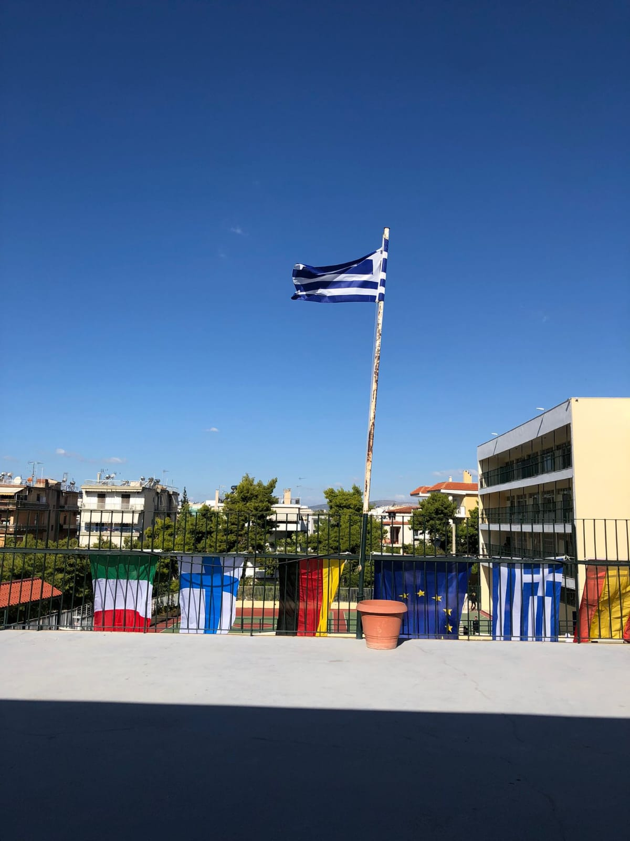
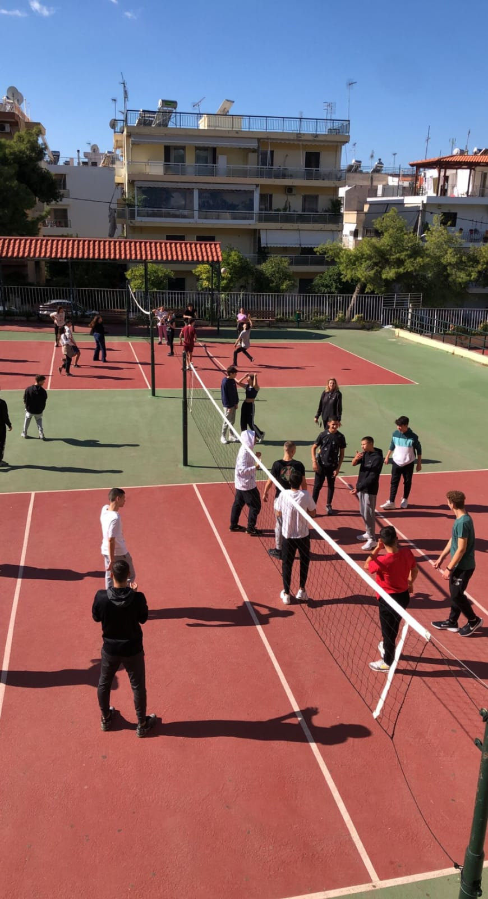
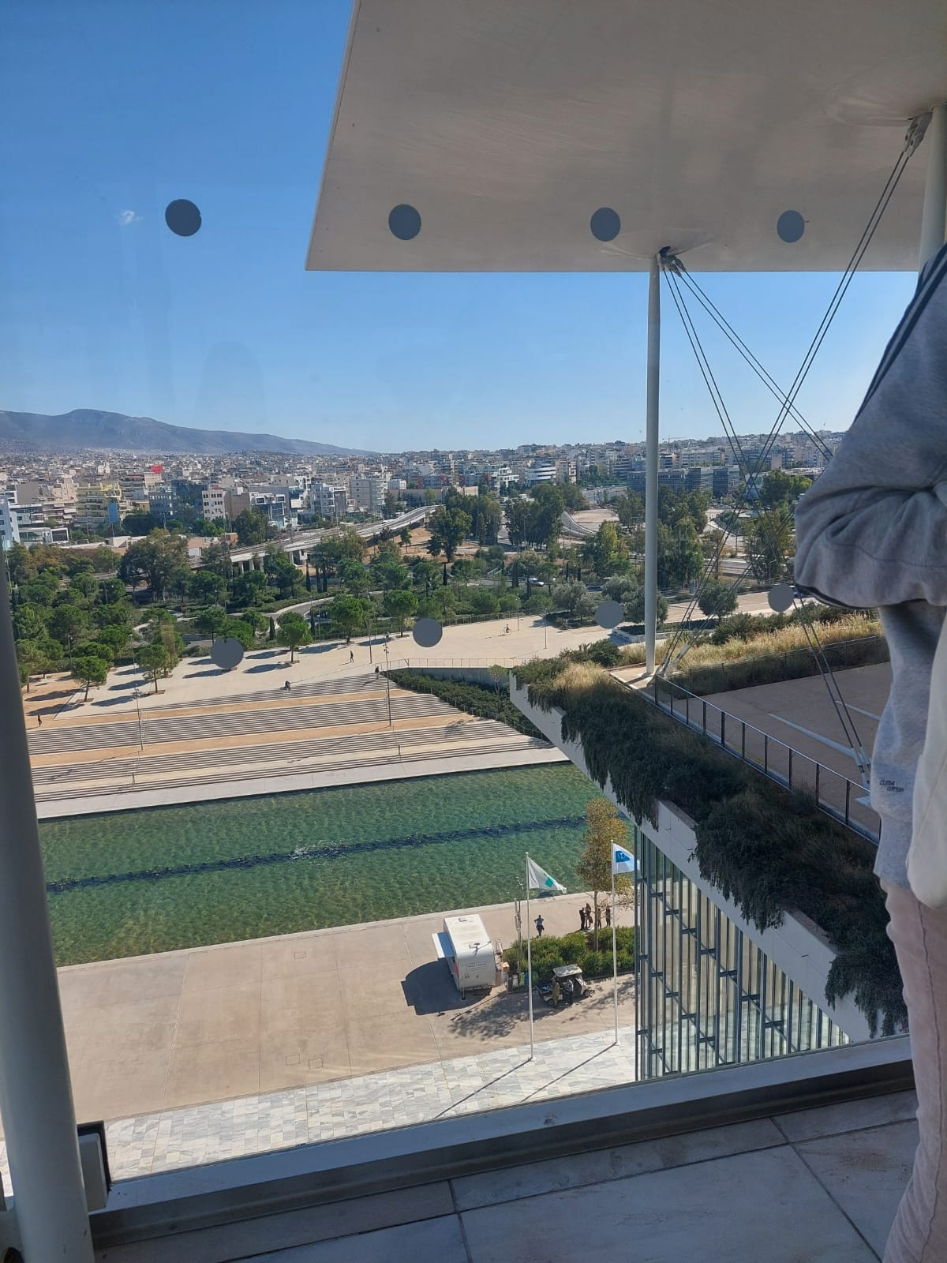
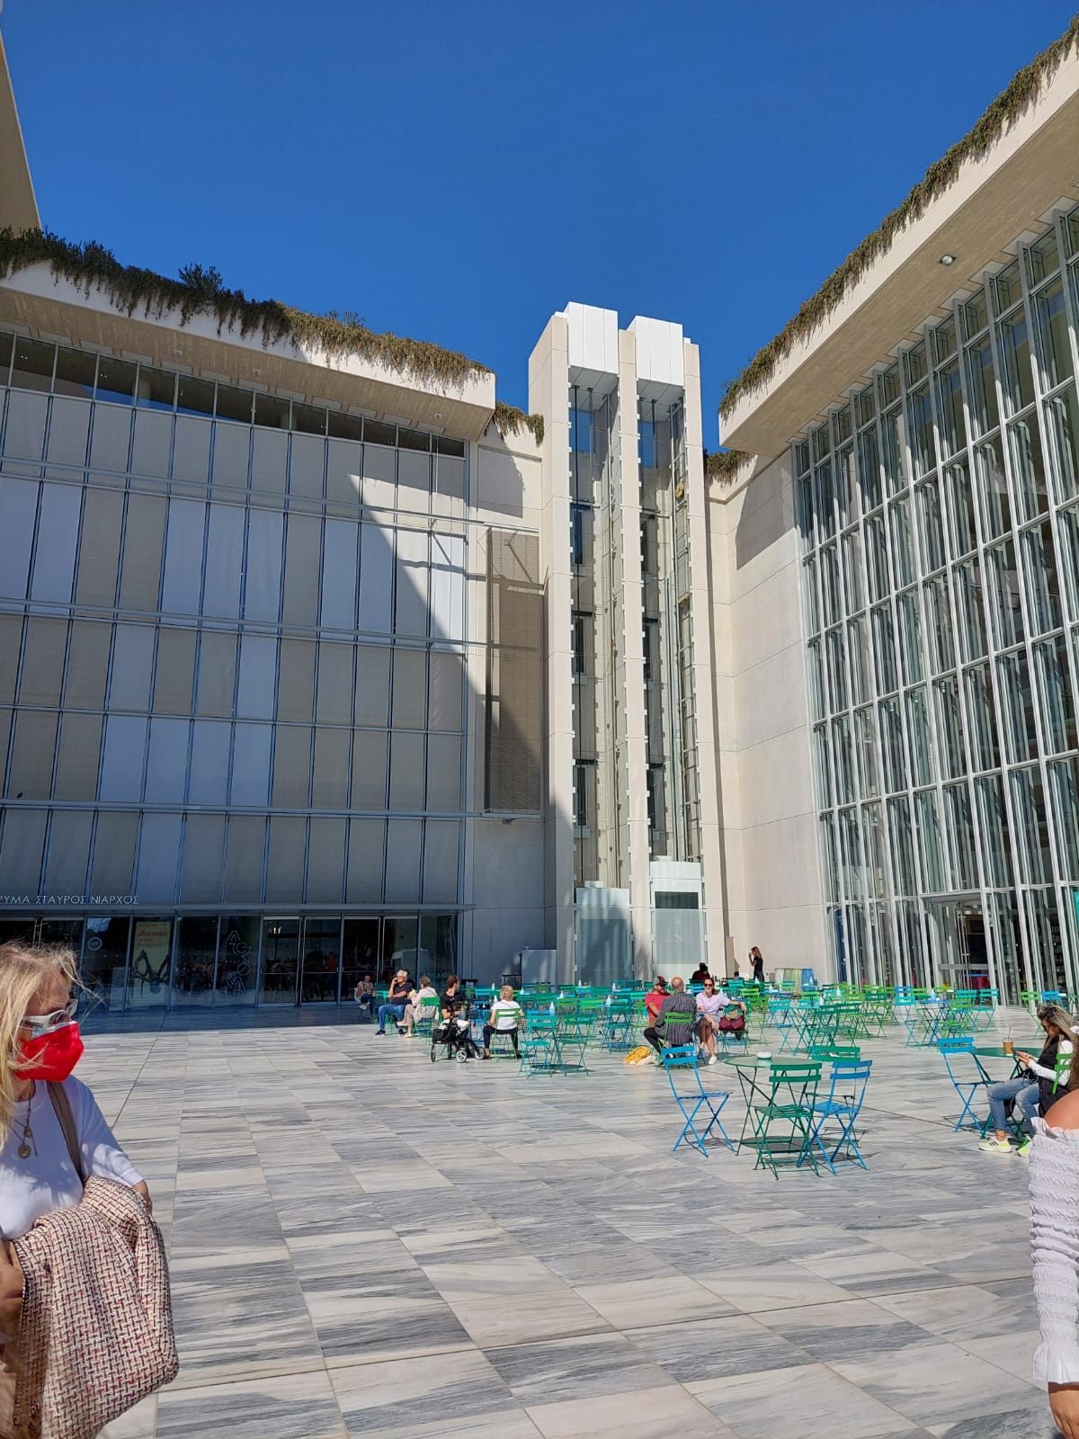
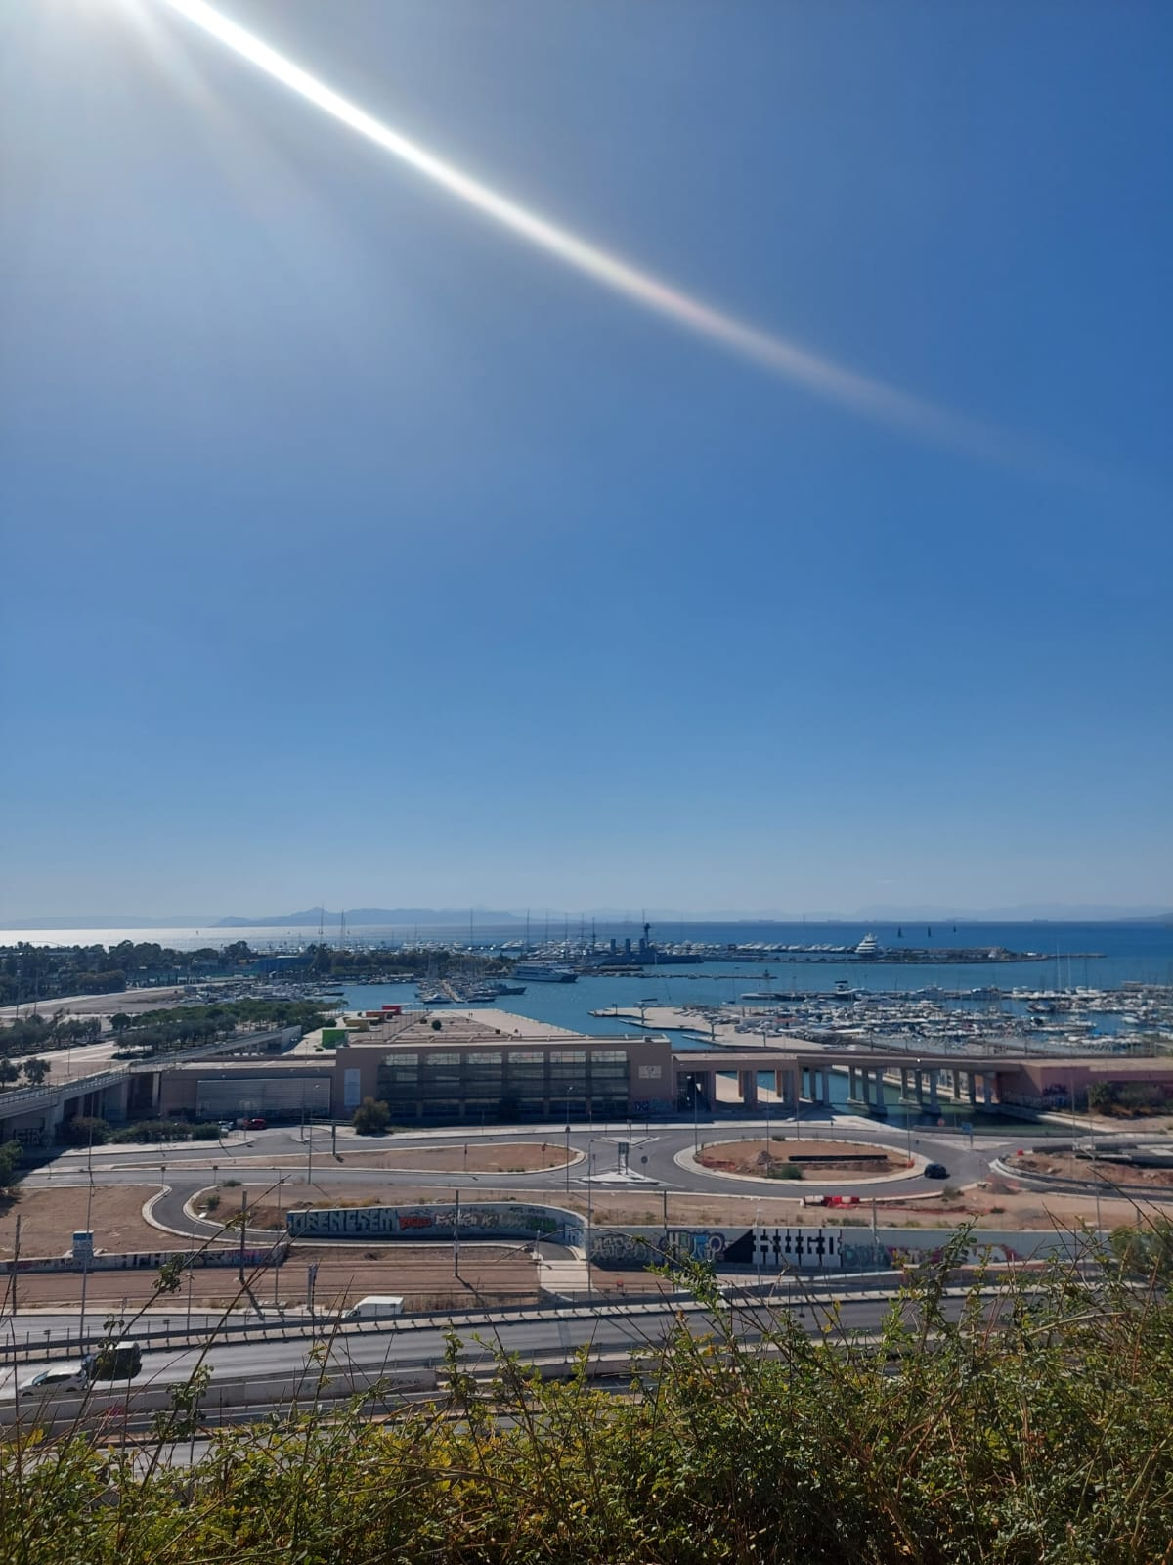
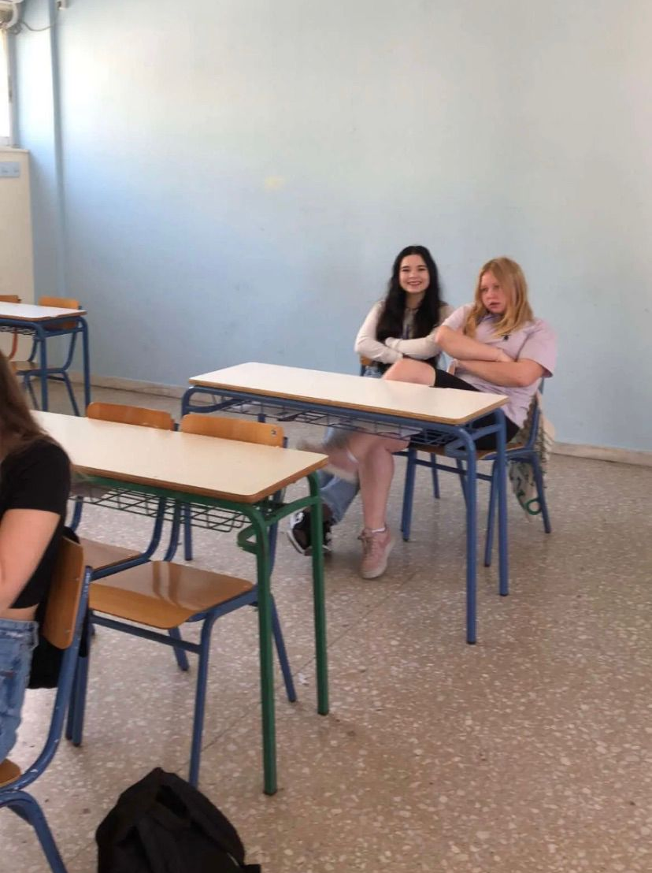
Monday 17.10.
In the morning, we went to the school of our hosts where we did different activities and watched the videos we had made earlier. Then we took the bus and left to the Stavros Niarchose, where we also ate.

Slide 4
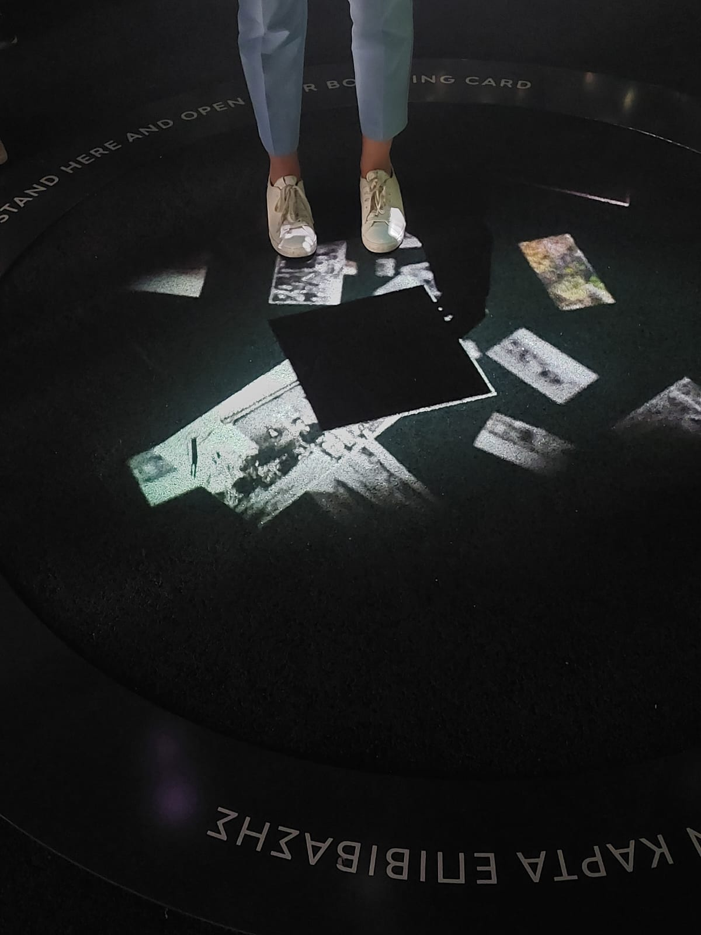
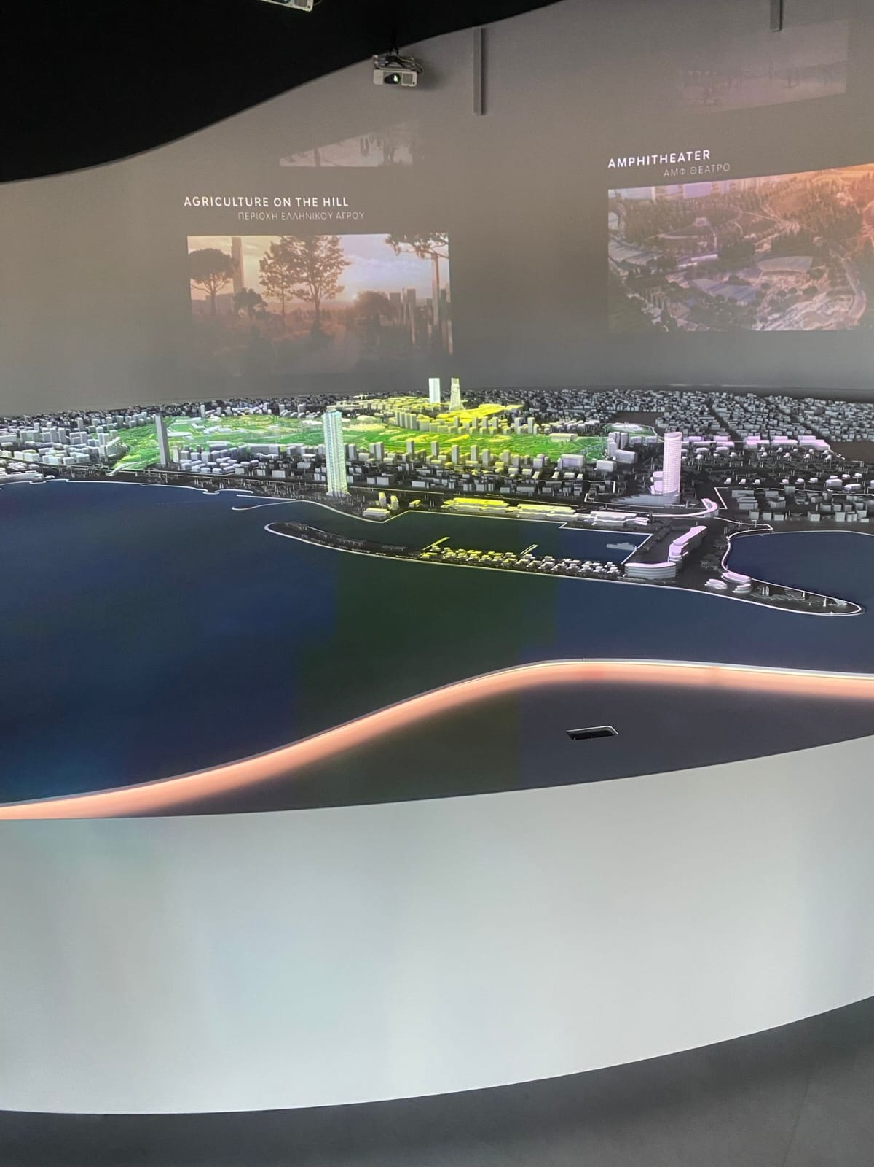
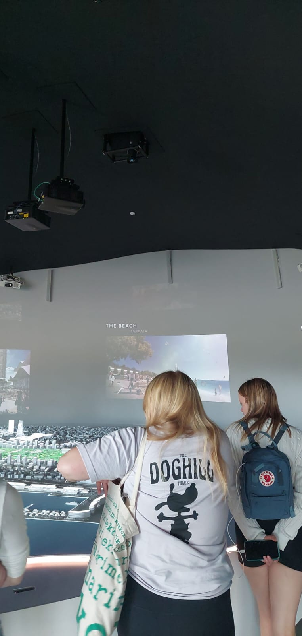
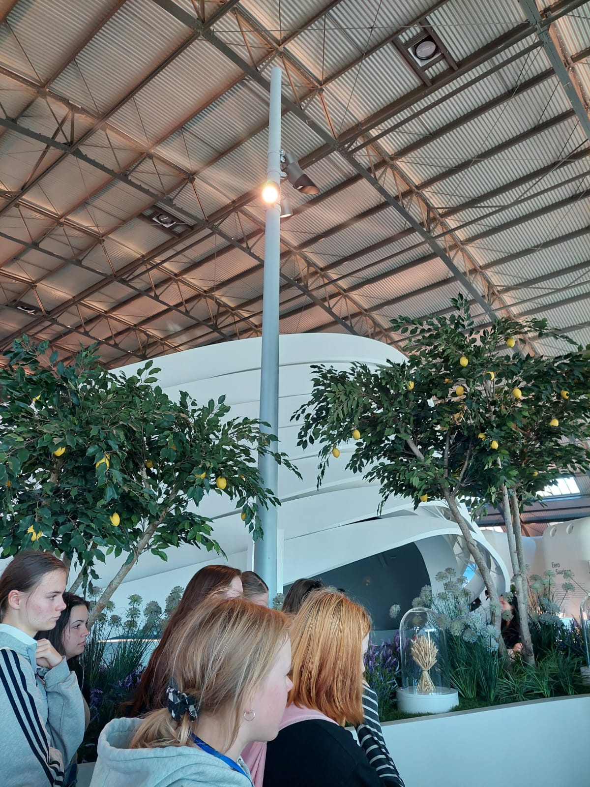
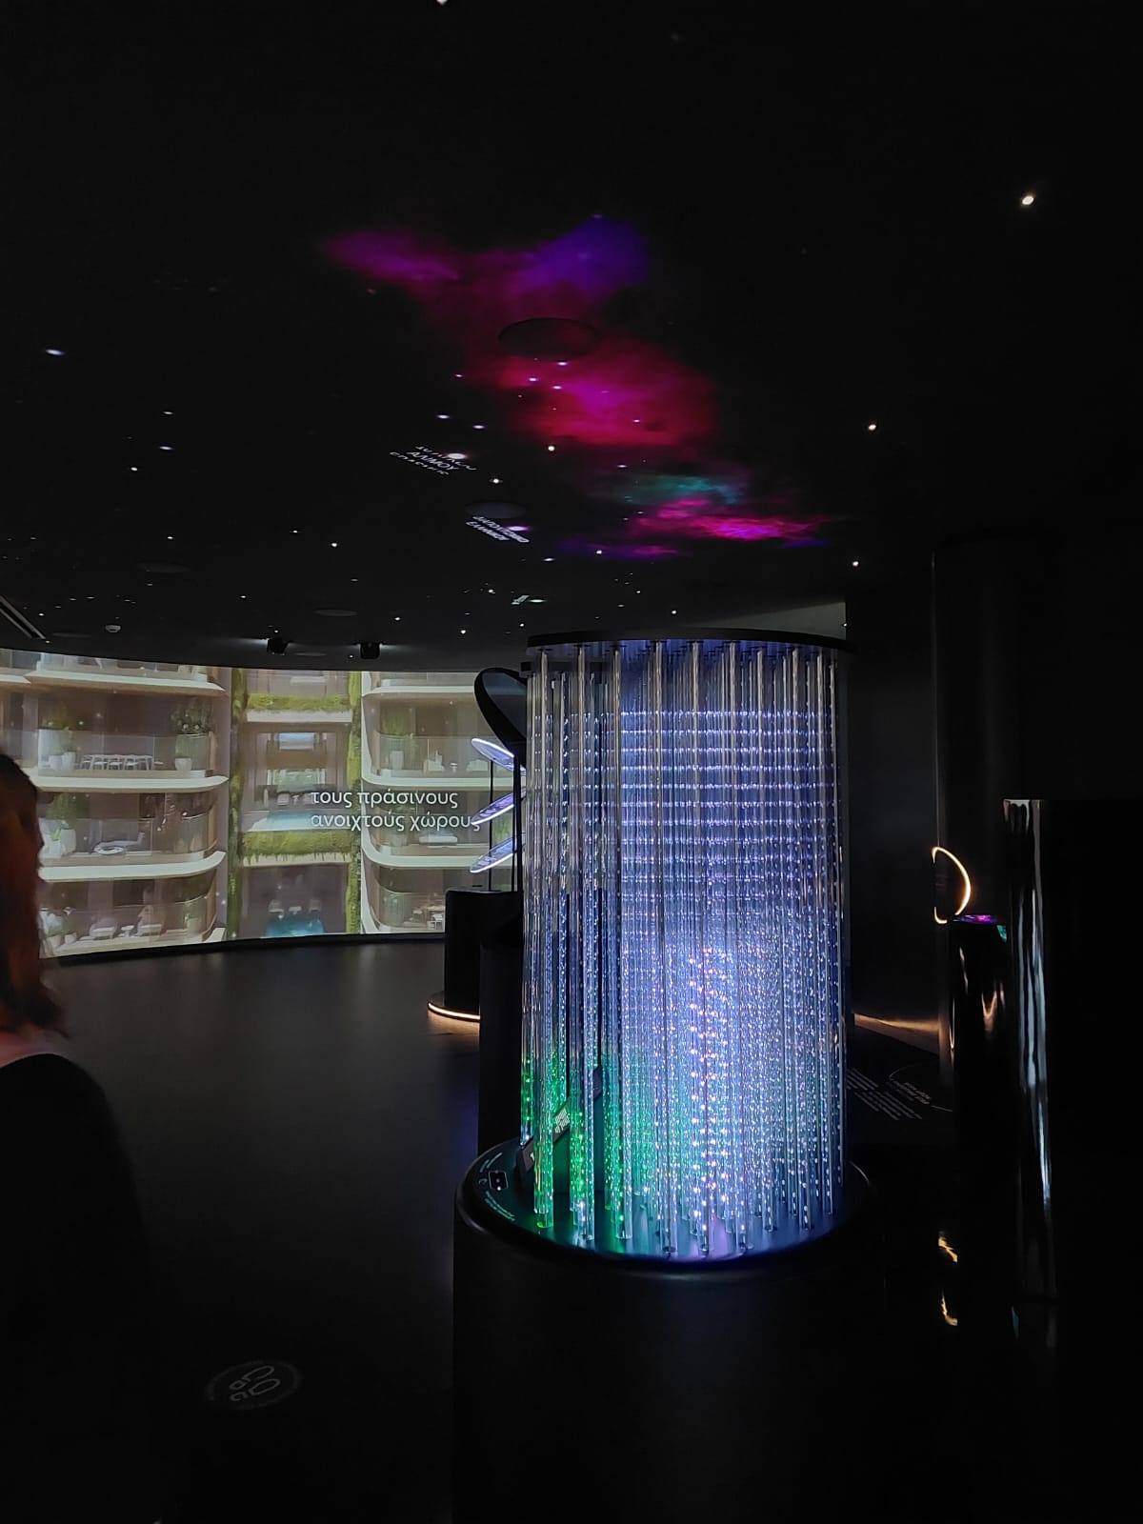
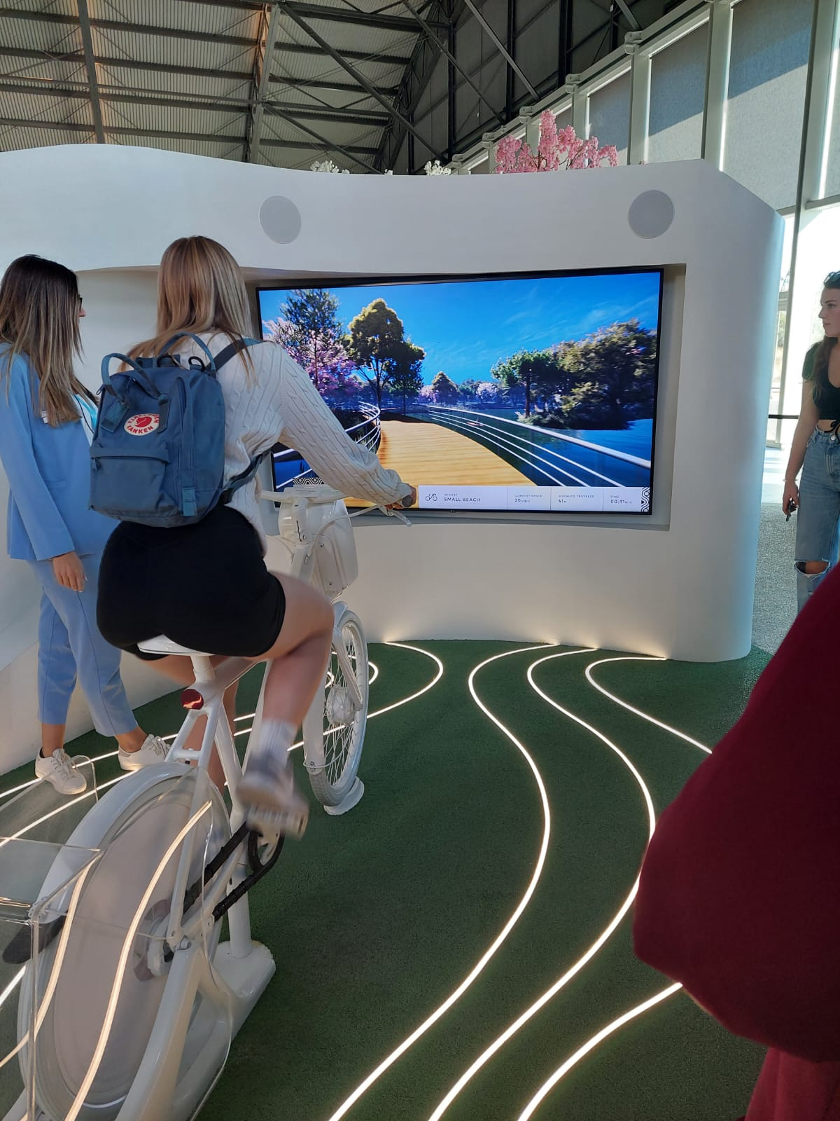
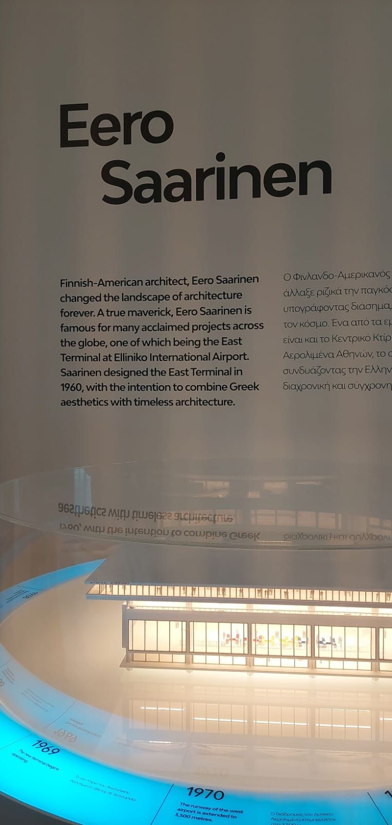
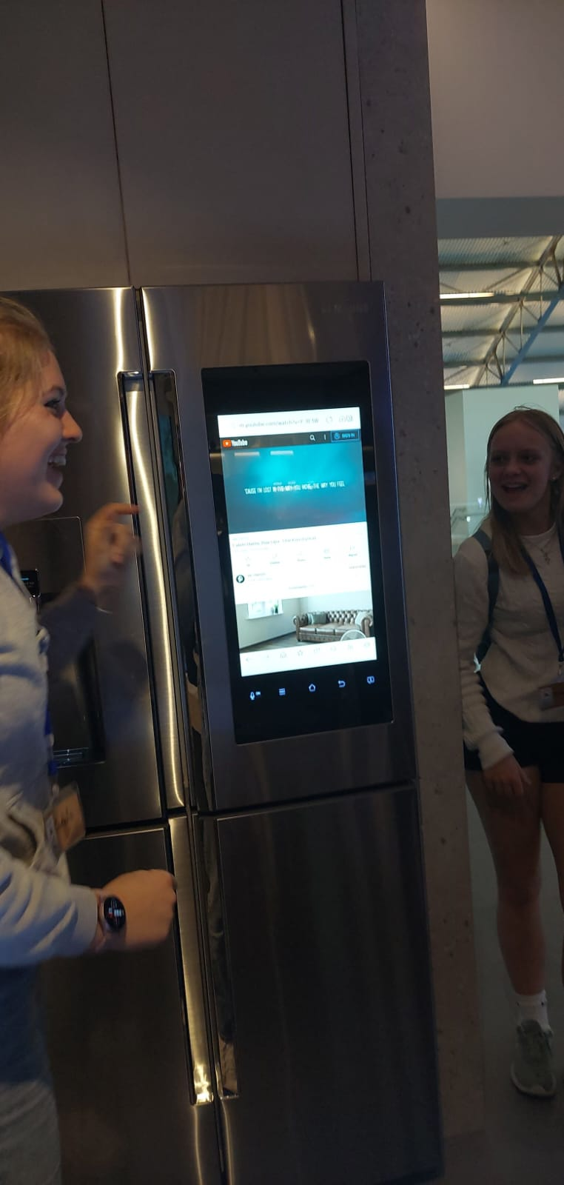
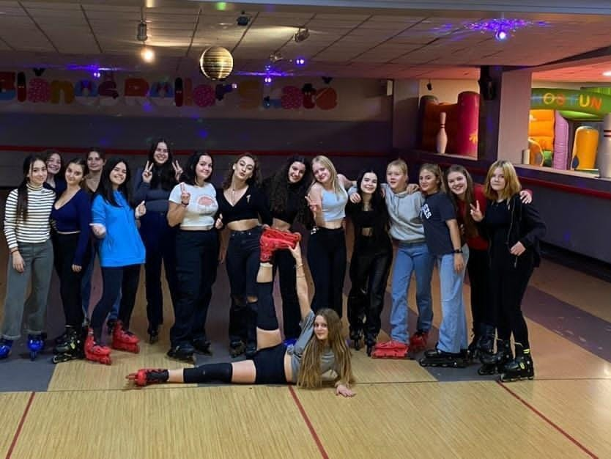
After that, we went to the Ellinikon Experience Park. Then we left to school, and walked home. In the evening, we hung out with our hosts and other students.

Slide 5
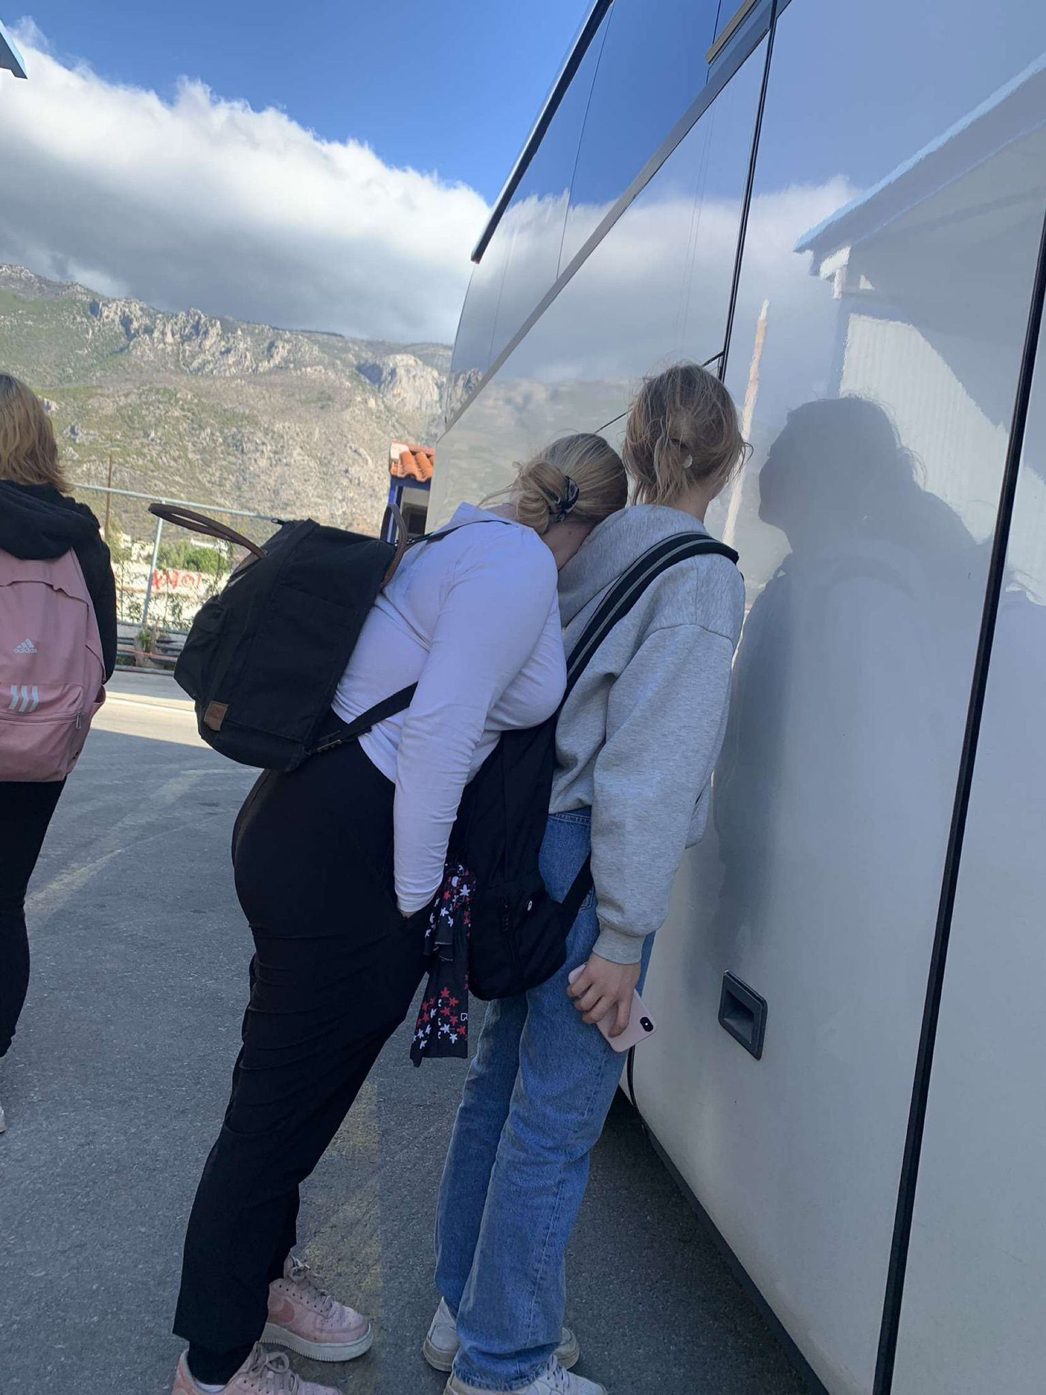
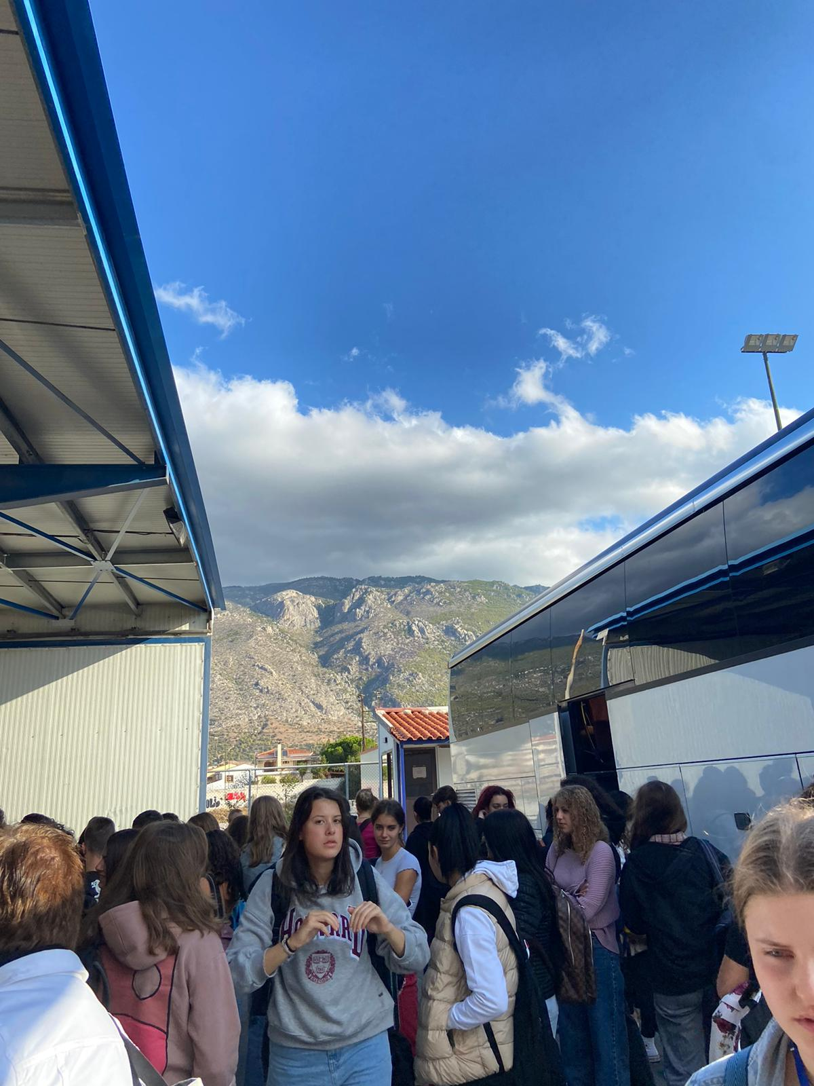
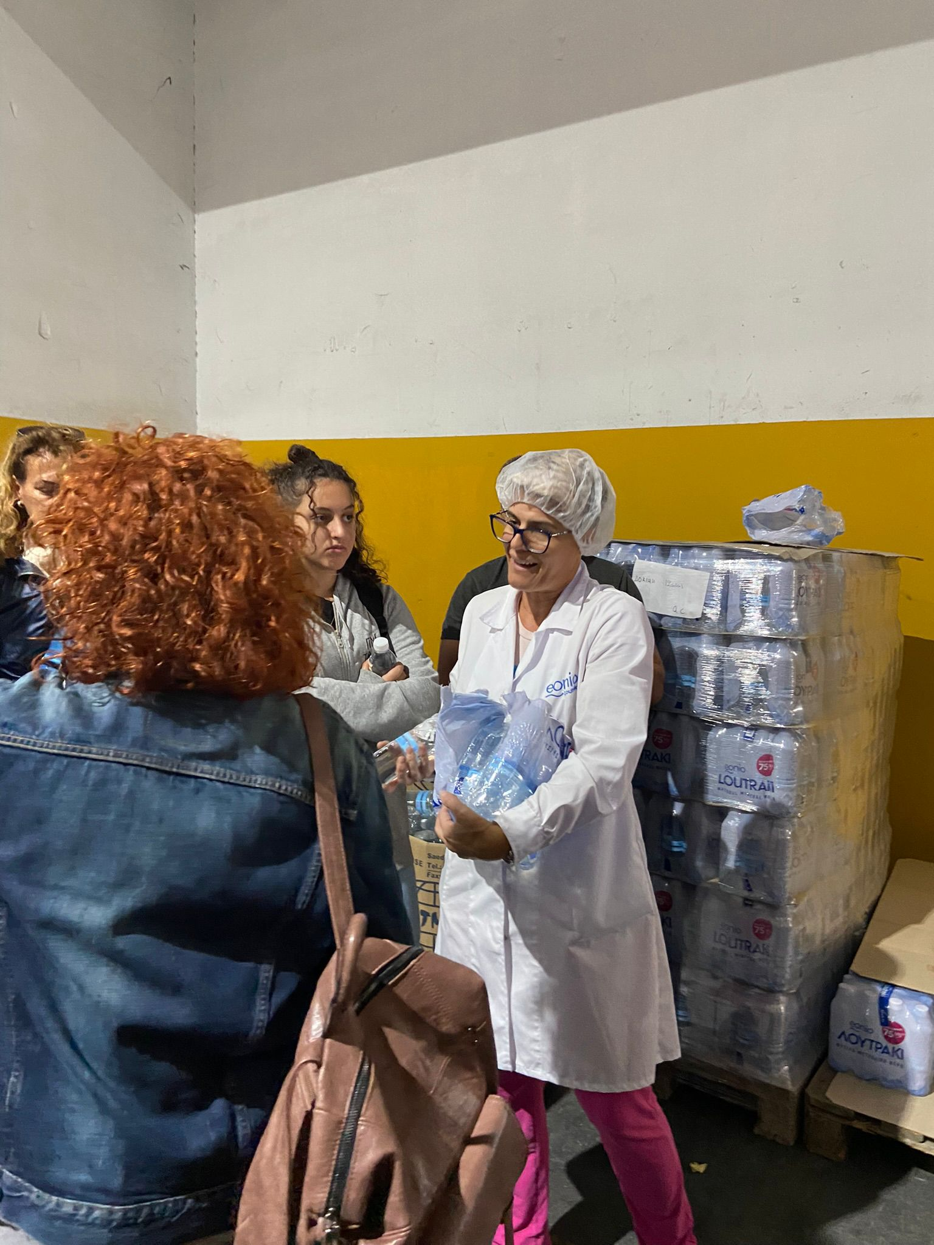
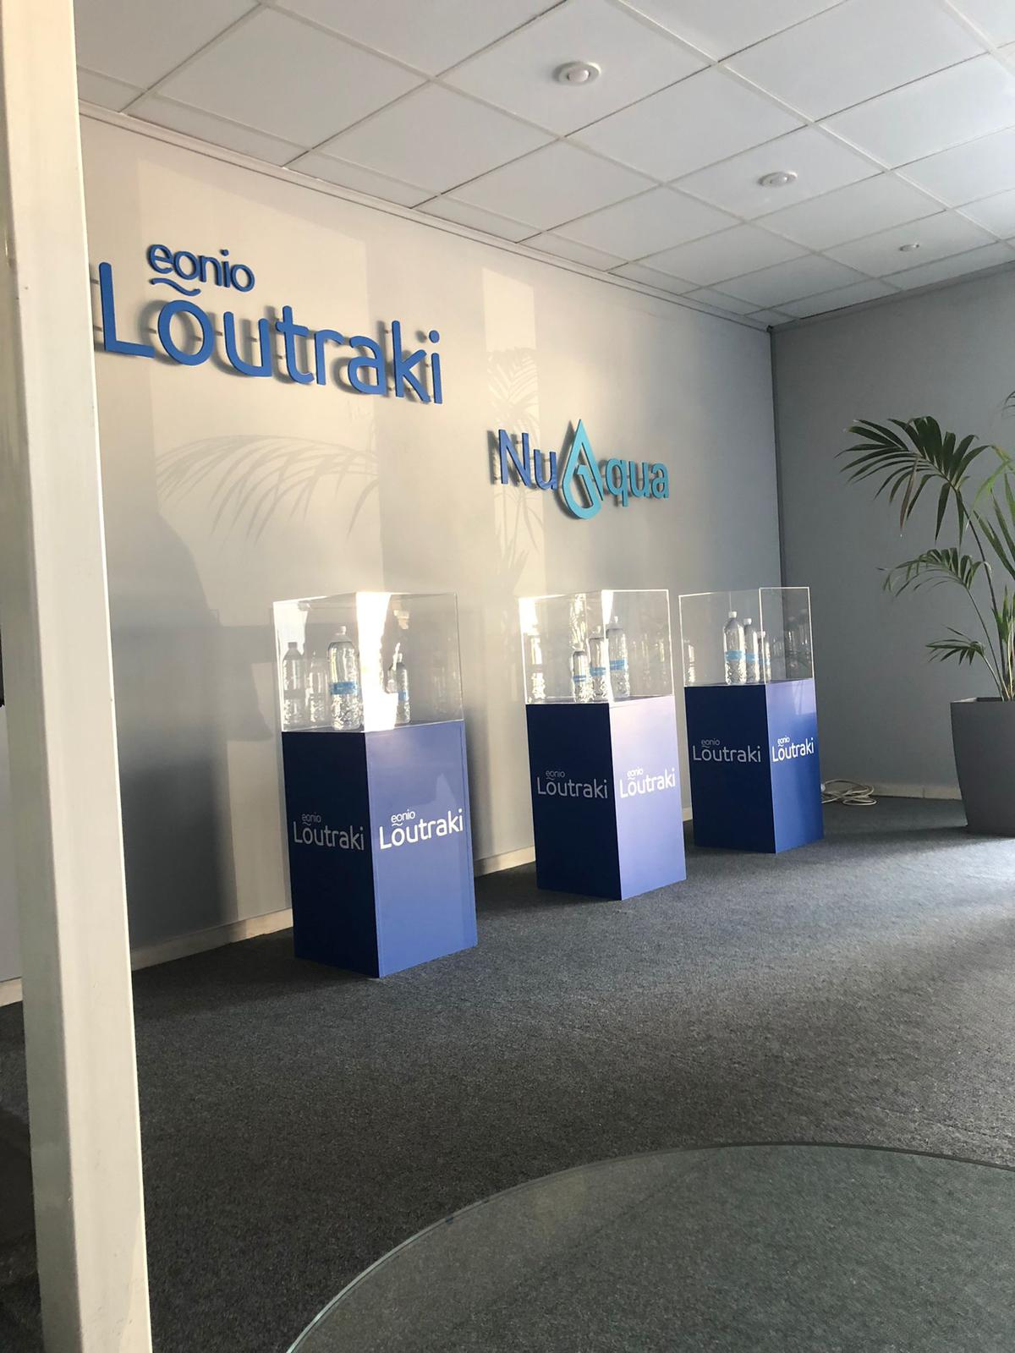
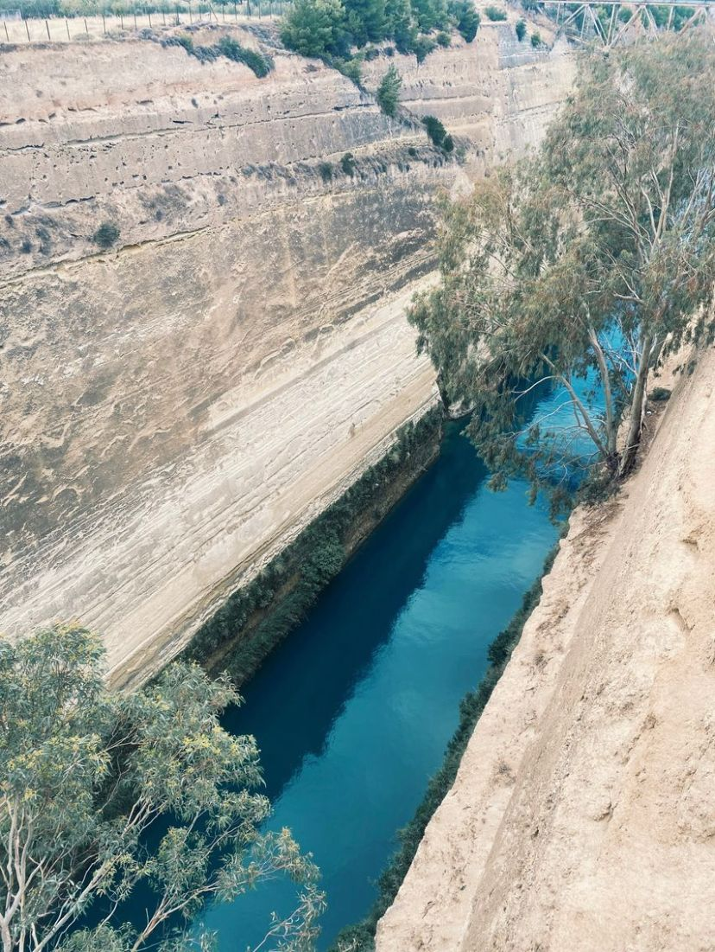
Tuesday 18.10.
We left our school by bus around 8:00 in the morning. Then we visited Mineral water bottling plant of Loutraki where we had a guided tour.
After that we went to Isthmus of Corinth. There we had free time at shops
and some of us ate before
leaving for Lygourio village to
have lunch and explore
the village.

Slide 6
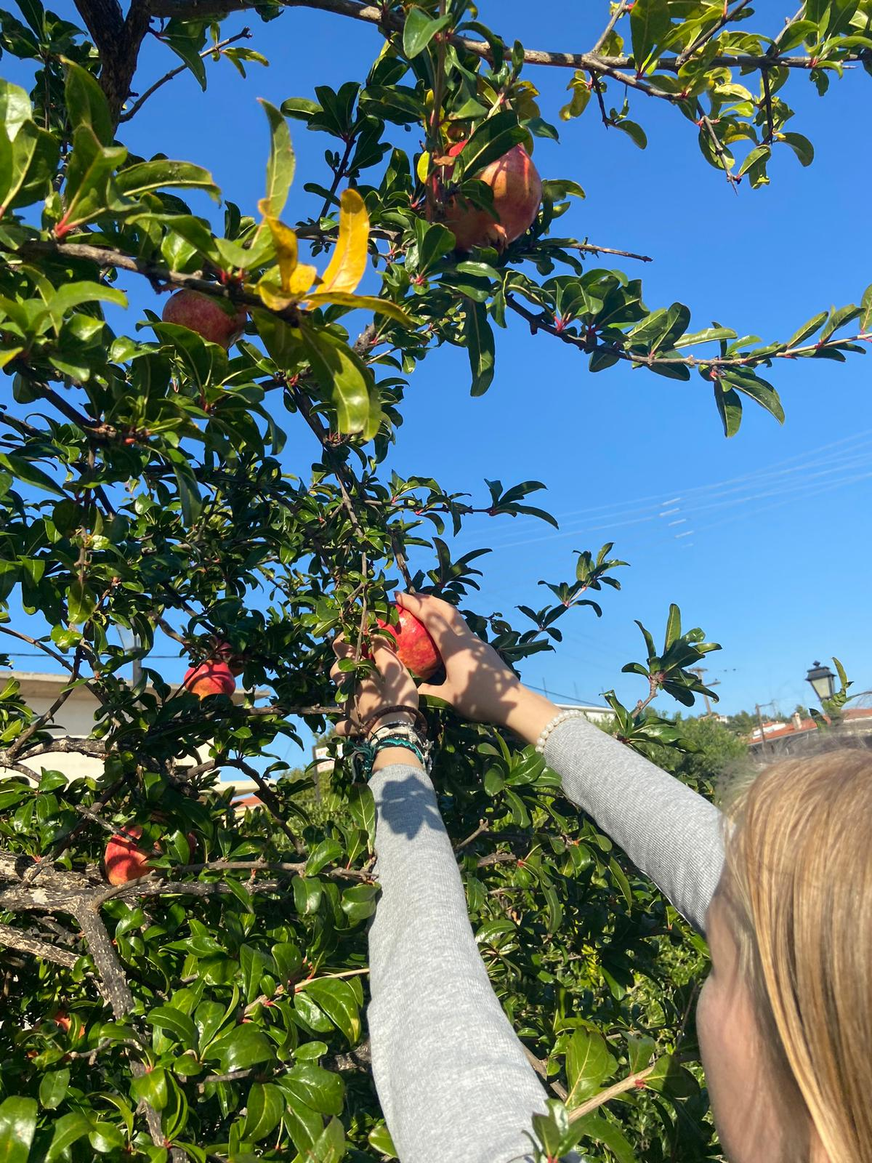
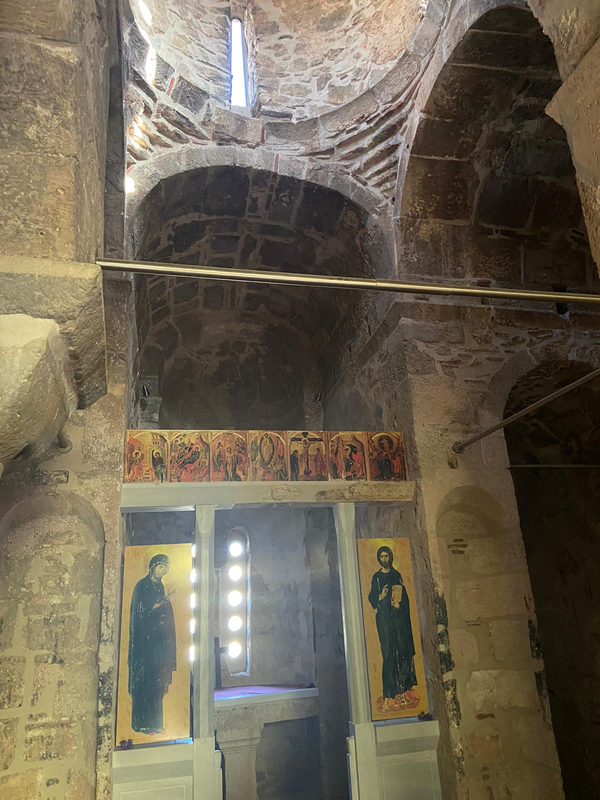
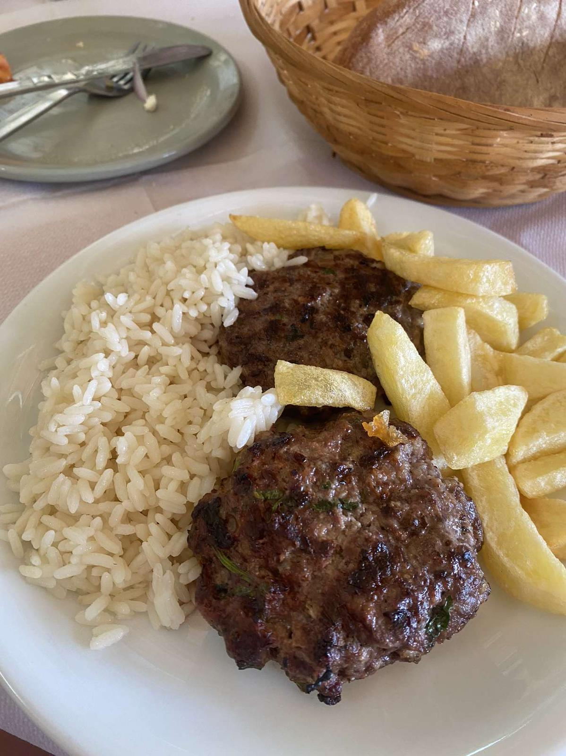
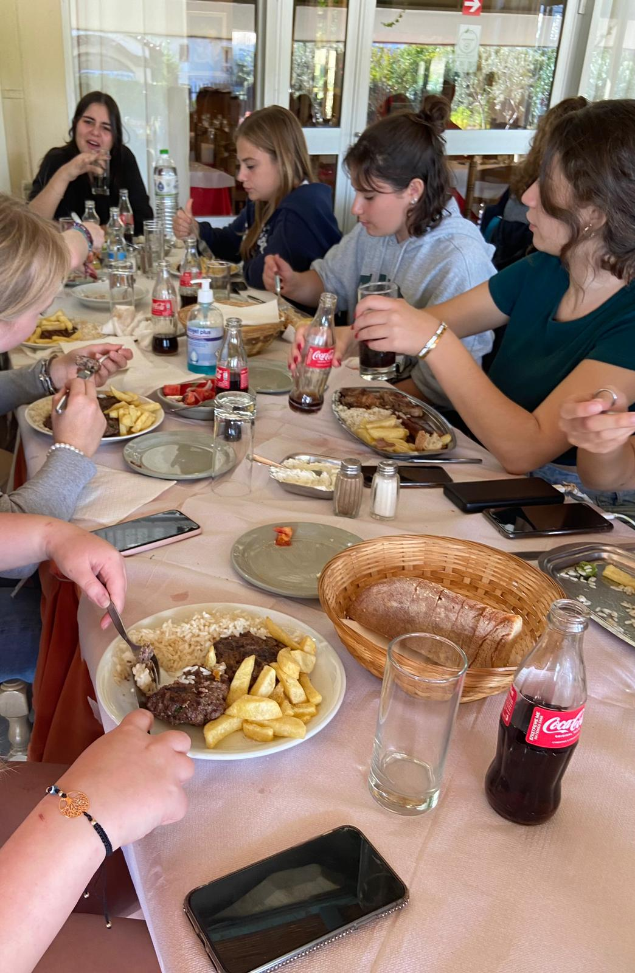
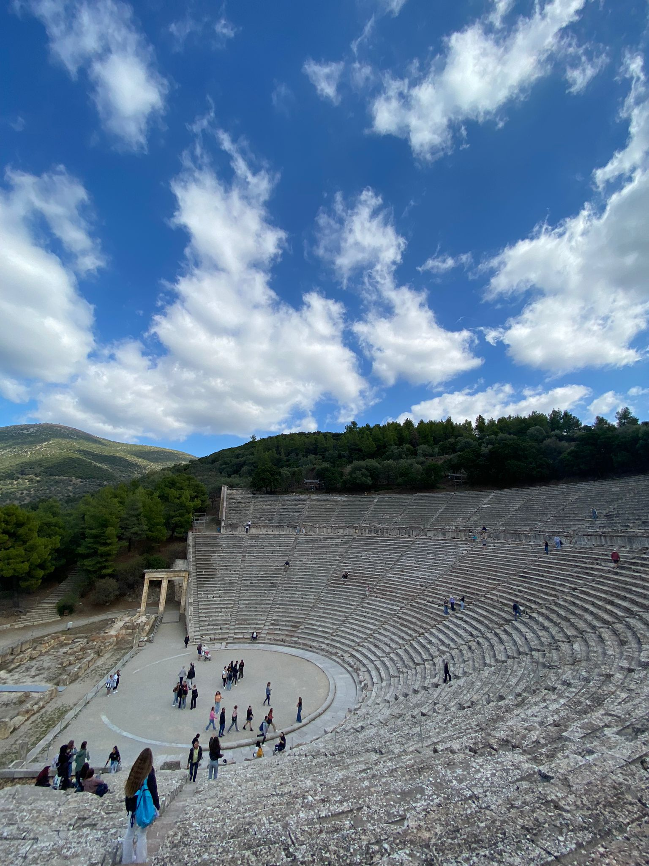
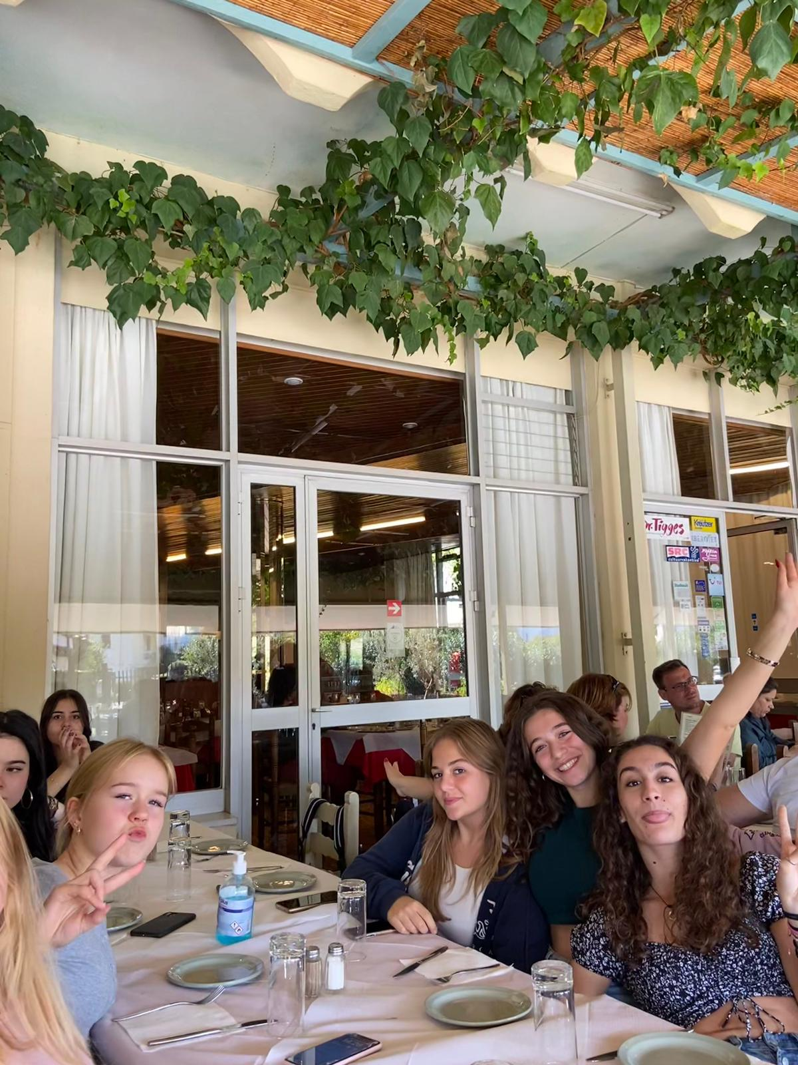
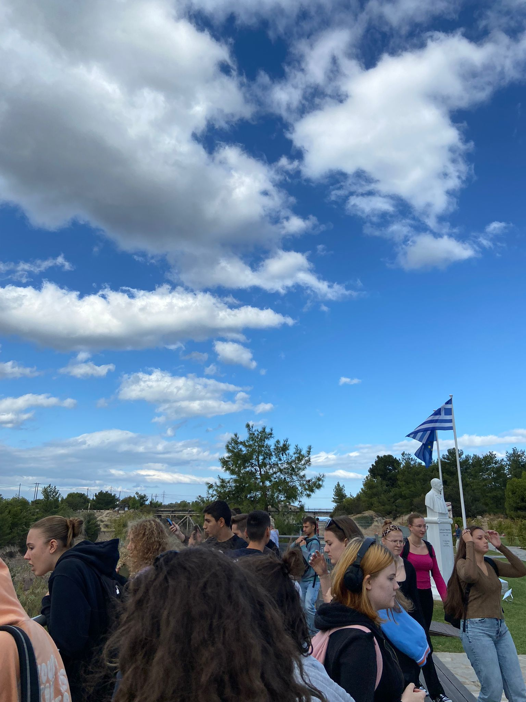
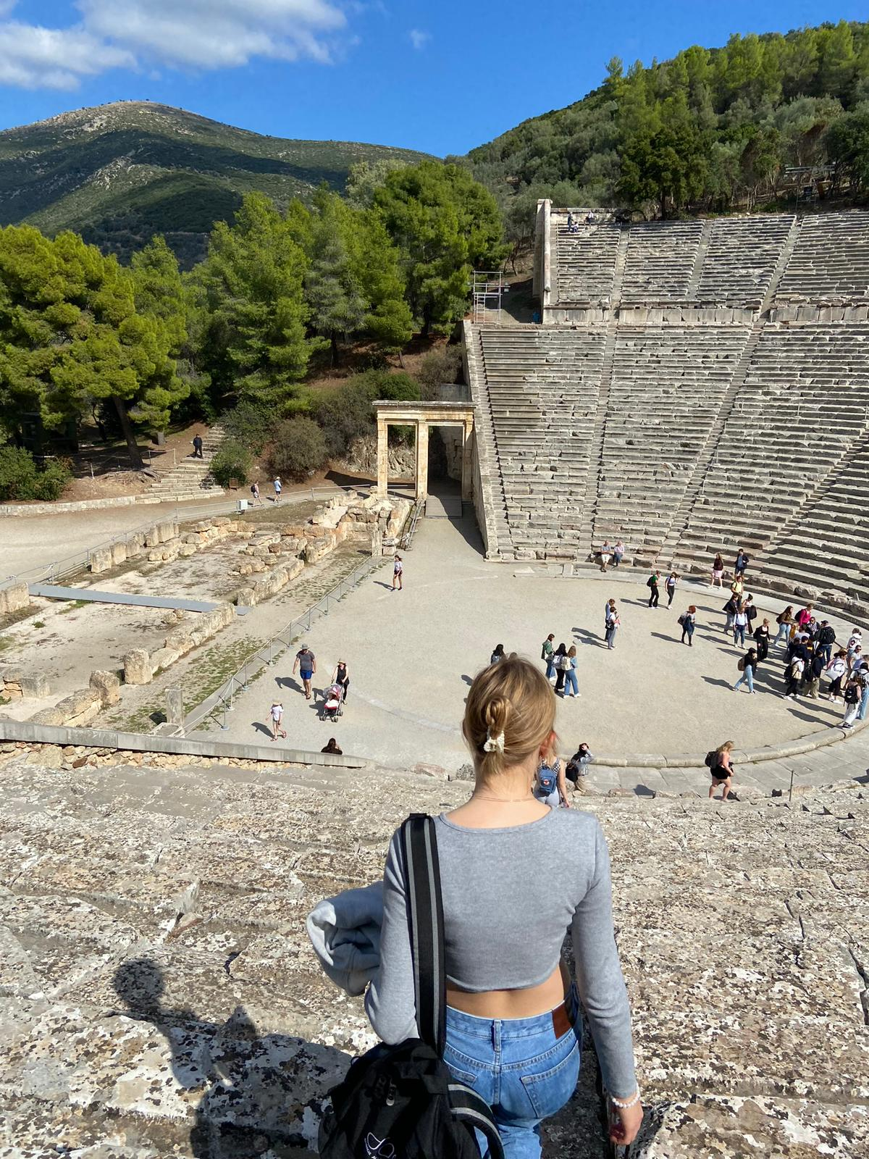
After lunch we headed towards the archeological site of Epidaurus.
After that we went back to Alimos, Athens and we had about three hour long bus drive.

Slide 7
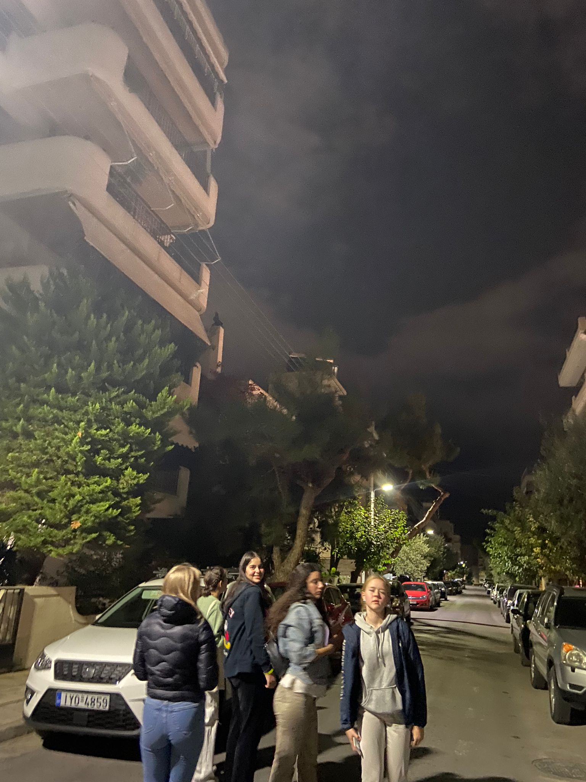
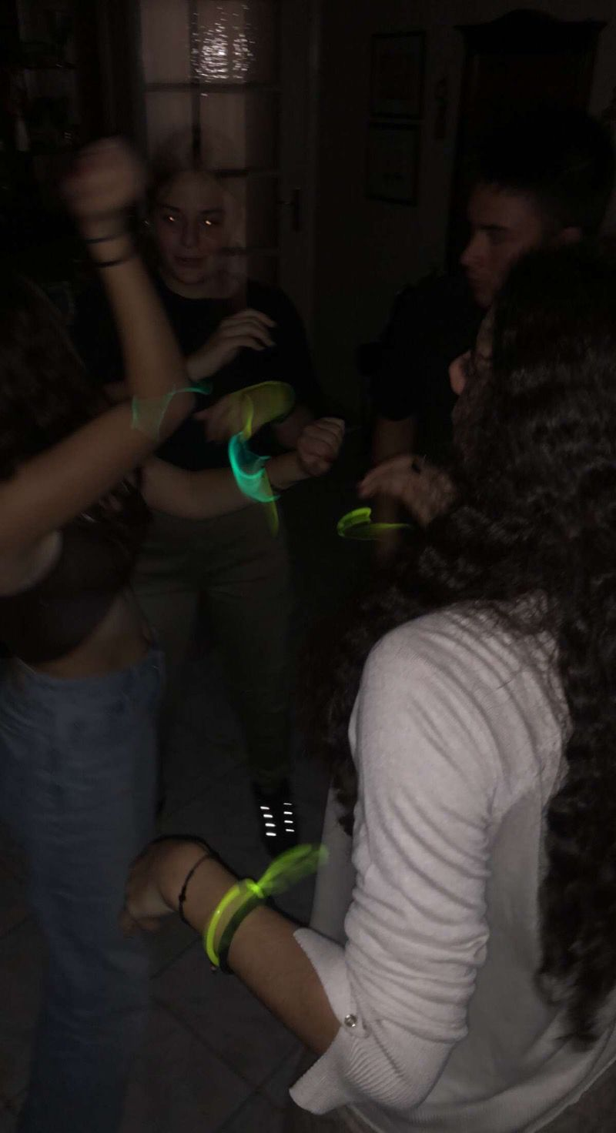
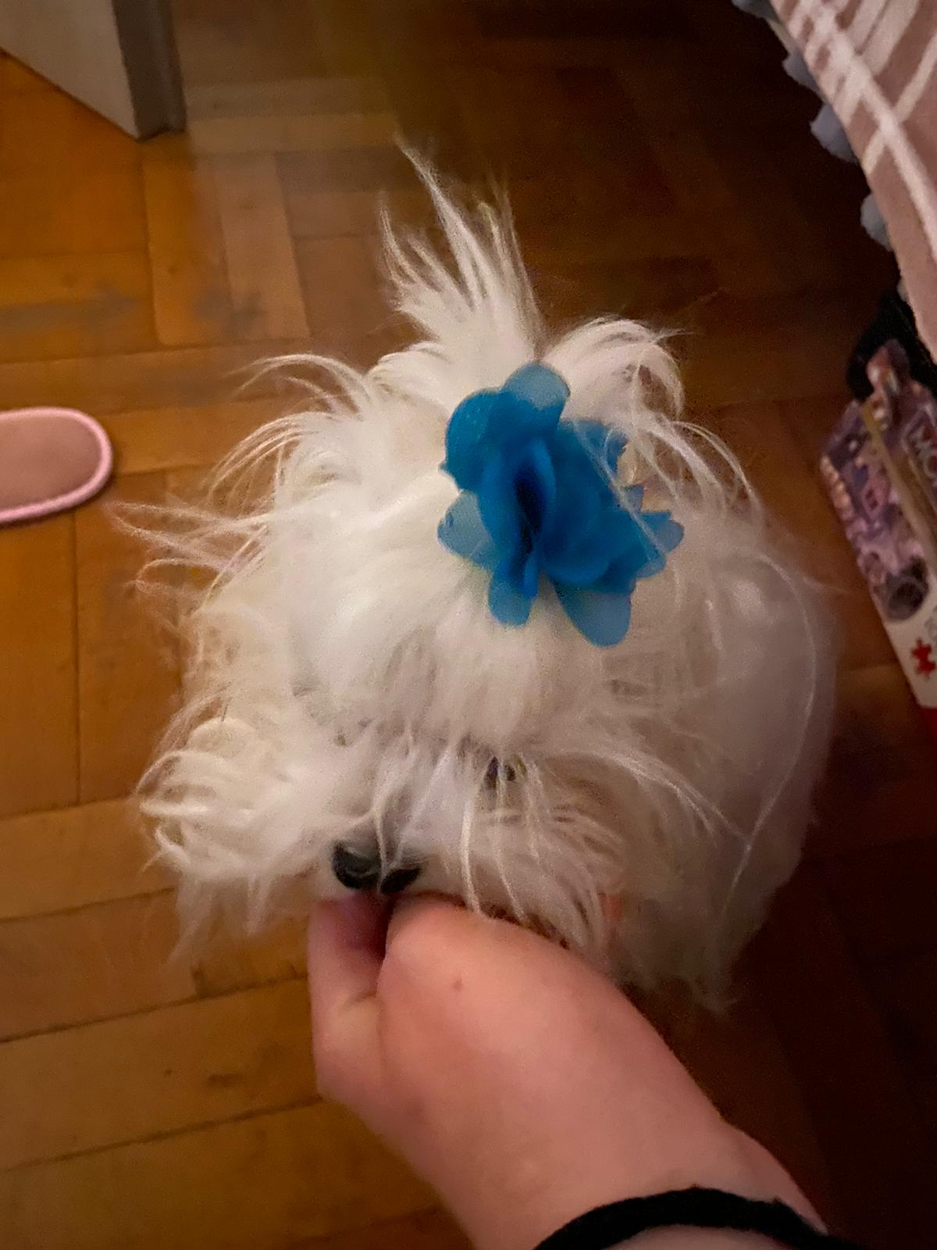
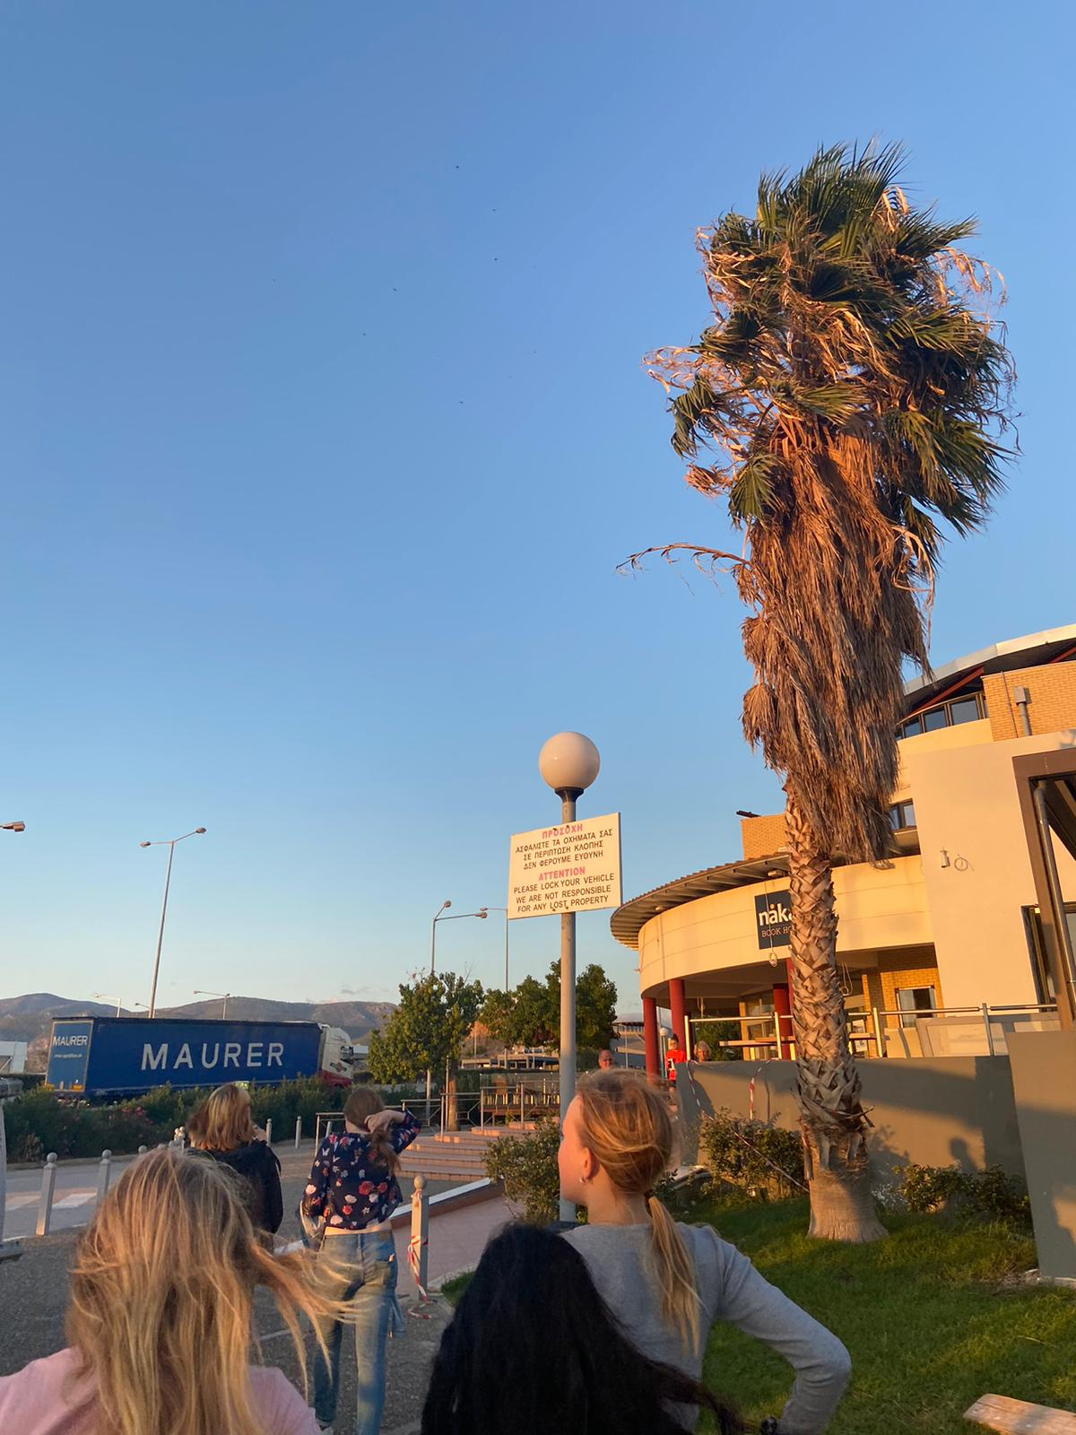
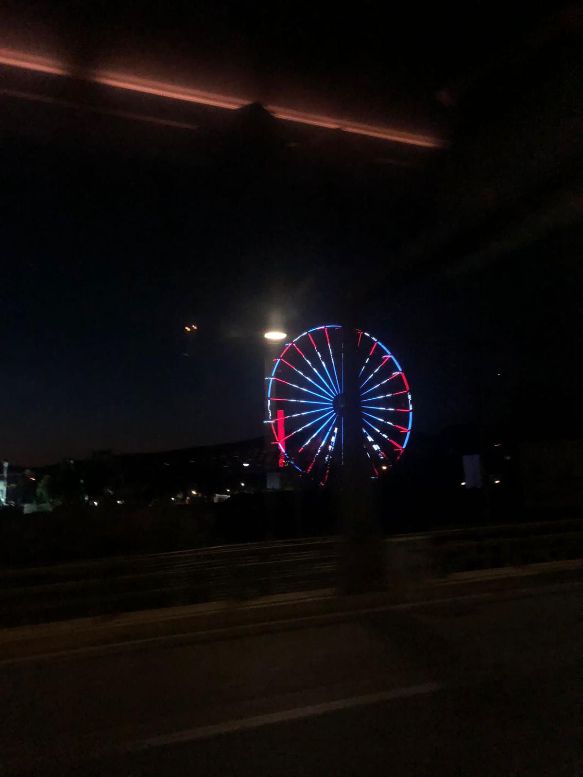
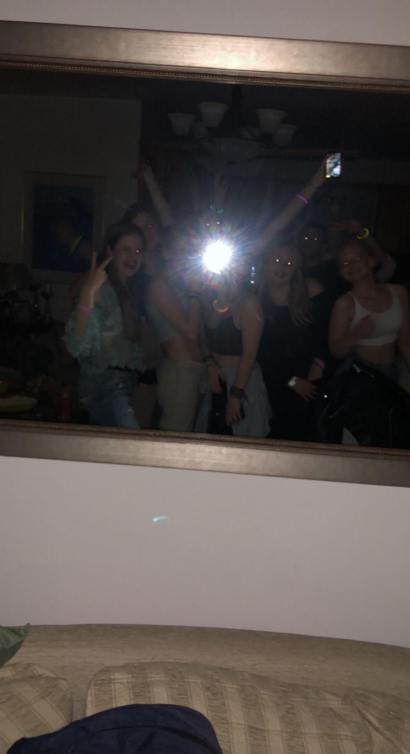
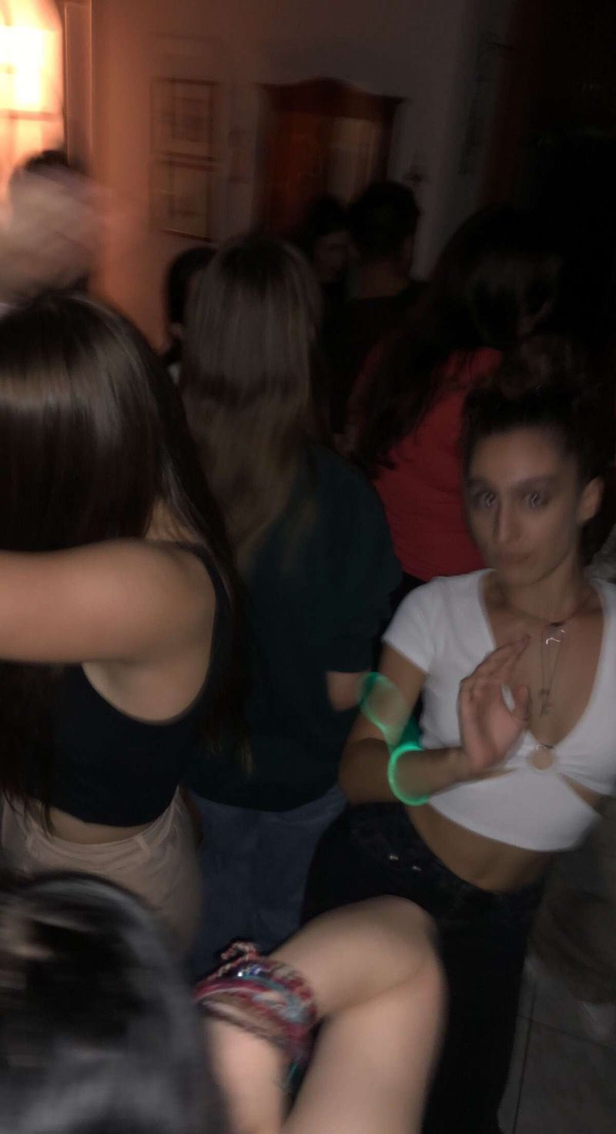
We arrived at Alimos around eight o’clock. Then we got ready for a house party. There we listened to music and chatted together. We got to know many new people during this day.

Slide 8
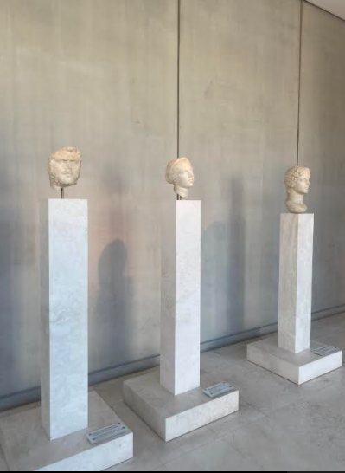
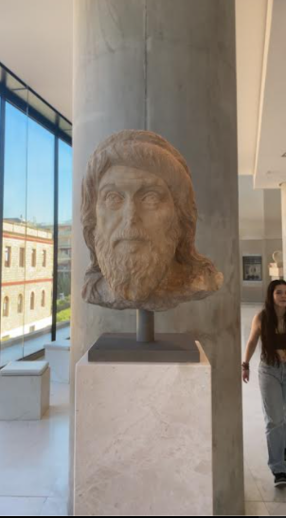
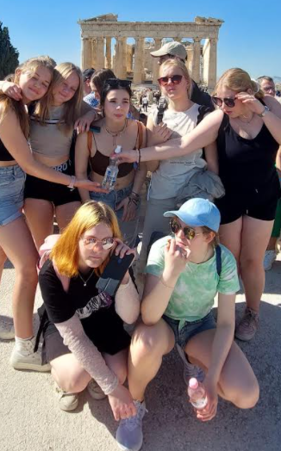
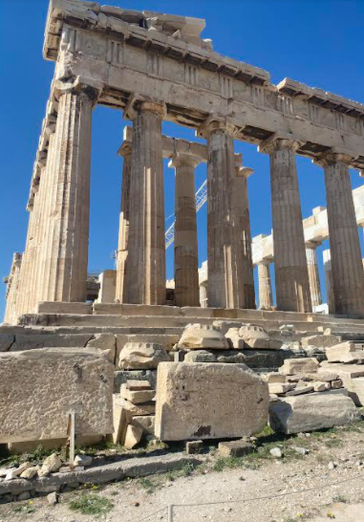
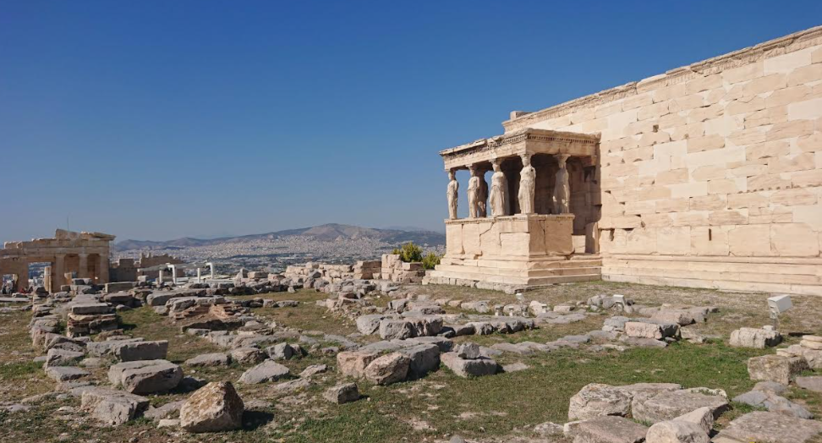


Wednesday 19.10.
Inside of the museum
We woke up about 7.30 in the morning because our school started at nine o’clock. The bus was a little late so we left for the destination at about 9.15. Our destination was the Acropolis museum and -hill. It was a beautiful and interesting place. There was a lot of stuff that we had been introduced to in our history lessons.
At the Acropolis hill

Slide 9






After that we went to the center of Athens. There were lots of stalls and people. We ate there with our hosts. The food was Greek national food, souvlaki. It has some kind of meat, vegetables, potatoes and tzatziki.
The stalls had lots of jewelry and souvenirs. There were so many people around so we had to keep our eyes on our backpacks and other stuff.

Slide 10






When our school was over, we went to our hosts homes, to get ready for the evening. Some of us went straight to the beach but others went to the mall first. The mall was quite big and it had lots of shops what we don’t have in Finland. We went shopping and bought some clothes.
At the end of the day we all went to the beach and had a great time together. We listened to music and danced.
.

Slide 11




Thursday 20.10.
We woke up early because we needed to travel 160km away from Athens to Kapsia Cave. Before entering the cave we had some free time and many of us played football. Besides all the dripstones there were also human bones and skulls.

Slide 12



After that we ate lunch at a restaurant in Vytina town where we also had free time.
We were supposed to go to the Open Air Water Museum but we were late from the schedule so we didn’t go.
Overall we sat a lot in the bus and arrived back to Athens in the evening.

Slide 13






Friday 21.10.
Friday was our last full day. From the school we left at 8.30. At 10.30 We arrived at the temple of Poseidon. After that we went to Varkiza town where we had lunch and free time and some of us went also swimming.

Slide 14





At 16 o’clock we were back at the school and all went back to our hosts’ places. At 20.00 we all went to eat in a restaurant, took photos and talked.

Slide 15




Saturday 22.10.
We woke up at 9 a.m. and spent time with our hosts for the last time. Some of us ate breakfast at cafeteria together and after that we went to the local supermarket to buy some last minute souvenirs. Then it was time to say goodbyes and leave for the airport by bus.

Slide 16





We had first landing in Germany, München. And then we flew to Finland, Helsinki. We were at home at around 2.45 am.

Slide 17

In München we met Finland’s ex prime minister Alexander Stubb. We took some photos and talked about icehockey and where he was coming from. He came to Finland on the same flight (Mimosa sat behind him). It was worth experiencing!

