Slide 1
Vaillinaiset apuverbit – Kooste
New Insights
Module 4 Grammar

Slide 2
Can, could
They can tap dance really well.
Why can’t you do it next week?
Can (osaa, voi) viittaa nykyhetkeen ja tulevaisuuteen.
She could count backwards when she was asked.
She could come with us if we needed more people there.
Could on imperfekti (osasi) tai konditionaali (voisi).

Slide 3
Korvaavat muodot
I’ll be able to do it next week.
We’ve been unable to reach him.
You must know how to fix this.
Korvaavia muotoja voi käyttää kaikissa verbimuodoissa.
Niistä yleisimmät ovat:
be able to
be unable to
know how to

Slide 4
May, might
You may go in now.
May we have a go at it?
May (saa, on lupa) viittaa nykyhetkeen ja tulevaisuuteen.
It might not be a good idea to tell her that.
They might agree if you explained the situation to them.
Might on kohteliaampi muoto tai konditionaali (saattaisi).

Slide 5
Korvaavat muodot
I wasn’t allowed to say anything.
They haven’t been allowed to go there yet.
When will they be allowed to do that?
Korvaavia muotoja voi käyttää kaikissa verbimuodoissa.
Tärkein on be allowed to.

Slide 6
Must
We must do it at once.
Why must you always say no to anything new?
Must (täytyy) viittaa nykyhetkeen tai tulevaisuuteen.
You mustn’t hide the truth.
I don’t have to do it.
Vrt. mustn’t (et saa); don’t have to (ei tarvitse/täydy)

Slide 7
Korvaavat muodot
They will have to be punished for that.
Do I have to say the words?
I didn’t need to do anything.
They were compelled to leave the race.
Korvaavia muotoja voi käyttää kaikissa verbimuodoissa.
Yleisimpiä ovat have to, need to, be compelled to, be obliged to.

Slide 8
Puhujan arvelu (menneisyys)
She can’t have been serious!
It couldn’t have been done on purpose.
You may have thought about it but you didn’t say anything.
They must have seen something.
Joskus on kyse puhujan arvelusta, ei varsinaisesta osaamisesta, voimisesta tai täytymisestä.
Silloin menneestä tapahtumasta käytetään muotoa
can’t/couldn’t / may/might / must + have + 3. muoto

Slide 9
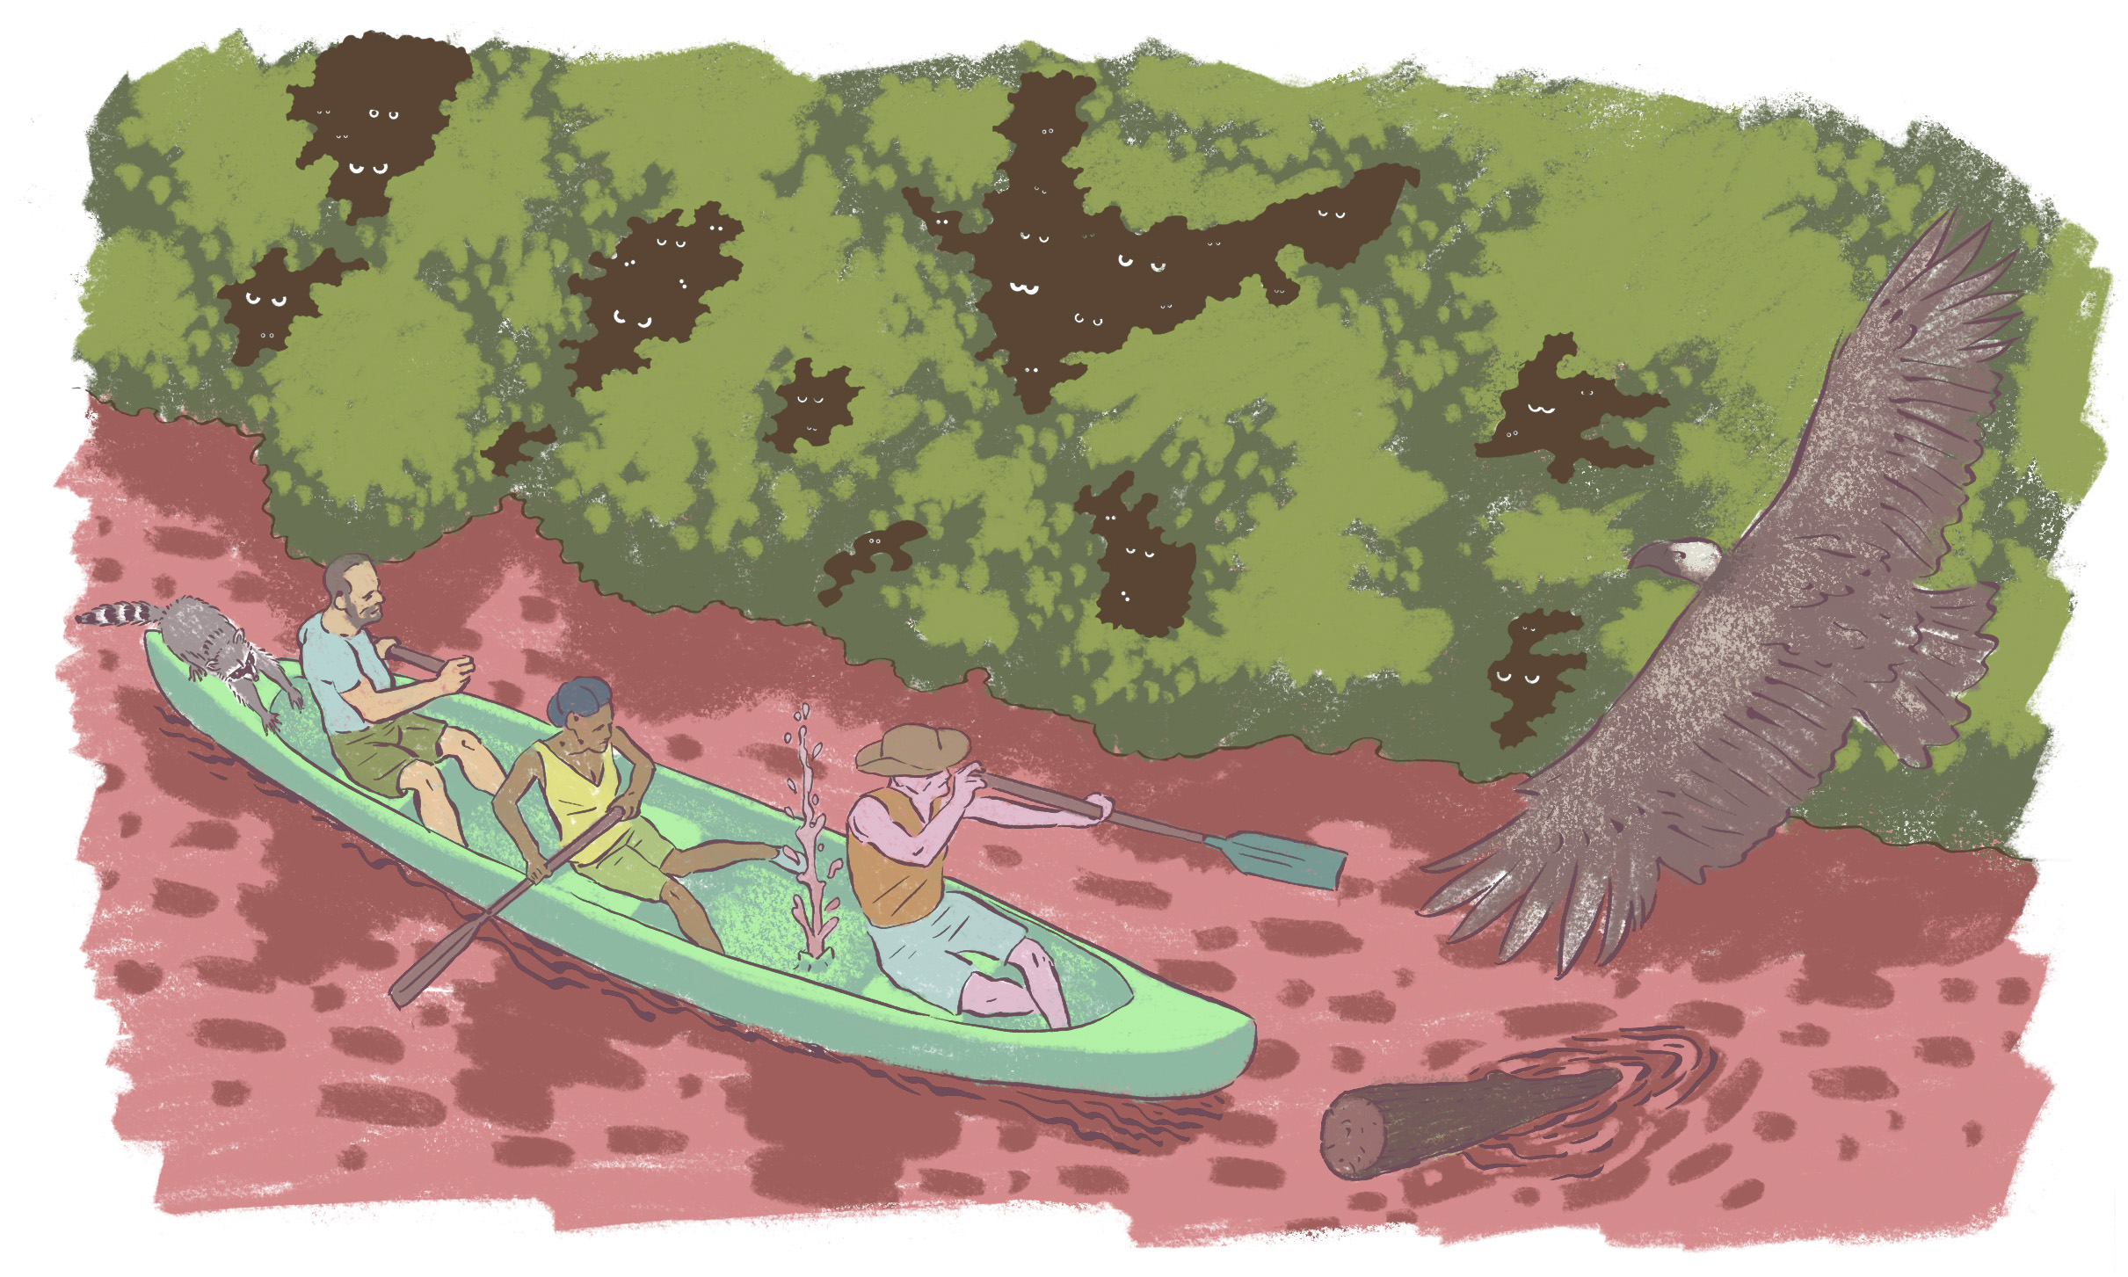
Practise.
Work with a partner. Look at the picture and come up with sentences with can, may and must.

