Slide 1

GBS De Kreke Kortemark
Belgium

Slide 2
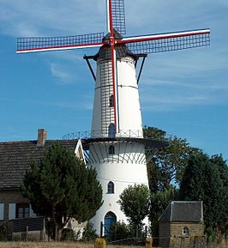

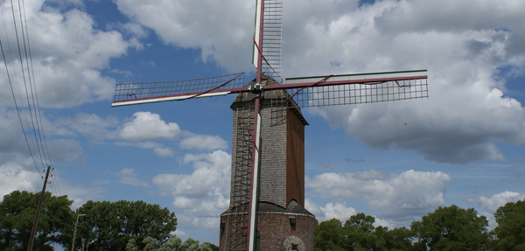
Kortemark:
small village
population: over 12 000 people
near the Northsea
famous for it’s brewery and it’s mills

Slide 3
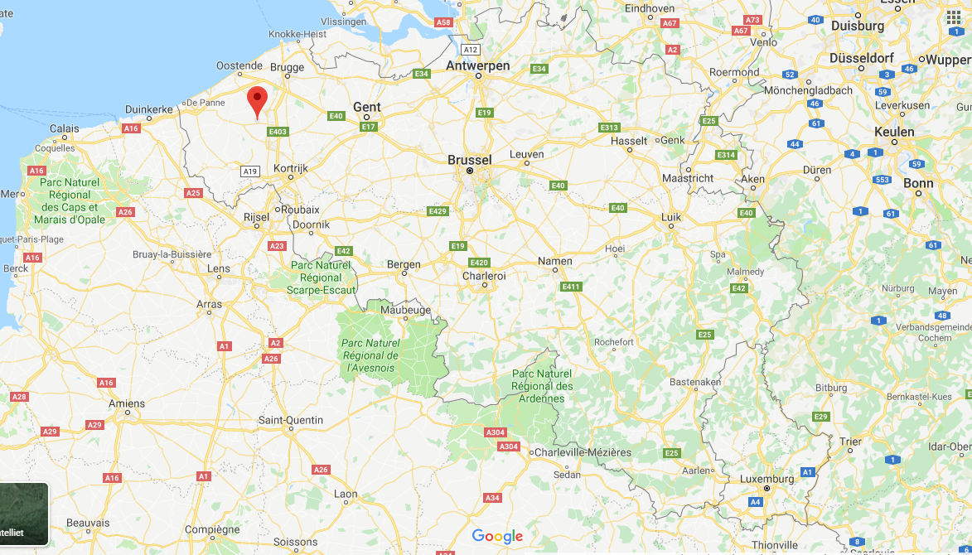

Slide 4
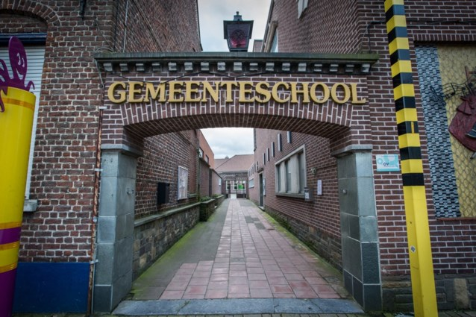
Our school:
70 toddlers (devided over 4 groupes): ages 2,5- 6
160 pupils (devided over 6 groupes): ages 6-12
Each class has about 25 children
22 teachers in our team (teachers, religion, sports, nurse for the young children, secretary, principal…)
Small school with a familial atmosphere (everbody knows everyone)

Slide 5
School SYStem in belgium
Children have to go to school at the age of 2,5 (kindergarten)
School is obligated when they are 6 (primary school)
At the age of 12 our pupils go to another school (secondary school)

Slide 6
School: 8.30 – 11.40 am
13.10 – 15.55 pm
School subjects:
  Ages 3-6: working with theme-weeks
  every theme: similar subjects:
  initiation maths, story, language exercices, crafts, singing, theater,
  5-6yrs old: contract work, initiation French
  2,5-3yrs old: possibilty to sleep in our sleepingclass
  Ages 6-12: mathematics( 6 hours), language( 6 hours (Dutch, French), crafts and music( 4 hours), world orientation( 5 hours (geography, biology, nature and science…), religion( 2 hours (free to choose: catholic, protestant, islamitic… religion, ethics…), sports( 2 hours),
  3 hours: free to choose

Slide 7
Music (learning to play an instrument): on Wednesday and Saturday
not in our school, not by our own teachers
Different languages in Belgium: Dutch, French en German
In primary school: Dutch
From age 6: French (by playing games, singing songs…)
From age 11: learning the language
In highschool: Englisch and German
Projects in our school:
  Sportprojects
  Healthproject: healthy breakfast, learning about teeth, hygiene, food triangle…
  Different excursions (to the ijzertoren (world war one), cosmix (solar system), forest, farm…)
  Picking up litter in the streets
  …

Slide 8
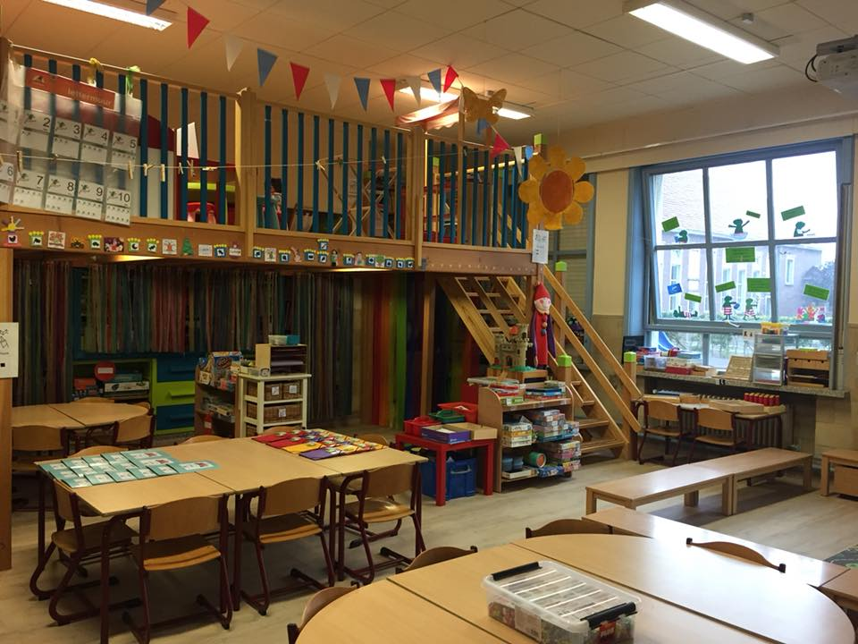
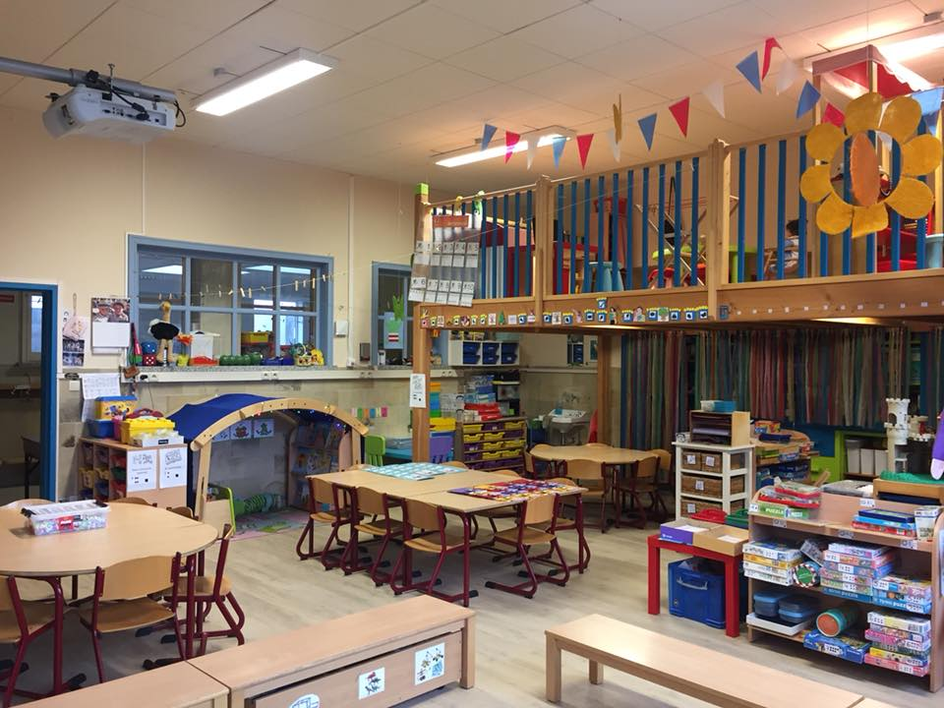

Slide 9
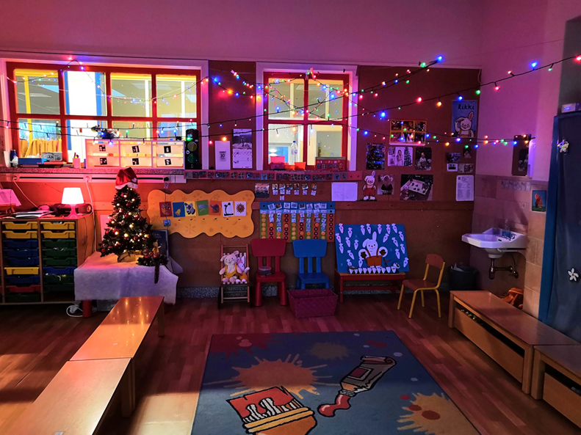

Slide 10
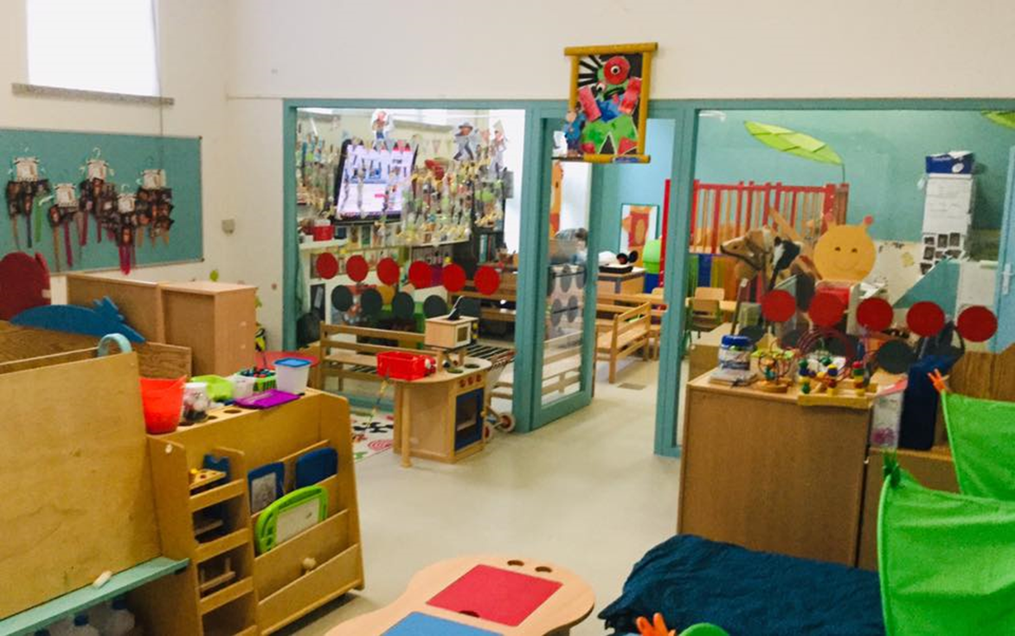
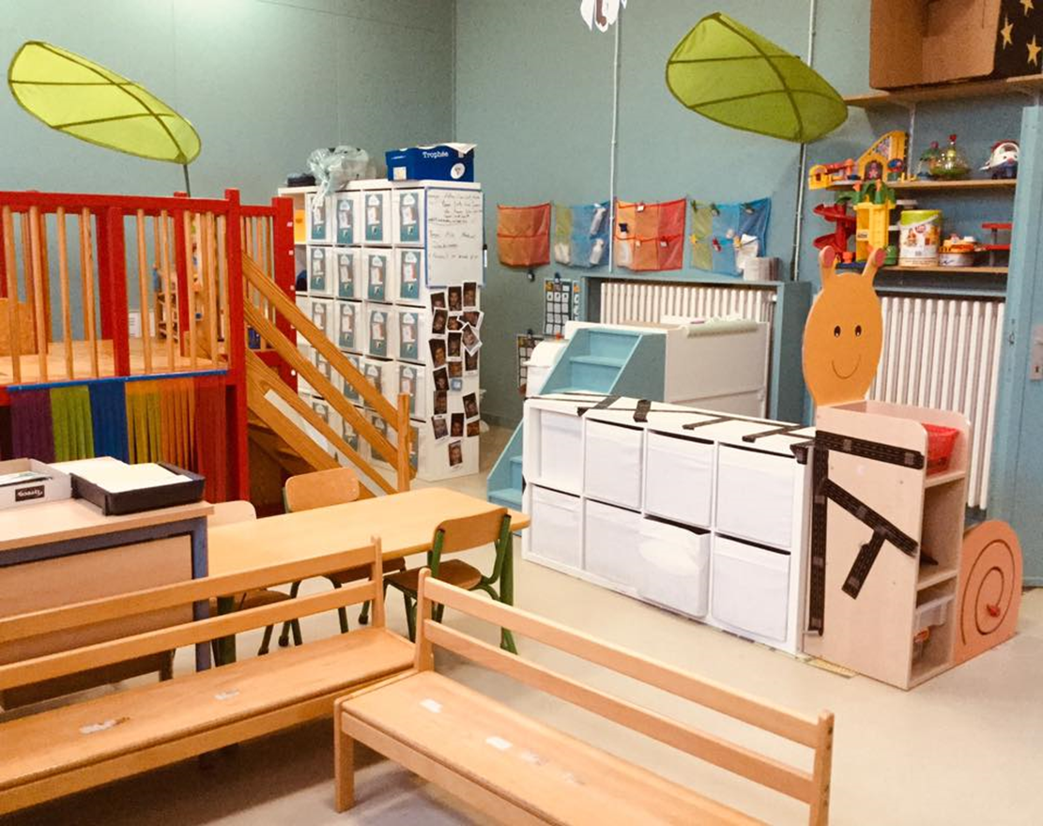

Slide 11
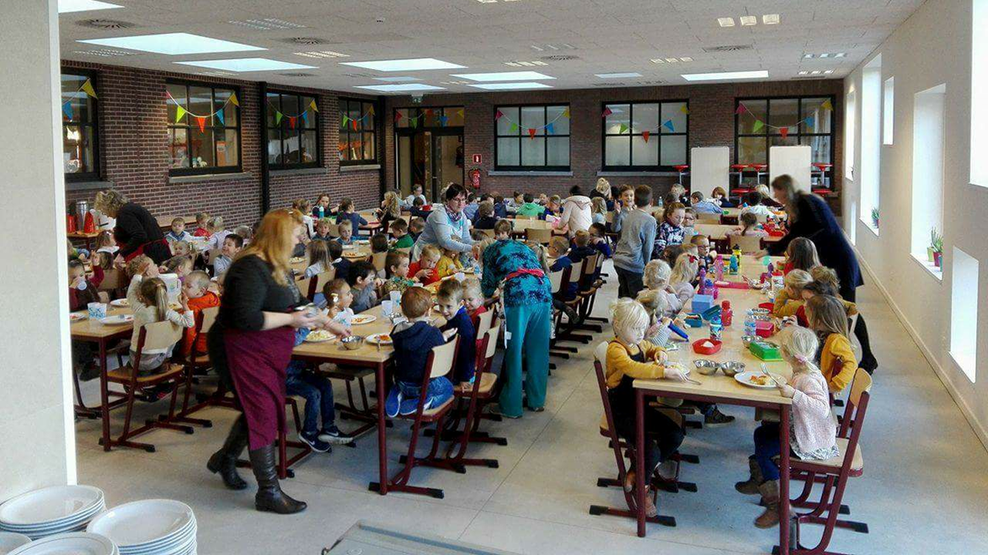

Slide 12
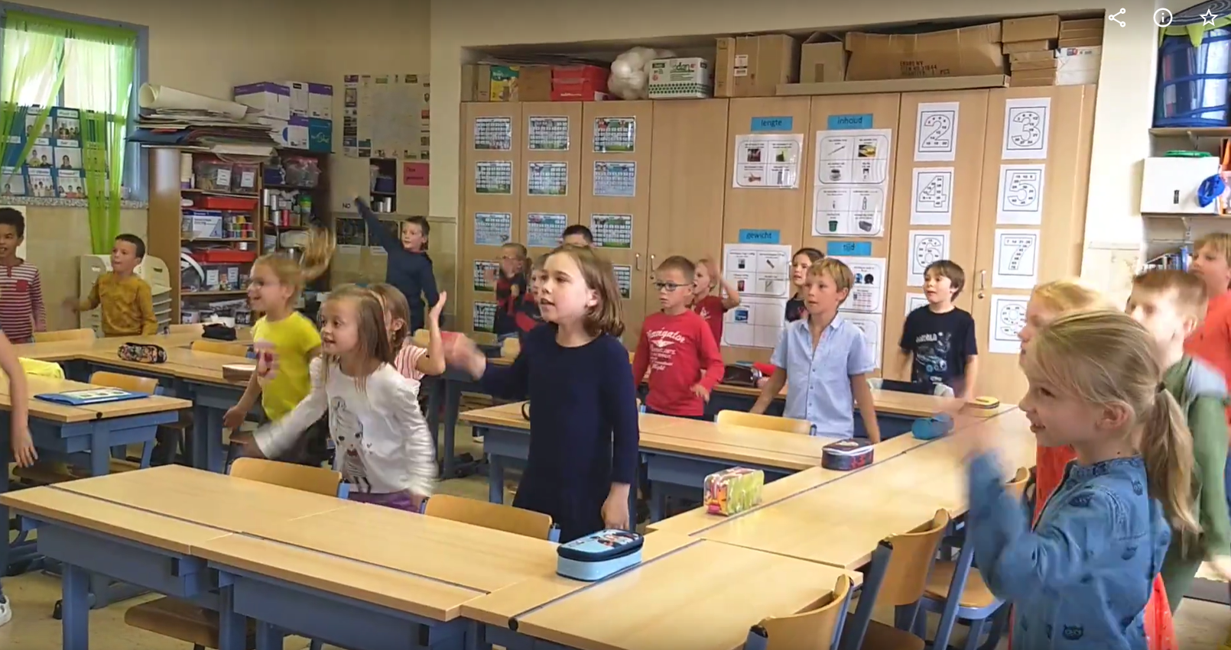
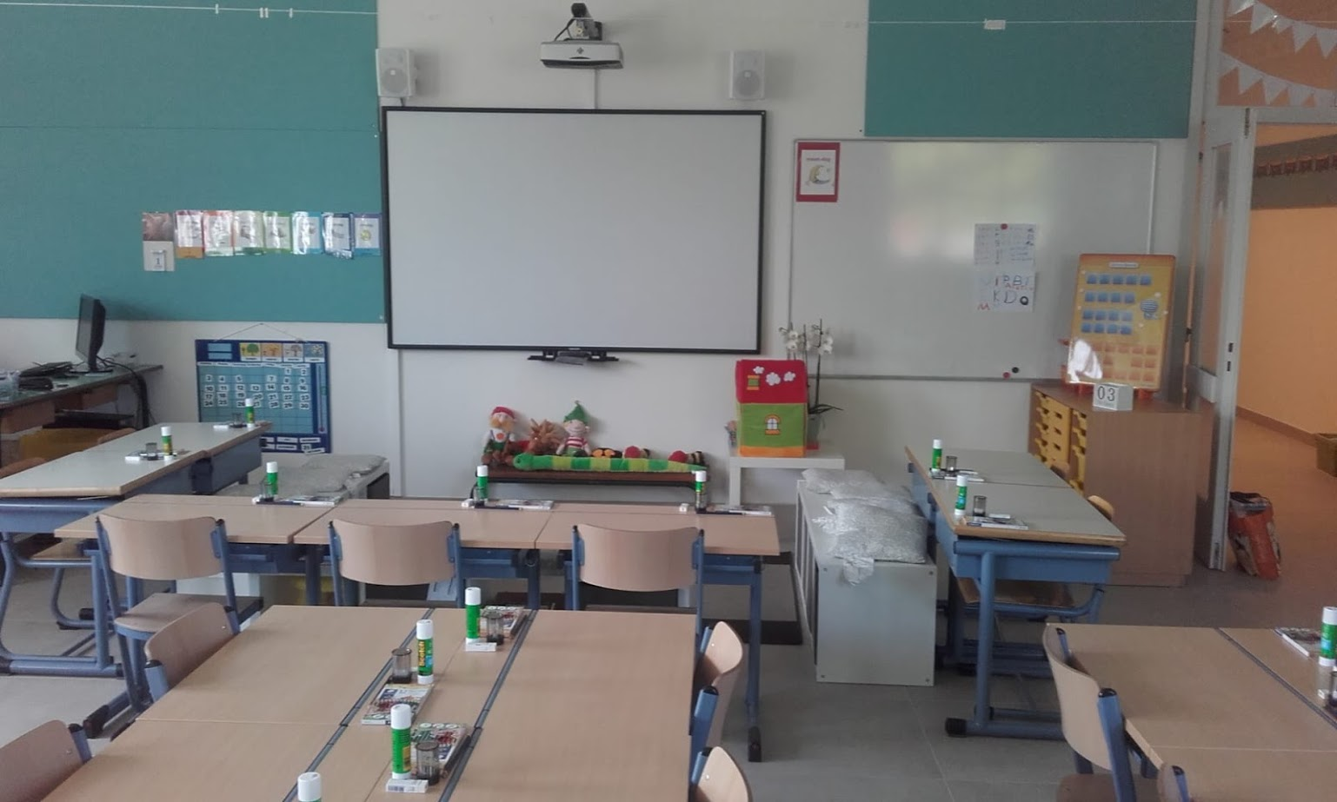

Slide 13
