Slide 1
Erasmus+ in omnibus omnia est
Logo Contest
GREEK VOTES

Slide 2
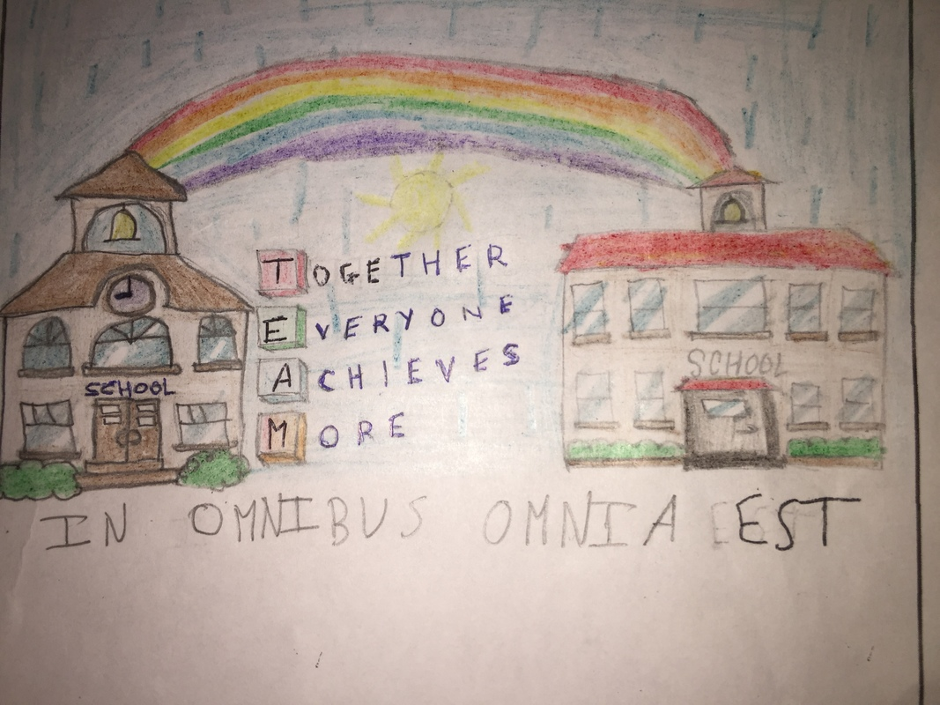
1 point

Slide 3
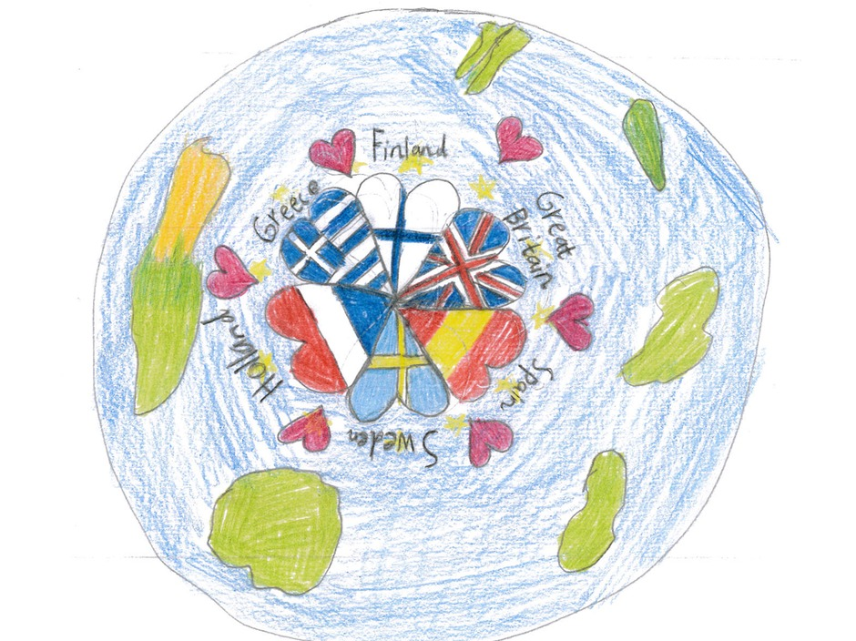
2 points

Slide 4
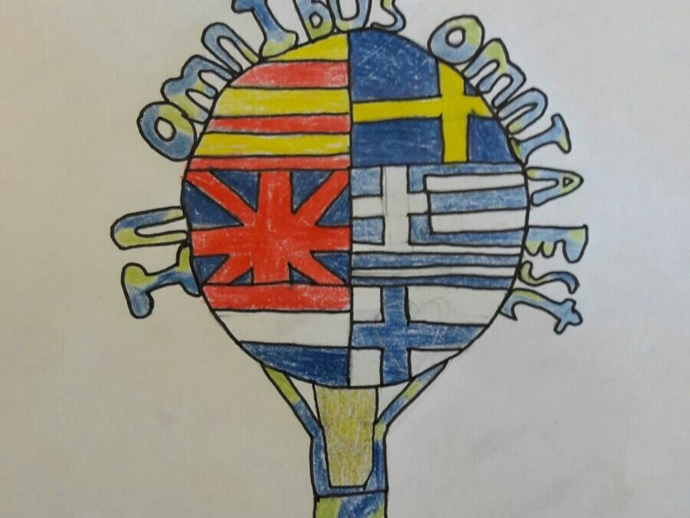
3 points

Slide 5
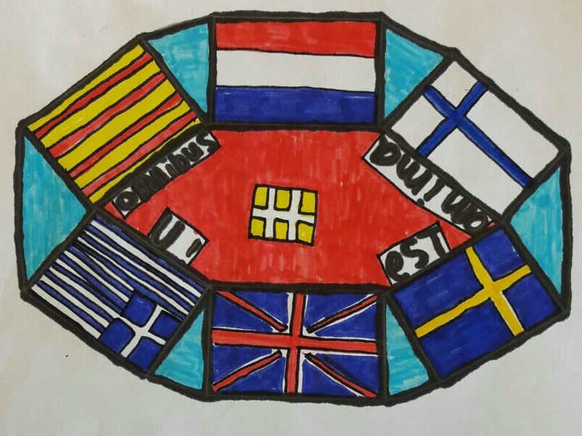
4 points

Slide 6

5 points

Slide 7
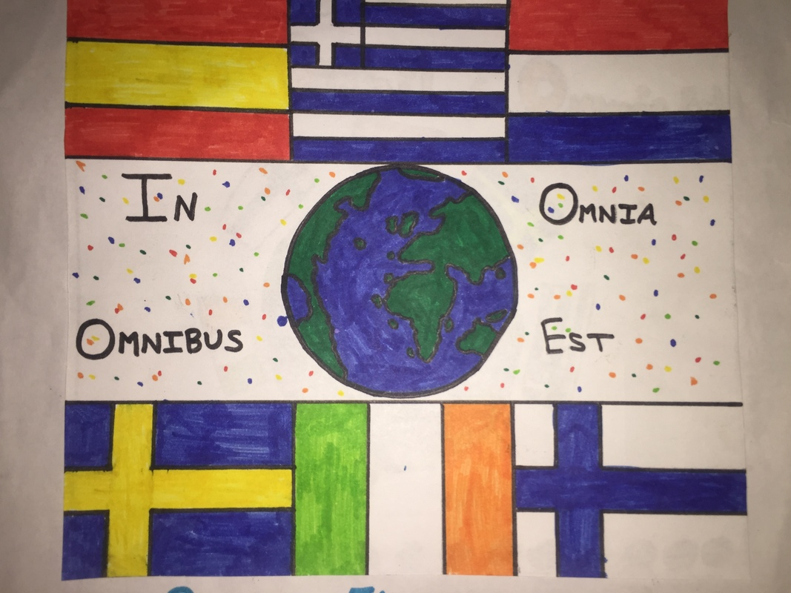
6 points

Slide 8
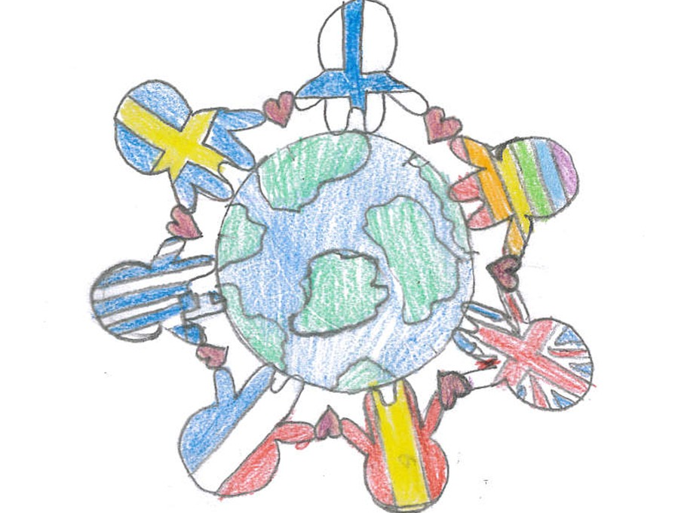
7 points

Slide 9

8 points

Slide 10

10 points

Slide 11
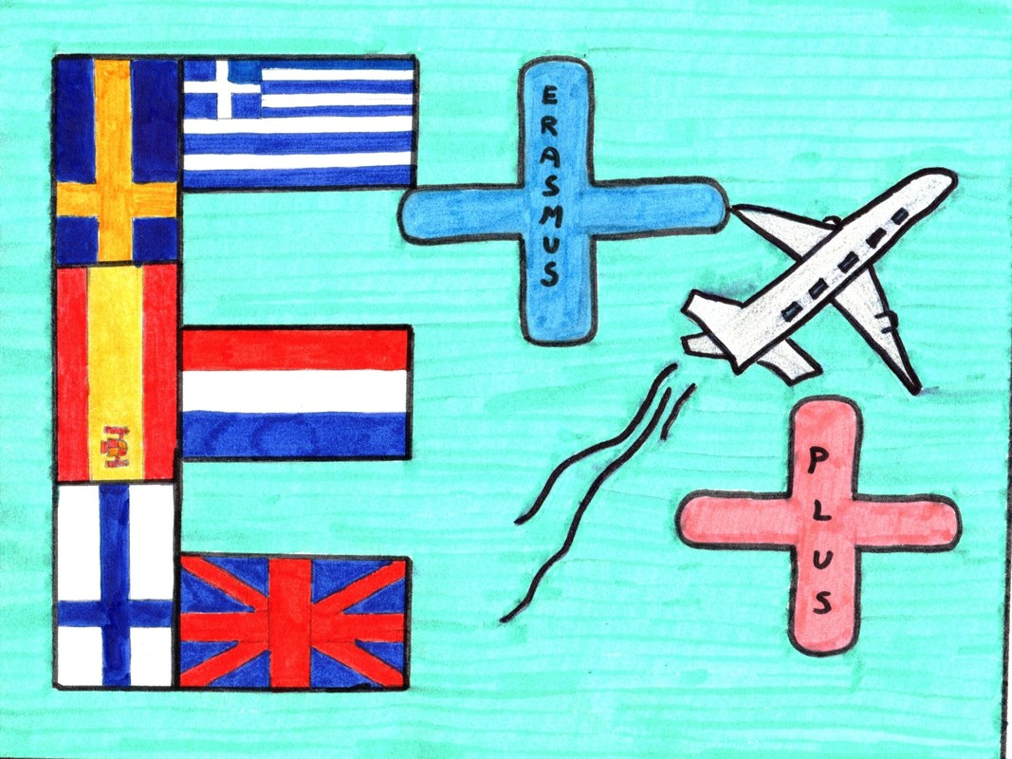
12 points

Slide 12
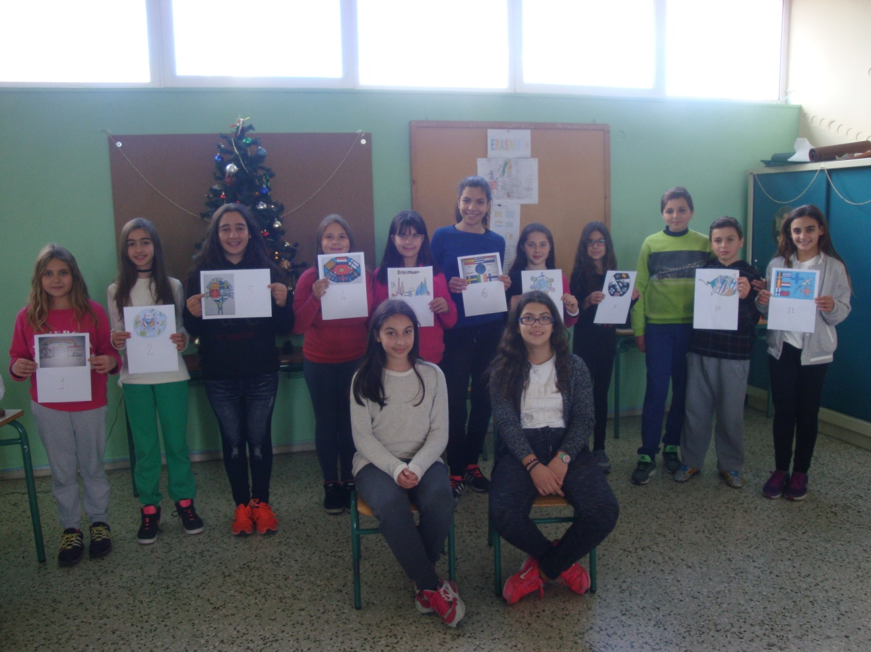
We enjoyed participating in this contest. It was such a It was such a fun for us to participate in this contest! Congratulations to all! Good luck to all!

