Slide 1
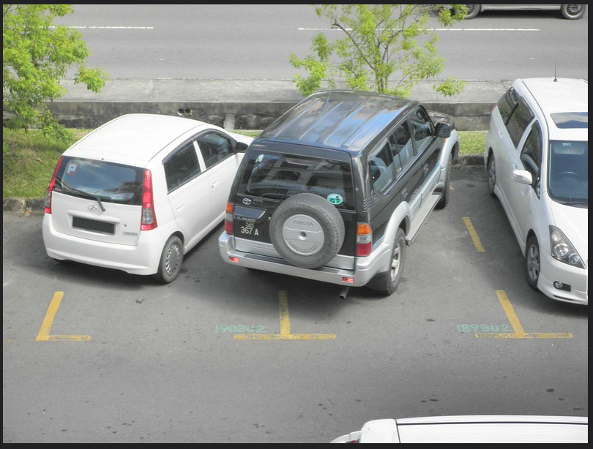
The lack of
parking spots in halu

Slide 2
Why did we choose this topic?
It’s important to us
It’s a problem that we face daily in school
We hear a lot of complains about the parking spots

Slide 3
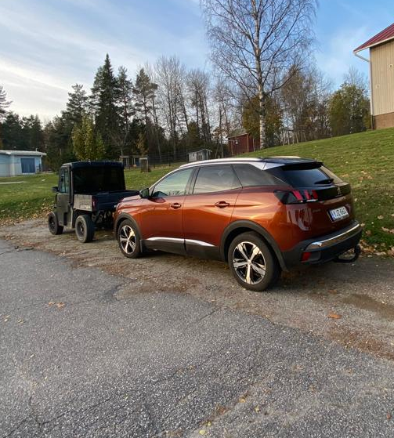
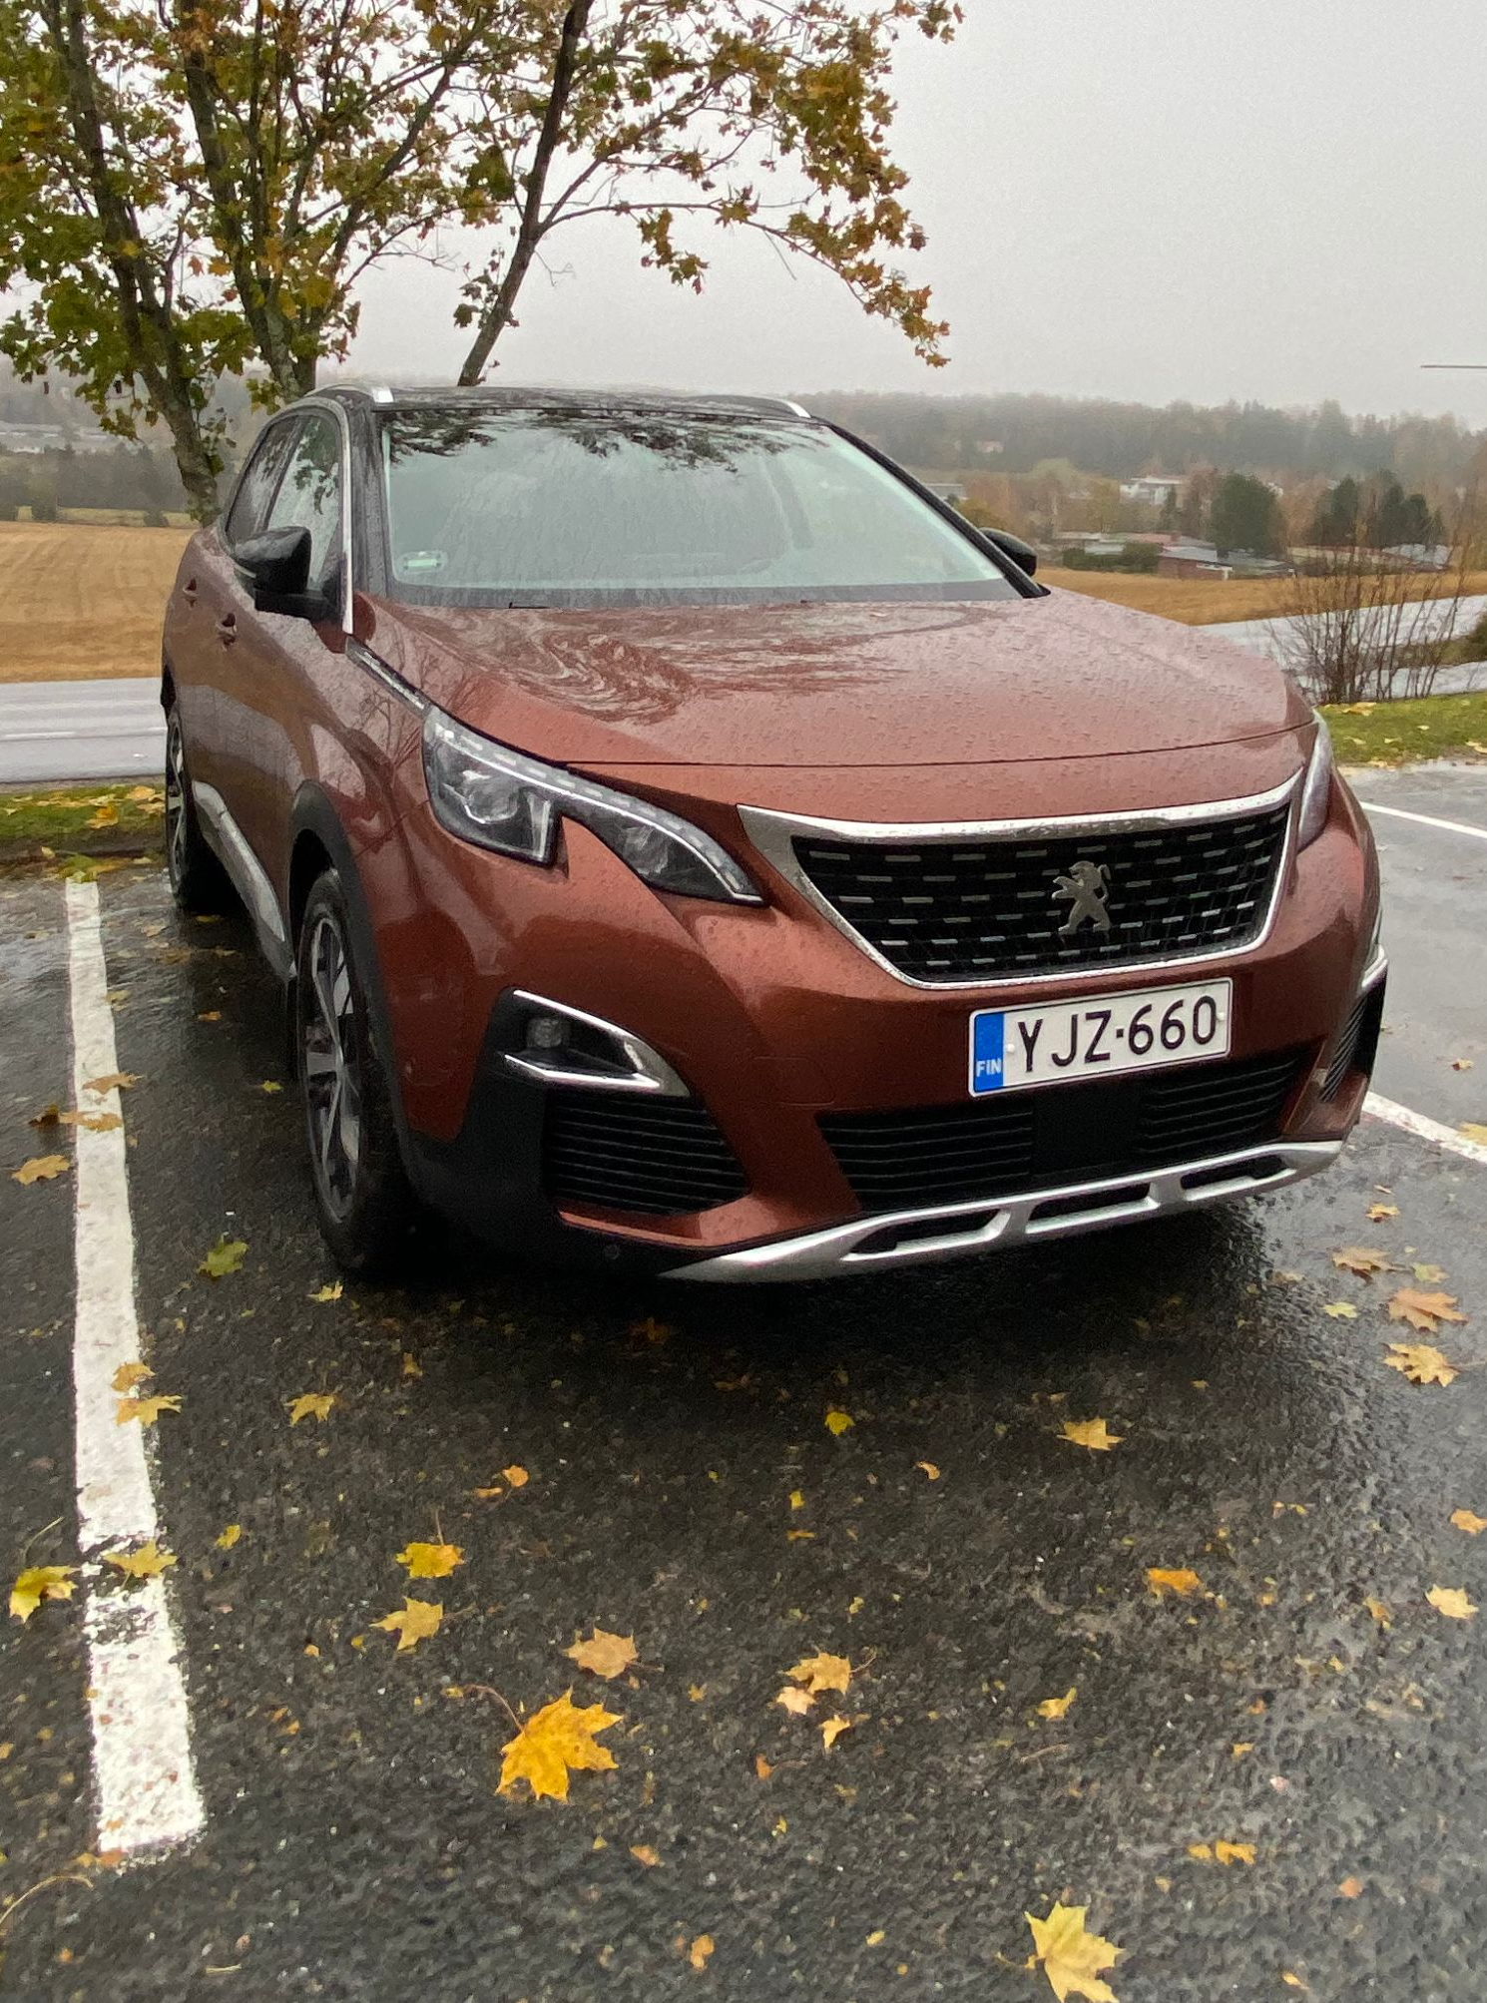
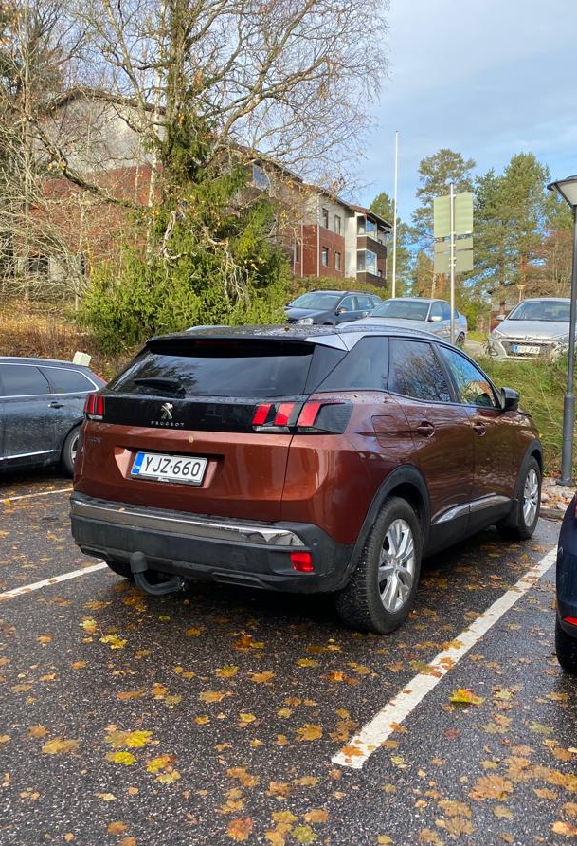
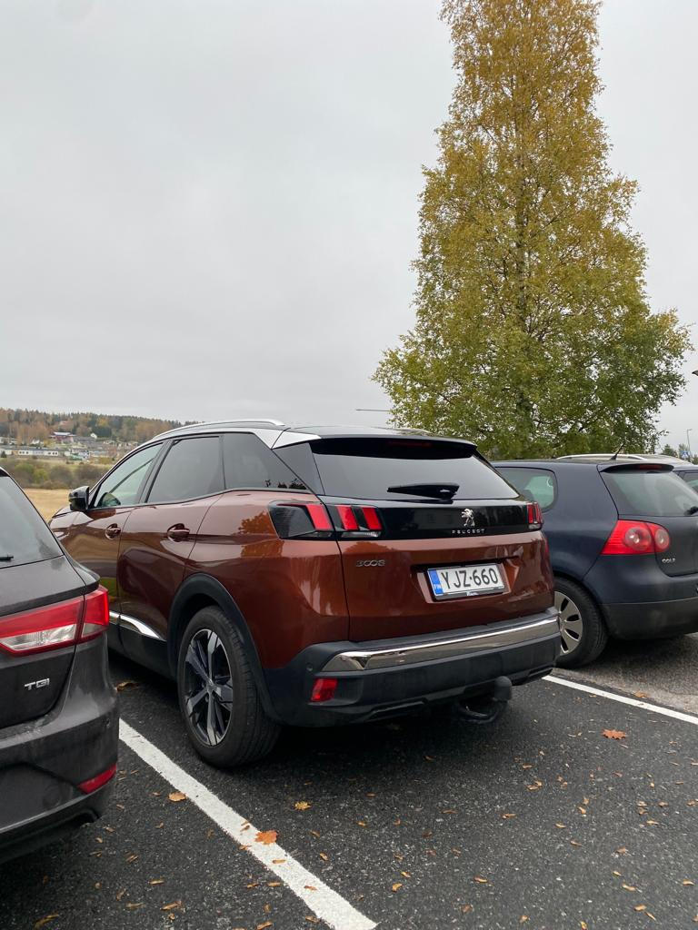
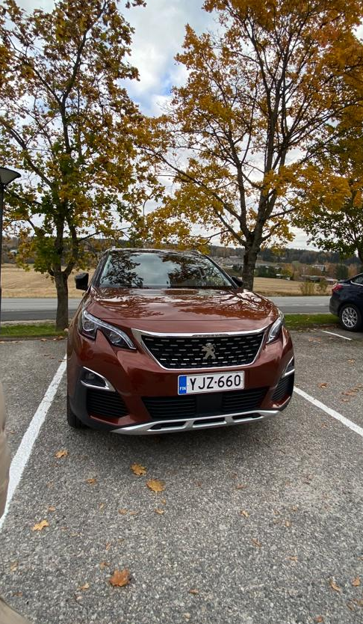
Our own experience
Monday 8:05
Wednesday 9:30
Thursday 9:30
Tuesday 8:05
Friday 10:50

Slide 4
Our own experience
If you come early to school, you usually get a parking spot but if you come 9.30 or 10.55 you have to drive somewhere else
Sometimes students don't park straight so you can't always fit in to the parking spot, especially if you have a bigger car
Sometimes rangers or moped cars are parked at the parking spots

Slide 5
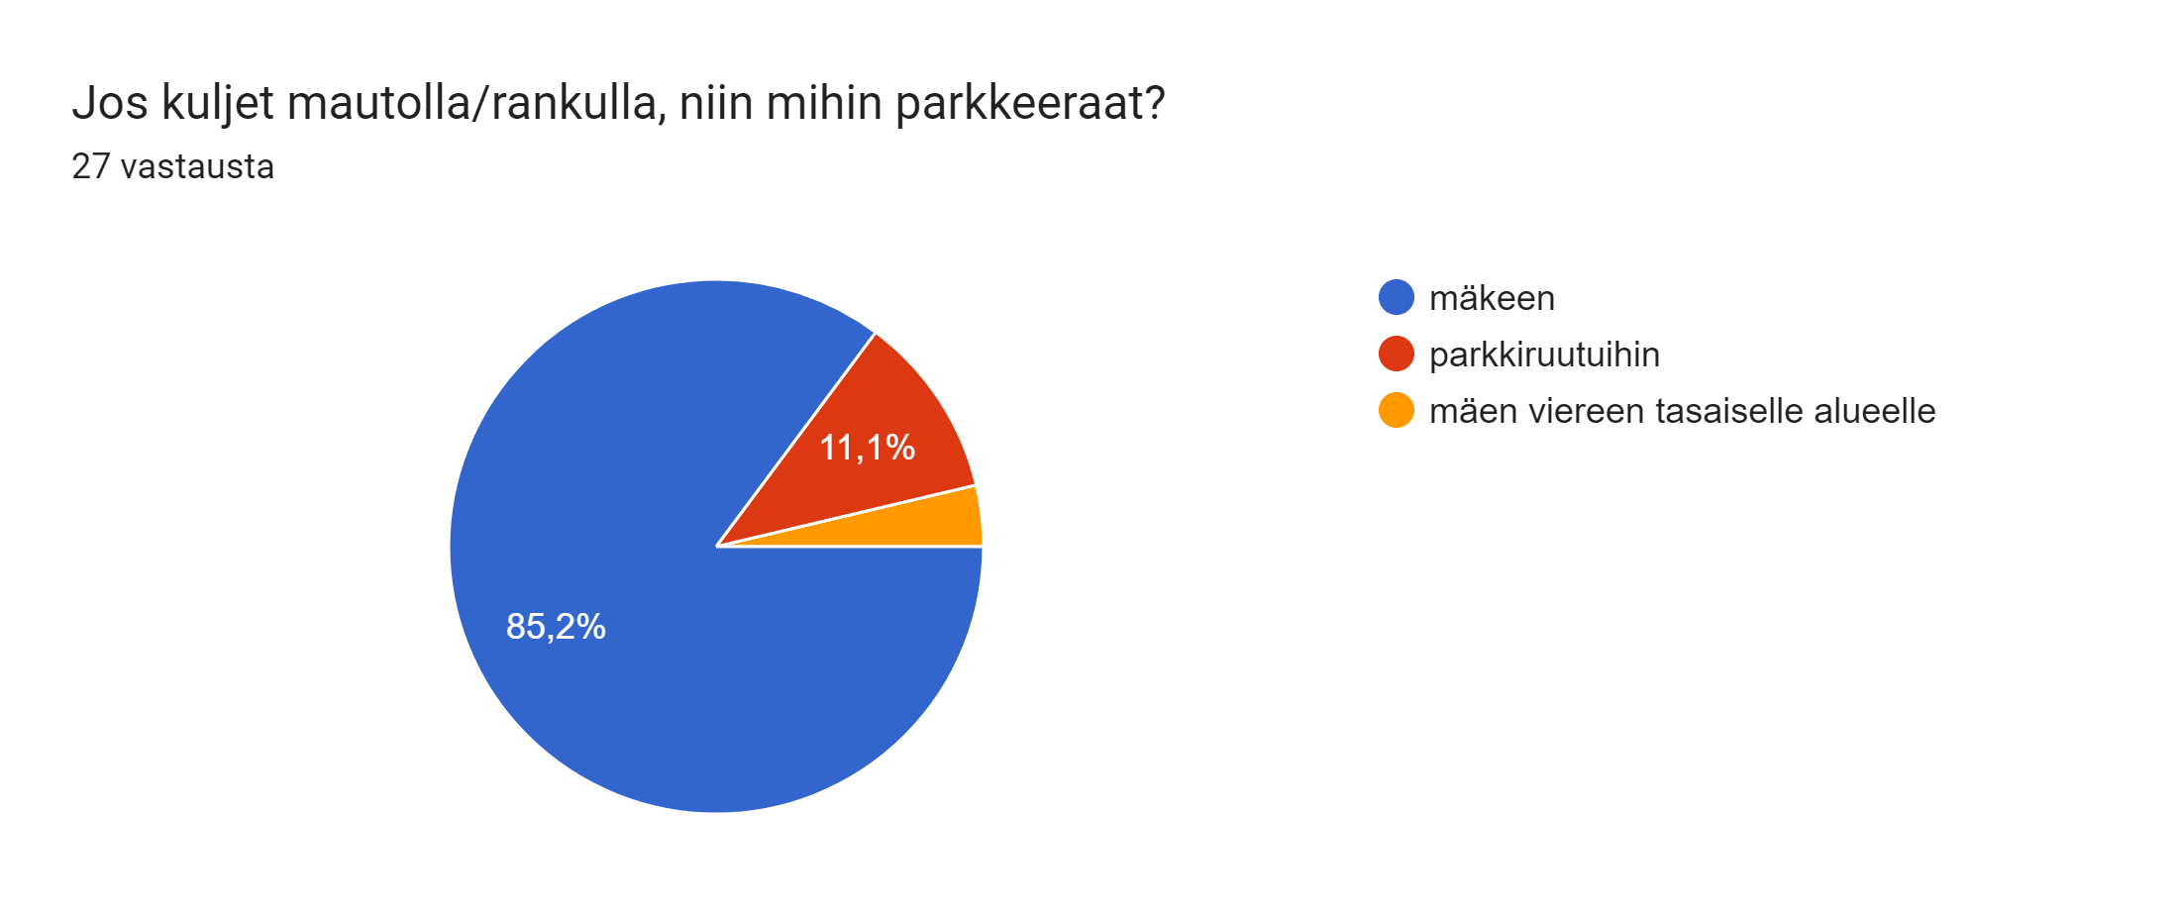
If you’re coming to school by moped car or ranger, where do you park?

Slide 6
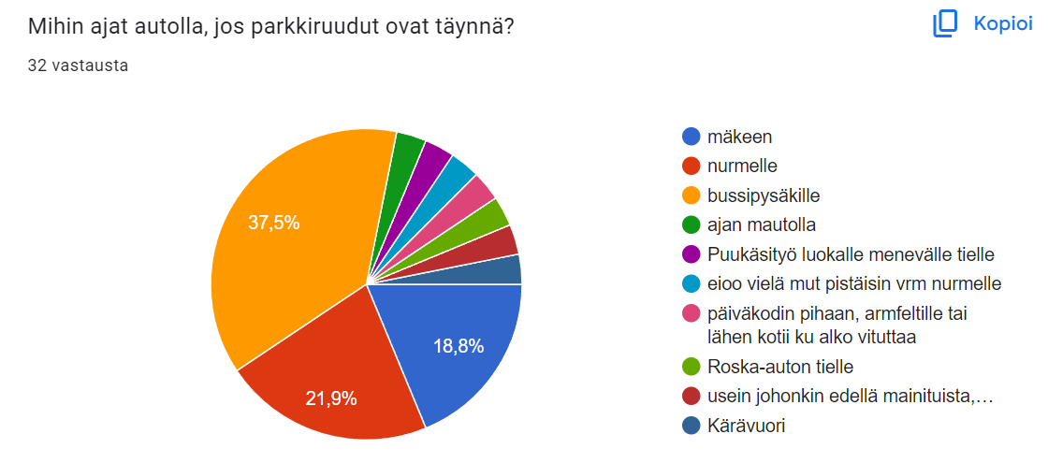
Where do you drive your car if the parking spots are full?

Slide 7
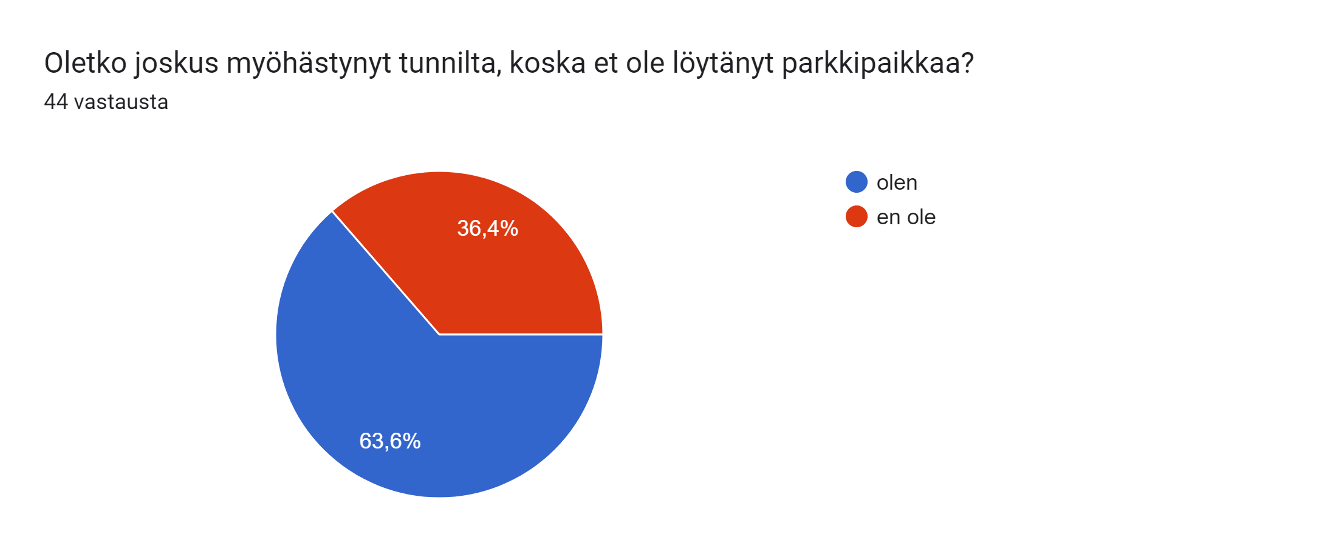
Have you been late from the class because you couldn't find a parking spot?

Slide 8
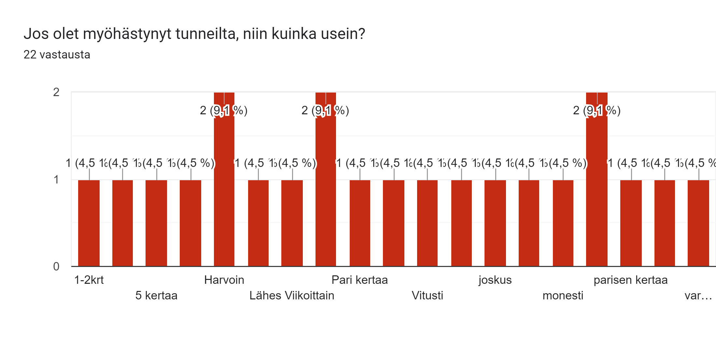
If you have been late to class, how often?

Slide 9
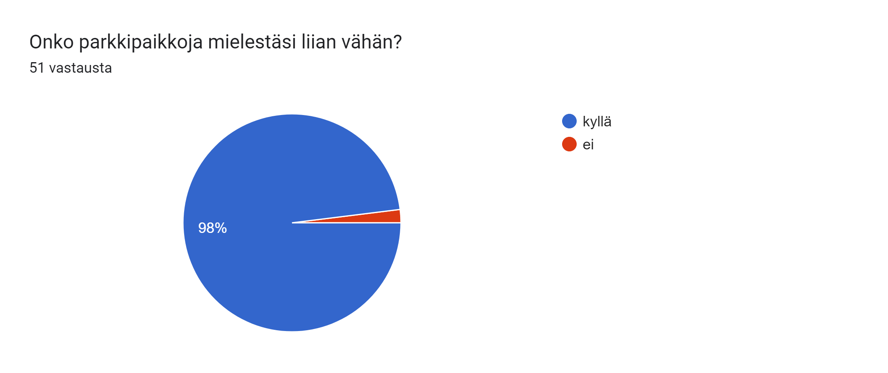
Do you think that there isn’t enough parking spots?

Slide 10








Slide 11
How we would solve this problem
We would expand the parking lot
Cheapen the bus tickets so more people would use public transport
  Exc. Have student tickets

Slide 12
Sources
https://www.flickr.com/photos/thienzieyung/5318972121
Forms to the students
Pennina’s car pics

