Slide 1
Mythology texts
Appreciation slides

Slide 2
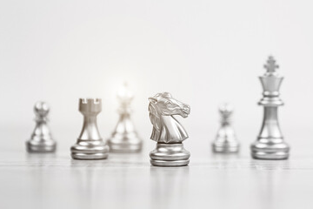

Koukuttava
Everyone knows who The King of Narragansett is. It is classified as general knowledge, and you should know their name too. A face so slimy and scaly can’t be forgotten once you’ve seen it. The stories they tell about them are so mordant and vicious that young children shouldn’t listen to them. Oh, you don’t know who The King of Narragansett is? Well allow me to introduce you to them--

Slide 3


Oma näkemys mukaan taruun
“I don’t think she was a monster. She was mistreated and raped by a God. That’s what she was. Yet she was the one to receive the punishment. Ignorant fools.”

Slide 4
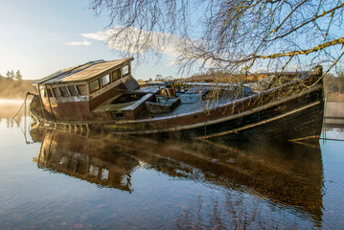
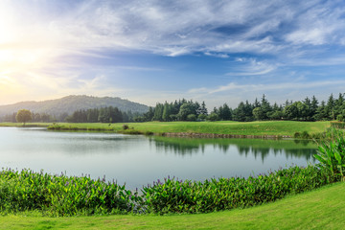
Mielenkiinnon herättävä
Some of the people who believe in Nessie not only believe that the in monster but it is actually a dinosaur too. The dinosaur is thought to be the last surviving plesiosaur, which are aquatic dinosaurs believed to have gone extinct 65 million years ago.

Slide 5
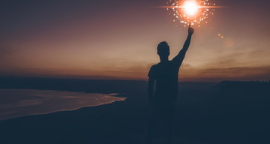
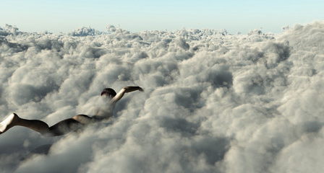
Elämän tarkoitusta pohtimaan kannustava
The monkey goblin Ash is possessing doesn’t have a clue about their power and meaning. They just live somewhere thinking they are just like everyone else unaware that they must live as long as possible, because their death might be the wake up call for Ash that makes everything vanish. Therefore try your best to stay alive! If you happen to be Ash, your death would be fatal to all of us.

Slide 6
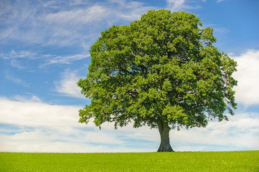
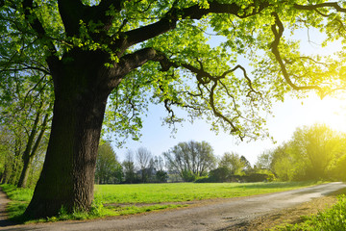
Söpöjä hahmoja
Farore told The Great Deku Tree that he is to spread his kin to earth, these kin are the Korok children, small wooden creatures that wary in size shape and colour. They are naturally playful little pranksters, which makes them great at hiding other Korok seeds that will sprout into trees. These children can fly using a deku leaf from The Great Deku Tree. There is nine hundred Korok children that are to go all over the earth and plant the seeds that will grow into trees

Slide 7

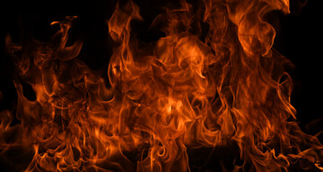
Kouvola mainittu
After the tree caught on fire there was a loud scream as if the tree could speak. Then there came these huge dark clouds that filled the sky and a black mist that covered the whole city. And almost in an instant it all got sucked in the tree’s corpse and the whole tree just vanished. The beautiful city that once thrived from the lively nature and immaculate landscape. Turned in to a dystopia.

Slide 8
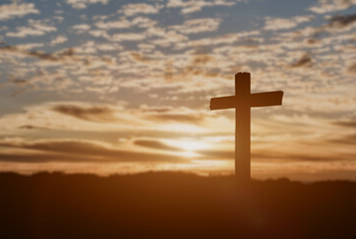
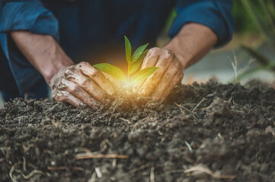
Syvällinen
If we could live forever, is there a point in doing anything after you wake up? You have all the time in the world, so there's no hurry. You wouldn't push yourself to try new things as frequently as you do when you know it could all be over tomorrow. Wheter we like it or not, death motivates us to live our life to the fullest and never take anything for granted.

Slide 9
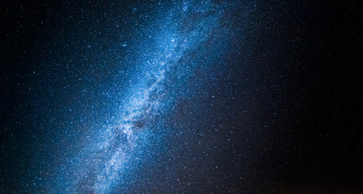
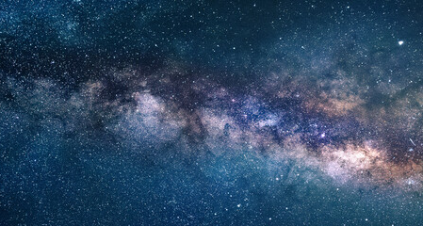
Myytin ja todellisuuden yhteensidonta
The tale confesses that no one can really anticipate what the Wanderer does. Even though God does not play dice with the Universe, this unpredictable beast might. And if you happen to forget things, it might be due to the Wanderer colliding accidentally into a planet thus damaging your memory while floating through the Universe.

Slide 10
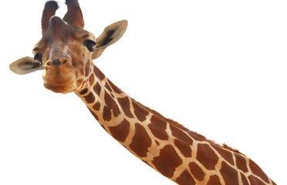
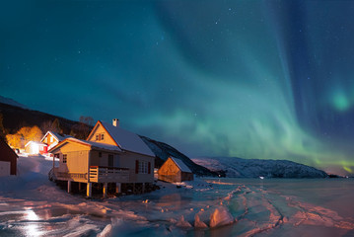
Yllättävä aihevalinta
The giraffe took it and flew to Finland, Lapland. At the destination she was starving. A reindeer guided her to eat these little blue berries. The giraffe fell in love with them and forgot the main reason she had come to Finland. The giraffe ate thousands of blue berries until the stomach trouble.

Slide 11
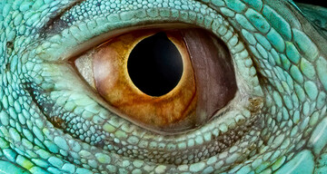
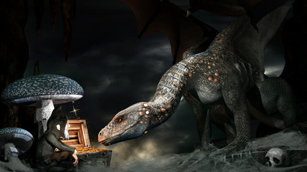
Mielikuvia
Most dragons could breathe fire, but there were exceptions. In the north, instead of fire, the dragons threw cold air that could freeze a person to death in seconds. It is said that dragons living near volcanoes were able to set themselves on fire.

Slide 12
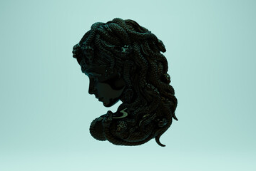
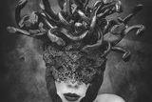
Nappilopetus
And it was all caused by an arrogant man who didn’t understand the concept of consent.

Slide 13
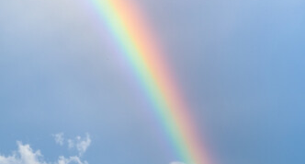
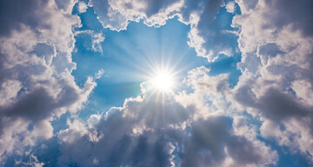
Henkilökuvaus!
On Mount Olympus, on the egde of a cloud, sat a delicate, ethereal young woman. Of course she wasn`t a mortal being, because she had long and beautiful golden wings shooting out of her back. Her skin had no scars or imperfections and it was a shade of fresh milk. In fact, she looked like she had been molded out of clay. Her long wisps of silver, white hair floated besides her as she stared in the distant void. She glowed like the dawn of sun but somehow her essence was filled with doubt.
  When you see a rainbow, know that it ends where the love of Goddess Iris died.

