Slide 1
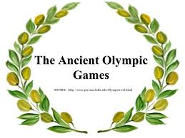
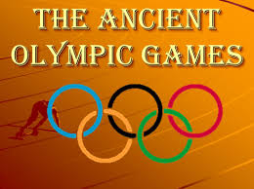

Slide 2
The first Olympic Games took place in Greece nearly three thousand years ago in 776 BC!

Slide 3
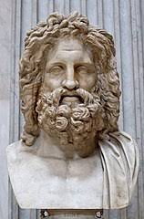
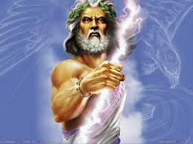
Originally it was a celebration,
an athletic competition held in honor of Zeus,
the king of the gods.
Closely linked to the religious festivals of Zeus.

Slide 4
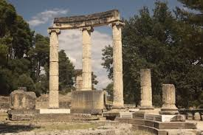
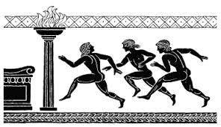
The games happened every four years, and during the games there was an Olympic Truce, wars and battles were not allowed so that athletes from different cities could travel safely to and from the games.

Slide 5
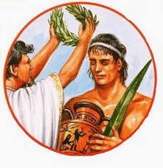
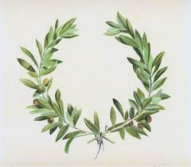
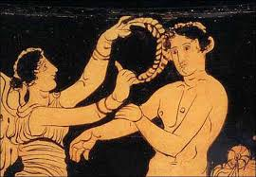
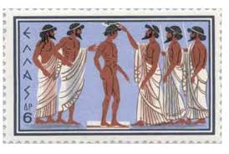
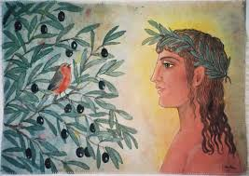
In Greece there was no second place.
Winners were given a laurel wreath for their head and a pot containing olive oil. The winners were awarded a wreath or crown of olive branches, which was a great honor, in greek those olive branches were called ‘Kotinos’. Often the winners received money and other prizes.
Winners were called ‘Olympionics’

Slide 6
In the ancient Olympics, only freeborn men were allowed to compete. Women could not take part in the Olympics.
Requirements to participate in the Olympics:
One had to be a male Greek freeman of over 18 years old.

Slide 7
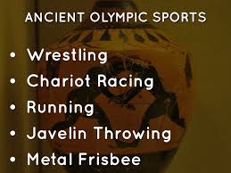
The ancient Olympic Games:
Had fewer events than the modern games
Olympic Games became the basis of the greeks’ earliest calendar the time was marked in 4 years that was called Olympiads!
Competition fosters excellence that was the belief of the ancient Greeks.
The most important thing is not to have conquered but to have fought well.
For the first 13 games The ancient Greek Olympics they had just one event the 200 yards dash
Τhen new events included:

Slide 8
Running

Slide 9
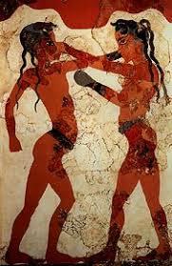
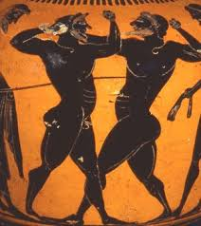
Boxing

Slide 10
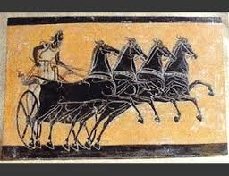
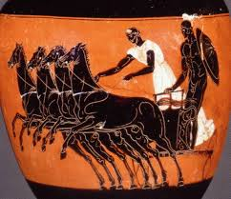
Horse and Chariot race

Slide 11
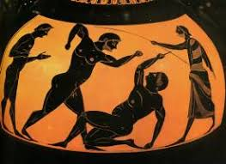
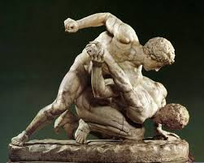
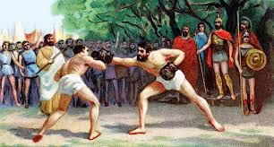
Pankration

Slide 12
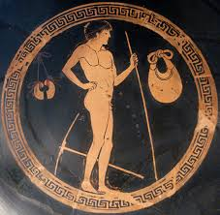
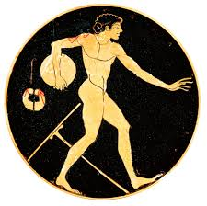
Pentathlon
Five events were contested over one day, starting with the stadion (a short foot race) followed by the Javelin throw, Discus throw, Long jump , and ending with wrestling.

Slide 13
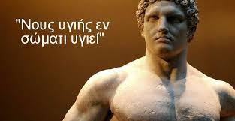
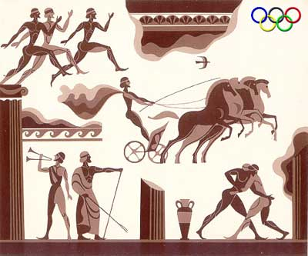
The ancient Olympic games only allowed people of Greek descent to participate.
Athletic training in ancient Greece was part of every free male citizen’s education. They had to exercise so that they would do well in war. Ancient Greeks loved sports and competition muscular bodies were admired sports developed for example courage and strenght!

Slide 14
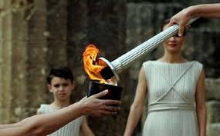
The ancient Olympics were held in the same place each time, in the city Olympia in Greece!
The Olympic rings and the Olympic flame or torch are the most important symbols of the Olympic games
The lighting of the torch is a reminder of the ancient Greek myth when Prometheus stole fire from god Zeus to give it to humans
Before each Olympics, the torch is lit in a special ceremony at the site of the ancient Olympics in Olympia, Greece.
It travels around Greece and then begins a special journey to the city that will host the Olympic games.

Slide 15
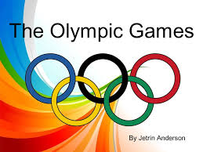
In 391 ad the Christian Roman emperor Theodosios banned pagant practices and the Olympic games stopped. The final games of the ancient Olympics were held in 393 AD, ending a tradition of over 1,000 years. It wasn’t until almost 1500 years later that someone tried to hold the Olympics again ,until the International Olympic Committee was created in 1894 by Baron Pierre de Coubertin of France.

Slide 16
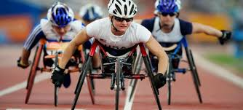
The first games organized by the IOC took place in Athens, Greece, in 1896, and featured 241 athletes from 14 countries. Women first competed in the Olympics in 1900.
The Olympics were expanded to include winter sports like skiing and figure skating and special winter Olympics were held to make that possible. Also, ‘Parallel Olympics’ now known as the Paralympics, began to be held for athletes with disabilities.

Slide 17
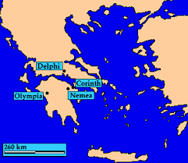
Where is ancient Olympia?

Slide 18
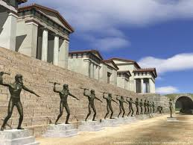
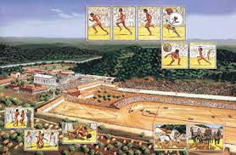
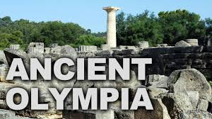
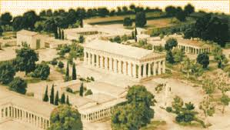

Slide 22
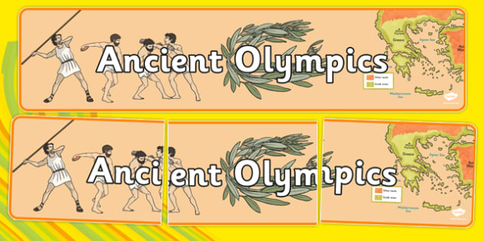

Slide 23
Let’s watch some videos
https://www.youtube.com/watch?v=d73yDLJ86ZI
https://www.youtube.com/watch?v=rW3RdNC0qfc
https://www.youtube.com/watch?v=VdHHus8IgYA
https://www.youtube.com/watch?v=jA6Y7gG3OLs&t=77s

Slide 24
Let’s Play!
Where did the Olympic Games were held?
Olympia
Sparta
Athens
Corinth

Slide 25
True or False ?
At the ancient Olympic Games women and men could take part
Running and horse racing were some of the Olympic events
The first Olympics is dated to 776 BC
At the ancient Olympic Games the prizes for the victors were golden medals

Slide 26
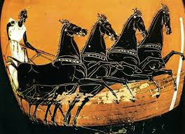
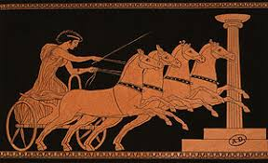
Can you recognize this Olympic event?

Slide 27
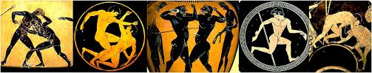
What is the name of that game?

Slide 28
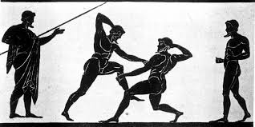
Can you recognize this ancient Olympic event?

Slide 29
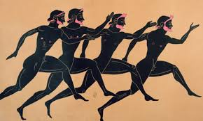
What is the name of that event?

Slide 30
Imagine that you had to take part in the Olympic games which sport would you choose?
Running
Boxing
Horse/chariot race
Pankration
Pentahlon

Slide 31
Let’s watch some videos
https://www.youtube.com/watch?v=d73yDLJ86ZI
https://www.youtube.com/watch?v=rW3RdNC0qfc
https://www.youtube.com/watch?v=VdHHus8IgYA
https://www.youtube.com/watch?v=jA6Y7gG3OLs&t=77s

Slide 32
Can you find differences between the ancient Olympics and the Olympic Games now?

Slide 33
Paint your favourite ancient Olympic game

