Slide 1
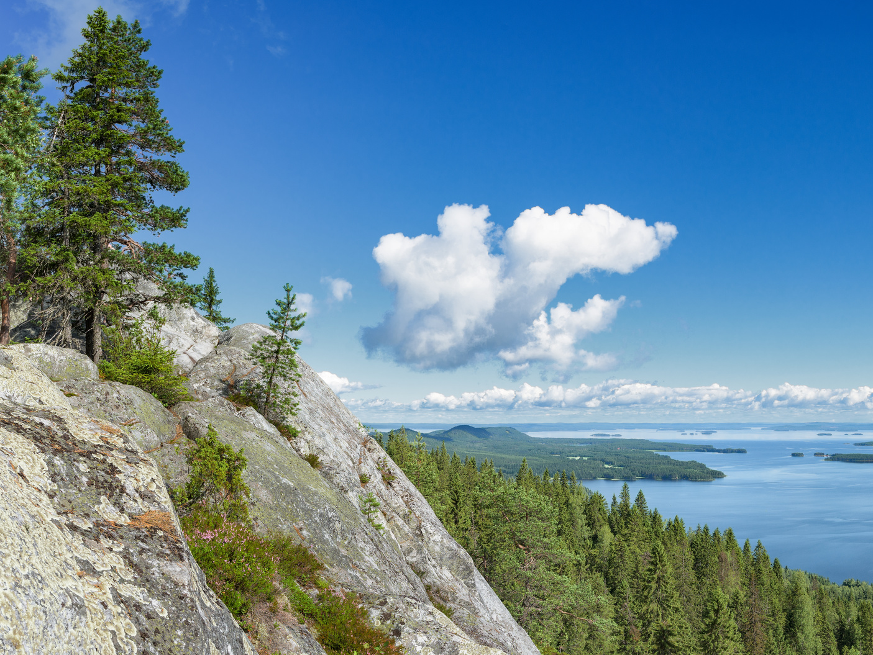
Finland

Slide 2
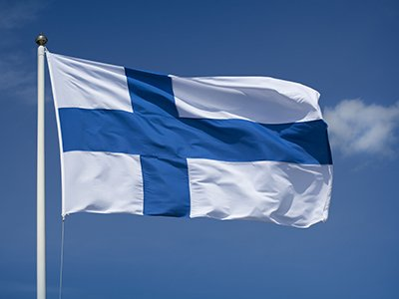
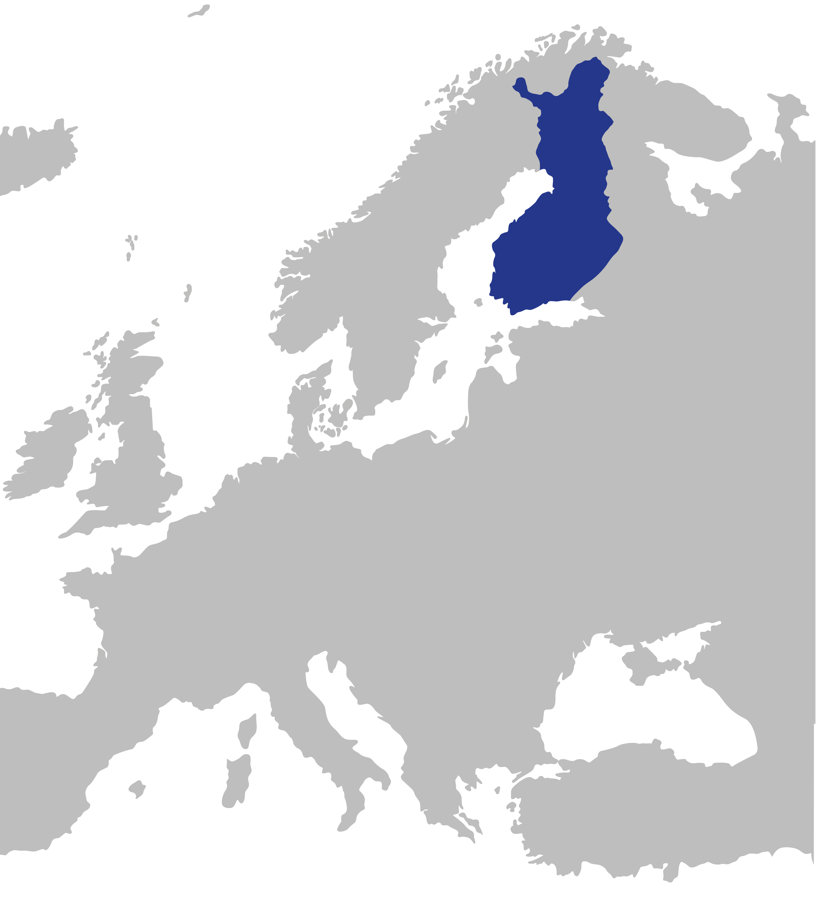
Finland in brief
Finland is located in Northern Europe.
Neighbouring countries are Russia, Norway and Sweden.
Belongs to the Nordic countries and to European Union.
Population is 5,5 million.
Capital city is Helsinki.

Slide 3
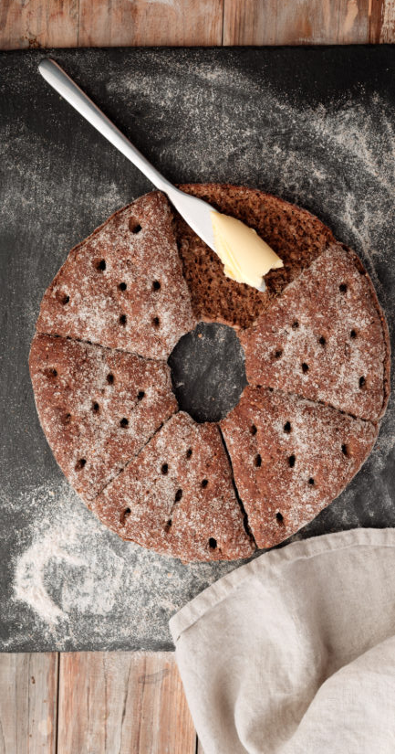
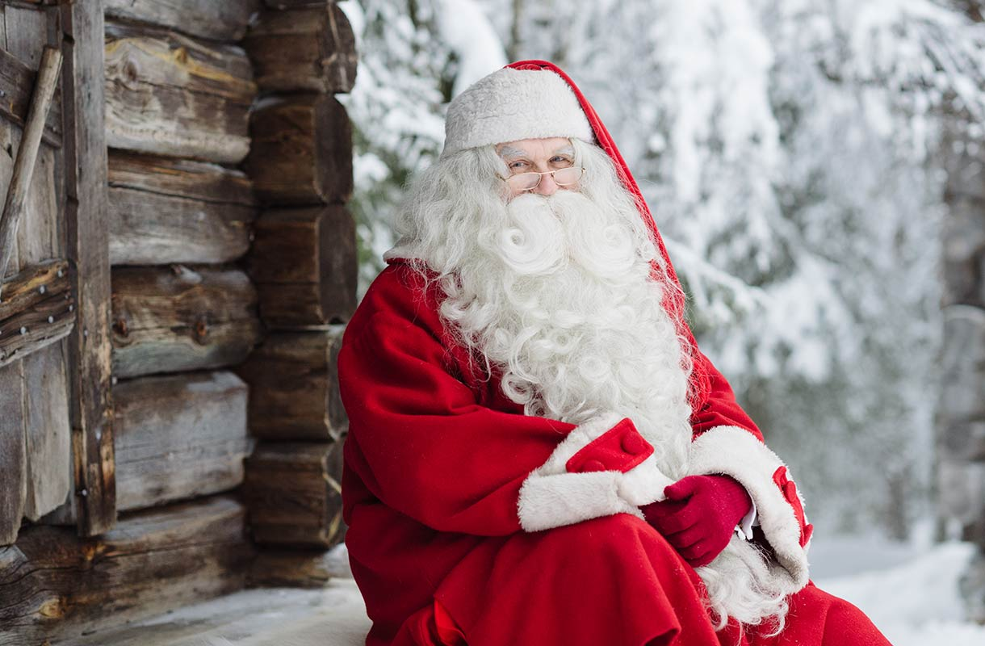
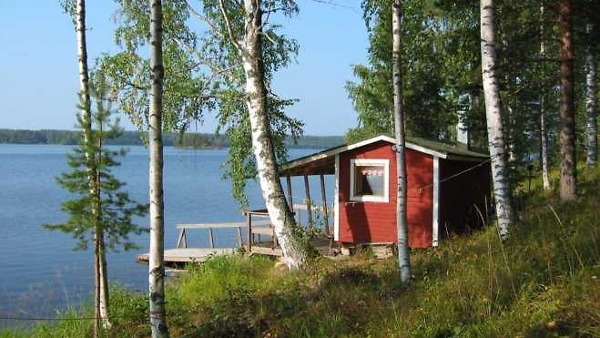
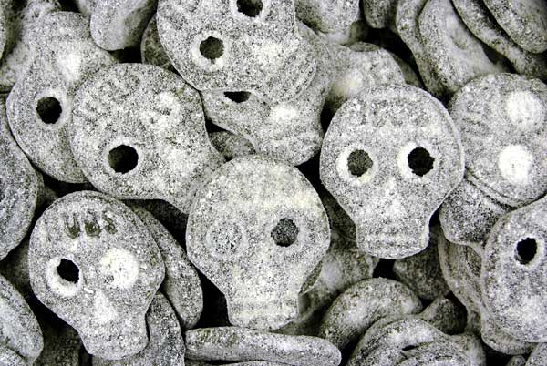
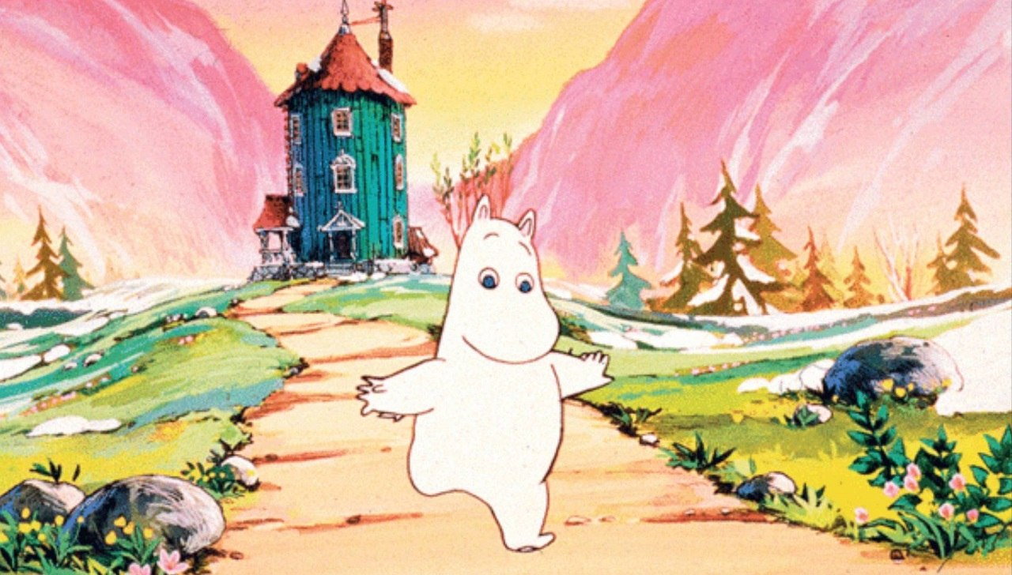
Important to us Finns
Rye bread
Ice hockey
Sauna
Santa claus
Salty liquorice
Moomin

Slide 4
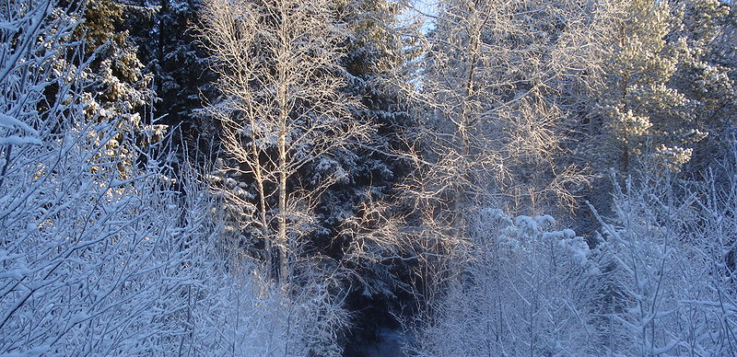
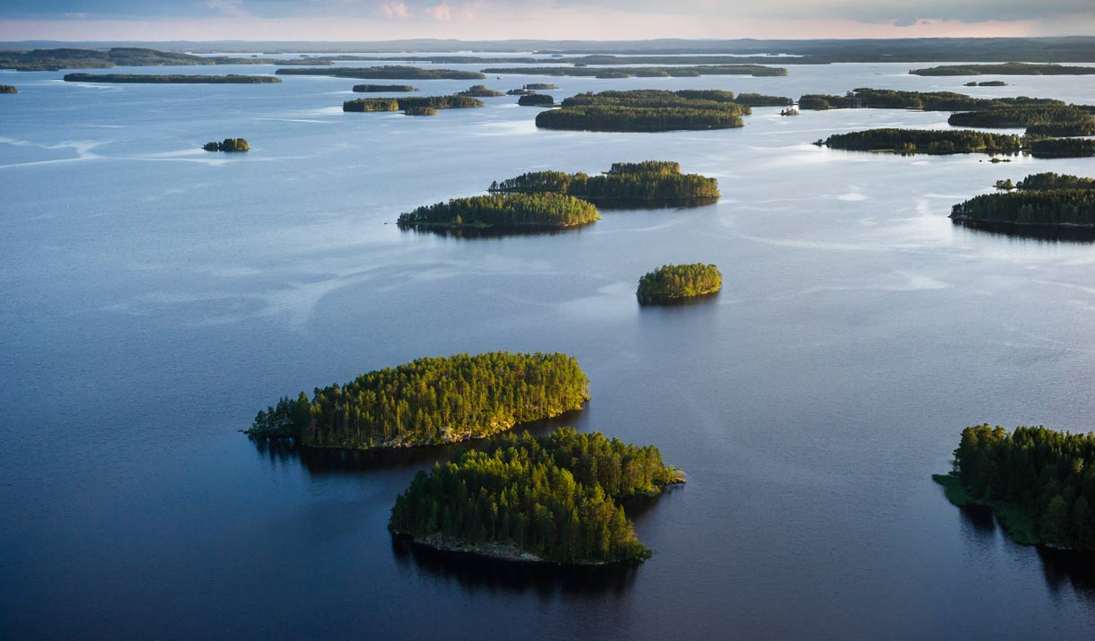
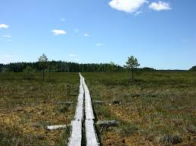
Finnish nature
In Finland we have over 180 000 lakes.
Nature consist of lakes, forests and
swamps.
Four seasons:
  Winter
  Autumn
  Summer
  Spring.

Slide 5
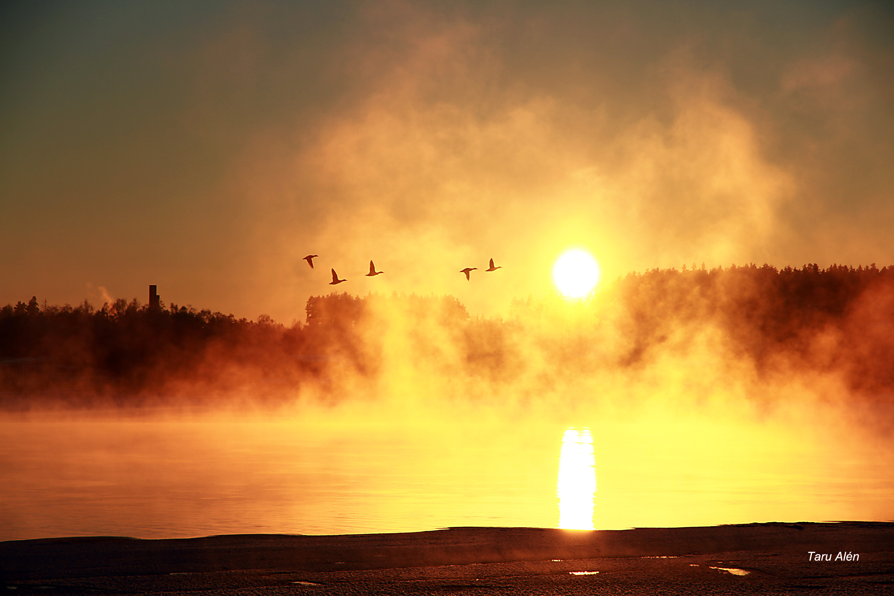
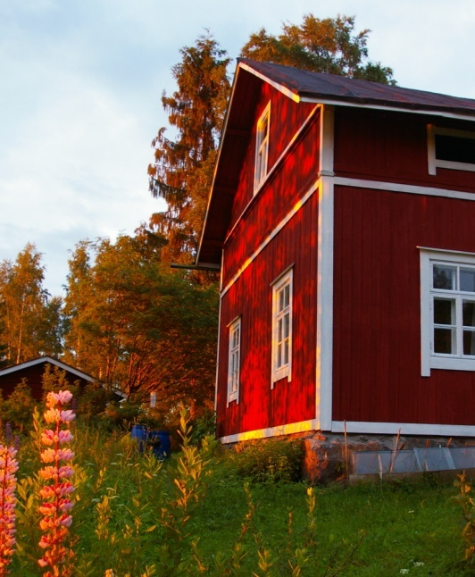
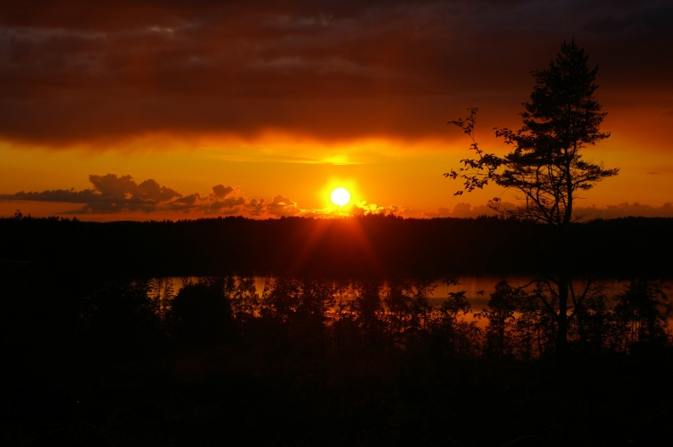
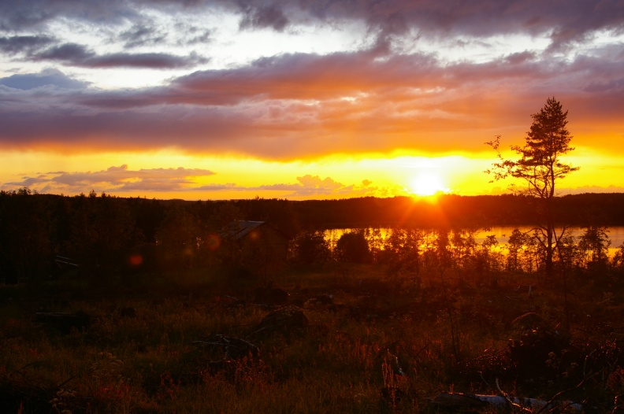
Midnight sun
The sun remains visible troughout the night.
Only seen in polar circles.
It's because of the inclination of the Earth's axis.

Slide 6
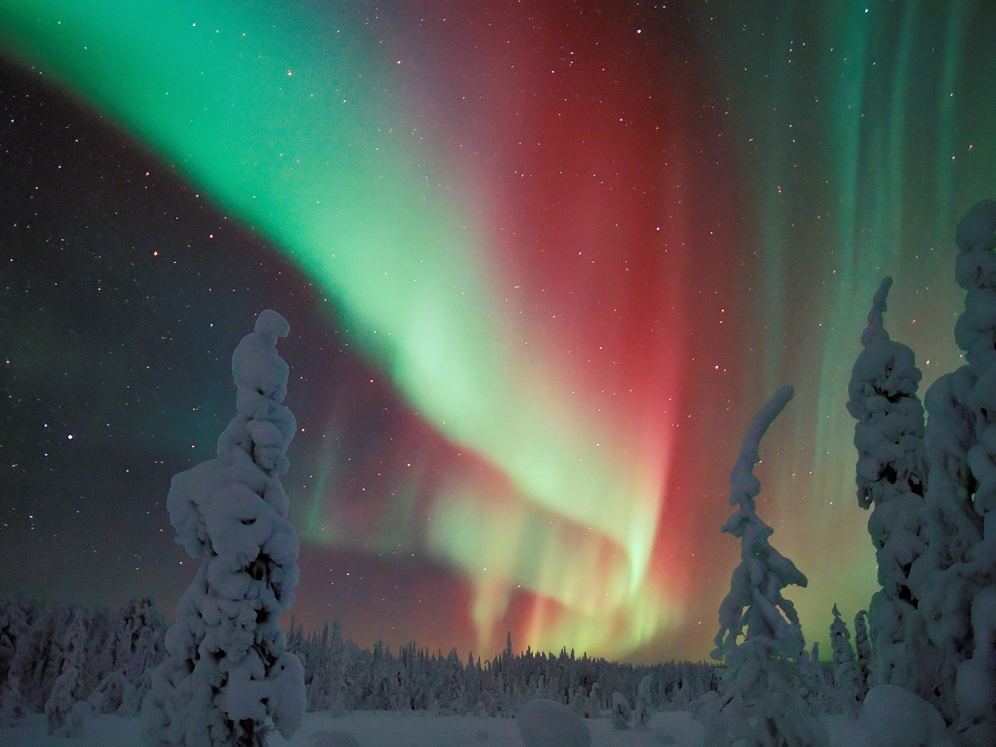
Northern Lights
A natural light display in the Earth's sky.
Mostly seen near the poles.
Happens when the solar winds touch Earth's atmosphere.

Slide 7
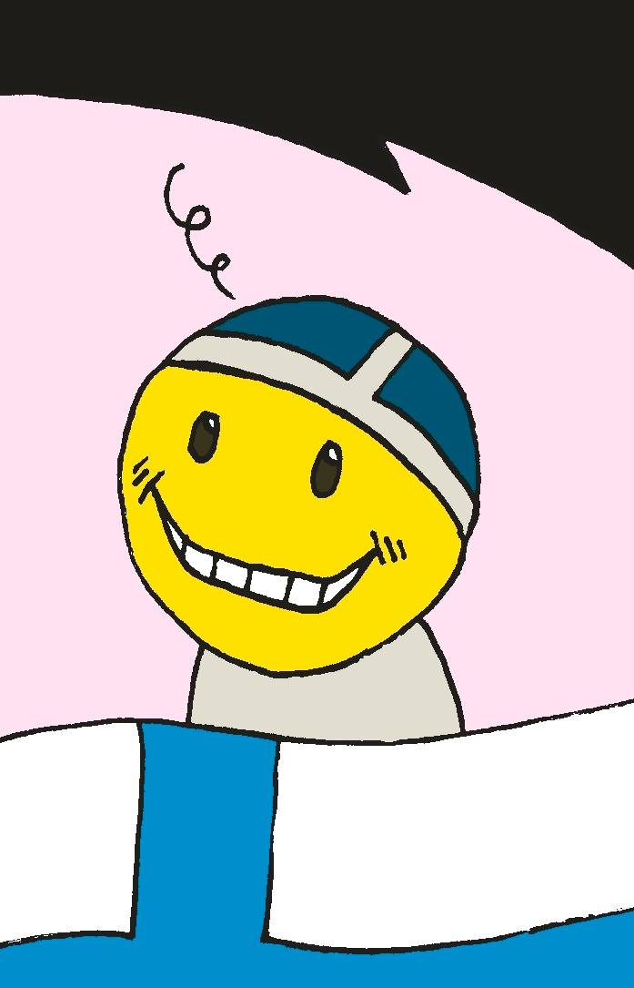
For the fifth year in a row, Finland was chosen as the happiest country in the world (year 2022)
https://www.youtube.com/watch?v=LXAI2hGVw7Y

Slide 8
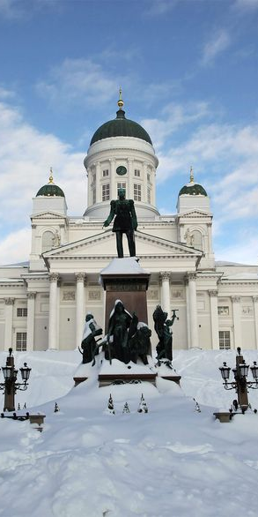
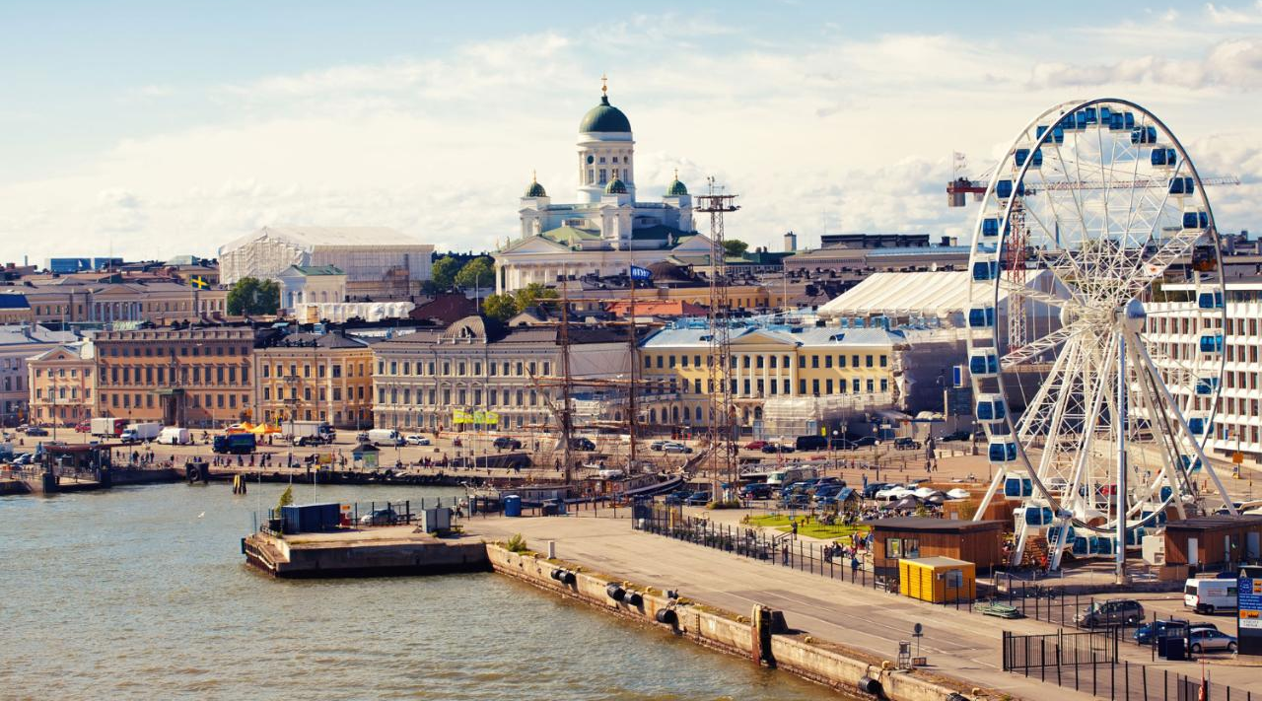
Helsinki

Slide 9
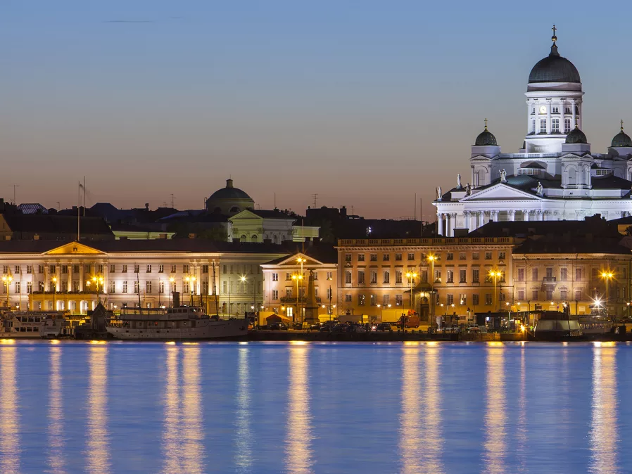
Helsinki
Helsinki is the capital city and the most popular city in Finland.
In Helsinki the population is
657 000 but in the wider
Helsinki region the population
is 1 200 000.
It's the country's most important center for politics, education, finance, culture and research.

Slide 10
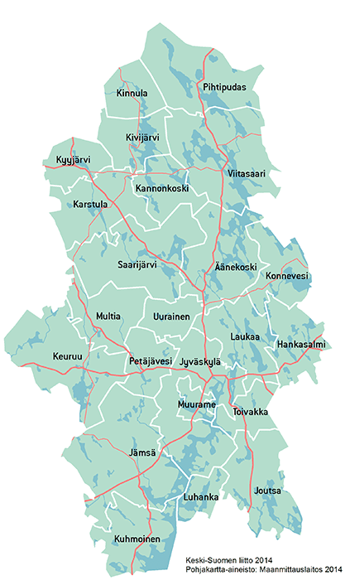
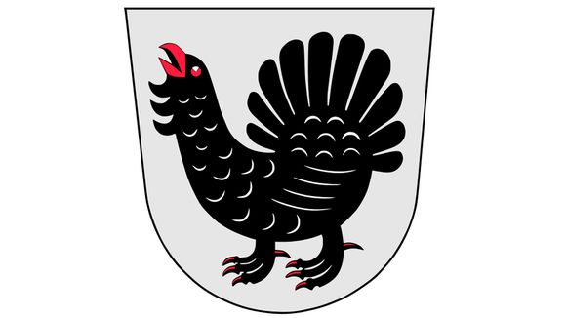
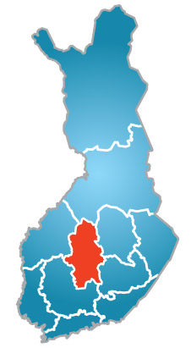
Central Finland
Central Finland has 22 localities.
Population: 273 000.
The nature here is
beautiful and there are
lots of
beautiful lakes,
swamps
and forests.

Slide 11

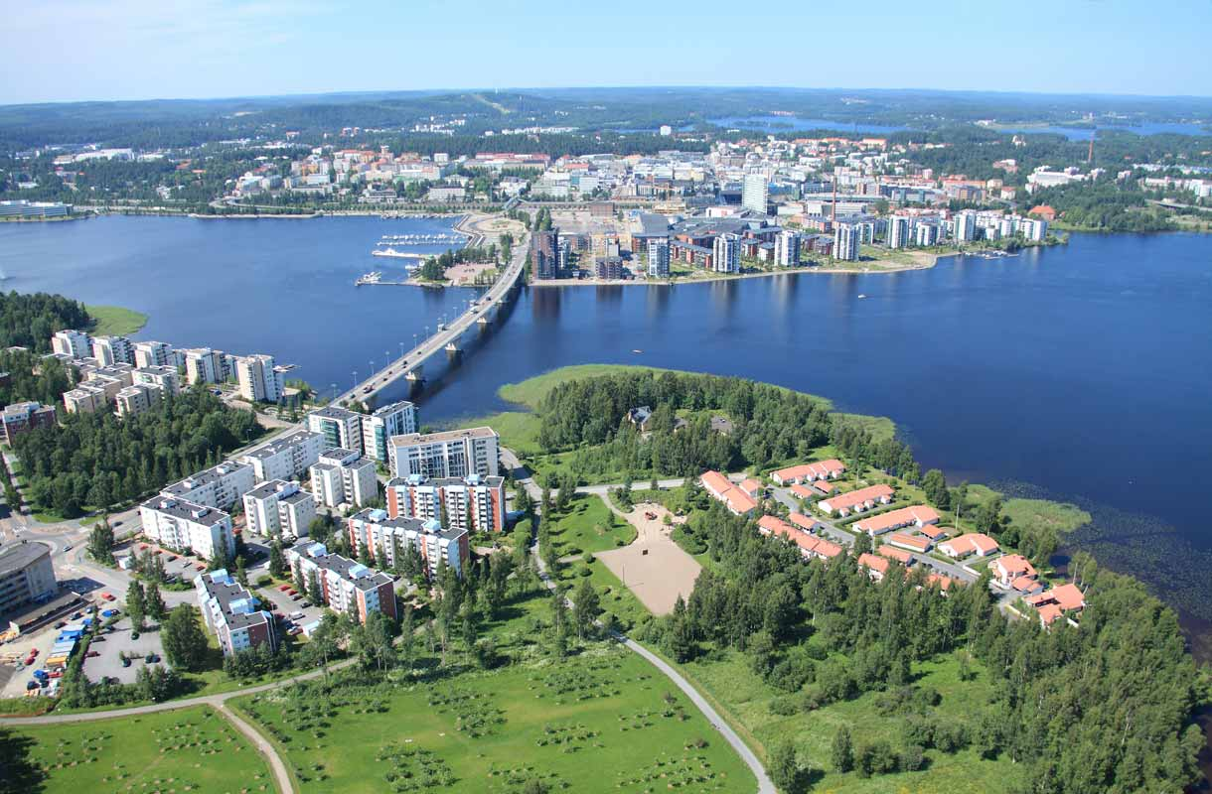
Jyväskylä - the largest
city in Central Finland
Jyväskylä is the 7th biggest city in Finland.
Population: 145 000
Founded at 1837
Many people come to
work in Jyväskylä from
other towns around it.
Alvar Aalto has designed
lots of buildings in
Jyväskylä, for example
the university.

Slide 12
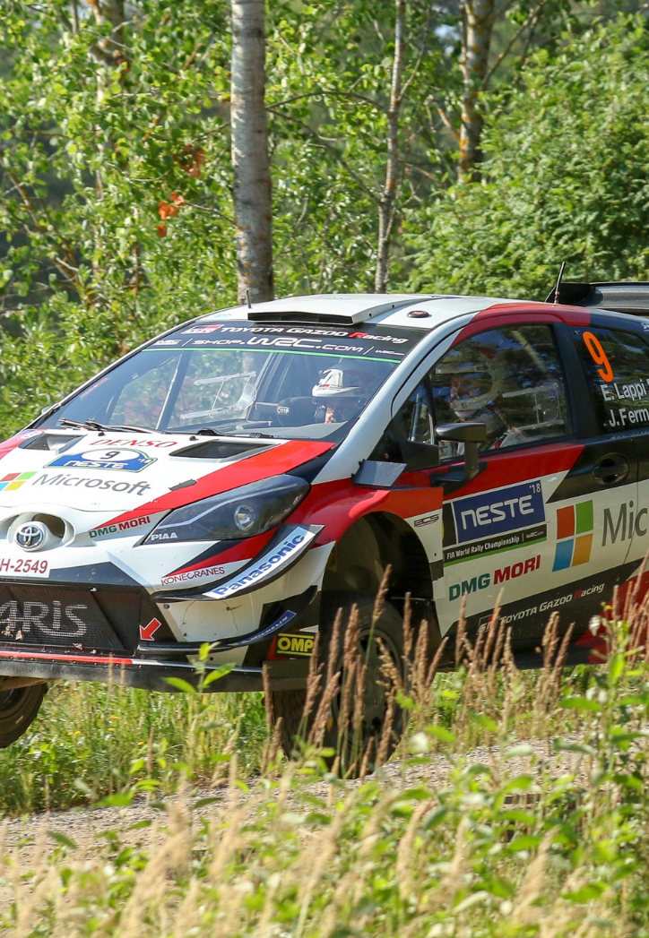
Neste rally
Neste rally is a tradition in Finland, it has always been driven around Jyväskylä.
It has always been a very big event and people have come all around the world to see it and to compete in it.
Finnish people are rally people, almost every Finn likes rally.
Ässämäki, Urria, Mökkiperä and
Moksi stages ar driven in Petäjävesi.

Slide 13
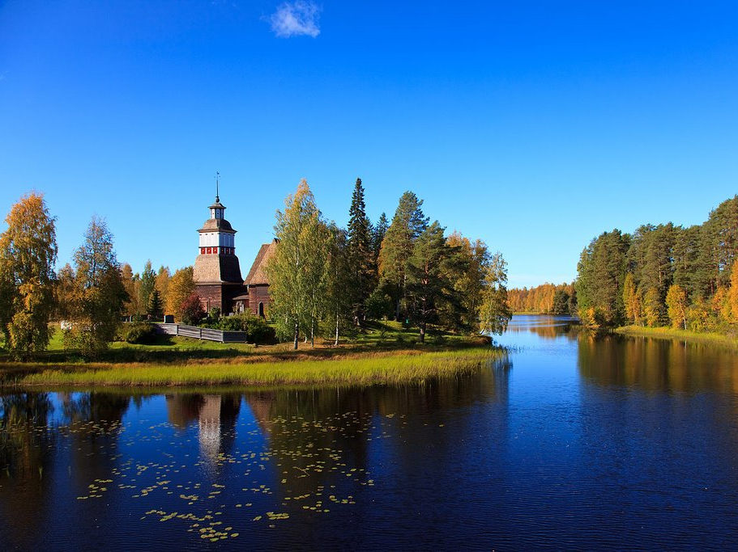
Petäjävesi

Slide 14
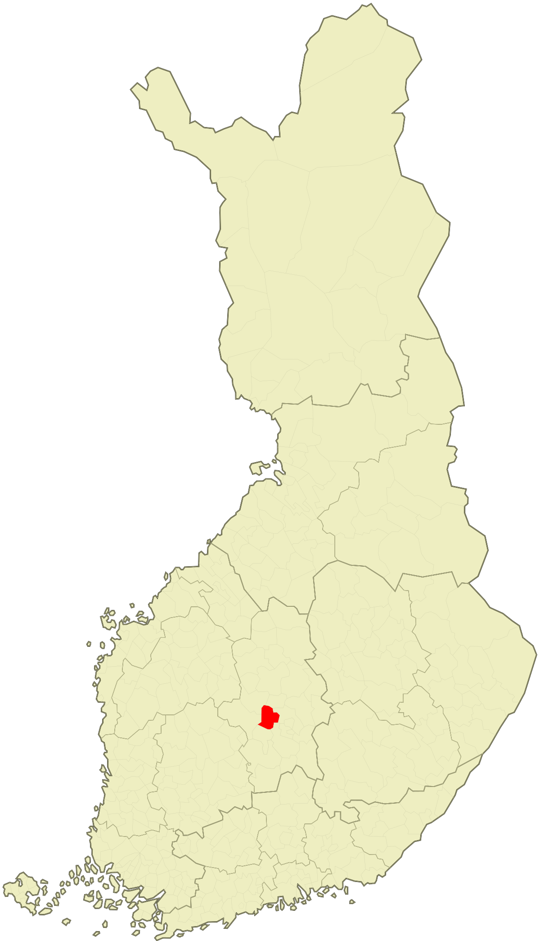
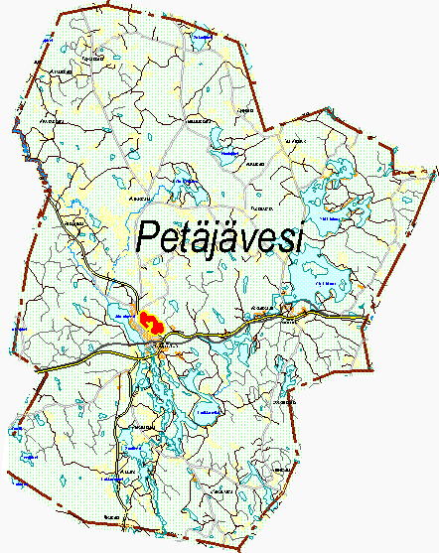
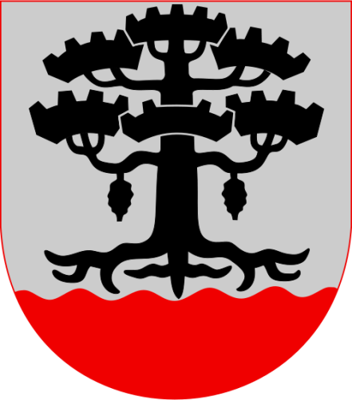
The location of Petäjävesi

Slide 15
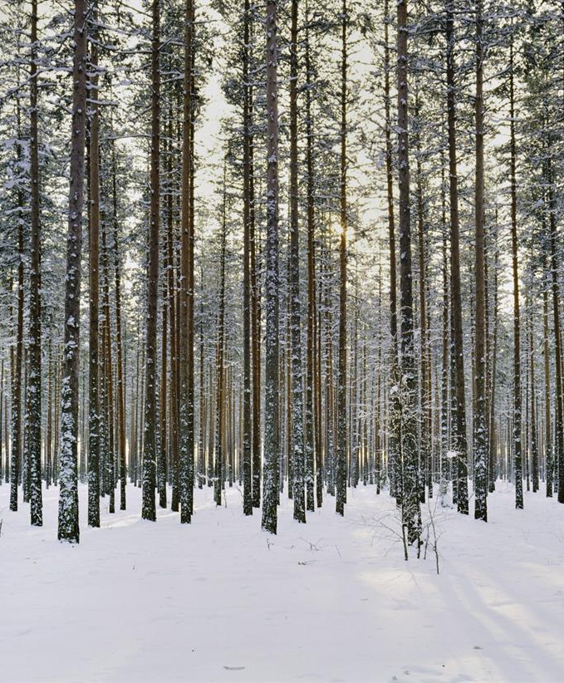
Petäjävesi
In brief
A little under 3 700 people.
There are almost 100 lakes.
petäjä= old pine
vesi = water –> lake

Slide 16
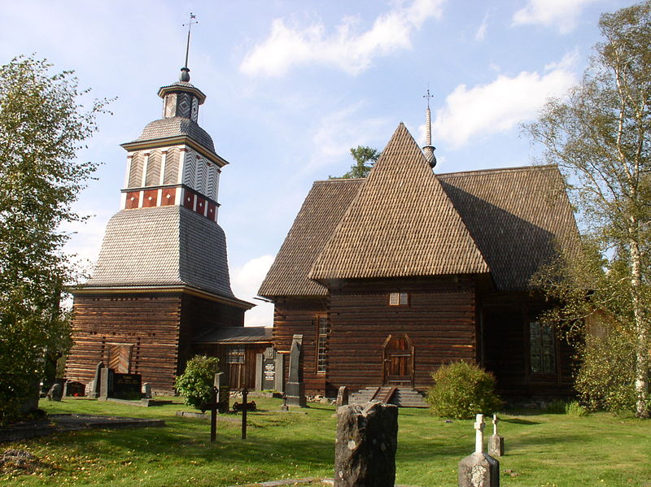
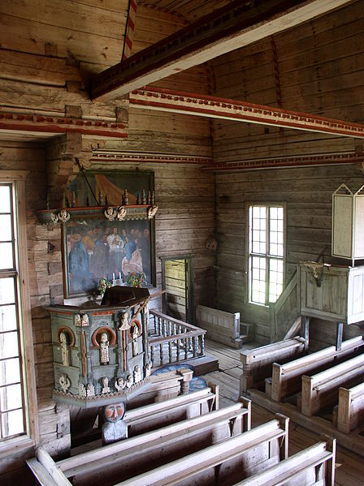
Old church
Jaakko Klementinpoika Leppänen builded wooden church in 1763-1765.
It has been chosen to be a UNESCO’s world heritage site in 1972.
It was chosen because it is a rare wooden church and representing it's own era.

Slide 17
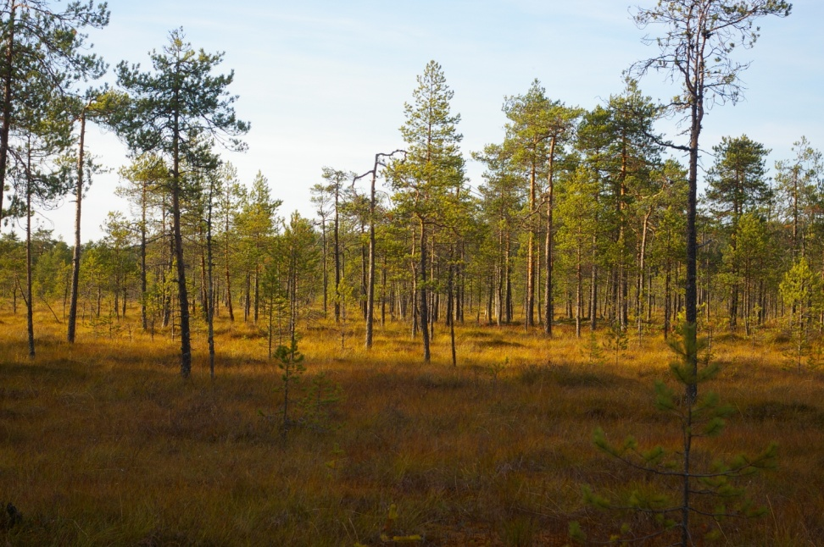
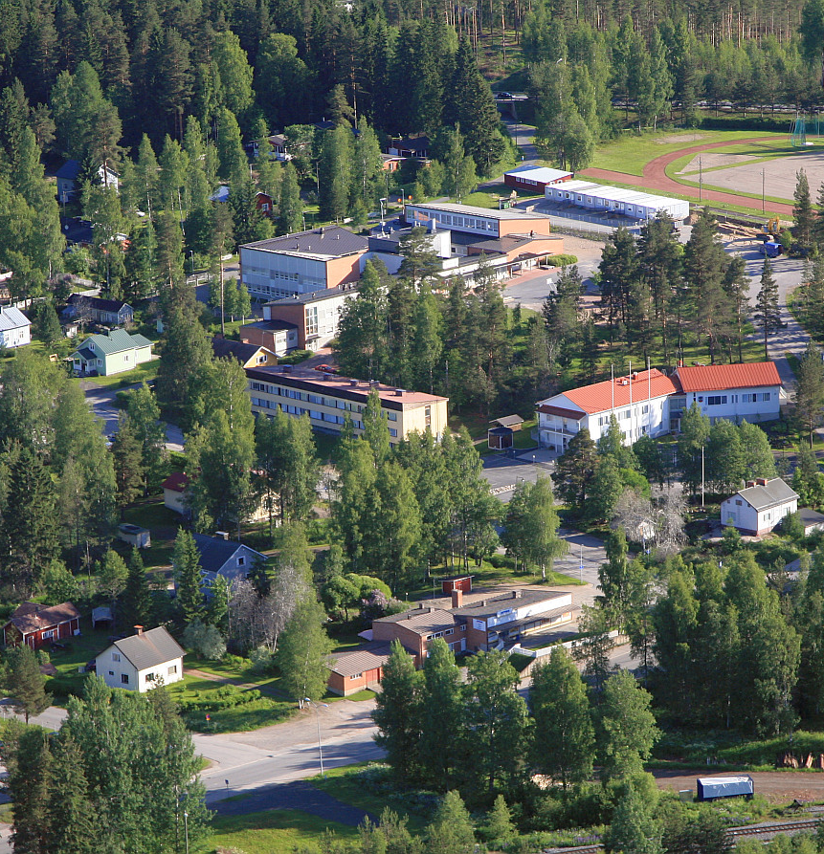
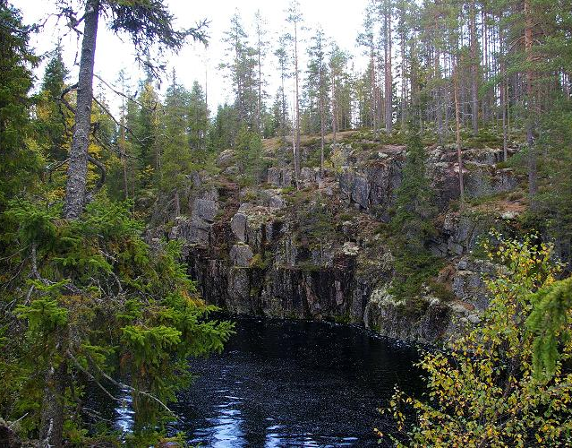
Some places in Petäjävesi
2.
1.
3.
1. Tampin kierros, a nature trail in a swamp.
2. An Aerial photo from Petäjävesi.
3. Karhunahas, a lake in a ravine.

Slide 18
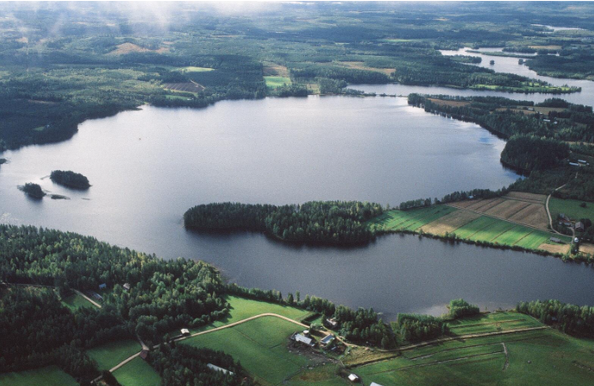
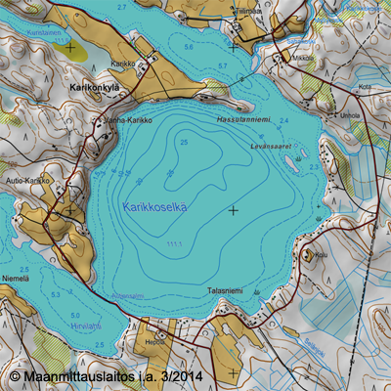
Petäjävesi Karikkoselkä is a pool made by a meteorite. ”The meteorite lake” was created approximately 70 million years ago.
1.

Slide 19
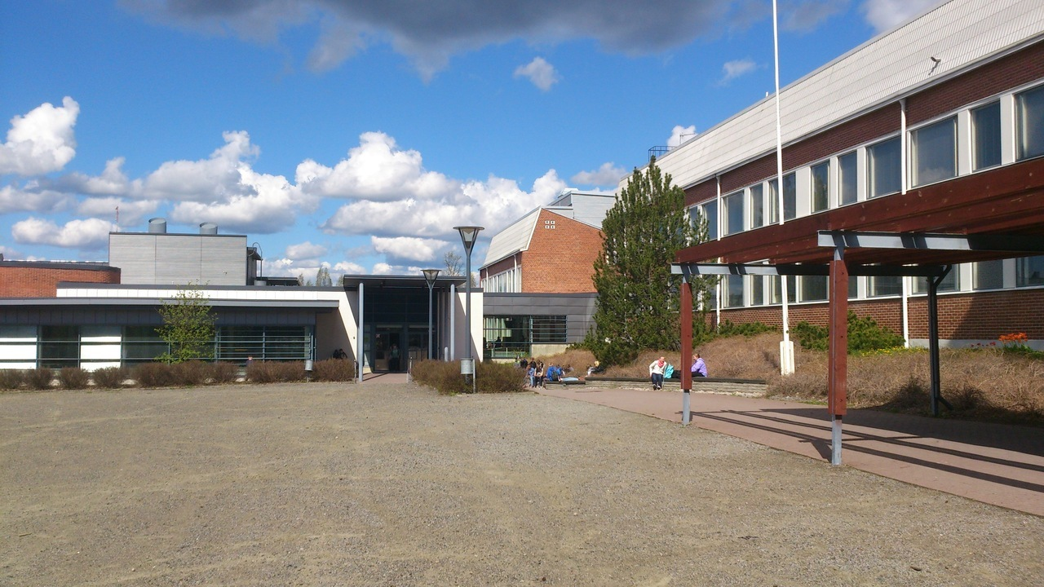
Our school, Petäjäveden yläkoulu
Our school has 160 students and there is a high school with 60 students in the same building.
Our school is quite small.
We have really good food here. Some of the best school foods in Finland.
There is always three classes of the same grade: A, B & C.

Slide 20
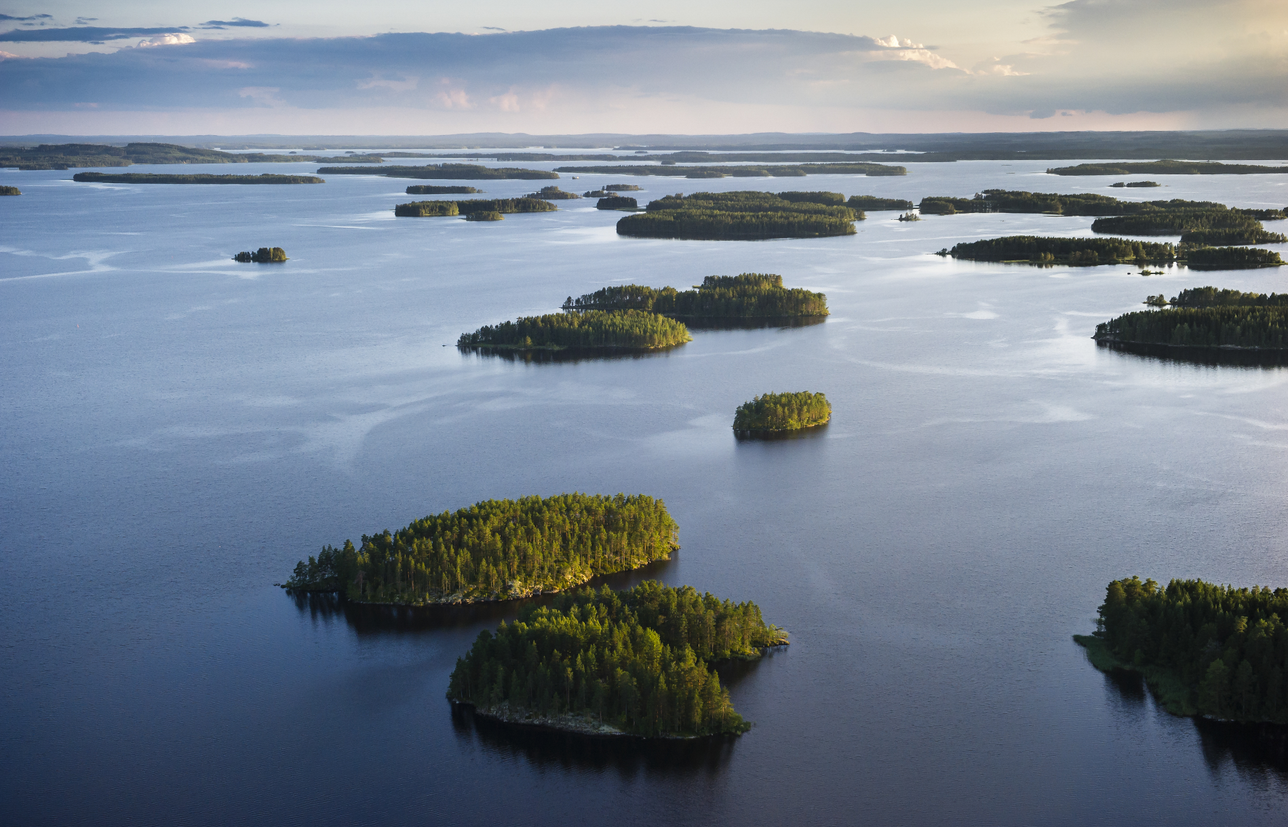
Sustainable choices
https://visitjyvaskyla.fi/kestavamatkailu/

Slide 21
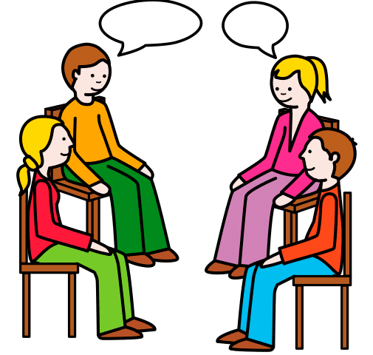
Finnish
Finnish compared to other languages - by Gurra - YouTube

