Slide 1
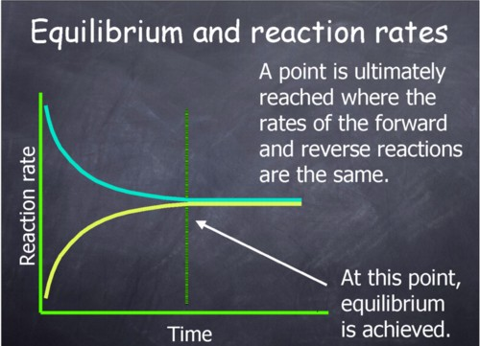
EQUILIBRIUM
Often times, chemistry theory refers to a closed system
  Where neither matter nor energy can enter or leave
  If it would be open, some products from the reaction could escape and equilibrium would not be reached
What then is equilibrium?
Most chemical reactions do not go to completion, but rather once some products are formed, the reverse reaction can take place (reactants reformed)
In a closed system the concentrations of reactants and products will eventually become constant: a state of dynamic equilibrium
Both reactions (forward and reverse) continue
The forward is equal to the reverse (concerning rates)

Slide 2
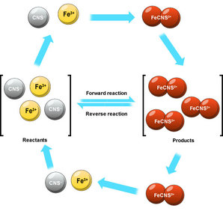
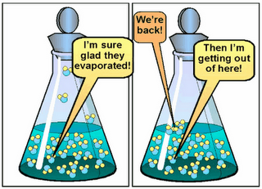
EQUILIBRIUM
Dynamic equilibrium also occurs in physical changes
Simply speaking, consider a closed flask with water in it
Faster moving molecules in the liquid will move from the surface to become vapor; slower moving molecules in the vapor will condense back into a liquid
An equilibrium is reached when the rate of vaporization equals that of condensation
The rate of change from liquid water to water vapor is equal
Chubby revision (2016)

Slide 3
EQUILIBRIUM CONSTANT
Consider the reaction:
  wA + xB ⬅➔ yC + zD
Equilibrium law states that at a given (specific for a reaction) temperature:
  K_{c}= [C]^{y}_{eqm} x [D]^{z}_{eqm} / [A]^{w}_{eqm} x [B]^{x}_{eqm}
  ”eqm” is the concentrations of A, B, C, and D
  K_{c} is known as the equilibrium constant
Consider the formation of sulfur trioxide in the Contact process:
  2SO₂(g) + O₂(g) ⬅➔ 2SO₃(g)
K_{c} = [SO₃]²_{eqm} / [SO₂]²_{eqm} x [O₂]_{eqm}
In examples such as this, reactants and products are in the same phase (homogeneous reaction…what might an example of a heterogenous reaction be?)
The magnitude of the equilibrium constant is related to the position of the equilibrium Nearly to completion K_{c} >>1
Barely proceeds K_{c} << 1
If it lies between 10⁻² and 10², both products and reactants are present in noticeable amounts
Chubby revision (2016)

Slide 4
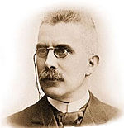
LE CHATELIER’S PRINCIPLE
K_{c} will remain constant if the temperature does
If the concentration of the reactants increases, more of the reactants must react in order to keep K_{c} constant
More products are produced, the position of equilibrium shifts to the right
”If a change is made to the conditions of a chemical equilibrium, then the position of equilibrium will shift so as to minimize the change made”.
Learn the effect of changes in conditions on the position of an equilibrium
Henry Louis Le Châtelier,
a man with a principle
(Wikipedia 2016)

Slide 5
LE CHATELIER’S PRINCIPLE: Concentration
A + B ←→ C + D
If more compound A is added to the system, the system will try to get rid of it, so the forward reaction would be favored (and eventually even)
C₂H₅OH(l) + CH₃COOH ←→ CH₃COOC₂H₅(l) ₊ H₂O (l)
Adding more ethanoic acid to the system increases its concentration
K_{c} ≠ (ester) x (water)/ (acid) x (alcohol)
The equilibrium must move to the right to restore the system

Slide 6
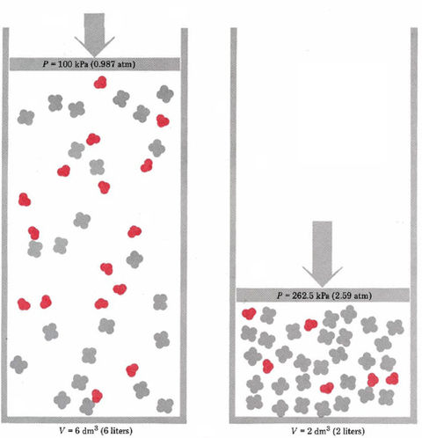
LE CHATELIER’S PRINCIPLE: Pressure
2NO₂(g, brown) ←→ N₂O₄(g, colorless)
If pressure is increased the mixture will go dark (conc of NO₂ increases) but then become lighter (equilibrium becomes more established)
Chemical Education Digital Library(2016)

Slide 7
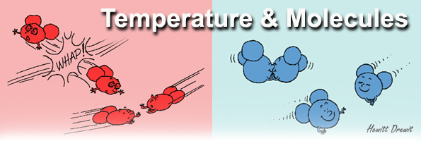
LE CHATELIER’S PRINCIPLE: Temperature
Changing temperature changes the K_{c} values…the rate of one reaction is affected more so than that of the other
Increasing the temperature of a system shifts the equilibrium in the direction of the endothermic change
More heat is absorbed
Reducing the temperature has the converse effect
When raising temp., forward and reverse reaction rates will both increase, but increasing the temperature will shift the equilibrium towards the endothermic direction

Slide 8
HABER PROCESS IN INDUSTRY
Manufacturing of fertilizers and production of nitric acid
N₂(g) + 3H₂ ←→ 2NH₃(g)
The volume of the reactants is greater than that of the product, so high pressure is required for this reaction
Lower temperatures can be used, but what effect does this have on the rates of reactions?
A temperature that is a compromise between yield and rate is needed: optimum temperature
For this reaction about 450°C
The rate at which the equilibrium is reached can be increased using an iron catalyst
Small pieces of iron are used (why?)
Still a low yield (15%)

Slide 9
CONTACT PROCESS IN INDUSTRY
Manufacturing of sulfuric acid
150 million tonnes produced world wide annually (most industrially produced chemical)
Fertilizers, paints, detergents, fibers
2SO₂(g) + O₂(g) ←→ 2 SO₃(g)
High pressure favors the production of sulfur trioxide
Similar temp to Haber process (450°C)
Again a catalyst is used
Extremely high yield (99%) at 2 atm of pressure, so anything higher is unecessary

