Slide 1

E.Y.ZH.N. National Action for Health in Primary & Secondary Education
Giannis Arnaoutis PhD
Teaching Associate, Harokopio University of Athens

Slide 2
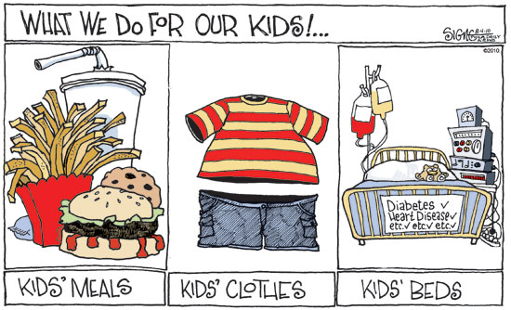
The problem…
What is the major public health problem affecting school-age children?
CHILDHOOD OBESITY

Slide 3
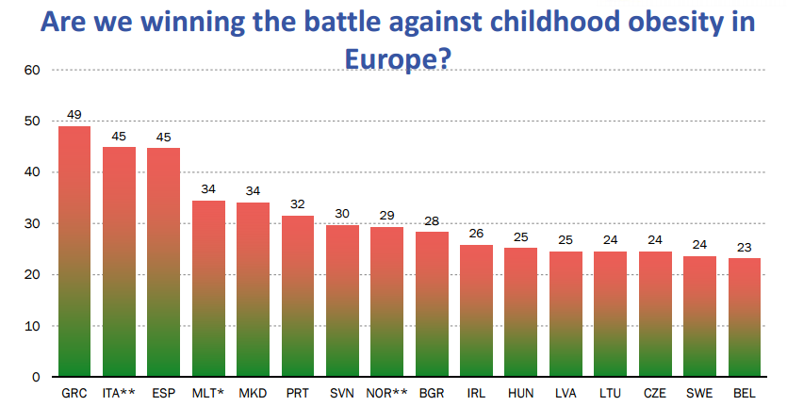
Prevalence of overweight among boys aged 7 years – 2010
(source: WHO-Europe)

Slide 4
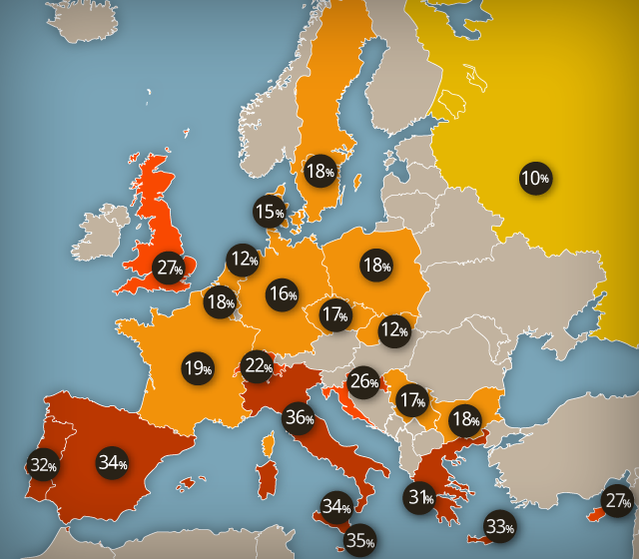
Prevalence (%) of overweight among children aged 7-11 years across Europe (IOTF)

Slide 5
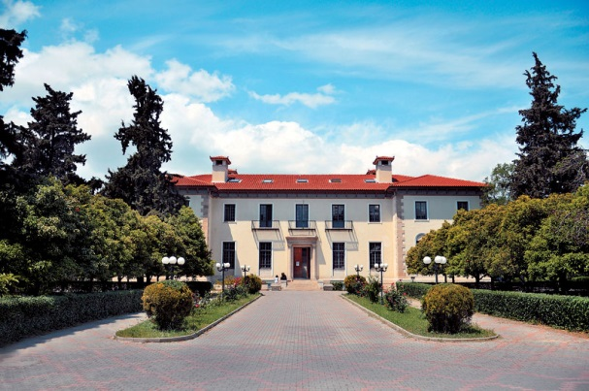
What is the EYZHN program?
A national, school-based program, coordinated by the Harokopio University (Dpt of Nutrition and Dietetics)
Implemented in cooperation with the Ministry of Education, Research and Religious Affairs from 2012
Aims at promoting a healthy lifestyle of the pediatric school population of Greece & ultimately establishing good health

Slide 6
Specific Goals
Offering access to all students and parents to valuable services related to their health -even in cases where access is not feasible due to geographic, economic or other barriers-
Preventing and dealing with risk factors for the health of children
Τraining the educational community on issues related to promoting the health of students
Creating a link between school, family and society, through collaboration between parents and teachers, including the parallel actions implemented for the community
Resulting to design and provide targeted health policies.

Slide 7






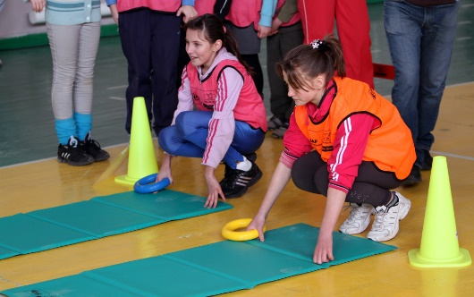
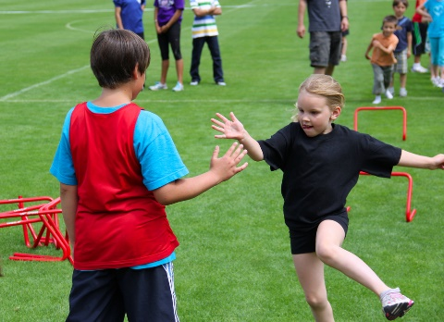
Assessment
Growth rate
Physical activity
Quality of diet
Physical fitness

Slide 8


1st stage: Measurements-Questionnaires
Educational Level | Anthropometry | Fitness assessment | Nutrition & Physical activity Questionnaire
Kindergarten
Elementary school –Year 1 |  | *
Elementary school –Year 2
Elementary school –Years 3-6
Middle School
High school
* Except 20m shuttle run test.

Slide 9
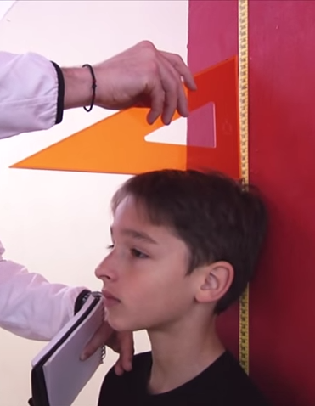
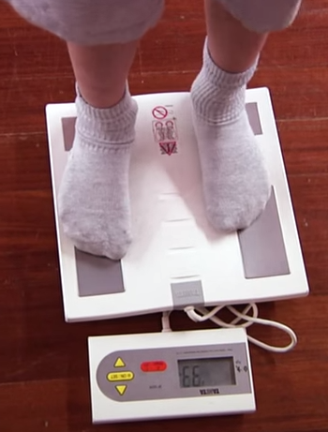
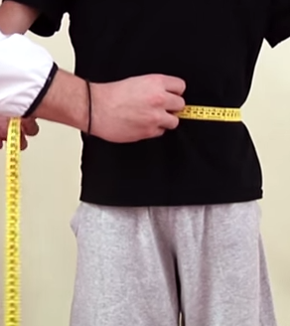
Anthropometry
Height
Weight
Waist circumference

Slide 10


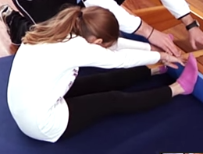
Fitness assessment
Standing Long Jump Test
(Broad Jump)
Sit-Ups in 30 seconds ’’
Sit and Reach Flexibility Test

Slide 11
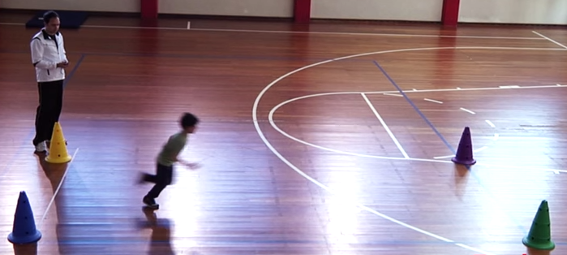
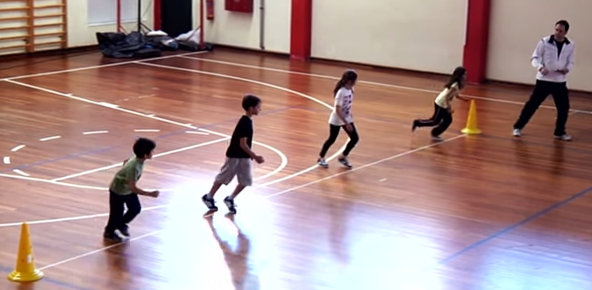
Fitness assessment
10 x 5m Shuttle Test
20m Multistage Fitness Test

Slide 12
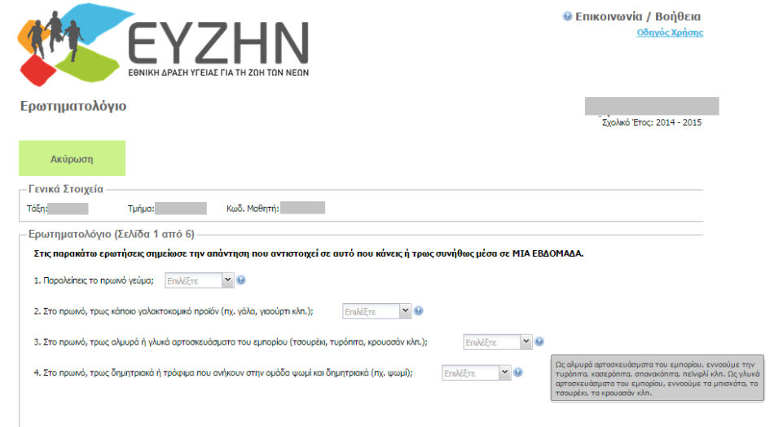

Nutrition & Physical activity Questionnaire

Slide 13
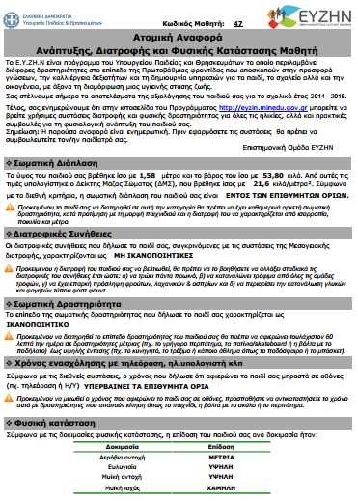

2nd και 3rd Stages:
Data entry / Algorithm
και electronical production of Student’s Individual Report

Slide 14

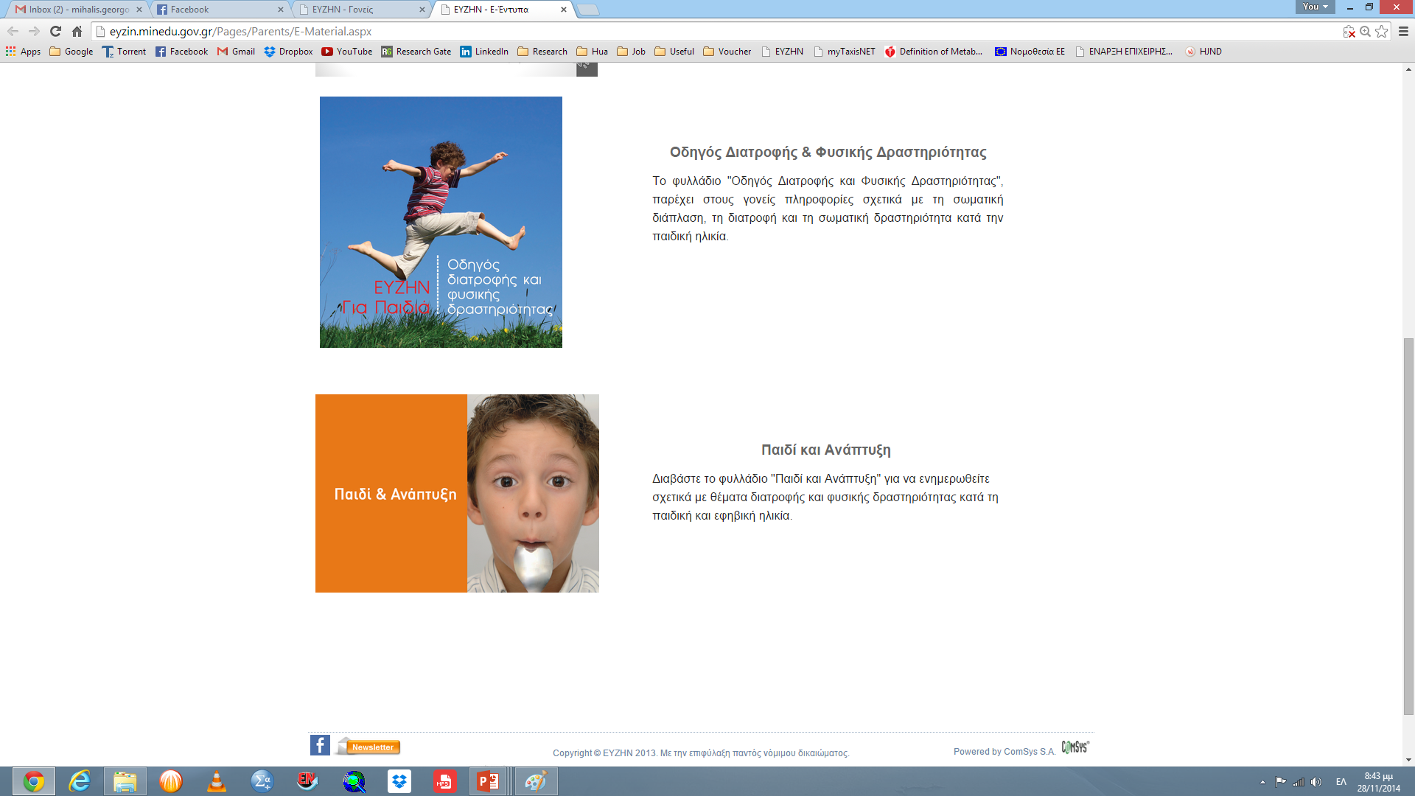



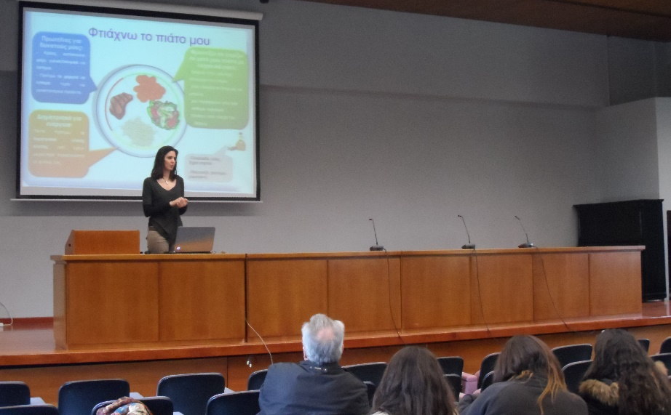
ACTIONS OF EYZHN
National media
Newsletter
e -leaflets
e -learning (parents & teachers)
Interactive presentations
Teachers
Parents
Students

Slide 15

EYZHN 2012-2016 - statistics

Slide 16



Assessment overall
2012-2016
>1.100.000 students
5-18 years
~ 5.000 schools
all over Greece

Slide 17


Results
3-4 out of 10 students overweight/obese
2007 – 2016:
childhood obesity in Greece
↑ % obesity boys Vs
girls
Greek islands:
% obese
% physical activity
↑ % obesity
↓ socio-economic status

Slide 18
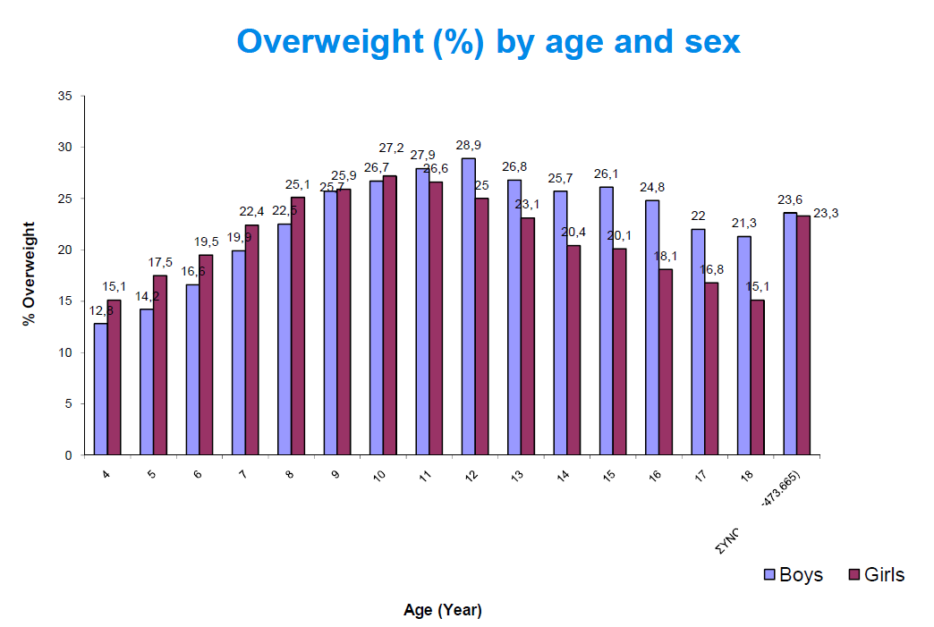

Slide 19
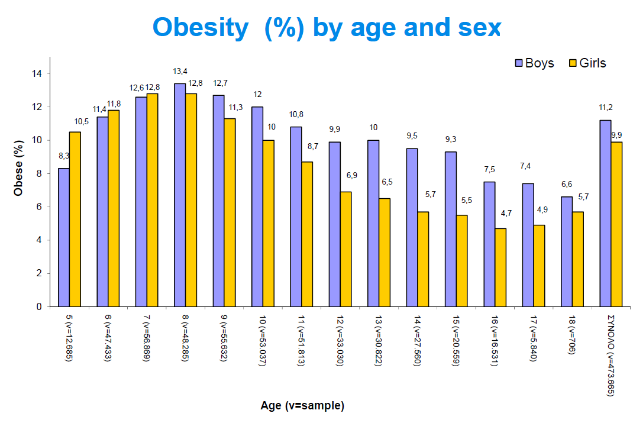

Slide 20

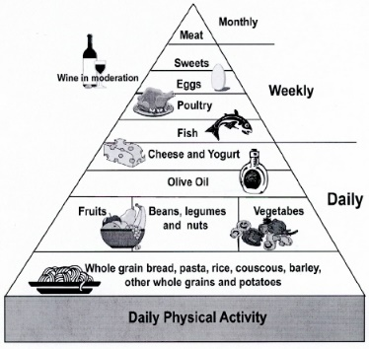
Results
~50% of the children: do not follow Mediterranean Diet
Western type diet
(sweets, sodas, junk food etc)
25% boys & 30% girls do not exercise outside school
45% students > 2h/day for sedentary activities
45% students
< 1h/ daily physical activity

Slide 21



GREECE, 2012-2016 8-18 yrs
ADHERENCE TO MD
Total
Notes:
In Greece, unfortunately more less only 4 out of ten children follow med diet, and 10 percent of children population are far away from this dietary pattern.

Slide 22
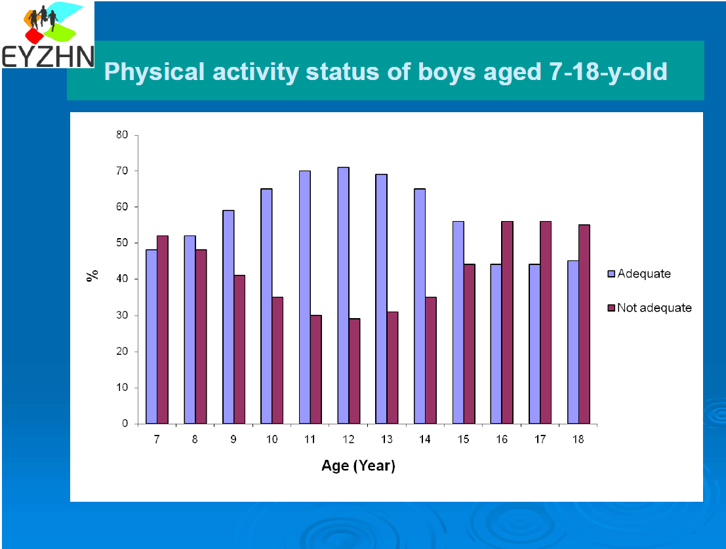

Slide 23
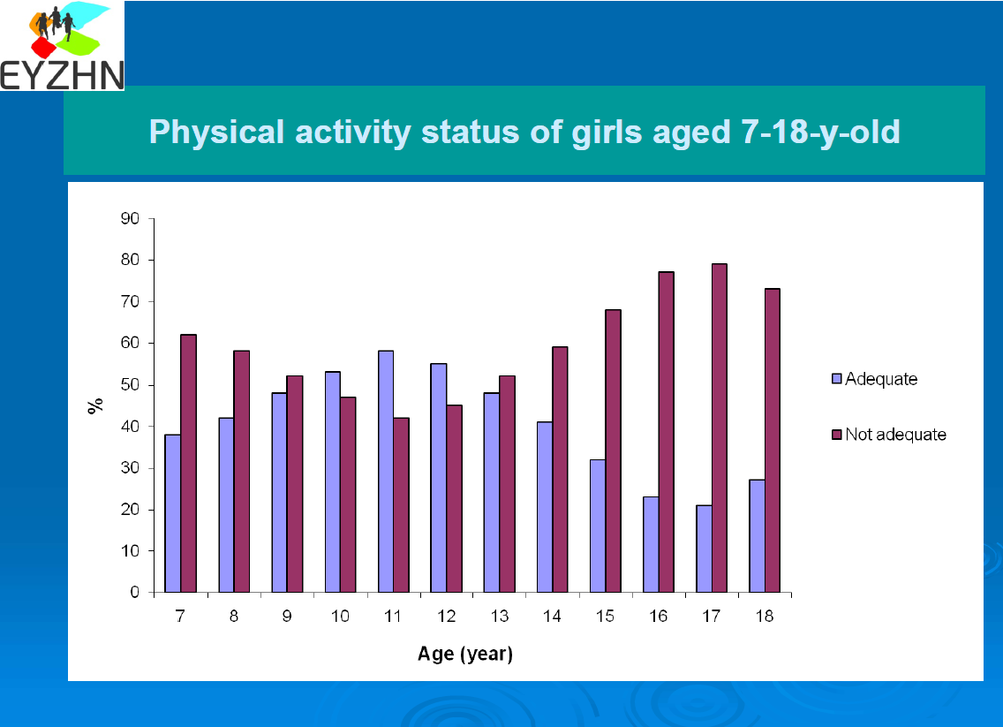

Slide 24


8 key areas for action..
Support a healthy start in life
Promote healthier environments, especially in schools and pre-schools
Make the healthy option the easier option
Inform and empower families
Encourage physical activity
Monitor and evaluate
Increase research
Restrict marketing and advertising to children
1
2
3
4
5
6
7
8

Slide 25
Inform and empower families
Parents are responsible for shaping their children's first food choices and play an influential role in the formation of eating and activity habits
The impact of parents (as role models, by setting rules and boundaries and by means of specific parenting behaviors) appears to be crucial.
Tools that can help parents to recognize when their child may be becoming overweight or obese and that can guide their response can be proven useful.
Nutritional information needs to become more useful and easy to understand for everyone

Slide 26




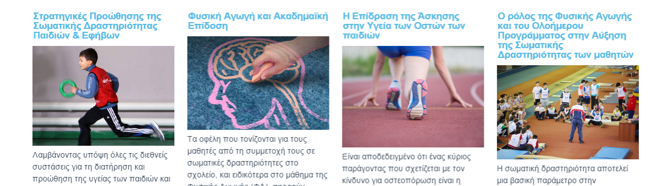
Website : eyzin.minedu.gov.gr
Parents
Children & Teens
Teachers
Scientific community

Slide 27

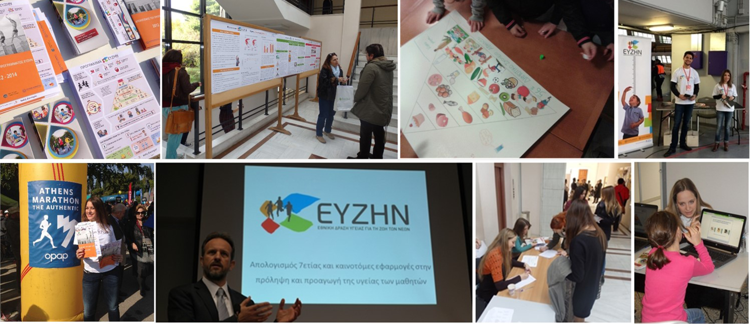
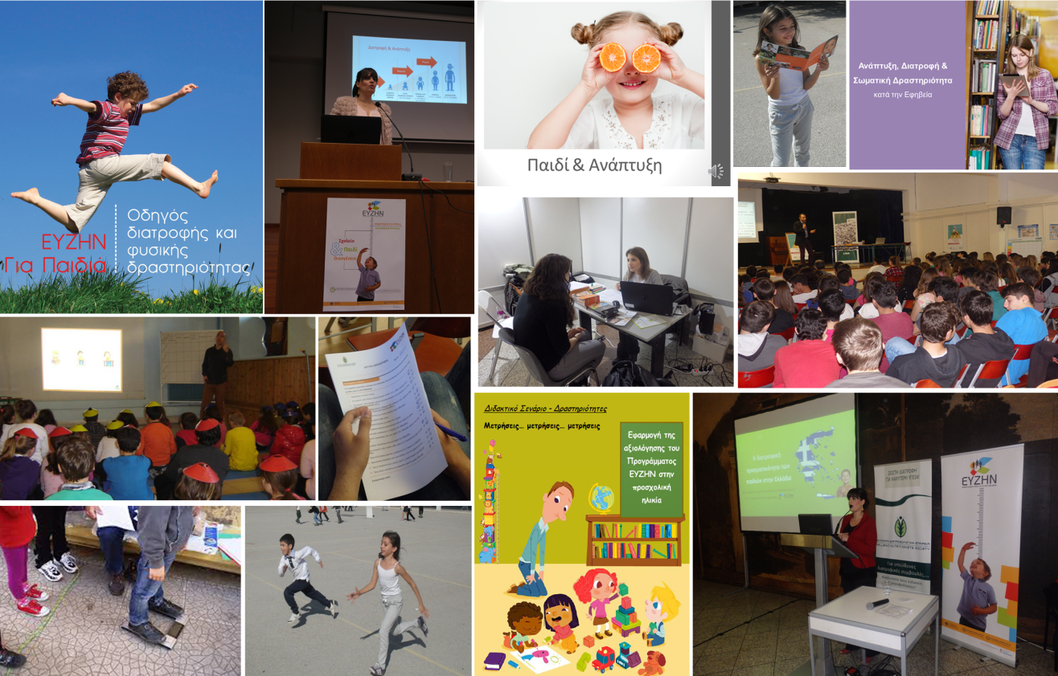
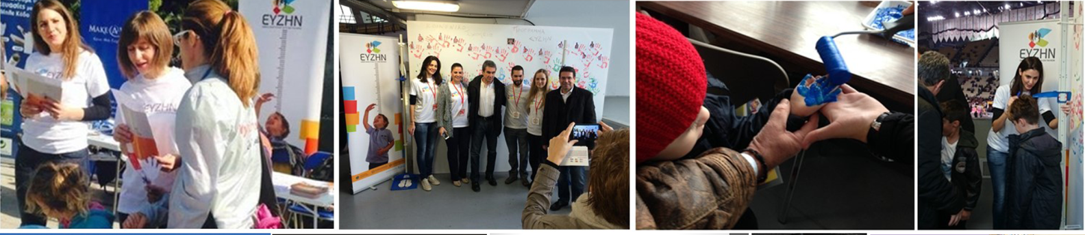
Thank You!

Slide 28

In Summary, Mediterranean Diet
To enjoy these health advantages, follow these dietary guidelines
Eat More:
Fruits
Vegetables
Nuts
Legumes
Whole grains
Fish in place of red meat
Olive oil
Eat less:
Red/processed meats
Sugar and baked goods
Sweets and soft drinks
Helps prevent:
Heart attacks
Strokes
Sudden cardiac death
Cancer
Weight gain
Alzheimer , Parkinson d.
Total mortality
Childhood asthma
Also increases:
Quality of life
Children school performance

