Slide 1

Why did the Central Powers lose the war?
1) Once the Schlieffen Plan had failed, removing all hope of a quick German victory, it was bound to be a strain for them, facing the war on two fronts
2) Allied sea power was decisive, enforcing the deadly blockade whch caused desperate food shortages and crippled exports, while keeping allied armies fully supplied
3) The German submarine campaign failed in the face of convoys protected by British, American and Japanese destroyers; the campaign itself was a mistake because it brought the USA into the war

Slide 2
Why did the Central Powers lose the war?
4) Entry of the USA brought vast new resources to the Allies
5) Allied political leaders at the critical time (Lloyd George and Clemenceau) were propably more competent than those of the Central Powers
6) The continuous strain of heavy losses told on the Germans - they lost their best troops in the 1918 offensive and the new troops were young and inexperienced. An epidemic of deadly Spanish flu made the situation more difficult, and the morale was low as they retreated

Slide 3
Why did the Central Powers lose the war?
7) Germany was badly let down by her allies and was constantly having to help the Austrians and Bulgarians. The defeat of Bulgaria by the British was the final straw for many German soldiers, who could see no chance of victory. Austria was defeated by Italy and Turkey surrendered in October 1918.
The combination of military defeat and dire food shortages produced a great war weariness, leading to mutiny in the navy, destruction of morale in the army and revolution at home
The German armistice was signed on 11 November 1918

Slide 4
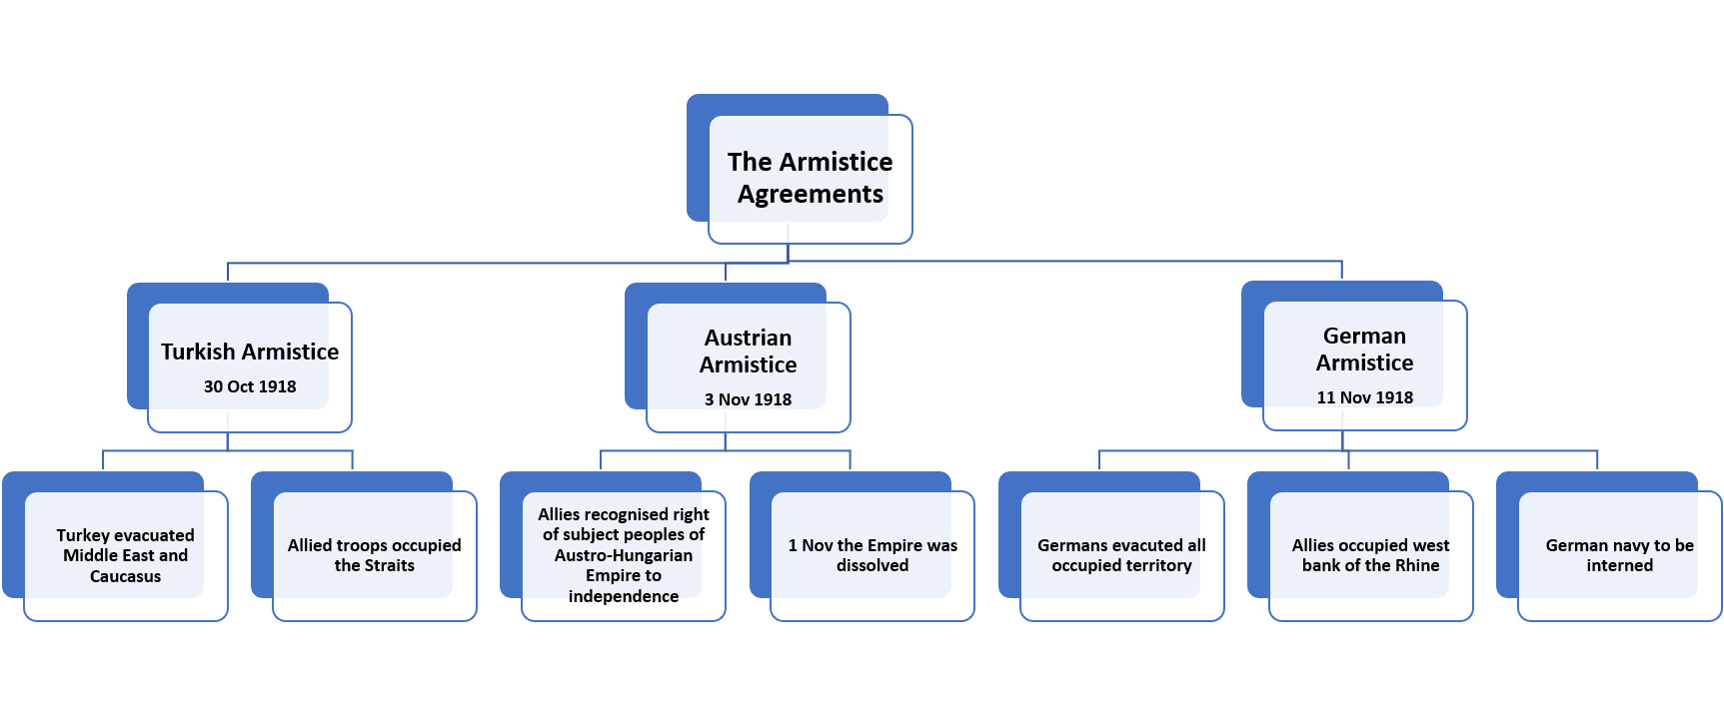
The armistices

