Slide 1

E-Rasmus Warsaw Team Finland

Slide 2
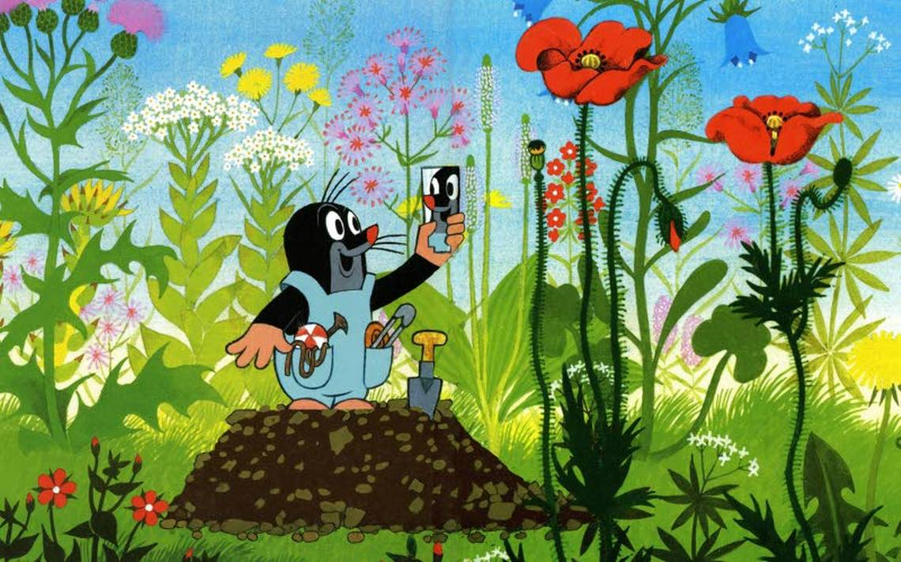
Animals That Hibernate
Hibernation means that the body temperature lowers and vital functions slow down. Small animals hibernate during the winter.

Slide 3
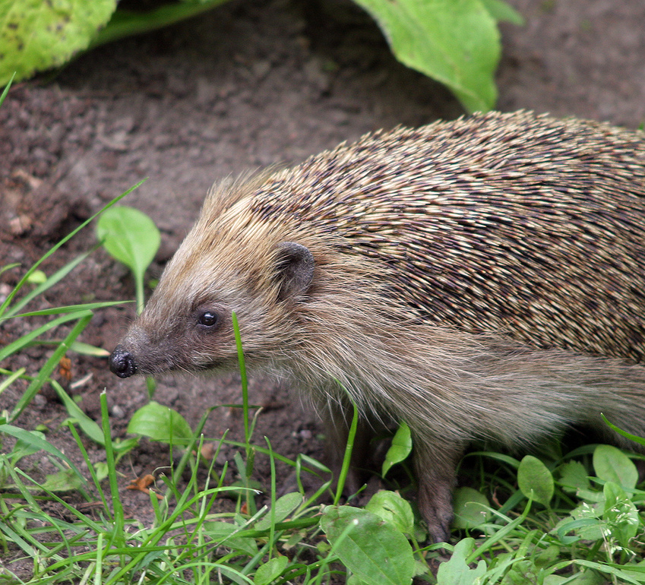
Hedgehog
Hedgehogs hibernate during winter.
Full grown hedgehog can be 20 to 30 cm long and weight 0,4 to 1,2 kg.
Hedgehogs eat almost everything from small insects to small vertabrate animals. They also eat plants and mushrooms.

Slide 4
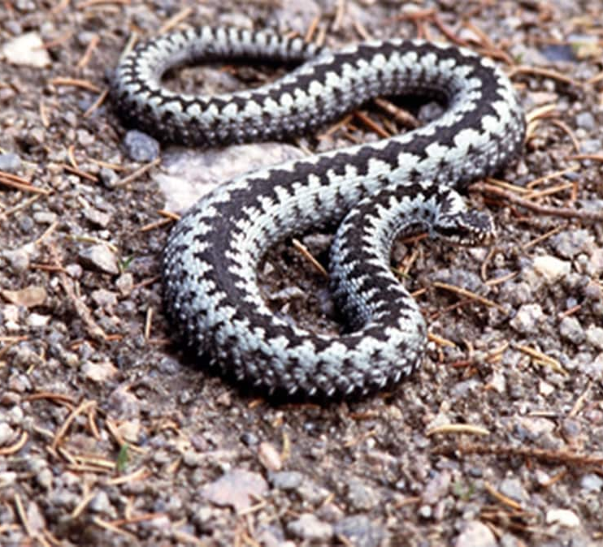
Viper
Viper is the only venomous snake that lives in the northest parts of the world.
Viper snake can be as long as 80 cm.
Viper eats small animals and eggs.

Slide 5
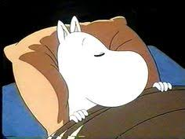
Mammals That Winter Sleeps
Winter sleep is a way to survive trough winter without any food for some mammals. Only mammals winter sleep.

Slide 6
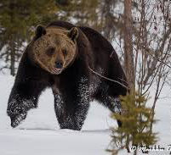
Brown Bear
Bears sleep half of the year. They even give birth to their cubs as winter sleeping.
Bears eat almost everything and hunt other animals like mooses. Especially they like berries such as blueberrys.
Bears can be 135 to 250 cm long and weight 60 to 300 kilos.
Sometimes bears may wake up during their winter sleep and then they are very angry and dangerous.

Slide 7
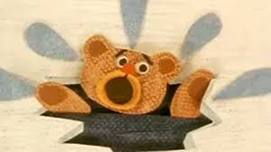
Other Well Known Animals In Finland

Slide 8
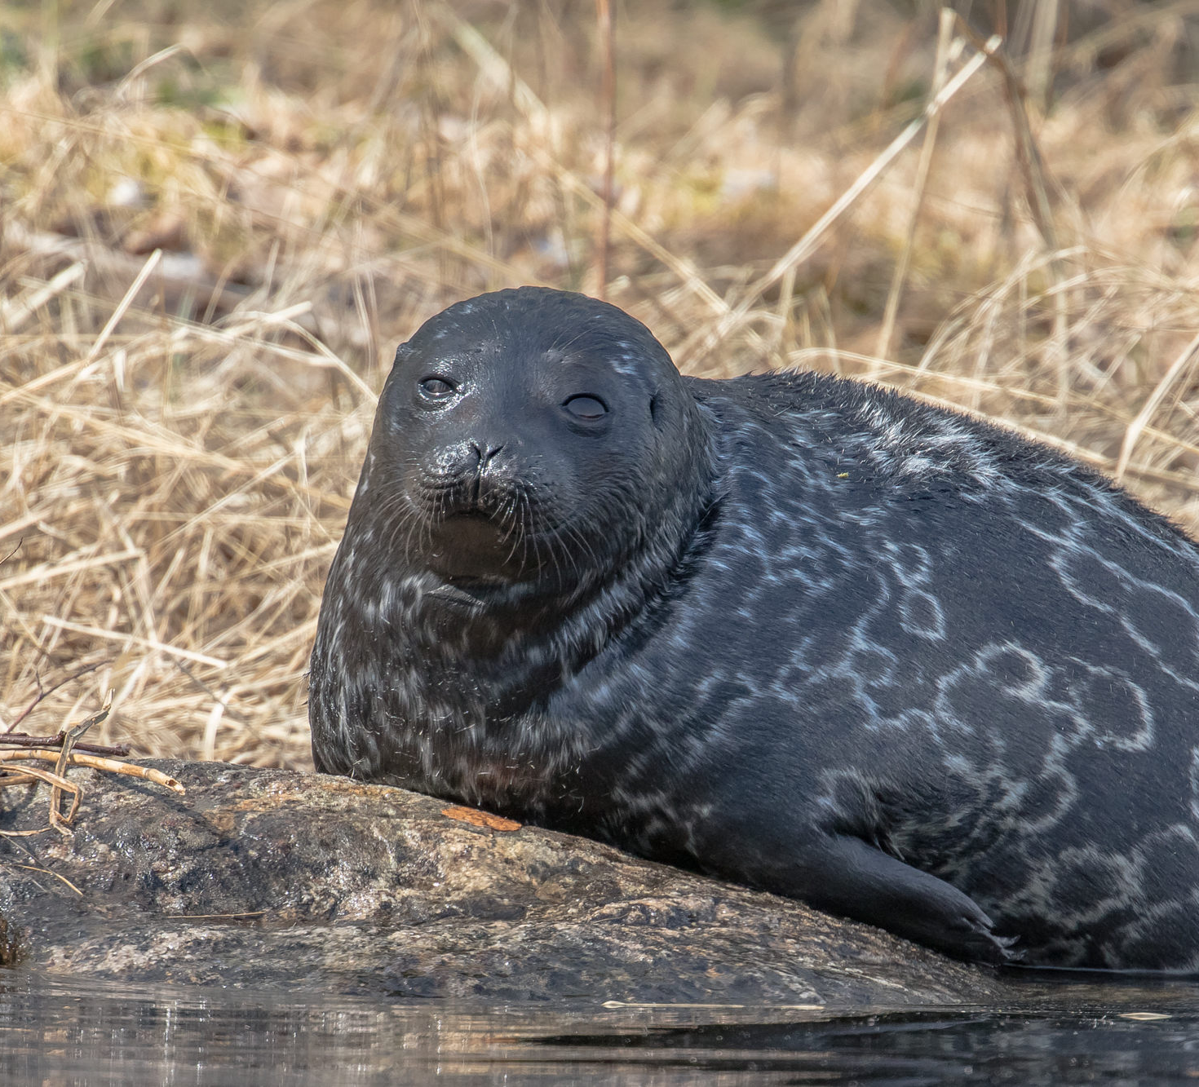
Saimaa ringed seal
Saimaa ringed seal is very endangered species. They only live in Saimaa and there are only 410 induviduals left.
The seals spend most of their time under the ice and can be under water up to 15 minutes. The seals have breathing holes they use to stay in the water longer.

Slide 9
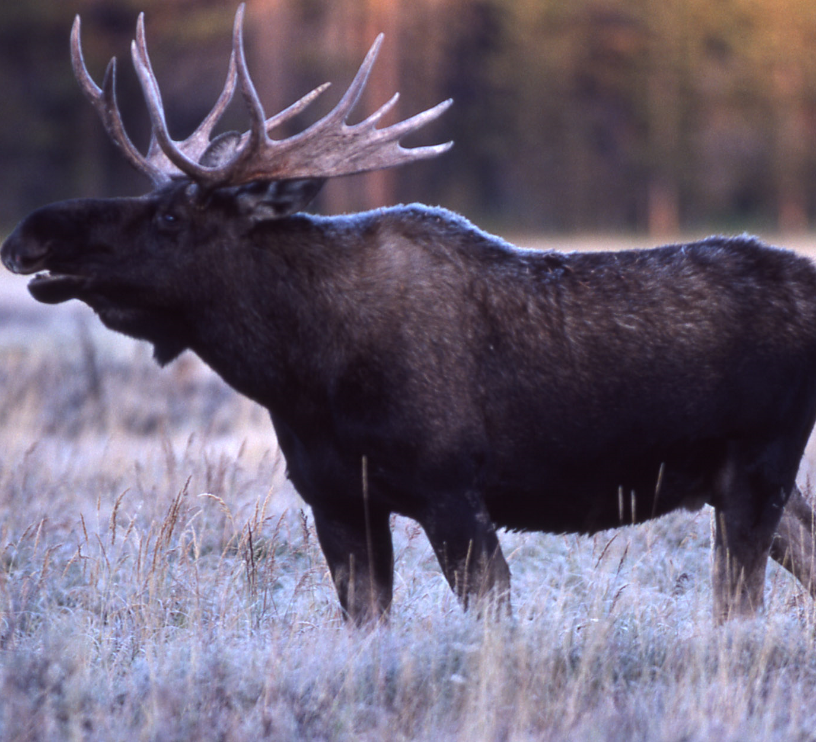
Moose
Moose stays awake all year around.
Stags have horns made of bone. They use horns to protect themselves from any threats.
Does don't have horns.
Mooses eat tree samplings and different hays.
An adult moose can weight even 700 kilograms.

Slide 10
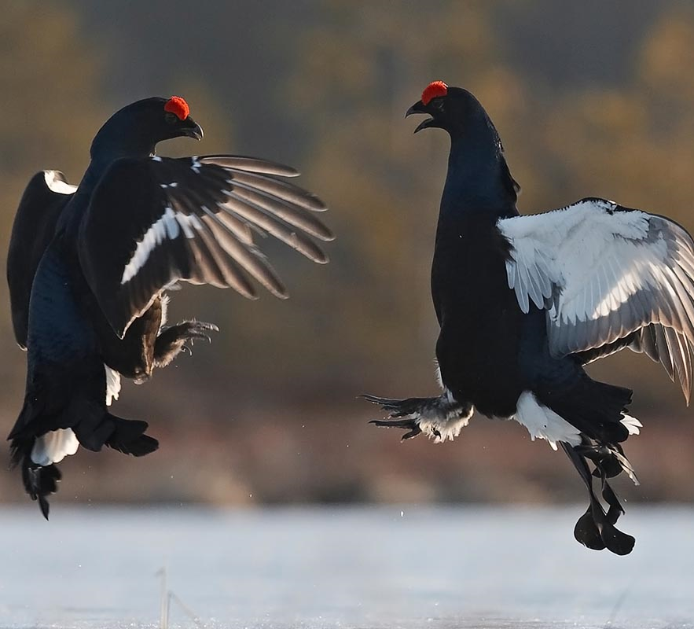
Grouse
In winter time grouses eat plants and in the evening they dig them selves a hole in the snow. The hole keeps the bird save from predators and keeps them warm.

Slide 11
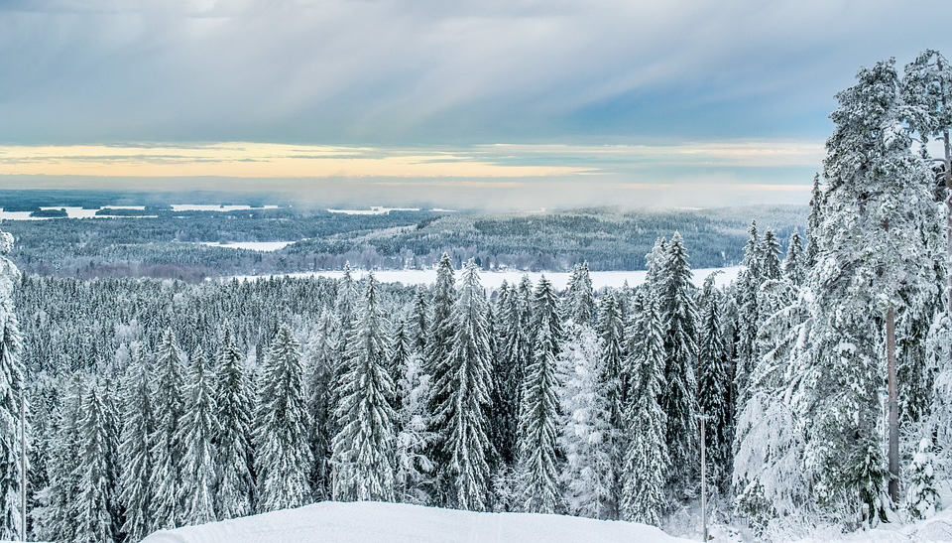
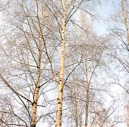
How Plants Survive The Winter
In the fall leaf trees and bushes drop their leaves because it stores the energy from the leaves to the trunk.
In Finland there is a lot of spruce-and pine trees because they stay green all year around. They stay green because the needles need less light and nutrients.

Slide 12
Video clip
https://mail.google.com/mail/u/0/#inbox/QgrcJHsHkKFzdkSzxtzqLbGPKZbsxSXfQgq

