Slide 1
Ways of Learning Language

Slide 2

singing

Slide 3

repeating

Slide 4
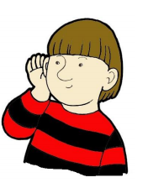
listening

Slide 5

talking

Slide 6
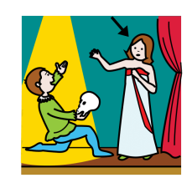
acting

Slide 7
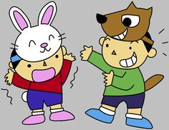
pretending

Slide 8
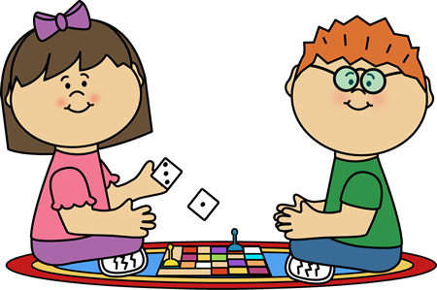
playing

Slide 9

drawing

Slide 10

With a partner

Slide 11

writing

Slide 12
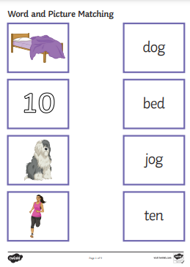
matching

Slide 13
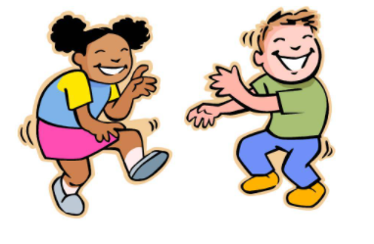
moving

