Slide 1


Plastic waste treatment in Europe, and it’s problems + increasing of recycling .

Slide 2
Plastic waste treatment in Europe
In Europe, energy recovery is the most used way to dispose of plastic waste, followed by recycling. Some 25% of all the generated plastic waste is landfilled.
The majority of waste consists of ferrous and nonferrous metal scrap as well as paper, plastic, textile and glass wastes and is mainly exported to non-EU countries like Turkey, India and Egypt.

Slide 3

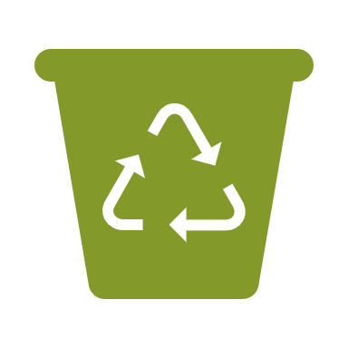

Problems with plastic recycling.
The main issues regarding plastic recycling are the quality and price of the recycled product, compared with the unrecycled counterpart.
Plastic processors require large quantities of recycled plastic, manufactured to strictly controlled specifications and at a competitive price.

Slide 4
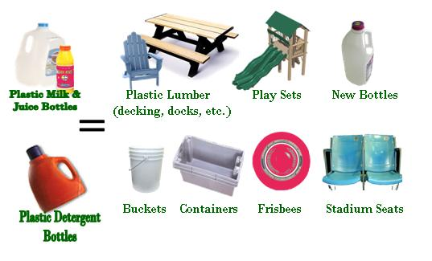
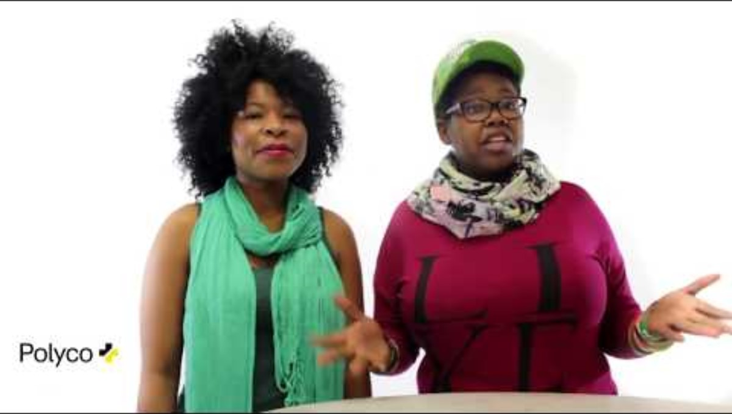
What is made from recycled plastic?
The collected plastic packaging is used as raw material for new plastic products at plastic refinery.
Recycled plastic is used to make: various consumer goods, for example dish, toilet and clothes brushes, shoe spoons, flower pots, watering cans, spray bottles.

Slide 5

How the EU will increase the amount of recycling
In June 2019, the EU adopted new rules to target the issue of plastic marine waste. It includes a 25% target for recycled content in plastic bottles by 2025 and 30% by 2030.
In November 2022, the Commission proposed new EU-wide rules on packaging, including proposals to improve packaging design.
As a part of the Green Deal, 55% of plastic packaging waste should be recycled by 2030. This would imply better design for recyclability, but MEPs (European parlament members) believe measures to stimulate the market for recycled plastic are also needed.

