Slide 1
How to improve school?

Slide 2

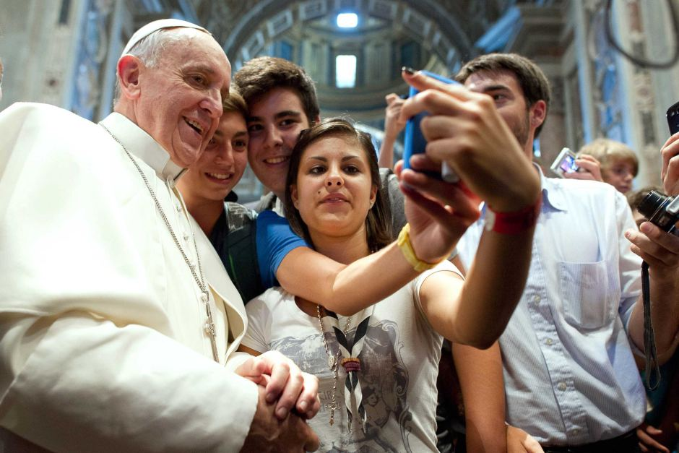
1.School trips
We can learn new languages
If you go abroad you can meet different cultures, and peoples
Have fun with each other

Slide 3
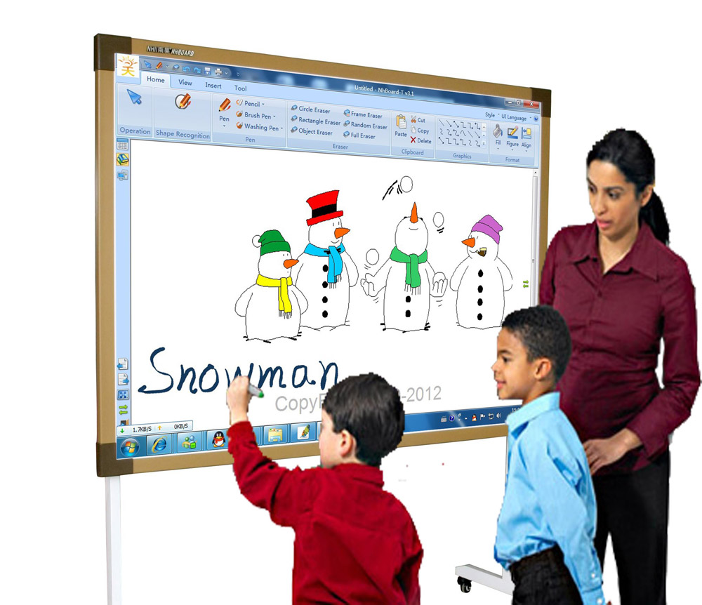
2.Modern technologies in schools
Helps to show students materials of lesson
→ imparts the courses
Lessons are more attractive for students

Slide 4

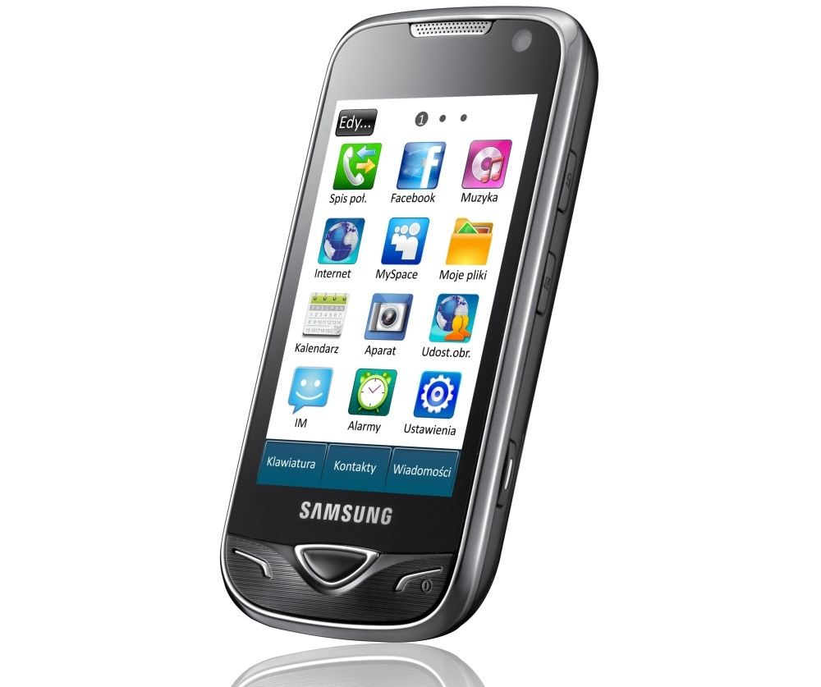
Start playing music in school breaks, which can help you to relax.
Internet connection by Wi-fi in schools, can help you find information, to search.
Mobile phones should be allowed in breaks

Slide 5

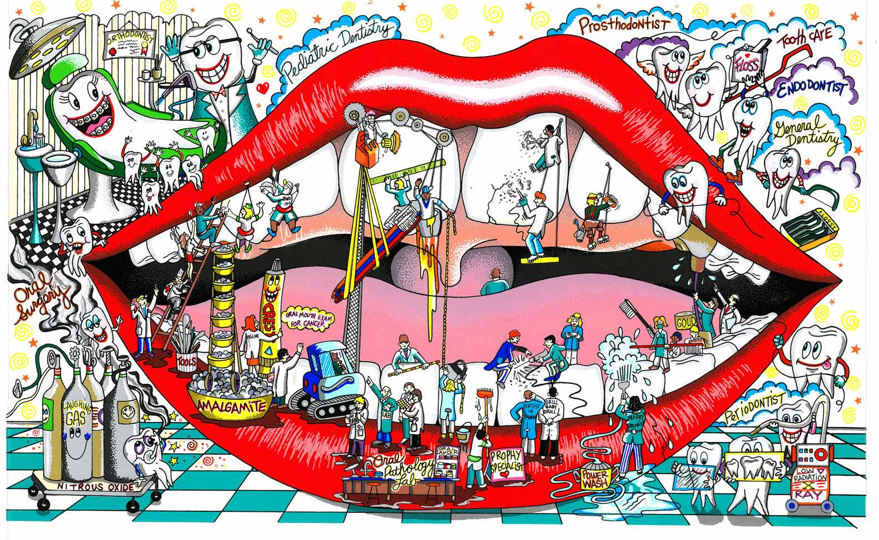
3.More art opportunities

Slide 6
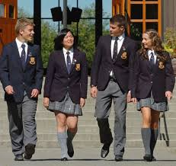
No school uniforms
When students can wear what they want, it makes them more comfortable.
Students can express themselves.

