Slide 1
THE BASICS OF TOK
TOK Jyväskylän Lyseon lukio

Slide 2
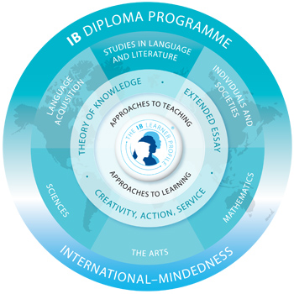
What is TOK?
One of the compulsory core elements in the IB Diploma Programme besides Extended Essay (EE) and Creativity, Activity and Service (CAS)

Slide 3

What is TOK?
TOK provides the opportunity to explore and reflect the nature of knowledge and the process of knowing
  TOK is a course about critical thinking and uniting the subjects
  in the DP

Slide 4
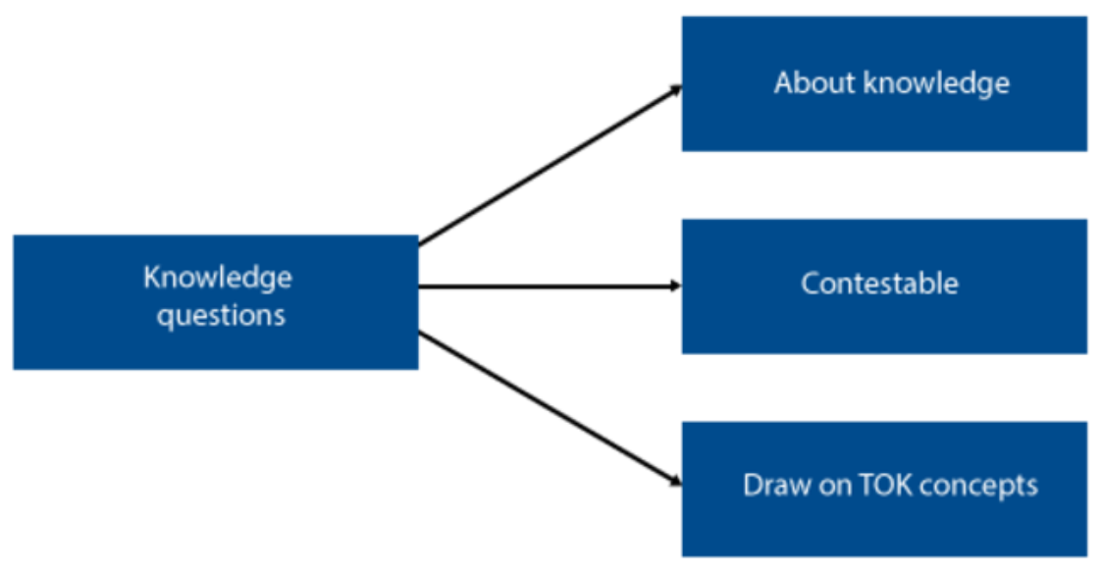
What is TOK?
The course centres on the exploration and the discussion of knowledge questions
Are some types of knowledge more useful than others?

Slide 5

What is TOK?
The knowledge framework
  Scope
  Perspectives
  Methods and tools
  Ethics
Everything in TOK should be explored
through the knowledge framework

Slide 6
TOK curriculum
Core Theme: Knowledge and the knower | Optional themes (study TWO) | Areas of knowledge
Nature of knowledge Knowledge framework Me as a knower | Knowledge and technology Knowledge and language Knowledge and politics Knowledge and religion Knowledge and indigenous societies | History Human sciences Natural sciences The arts Mathematics
Assessment: TOK Exhibition (internally assessed) TOK Essay (externally assessed)

Slide 7

TOK exhibition
Individual exhibition with three objects that connect to one knowledge question
One file maximum of 950 words for each student (ManageBac)
Approximately 8 hours of work per student
Internally assessed by the school’s TOK teachers

Slide 8

TOK essay
Individual essay on a prescribed title from a list of six titles
Maximum length of the essay is 1600 words
Planning and progress form (TK/PPF) for each student (ManageBac)
Externally assessed by the IBO

Slide 9

TOK assessment
TOK essay 0–10 marks
  Points are doubled
TOK exhibition
0–10 marks
TOK essay weights 67% and TOK exhibition 33% in the assessment

Slide 10
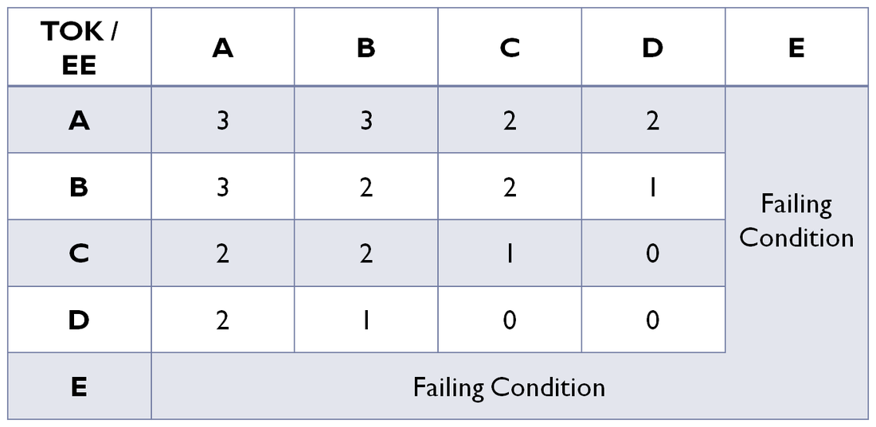
TOK assessment

Slide 11

TOK course materials
All TOK course materials are available in peda.net
In addition to peda.net, Teams and ManegeBac are used

Slide 12

Got a burning question?

Slide 13
Picture sources
IB DP <http://www.yis.ac.jp/page.cfm?p=763> Accessed 7th of April 2015.
TOK Course <http://www.theoryofknowledge.net/about/the-tok-course/critical-thinking-ib-diploma/> Accessed 7th of April 2015.
Knowledge questions. TOK Guide for First Assessment 2022. Published in February 2020.
Impossible framework <https://www.1001freedownloads.com/free-clipart/impossible-cubes> Accessed 26th of March 2020.
TOK exhibition <https://www.theoryofknowledge.net/tok-2022/tok-exhibition/> Accessed 26th of March 2020.
TOK essay <http://ibmeme10.blogspot.fi/2014/09/how-to-write-tok-essay.html>
Connected heads <http://www.ibsolved.com/ib-grade7-notes-and-assessments/tok-presentation-script-1010> Accessed 7th of April 2015.
Pile of books <http://megeniusforever.blogspot.gr/2013/12/jntuk-3-1-2-2-2-1-all-subjects.html> Accessed 7th of April 2015.

