Slide 1
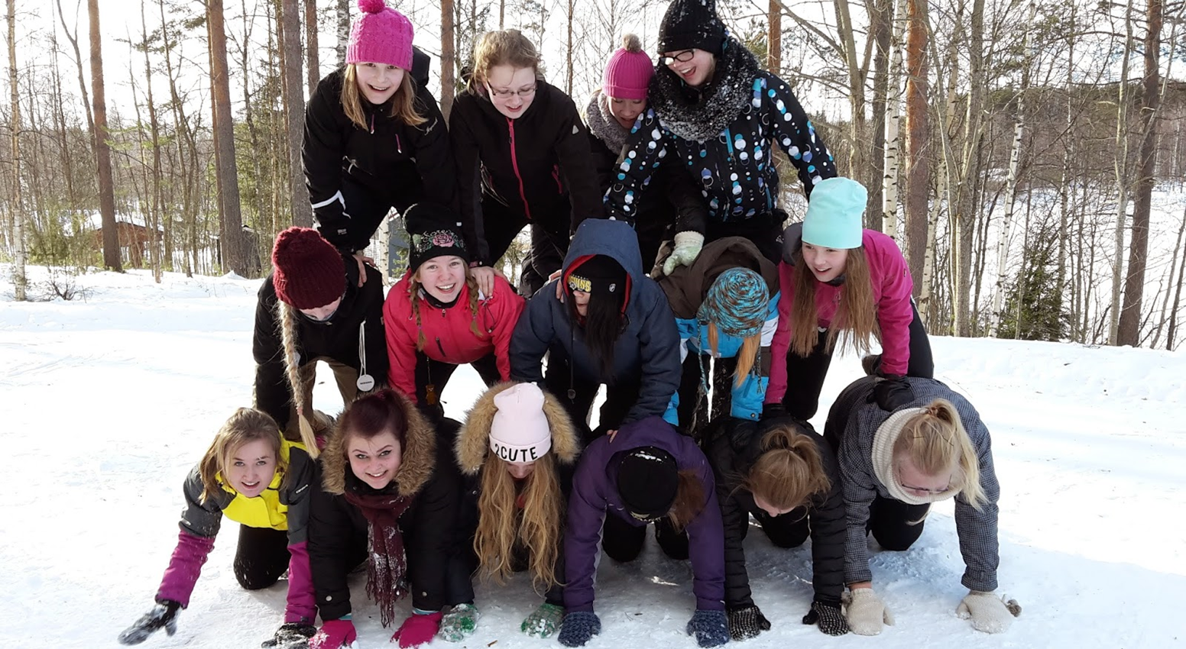
Winter sports in Anttola School
In Anttola school we have a winter sport day every year. We can choose what sports we want to do. Then we splitt into groups and have a fun day playing and spending time with our friends. Next you will see some sports that can be done in Anttola.

Slide 2
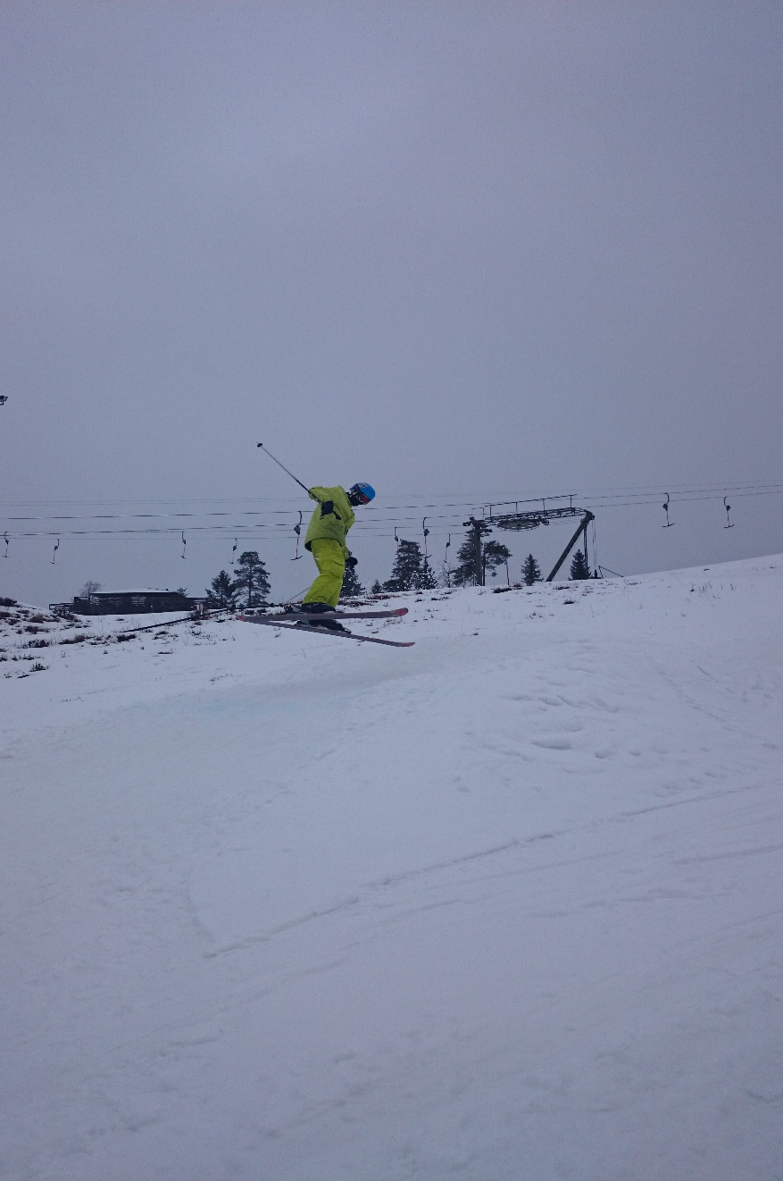
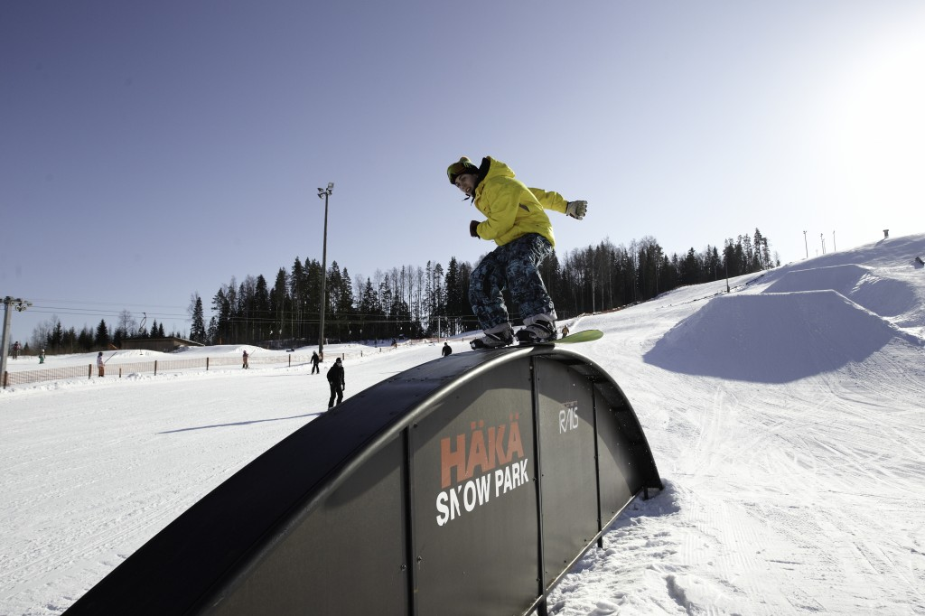
Downhill skiing

Slide 3
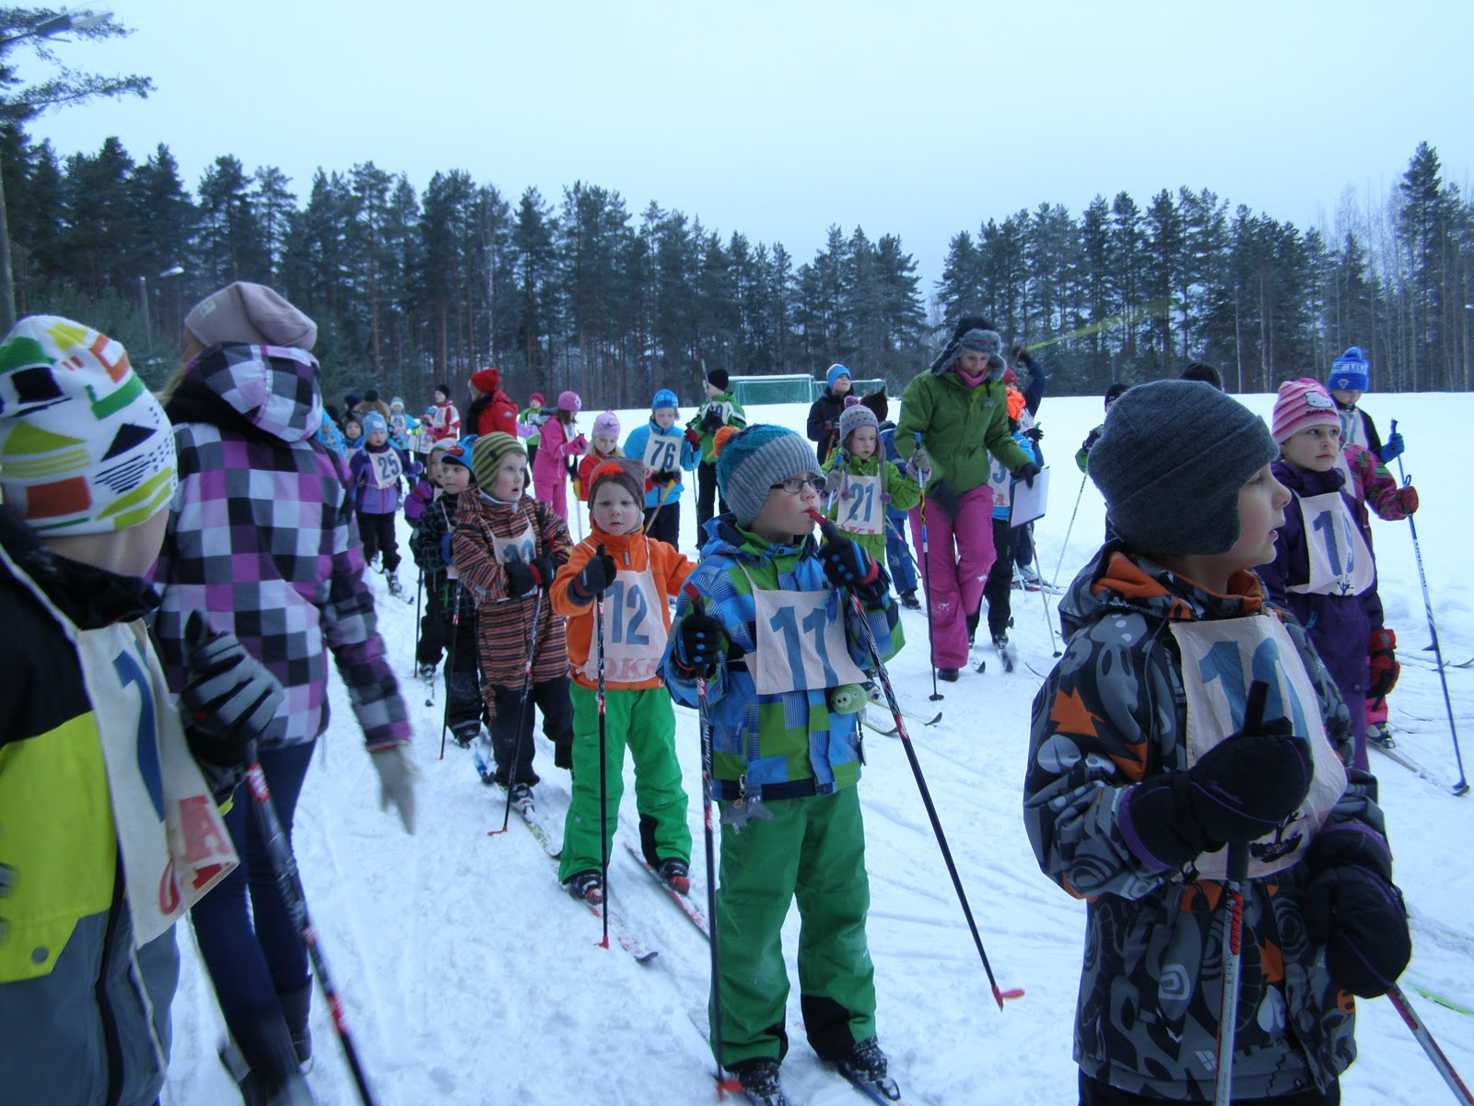
Cross-country skiing

Slide 4
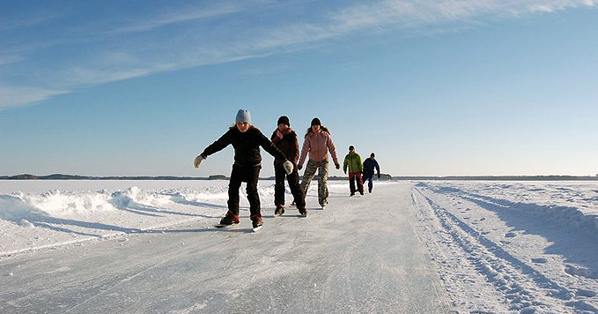
Ice Skating

Slide 5
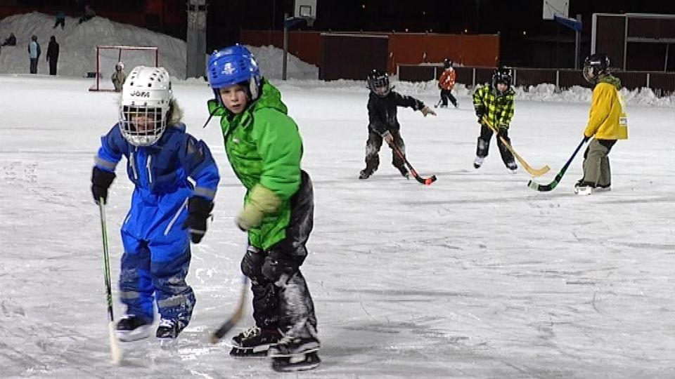
Ice hockey and Ice bandy

Slide 6
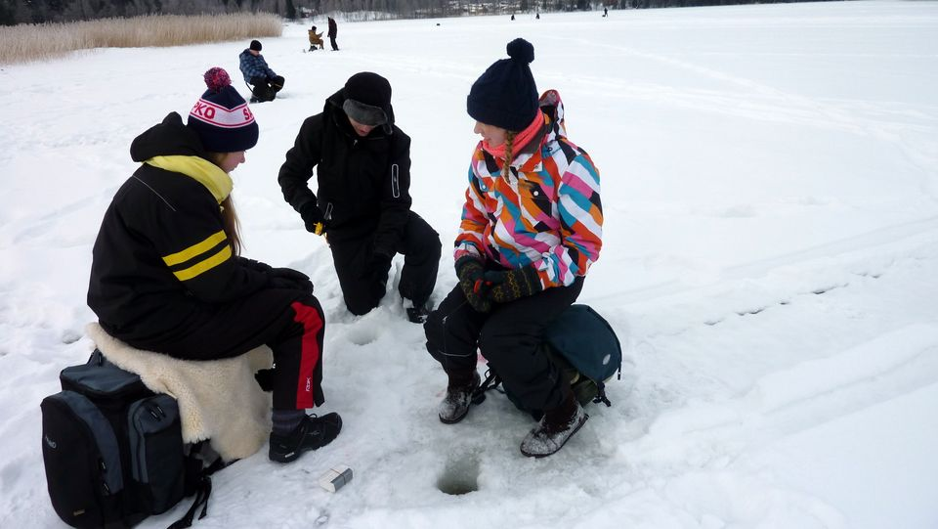
Ice Fishing

