Slide 1
Wednesday Group 2 The Hunger Games
Lesson objective:
To develop an understanding of the difference between a Utopia and a Dystopia.

Slide 2

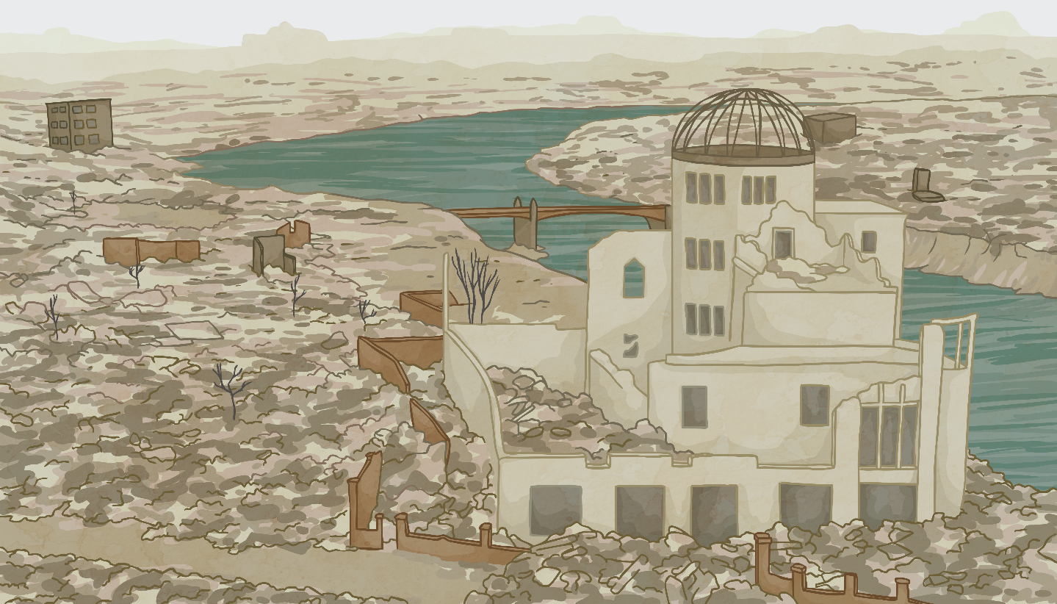
Starter Task
Look at the statements you have been given on the sheet Agree or Disagree
For each statement, decide with someone you can talk to at home whether you agree or disagree

Slide 3
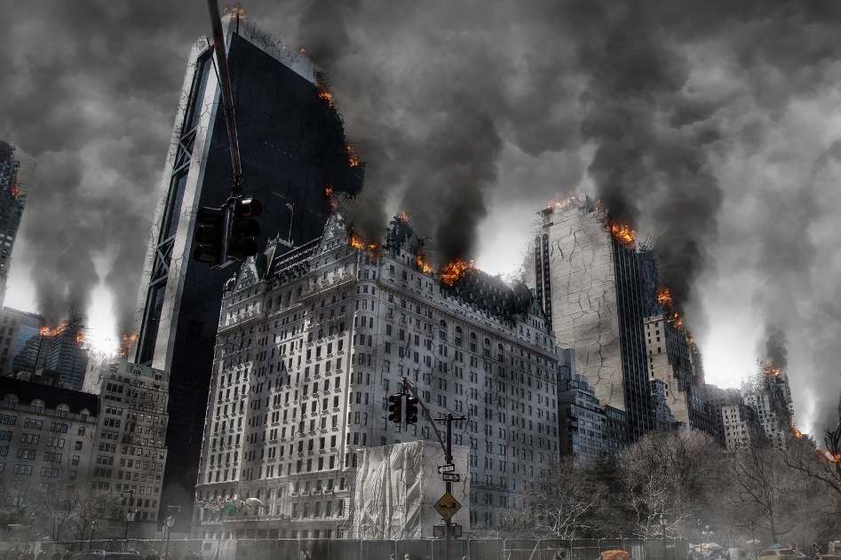
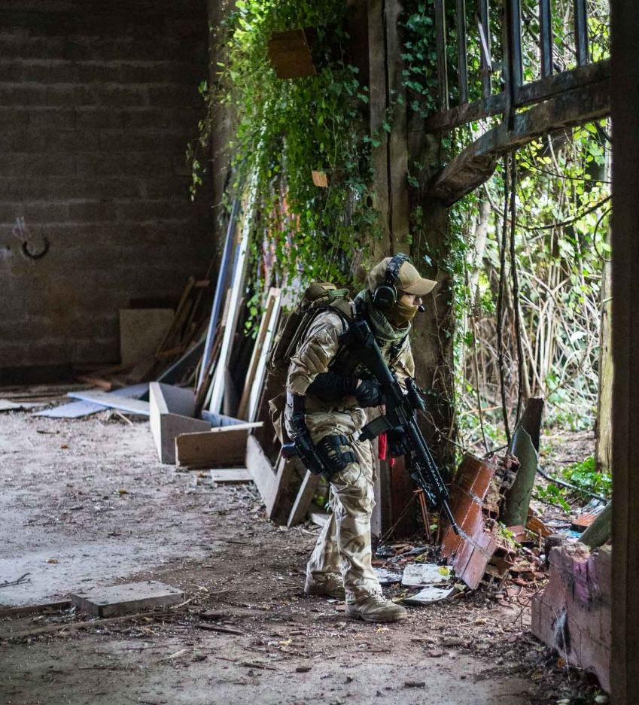
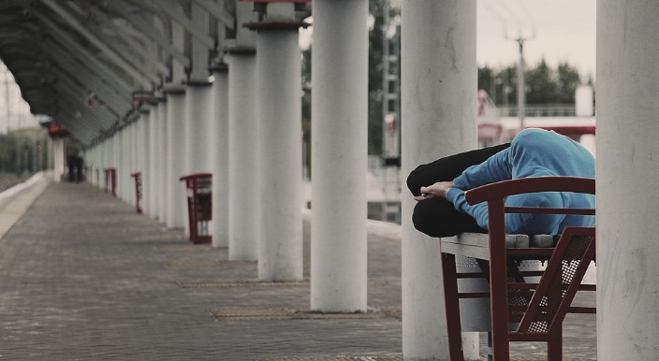
What Is a Dystopia?
Using the images below, what do you think a dystopia might be?
Note down your ideas.

Slide 4

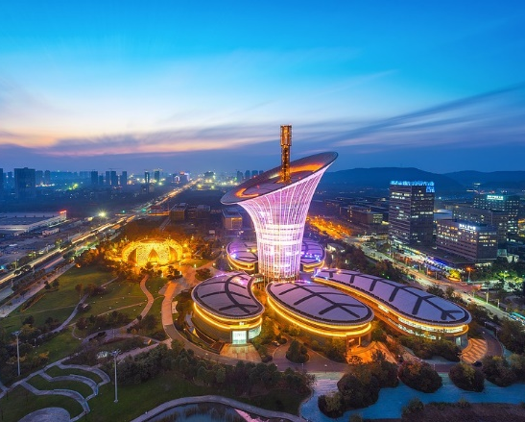
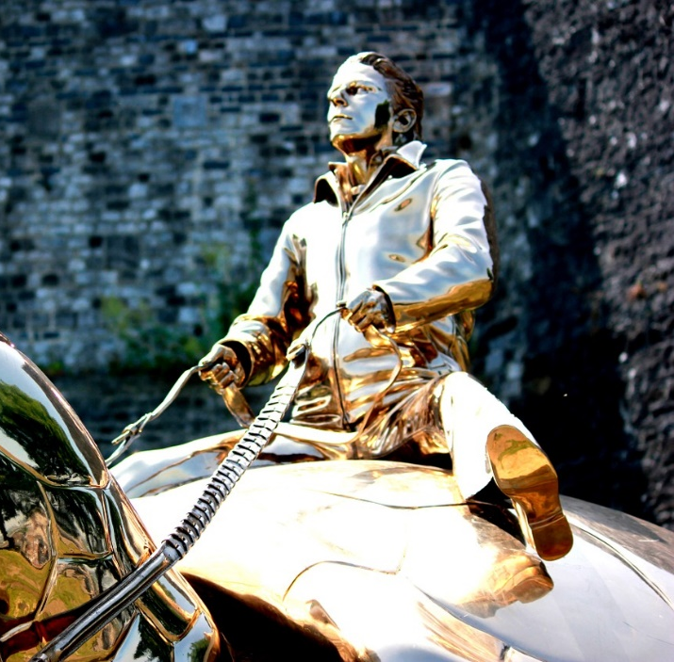
What Is a Utopia?
Using the images below, what do you think a utopia might be?
Note down your ideas.

Slide 5

Defining a Dystopia
Dystopia
An imagined place or state in which everything is unpleasant or bad;
a place where people are controlled and treated unfairly.
Is the Capitol a Dystopia?
Utopia
An imagined place or state where everything is perfect;
a peaceful world;
a happy and cared-for society;
a place where people are listened to and their best interests and well-being are acted on.

Slide 6

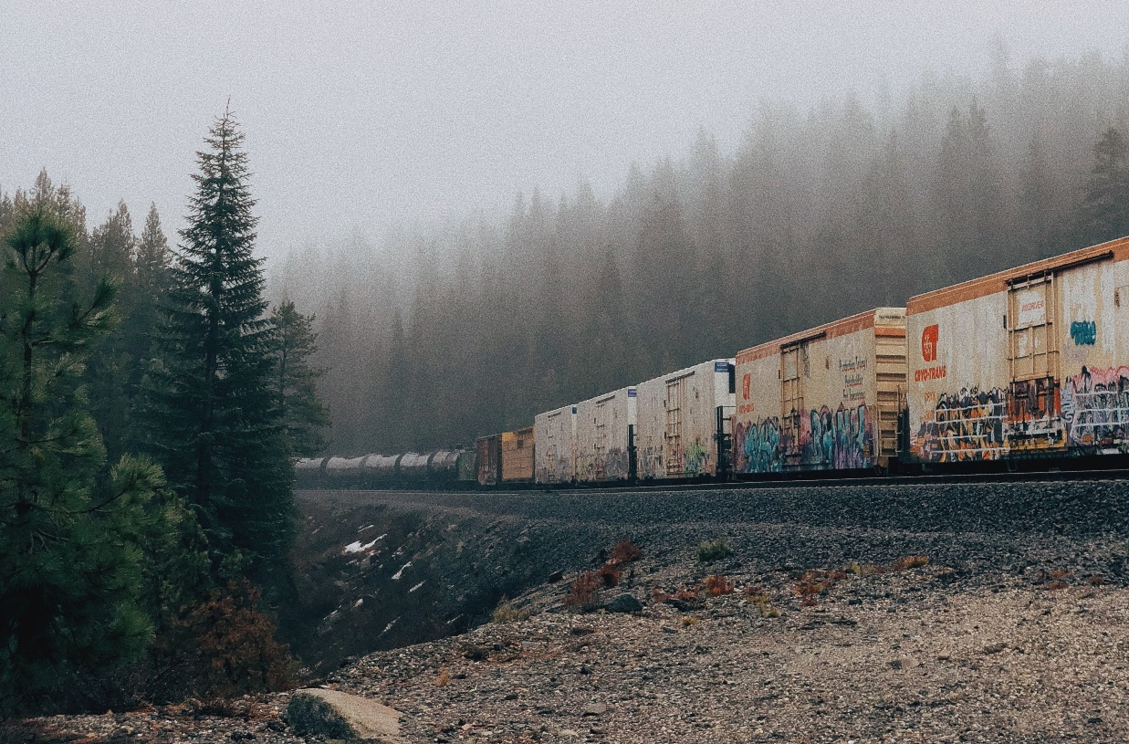
Learning Review
Answer the key questions below in your own words:
What is a dystopia?
What do you think it would be like to live in a dystopian world?

