Slide 1
HUMAN RELATIONSHIPS
HL EXTENSIONS
IB Psychology LAJM

Slide 2
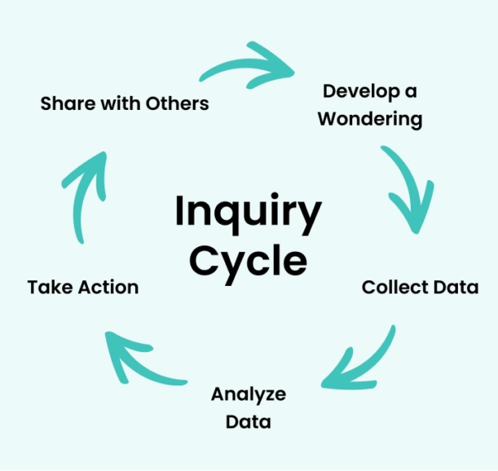
About the HL extensions
HL extensions for each context are:
  (1) Culture
  (2) Motivation
  (3) Technology
HL extensions are based on inquiry learning

Slide 3
About the HL extensions
Teacher will give prompts to encourage students to investigate a topic under each context related to culture, motivation and technology
Students will explore, investigate, reflect and finally share their findings with the
whole class
  The findings will prepare the students for Paper 3

Slide 4

About the HL extensions
Paper 3 is focused on HL extensions and
data-analysis
In Paper 3 you will have a set of stimulus materials that reflect HL extensions and where data-analysis is applied

Slide 5

HL extensions in human relationships
Culture
  Different strategies for developing and maintaining cross-cultural relationships
  The role of culture and strategies for cross-cultural communication

Slide 6

HL extensions in human relationships
Motivation
  The role of motivation to influence group behaviours
  The motivational strategies to change individual behaviours
  The role of motivators in leading to greater employee satisfaction and performance

Slide 7
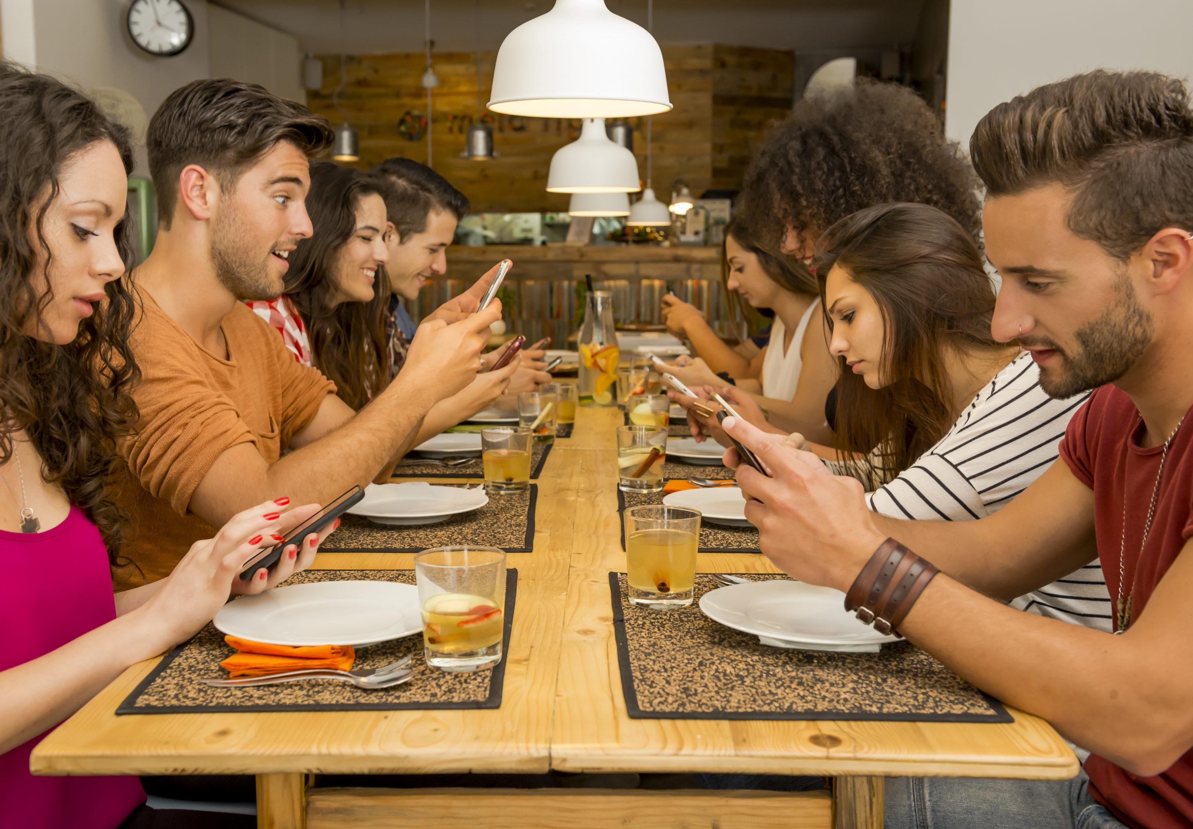
HL extensions in human relationships
Technology
  The impact of technology on interpersonal relationships
  The role of social media contributing to group behaviour
  The use of technology to assist with acculturation into a new society

Slide 8
Culture in human relationships
(1) Can genuine cross-cultural relationships be intentionally developed, or do they only emerge through authentic shared experiences?
(2) To what extent do communication strategies overcome cultural differences, and when might they reinforce stereotypes?
What could be your prompts?

Slide 9
Motivation in human relationships
(3) Can group behaviour truly be motivated from the outside, or does lasting change only occur when motivation comes from within the group itself?
(4) Do motivational strategies create genuine behavioural change, or do they simply encourage temporary compliance?
(5) Do the factors that increase employee satisfaction also drive high performance, or do they sometimes conflict?
What could be your prompts?

Slide 10
Technology in human relationships
(6) Has technology strengthened interpersonal relationships, or has it replaced meaningful connection with constant communication?
(7) Does social media shape group behaviour, or does it merely amplify behaviours and beliefs that already exist?
(8) Does technology accelerate genuine integration into a new society, or can it unintentionally slow acculturation by maintaining ties to familiar cultures?
What could be your prompts?

Slide 11
TASK
(1) Collect data/sources for each prompt
  Find both quantitative and qualitative sources
  Find examples of tables and graphs
(2) Analyse/interpret the data/sources you found relevant to the prompt
(3) What kind of arguments, counter-arguments and conclusions can you make?
(4) Prepare to share your insights with others
  Create PowerPoints with examples like in Paper 3

Slide 12
Extra tips for the inquiry
Keep the basic concepts in your mind and try to apply them to your inquiry
  Bias, causality, change, measurement, perspective and responsibility
Use the Kognity HL extension boxes as a starting point

Slide 13

Tips for culture
All inquiry questions related to culture can be linked with globalisation

Slide 14

Tips for motivation
Try to implement motivational theories
  Self-determination theory
  Maslow
  Theory of achievement motivation

Slide 15
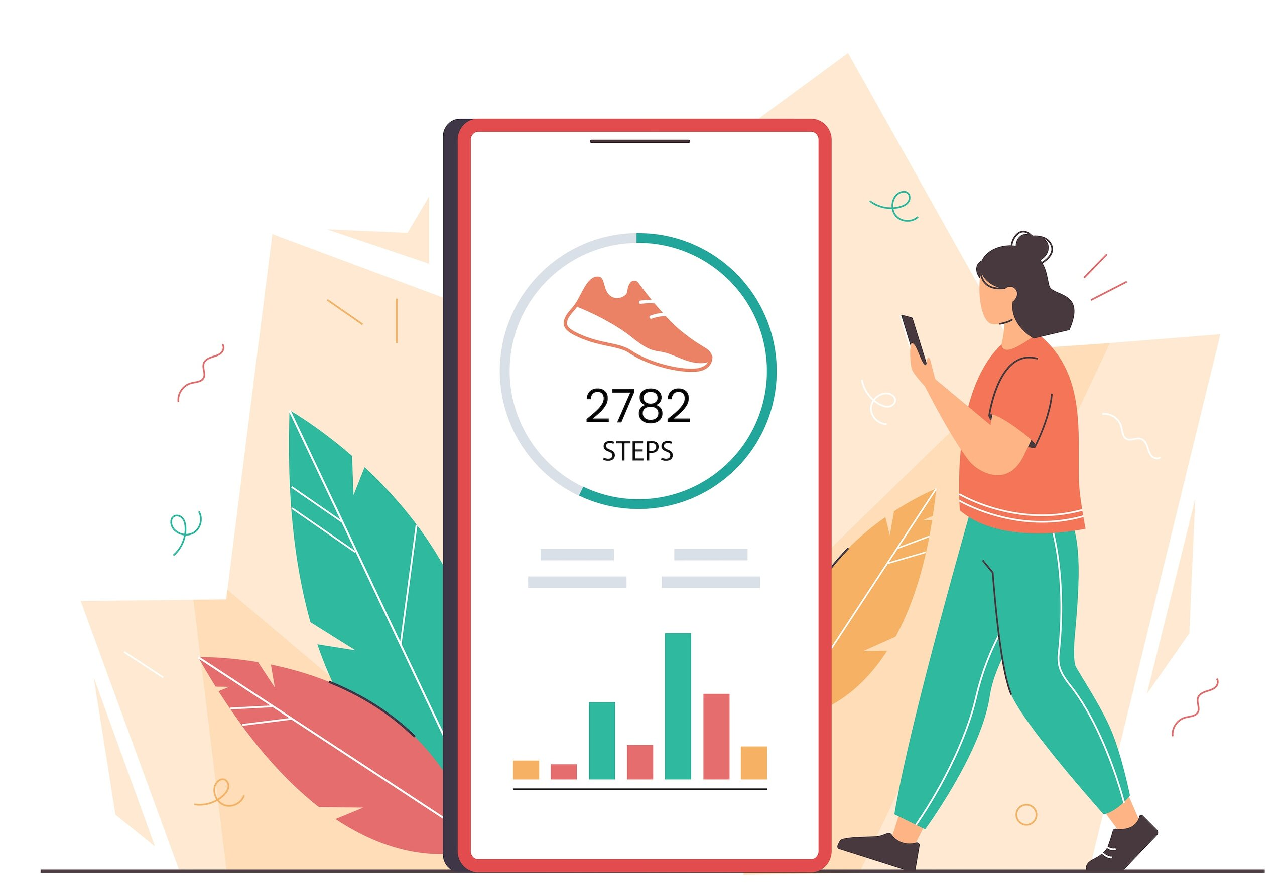
Tips for technology
Try to pinpoint specific technologies and/or applications to each inquiry question

Slide 16
Picture sources
Inquiry-based learning <https://www.clickvieweducation.com/en-au/blog/teaching-strategies/inquiry-based-learning> Accessed 2nd of October 2025.
IB logo <https://commons.wikimedia.org/wiki/File:International_Baccalaureate_Logo.svg> Accessed 2nd of October 2025.
Cross cultural communication <https://executive.berkeley.edu/thought-leadership/blog/cross-cultural-communication> Accessed 2nd of September 2026.
Group <https://www.counselling-directory.org.uk/articles/success-at-work-the-study-of-organisational-behaviour> Accessed 2nd of September 2026.
Technology on the table <https://carolinatails.org/technology-vs-relationships/> Accessed 2nd of September 2026.
Globalization <http://www.mining.com/web/people-think-globalization-country/> Accessed 1st of October 2018.
Woman jumping <https://www.integrativenutrition.com/blog/2018/07/personal-independence-day> Accessed 7th of January 2026.
Step counter app <https://thinkib.net/psychology/page/60450/technology-exercise-apps> Accessed 2nd of April 2026.

