Slide 1
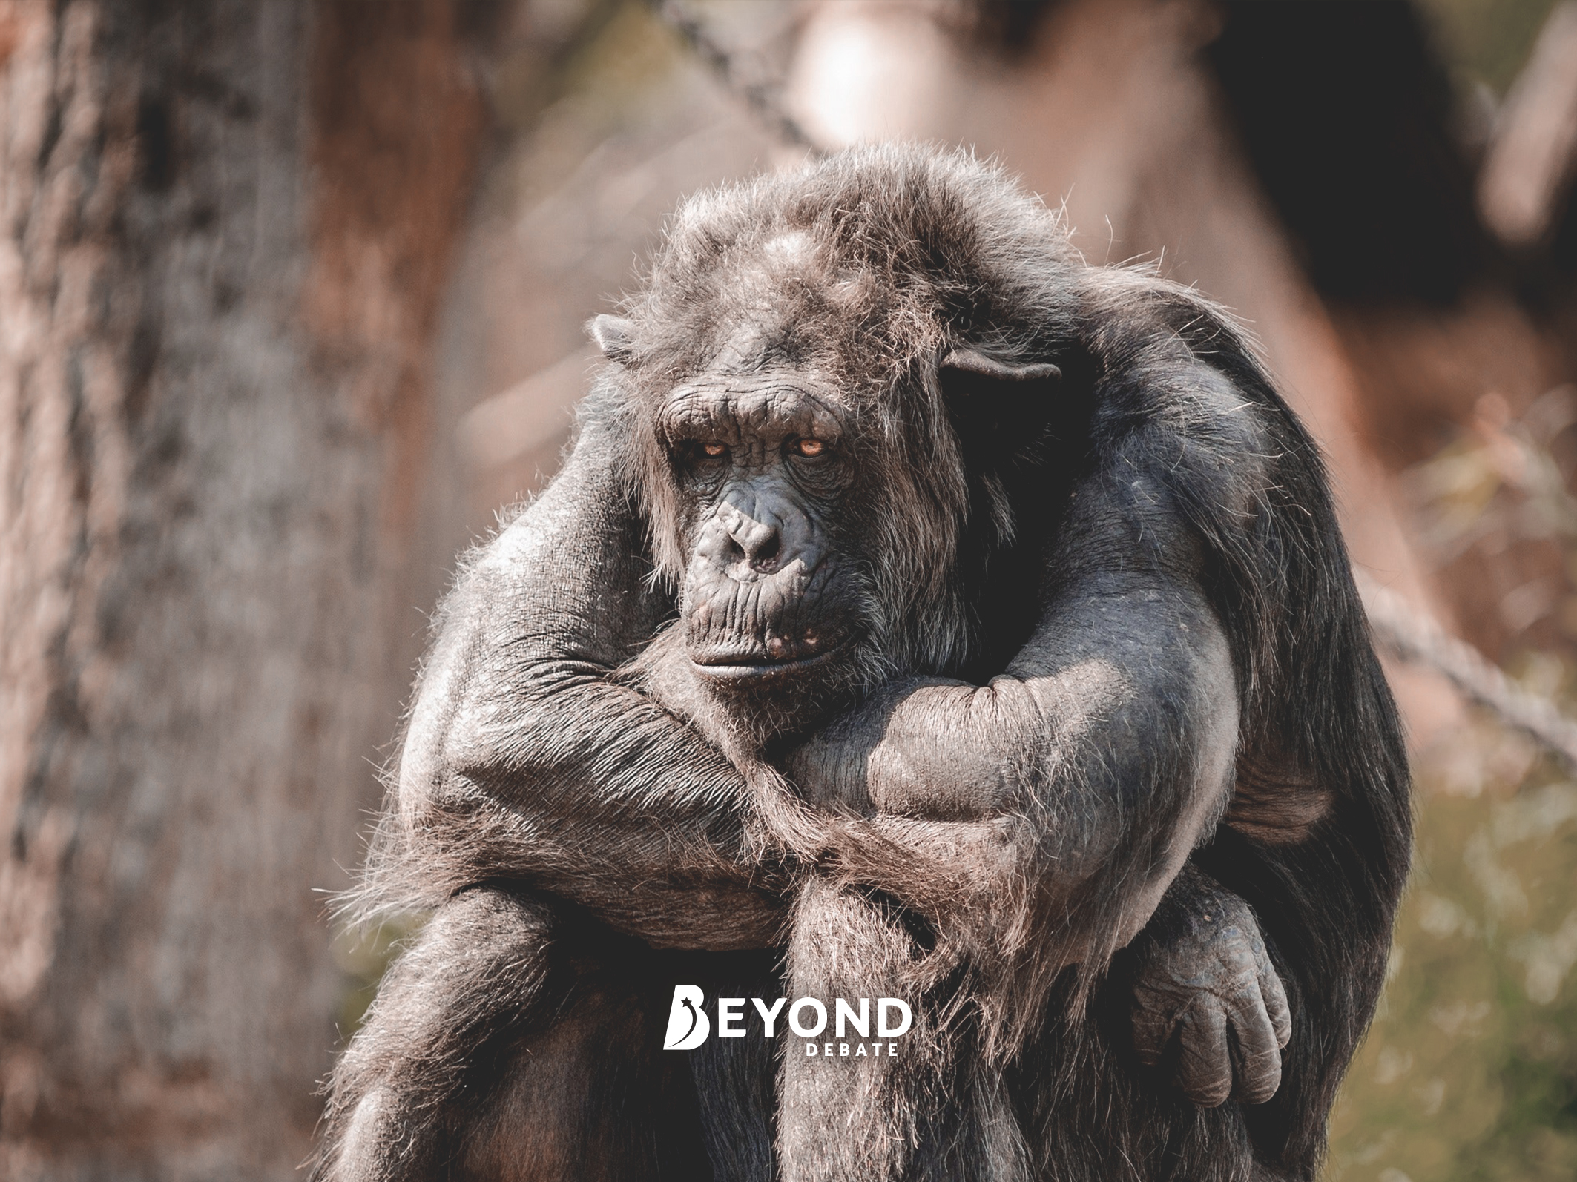
Topic
Zoos Are Cruel and All the Animals Should Be Released into the Wild.

Slide 2
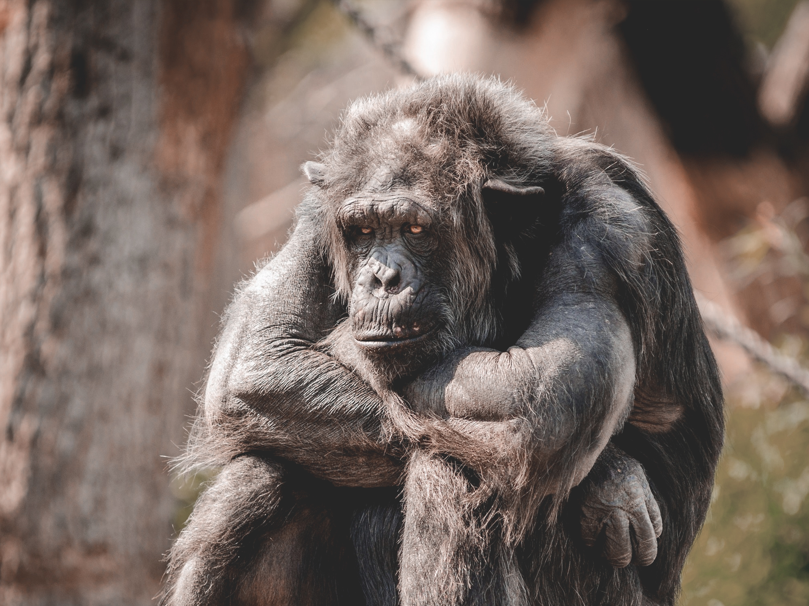
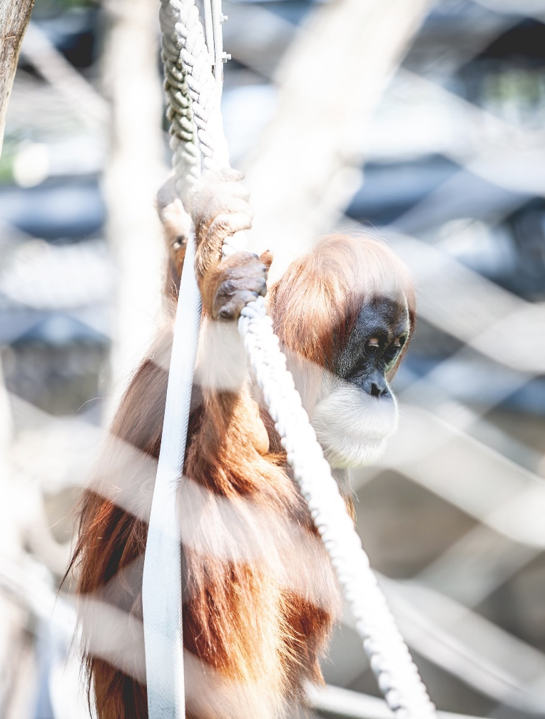
Zoos: The Context
In May, 2019 a Canadian zoo owner in Quebec was charged with animal cruelty when a member of the public reported that the animals were kept in poor conditions and expressed concern for their welfare.
Zoos began their life as ‘menageries’, typically an enclosed space used to keep exotic animals in captivity. Menageries often belonged to rich aristocrats and royalty as a sign of their wealth
and power.
Modern zoos often incorporate scientific research, educational exhibits and conservation efforts but many activists argue that zoos are unnatural, cause unnecessary stress to animals and argue that animals are simply kept for human entertainment.
Do you think zoos should be closed down and their animals released into the wild?

Slide 3

“People don’t understand the good that a zoo does. There are education centres for school visits that provide people with a chance to see animals that they’d otherwise never see in the wild. Zoos are also really important for research and conservation efforts too. A lot of money is invested in preserving natural habitats and zoos play an important role in looking after endangered animals.”
“These horrendous places should stop kidding themselves by suggesting that zoo visits are educational. Most visitors don’t spend much time reading the information boards – they just look at the animals and move on. Animals often show signs of stress at being forced to live in captivity, many are made to live in unnatural climates and there’s just something wrong about forcing animals to live a life where people stare at them all day for entertainment.”
What Do You Think?
Who do you agree
with? Why?
What Do You Think?
Who do you agree with? Why?

Slide 4
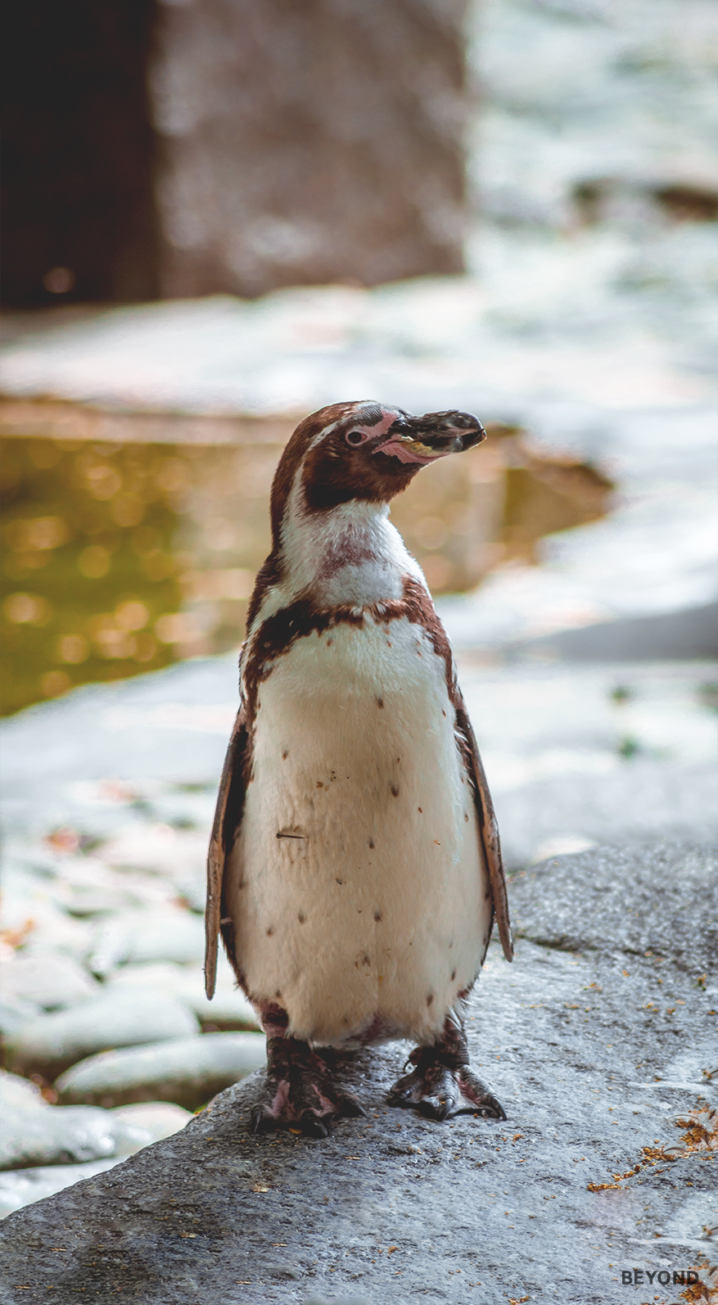
For and Against
Considering different points of view as well as your own, consider why some people would want to keep zoos open while others would want them to close permanently.

Slide 5
Research Activity
Many zoos now include educational facilities, researchers and attempt to preserve endangered species. Find and research a zoo on the Internet or by using your phone and answer the following questions.
How many animals does this zoo contain?
Does this zoo offer educational facilities?
Does this zoo attempt to conserve endangered species?
What endangered species does this zoo keep?

Slide 6
The Big Question:
Zoos Are Cruel and All the Animals Should Be Released into the Wild.
Working with your group, prepare a speech or presentation to tackle the statement above. Consider the pros and cons and come to a conclusion that you can present to the rest of your class.

Slide 7
