Slide 1
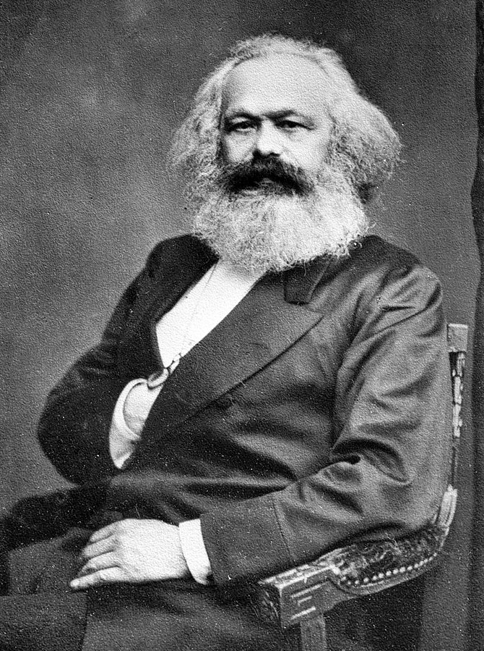
DISCOURSE & LITERACY
12 December 2020
karppinen.anne.m@gmail.com

Slide 2
Media and Ideology
What is the function of media in the Western society? How can we tell if it’s ideologically charged?
Whose interests do media serve?
What is the role of the audience?

Slide 3
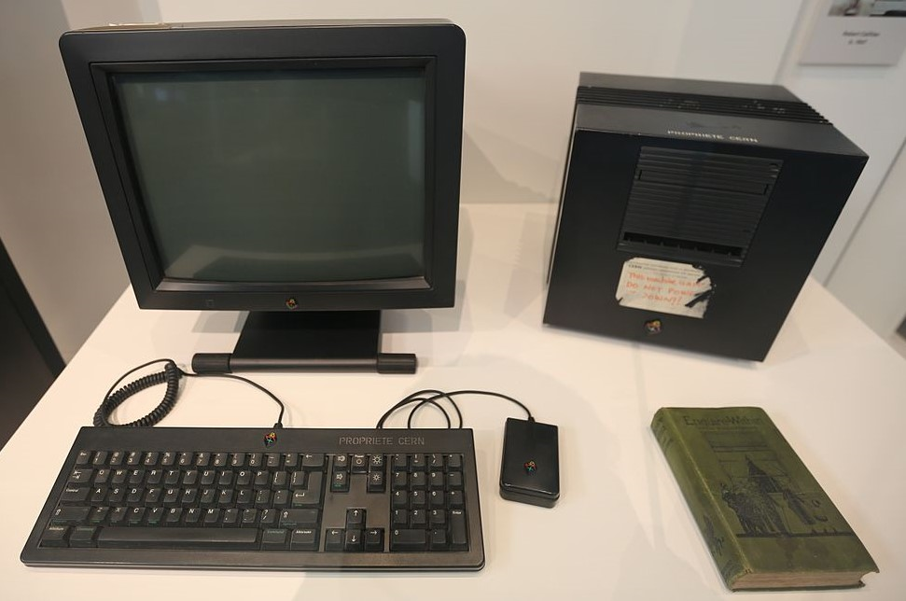
[M]edia content is the outcome of a complex process of production in which social, political and economic factors interact to produce a particular and distinctive end production.
Ciaran McCullagh: Media Power: A Sociological Introduction. 2002.
Cultural goods are not just information that expresses and communicates meanings. These meanings also express moral norms, values, judgements. Culture is therefore inherently political.
Christian Fuchs: Culture and Economy in the Age of Social Media. 2015.

Slide 4
Ideology?
A set of ideas, beliefs, and assumptions about the world. Often used to refer specifically to dominant and/or misleading sets of ideas that reflect and reinforce dominant power relations.
Paul Hodkinson: Media, Culture and Society. An Introduction (2011)

Slide 5
The Marxist Approach
Capitalism is characterised by the ownership of wealth and property by the bourgeoisie and the exploitation of the non-wealth-owning proletariat.
-> the bourgeoisie control the means of production; the proletariat work to produce objects which generate wealth
-> the only way the proletariat can pay for these objects is by paying their wages back to the bourgeoisie
“Capitalist economic relations are accompanied by a corresponding set of dominant cultural values, ideas, and beliefs - ideology in other words. The circulation of this dominant ideology - via institutions such as the family, the political system, and religion - acts as a support for the material situation from which it emerged --”

Slide 6
The Frankfurt School and Mass Media
Active in the 1930s and 40s in Germany and USA
Theodor Adorno, Max Horkheimer, Herbert Marcuse
One of the first in-depth meditations on the effects of mass media in the West
-> “critical theory”
Feared the continual growth of the capitalist system and its effects on human creativity and freedom
“Although their foundations were Marxist, the emerging cultural phenomena (such as modernism and fascism) and the emergence of mass media ‘raised questions that highlighted the inadequacy of treating culture as a superstructural expression entirely determined by the economic base’”. Taylor and Harris 2007

Slide 7
Criticised the content of culture industry products which, as a result of profit maximisation, are wholly standardised
-> the consumption of such products is simple, repetitive and effortless (vs. the consumption of ‘high’ culture)
-> The culture industry helps to incorporate ‘the masses’ into the system, and discourages them from thinking beyond the present moment and forming any more fundamental desires (or critiques of the system)
The culture industry is essentially subordinate to the demands of industry and government

Slide 8
Problems with the Frankfurt School
High-flown ideas of the ideal humanity - but no real theory behind these
Quick dismissal of the value and nature of mass culture (f.ex. Adorno’s famous dislike of all forms of jazz)
Little analysis of the actual structure of the culture industry
Setting themselves above the ‘masses’ - if they know how criticise culture, surely others can learn, too?

Slide 9
Ideology Criticism
Antonio Gramsci: the importance of independent struggle and change within the realm of culture and ideas
Hegemony: the predominance of taken-for-granted ways of understanding the world that strengthen the interests of the dominant political group
-> civil society is characterised by on-going struggle between hegemonic and counter-hegemonic ideas
Dominant sets of ideas within media content can be exposed and challenged
-> the role of the social theorist /audience is heightened
E.g. youth subcultures “appropriate for their own purposes and meanings the commodities commercially provided”
-> oppositional meanings from the originally intended

Slide 10
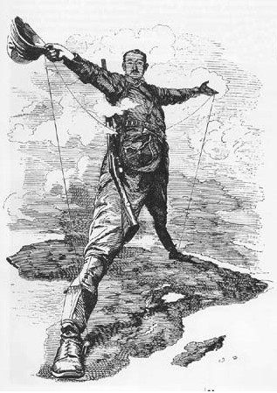
Theories of Cultural Imperialism
Focus on the globalisation of culture as a highly unequal process dominated by powerful capitalist interests based in wealthy countries
Transnational companies distribute standardised forms of international media culture to as many countries as possible
Domestic media in smaller countries are forced to rely on cheap, imported products
-> money flows out of the small countries to the big companies
The broadcasting of capitalist social relations and the normalising of the American way of life

Slide 11
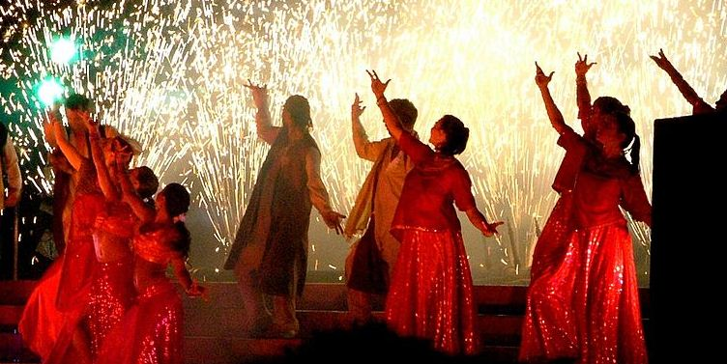
However, these theories fail to take into account the range and complexity of cultural products that are transferred around the globe
Also, countries such as Brazil, Mexico and India have their own media industries which create counter-flows with the European and American ones
The Internet and social media have changed the distribution of cultural texts
http://www.bbc.co.uk/programmes/b01n0xps

Slide 12
From the 1980s on, many countries have established bi- and multilateral international media co-production treaties
-> supporting the collaboration of media production companies and, crucially, the sharing of financial and production resources
The largest treaties are (unsurprisingly) within the EU
- Canada is also an active partner, the US not so much
International co-productions can provide important creative ‘local content’ benefits
-> can add to the creativity and multicultural, multimarket appeal of the product, but can also add many layers of business and logistical complexities

Slide 13
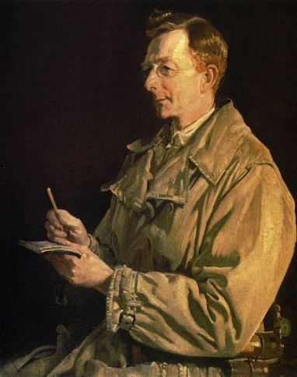
Activity: Ideology in the press
Read the two news items and discuss:
- What seems to be the main message of the text?
- Do you think something has been left out / is not being reported?
- How is the news item structured? What kind of information is foregrounded (i.e. reported first)?
- How is the audience constructed? I.e. who do you think is supposed to read / agree with this piece? What kind of knowledge is assumed from the readers?
- What do you think these news items tell about the society they were written in?

Slide 14
Scientific literacy
Scientific literacy is the knowledge and understanding of scientific concepts and processes required for personal decision-making, participation in civic and cultural affairs, and economic productivity.
- US National Science Education Standards, 1996
Scientific literacy comprises or calls for some understanding of:
- scientific terminology and concepts
- scientific enquiry and practice
- the interactions of science, technology and society.

Slide 15
Individuals don’t simply appropriate scientific knowledge and apply it in the solution of their science-related problems.
-> for science to become useful in our everyday lives, it must be “restructur(ed), rework(ed) and transform(ed) … into forms which serve the purpose in hand”.
For the vast majority of adults, the media constitute their main source of information about science and, significantly, about science-related matters that have an impact on society
What is shown, spoken or written may influence the opinions and actions of individuals and communities in respect of these socio-scientific issues.
-> f.ex. a person will start using dietary supplements based on what they’ve seen on TV

Slide 16
Science in the news is by no means the only mechanism for illustrating the relevance of science in everyday life, but it is arguably one of the more powerful.
“-- understanding science-in-the-media has something to do with understanding media science, but mostly it is about understanding media.”
Gregory and Miller: Science in Public (1998)

Slide 17
Science in the News
“News on television and in the press is not self-defining. News is not ‘found’ or even gathered so much as made. It is a creation of a journalistic process, an artefact, a commodity even.” (Philo 1983)
Journalists and editors decide what counts as news on a particular day
Science journalism is first and foremost journalism
-> the priorities are the same as for any other story

Slide 18
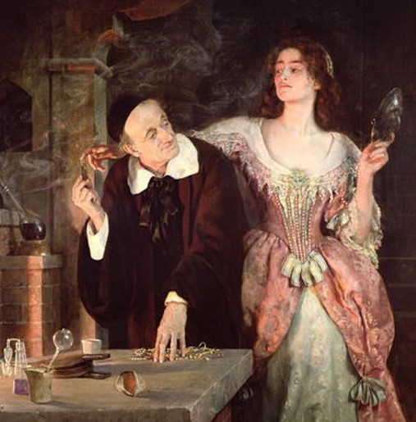
Stories are rarely selected on the basis of their scientific value, but rather on the basis of their newsworthiness.
Emphasis on the ‘nowness’ of science reporting - a lot of science-in-the- media is science in the making, not ‘core’ science
-> instead of being ‘established’ knowledge, cutting-edge science is often tentative and contested
Media often highlight the latest study, instead of looking across all studies

Slide 19
Journalists often have to work hard to make complex science simple, but not simplistic
‘Personalising’ the story helps the process. If conflict/controversy is involved, so much the better.
-> items relating to genetic modification, cloning and climate change are common in the media.
Journalists look for fascination value:
“First, there are ‘awe and wonder’ stories, for example, those relating to the very big, the very small and the generally ingenious. As a consequence, astronomy is well represented in the news. Second there are ‘weird and wacky’ stories, often filling the ‘and finally’ slot.”
Jarman, Ruth and Billy McLune. 2007. Developing Scientific Literacy: Using News Media in the Classroom.

Slide 20
Fundamental to both popular and quality press journalists is a clear notion that the primary task of newspaper science coverage is neither to educate the public nor to make the public scientifically literate, but a rather more modest goal of supplying interesting, informative and entertaining coverage.
(Hansen 1994)

Slide 21
Scientific Sources in the Media
Sources in journalism provide key information, points of view, and credibility
Also give journalists the opportunity to distance themselves from the topic
-> (semblance of) objectivity and neutrality
The elite science and medical journals (Nature, Science, The Lancet etc.) are a foremost source of stories
The fact that the research is peer reviewed offers the media a warrant of reliability

Slide 22
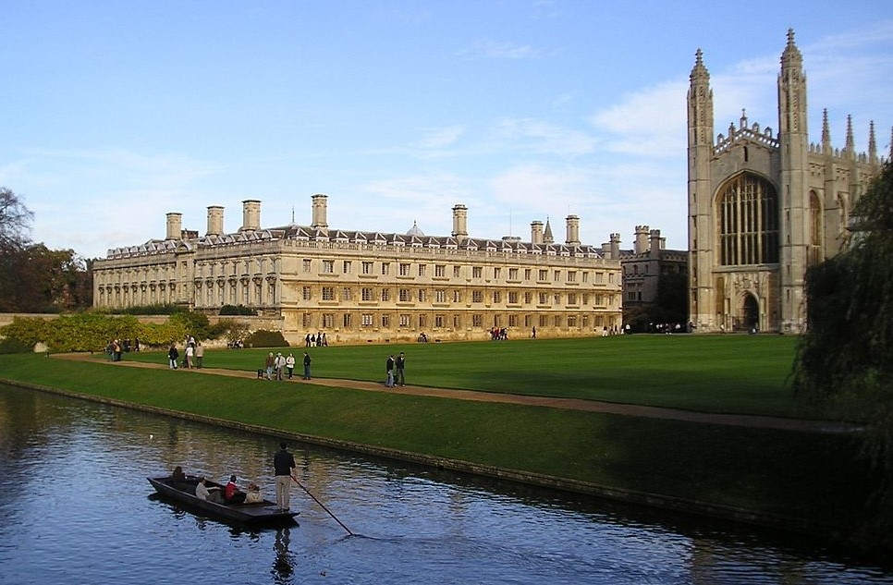
Major scientific and medical conferences are also a source of stories.
Universities have press offices and give press releases and conferences
-> benefit the researchers by giving them visibility
News agencies (Reuters, Associated Press) also serve as a source for science news
> generally a preference for larger, well-known institutes and researchers
-> privileging their world view and obscuring alternative results

Slide 23
Factors behind science reporting
Expertise: not all science reporters are experts in the field, or even in any science
Space requirements: the limitations of airtime or column space -> omission of detail
Time: journalists work to strict deadlines -> wide-ranging research isn’t always possible
“Do you want it good, or do you want it now? There’s only one answer.” Simon Pearson, Night Editor of The Times
-> Science correspondents need to come quickly up-to-speed on a host of emerging events or issues as they surface from one day to the next.

Slide 24
Codes and Conventions
The reporting of news, including science news, follows certain codes and conventions.
These have evolved over time and are shaped substantially by the professional and organisational culture, context and constraints within which journalists work.
Successful science reporting must be
- enticing to catch the attention of readers, viewers and surfers
- wide-ranging to attract a large audience
- fast

Slide 25
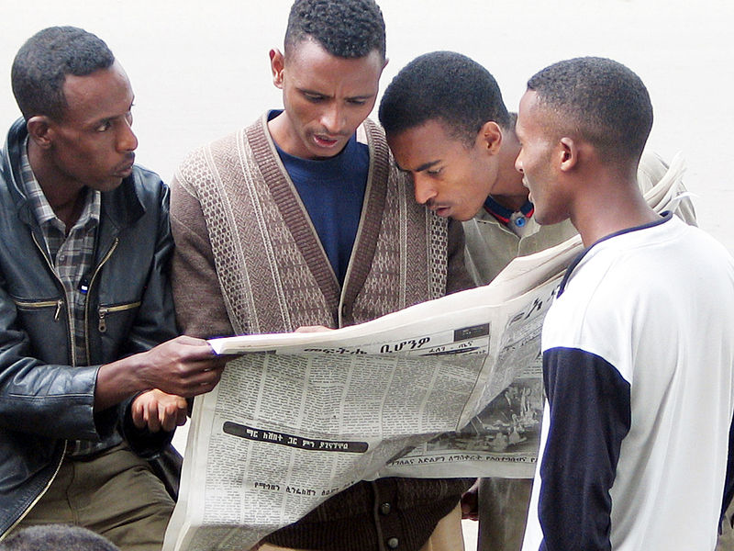
-> ‘Human interest’ stories
Story angles and subthemes will be chosen for their perceived relevance to the audience.
The report, if possible, will be personalised and presented in narrative form.
-> science in the news has its strengths, but also limitations as a source of information
-> science writing in the context of news shouldn’t be judged by the same criteria as science writing in academia

Slide 26
Superficial and sensationalist?
Academic researchers are interested in the details, journalists in the bigger picture
“A news account, by its very nature, is a compromise between the facts and the general impression. Beyond a certain point, what it gains in precision it loses in communication.”
Media are accused of overstating certainty, applications and implications, controversy, and risk.
-> is visibility in the media of more value than accuracy?
https://www.bbc.com/news/science_and_environment
https://us.cnn.com/specials/space-science

Slide 27
The Language of News
Media language is never neutral
-> follows its own laws and conventions
Concise, economical language: compressing complex messages into a few (key) words
Immediacy: the use of the present tense & active voice create a sense of urgency and drama
In print, journalistic language tends to be colourful
-> in science articles also metaphorical
Adventurousness: science news constantly introduce new terminology

Slide 28
Word choices reinforce certain ideologies:
- ‘Frankenfood’, ‘mutant crops’, ‘playing God’
Such words are introduced to persuade the reader / viewer with their emotional effect
Reporting words (and other lexical choices) are used to steer audience opinion:
Scientists point out that the effects are not yet fully known.
Vs.
Scientists admit that the effects are not yet fully known.

Slide 29
So what if the Earth IS flat?
Despite being literate, and having an infinite amount of information available, many people still prefer conspiracy theories of all kinds to ‘official’ science. Why?
Is this simply a matter of scientific literacy? Philosophy Tube makes a strong case for it:
https://youtu.be/AGvGQSazaTM?t=490

Slide 30
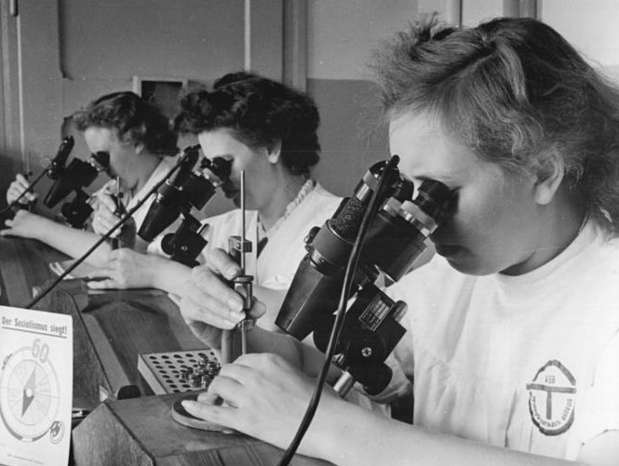
Activity: Science in the news
Exercise 2:
- Read the news articles
- Think about why they have been chosen for that particular news source and why they might interest their audience?
- Look at the structure and content of the pieces (word choices, reporting verbs, tone, etc.). Who are the ‘experts’ in this story? Where does the ‘scientific’ information come from?
-> Do you find them trustworthy/sufficiently scientific?
- Note that the first article has been shortened
(you can read the full text online if you wish)

Slide 31
Bibliography
Ciaran McCullagh. 2002. Media Power: A Sociological Introduction. Basingstoke: Palgrave.
Christian Fuchs. 2015. Culture and Economy in the Age of Social Media. London: Routledge.
Hodkinson, Paul. 2011. Media, Culture and Society. An Introduction. London: Sage Publications.
Jarman, Ruth and Billy McLune. 2007. Developing Scientific Literacy: Using News Media in the Classroom. Buckingham: Open University Press.
Storey, John. 2001. Cultural Theory and Popular Culture. An Introduction. Harlow: Prentice Hall.
Taylor, Paul, and Jan Harris. 2007. Critical Theories of Mass Media : Then and Now, McGraw- Hill Education. ProQuest Ebook Central.

Slide 32
Scientists by Bundesarchiv, Bild 183-64996-0001 / Schmidt / CC-BY-SA 3.0, CC BY-SA 3.0 de, https://commons.wikimedia.org/w/index.php?curid=5430212
Nordkorea 2015 by By Uwe Brodrecht - 0911 CC BY-SA 2.0, https://commons.wikimedia.org/w/index.php?curid=47776728
First internet server By Geni - Photo by user:geni, CC BY-SA 4.0, https://commons.wikimedia.org/w/index.php?curid=37841715
University of Cambridge By Christian Richardt - Own work, CC BY-SA 3.0, https://commons.wikimedia.org/w/index.php?curid=12437
Newspaper readers in Addis Ababa By Terje Skjerdal from Høvåg, Norway - https://commons.wikimedia.org/w/index.php?curid=19021198

