Slide 1
Teacher collaboration

Slide 2
Teacher collaboration is…
More than collegiality ’doing things together for job-related purposes’ (Kelchtersman, 2006: 220
’a positive value (supportive, stimulating, rewarding, … democratic) relationships among equals’ (ibid. 2006: 221)
Collaboration can involve:
  developing practices together
  teaching together
  coordinating actions
  aligning goals
  making-decisions together
’Not just a collection of meetings but a way of life’ (Hargreaveas, 2019: 611)

Slide 3
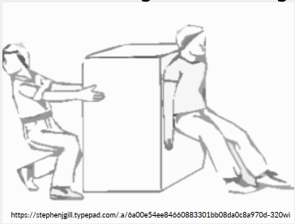
Collaboration has…
A ’push and pull’ dynamic with peers ’pulling each other in by inspiration and motivation to engage in interesting work, and pushing each other on and up to ever higher standards of performance together (Hargreaves, 2019: 613).
A tough edge… as collaboration can benefit if communities ’can productively engage in conflict’ they rather than those that suppress or ignore difference (Keltchermans, 2006: 233).

Slide 4
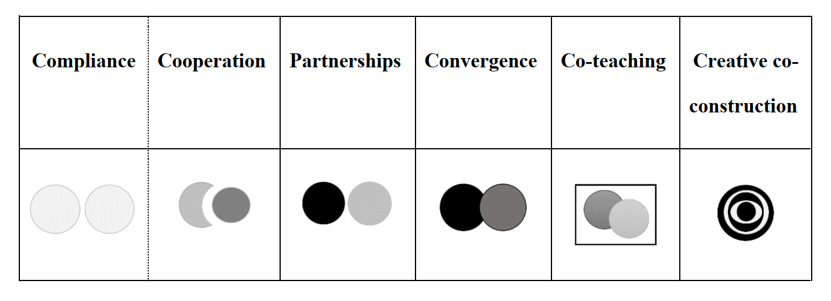
Different forms of teacher collaboration
Moate, 2023 forthcoming

Slide 5
Compliance & collaboration
Compliance is represented by two light grey circles indicative of the teachers’ minimal presence and reluctance to share their professional space, whether physical, epistemological or pedagogical. Even compliance, however, has the potential to be productive if teachers see improvement, for example, in student participation (Escobar Urmeneta, 2020).
Cooperation illustrated by a crescent and circle representing the way teachers can accommodate each other’s expertise. Cooperation can involve students being ‘pulled out’ of mainstream or content lessons or language teachers being ‘pushed in’ to subject classes to support students’ language development (Bell & Baecher, 2012). Cooperation can also be approached as ‘one teach, one drift’ which requires little preparation by the teachers (Méndez García & Pavón Vázquez, 2012) or can be facilitated through preparatory courses.
Neither compliance nor cooperation require significant dialogue between the teachers as they are largely dependent on organizational, rather than interpersonal, arrangements.

Slide 6
Partnerships & convergence
Partnerships are a more intensive approach to collaboration represented by two circles side-by-side, this time in darker shades indicative of their greater presence. A partnership needs to be equal with shared responsibilities, not just divided territory, however partnerships can be arranged in different ways including ‘one teach, one observe’, parallel teaching, alternative teaching or station teaching.
Convergence is an even more intensive approach as represented by the overlapping circles. Convergence is facilitated by dialogue between teachers in which a shared vision is developed (Aguilar Cortés & Alzate, 2015). Convergence can take place outside of classrooms through the careful planning of teams and programmes, in separate yet complementary lessons with, for example, the language teacher introducing key vocabulary and structures prior to the subject lesson (Pavón Vázquez, et al., 2015) or in shared classrooms with the practice of ‘one teach, one assist’.
With these arrangements the teachers are aware that their work should complement each other and provide a richer learning environment. All of these practices involve good communication between teachers and not only benefit from, but also require mutual respect and understanding.

Slide 7
Co-teaching & creative co-construction
When co-teaching, teachers share the teaching space, either taking turns or co-constructing pedagogic action together. For example, one teacher can explain to students as the other makes notes on the board or paraphrases what is said (Escobar Urmeneta, 2020), or as one teacher teachers, the other teacher can model student language use helping students to actively participate in lessons (Turner & Fielding, 2020).
Creative co-construction, however, goes beyond the initial or individual expertise of collaborating teachers. In this case, teachers’ pedagogical repertoires and potential are enriched as they learn from each other, adopting and modifying each other’s practices (He & Lin, 2018; Giles & Yazan, 2020). Moreover, in creative co-construction the combined resources and investment of teachers generate new pedagogical options in the planning (Nguyen & Dang, 2020) and realisation (Gardner, 2006) of CLIL lessons.

Slide 8
Fostering successful collaboration
Successful collaborations benefit from both organizational and interpersonal investment (Martin-Beltán & Peercy, 2012; Zappa-Hollman, 2018).
  Regular opportunities to communicate
  Appreciation for the investment creates more sustainable and rewarding forms of collaboration (Bell & Baecher, 2012).
  As student needs, staffing arrangements, resources and pedagogical repertoires vary over time, collaborative approaches should be modified and used flexibly (Escobar Urmeneta, 2020; Bauler & Kang, 2020).
  Careful consideration should be given to how encounters between teachers are understood and arranged and what is needed for collaboration to be sustainable

