Slide 1
Open classroom doors!
Teaching languages online is the key
Juhani Koivuviita
Finnish teacher
Finnish Institute in Estonia
The FIPLV NBR Conference 2016
June 10th Tallinn

Slide 2
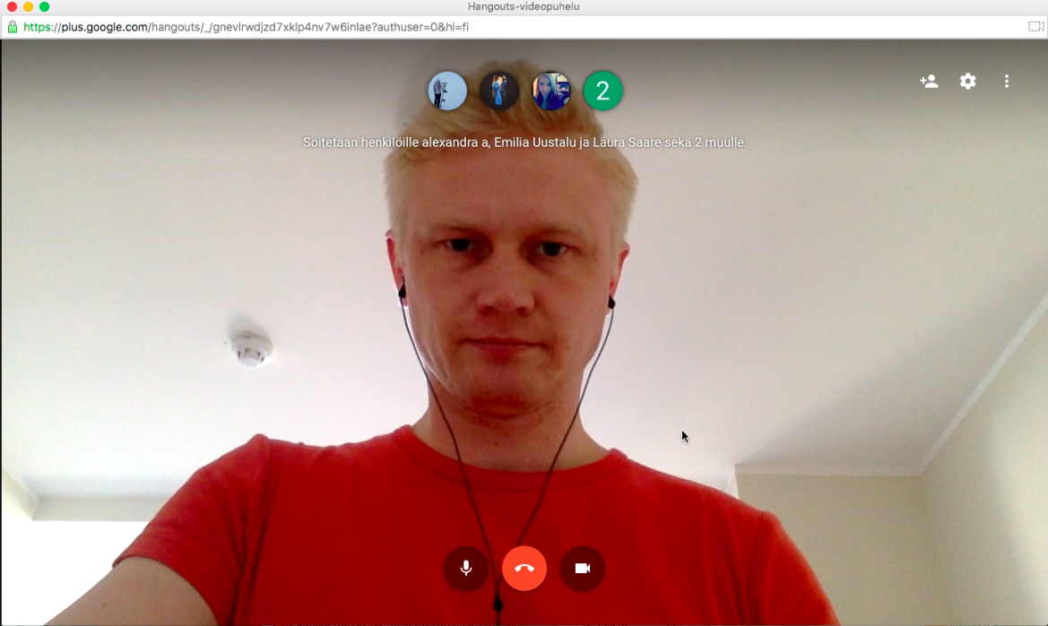
Hei! Puhutaanko suomea?

Slide 3
Online course Practical Finnish
A pilot project, spring semester 2016
Funded by the Estonian Ministry of Education
Coordinated by the Finnish Institute in Estonia
Planning and teaching by the Finnish teacher Juhani Koivuviita

Slide 4

12 students
Who can’t study Finnish in their own school
Whose language skills are way ahead the others
Who would like to communicate more in Finnish
From all over Estonia
Upper secondary level

Slide 5

35 hours
12 students divided into 3 groups
75 minute lesson once a week
Extra materials and tasks in Peda.net
Individual study project in May
Study trip to Finland in May

Slide 6
Google and Peda.net
Google Hangouts
Google Apps for Education
Peda.net learning environment: https://peda.net/viro
Other programs and online material: Quizlet, Kahoot, websites

Slide 7
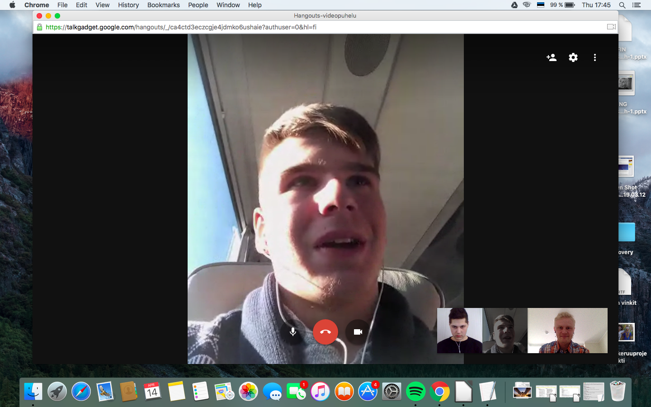

Slide 8
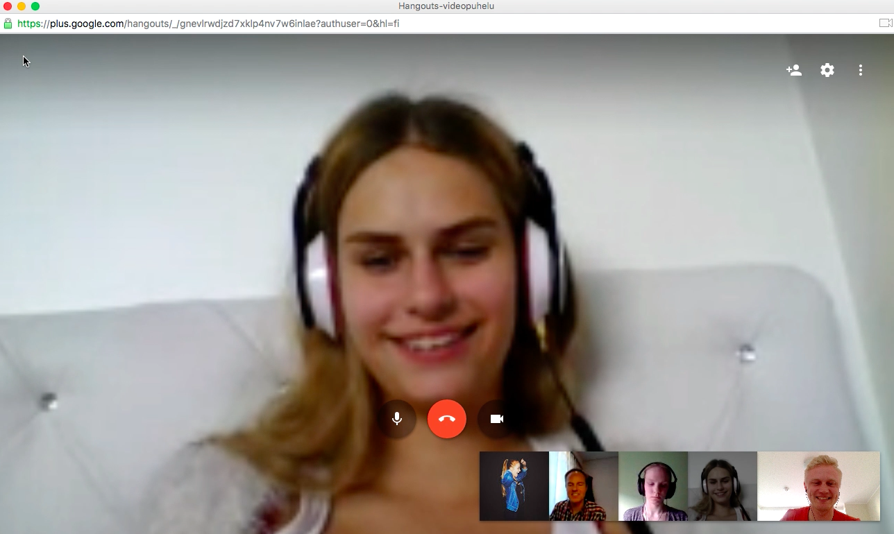

Slide 9
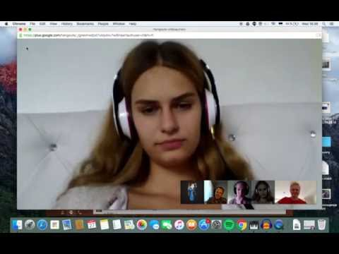

Slide 10
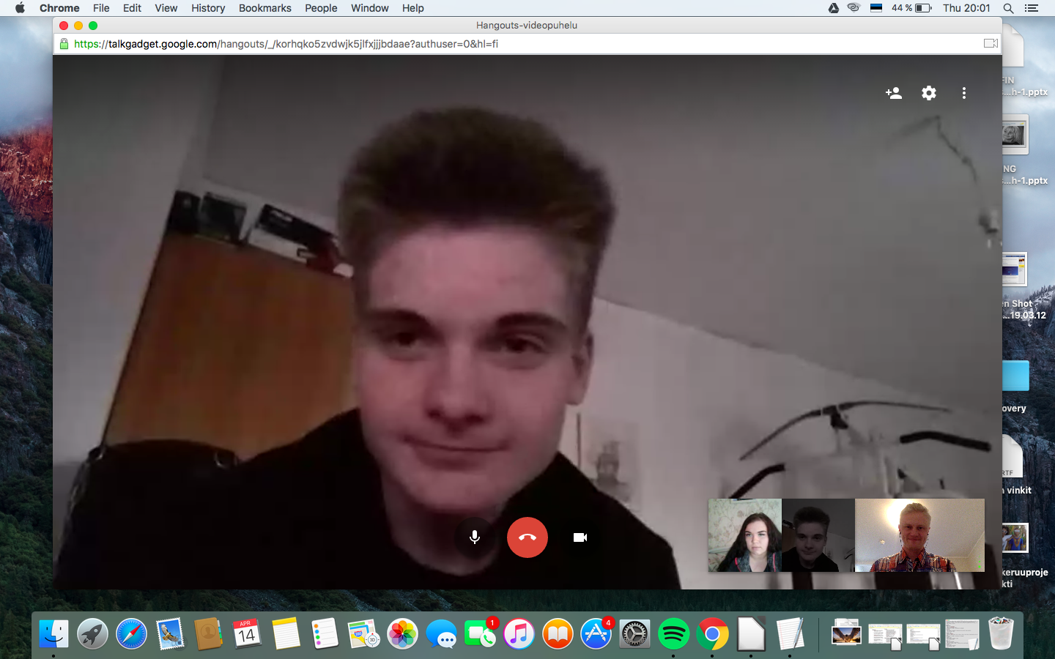

Slide 11
Let’s test it out! Follow me!

Slide 12
Team up - think about it - share the thoughts
What kind of possibilities do you see?
How would you use this in your teaching?
What are your biggest doubts at the moment?

Slide 13
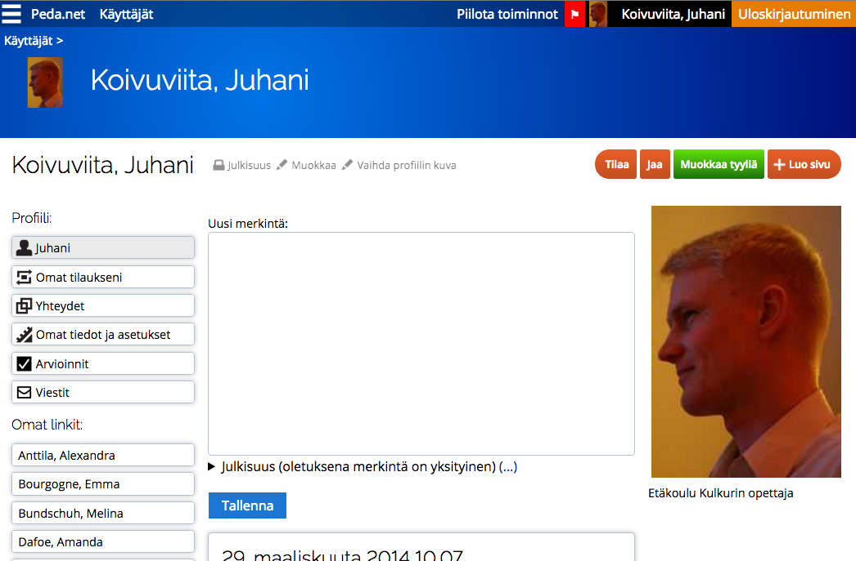

Slide 14
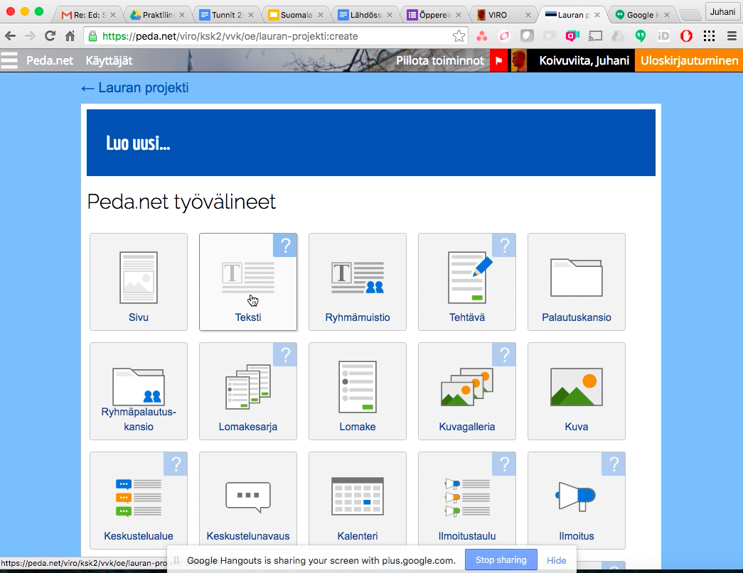

Slide 15
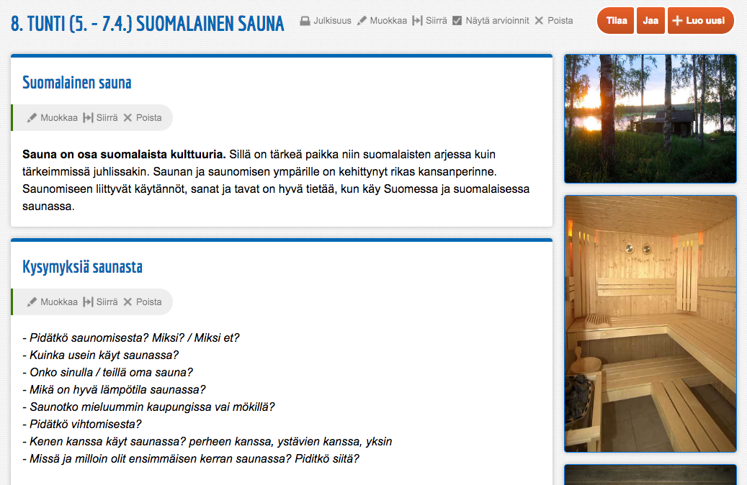

Slide 16
Online classroom
Engaging
Classmates
Online materials
Problems with the connection
Not possible to work in pairs

Slide 17
The pilot project
Positive experience
Easy to arrange
Flexibility
Free course vs. payed course?
Formal vs. informal teaching?

Slide 18
How to open up the classroom?
Invite a mother tongue speaker to your lesson
Invite other school’s students to your online lesson
Create and gather materials online to enable learning while you’re not teaching

Slide 19
How should you act as a teacher?
Be brave, since you’re not “hiding” in your classroom anymore
Be brave, since teaching online might be new to you
Be brave, since in the digital world something can always go wrong

Slide 20
How to get courage?
Think about how to teach online
Read about how to teach online
Just do it!

Slide 21
Teaching languages online is the key!
We’ve discussed these matters today:
What can you do online
What are the best ways to do it
How to communicate the best way with the students
“The truth is out there”
Be brave and start working online. Only action creates action.

Slide 22
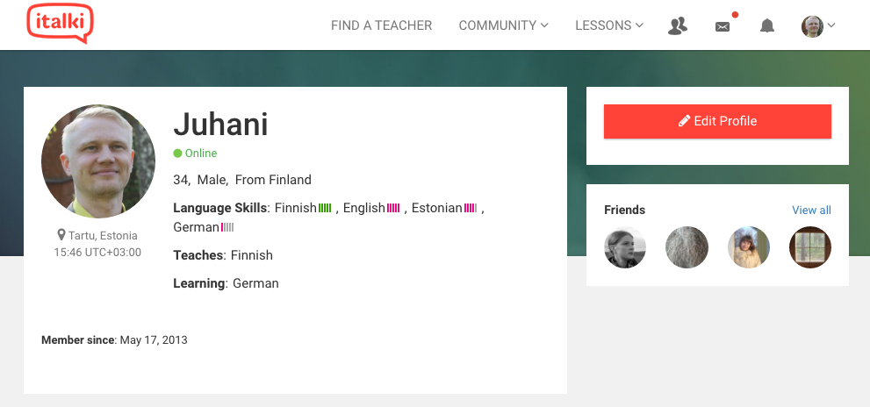

Slide 23
Feel free to contact me
Juhani Koivuviita
juhani.koivuviita@gmail.com
Skype: juhani.koivuviita
https://peda.net/p/juhani.koivuviita

