Slide 1
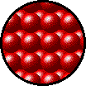

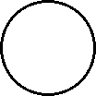
States of Matter
Solids, liquids, and gases differ in the movement of
particles, the attractive forces between particles, and
inter-particle spacing
Solids have a fixed shape, fixed volume, and particles held together by intermolecular forces in a fixed position
Particles may vibrate about a certain point, but they do not have the velocity to move about
Liquids have a fixed volume, but take the shape of the container they are found in. Particles are held by intermolecular forces.
Diffusion might occur
Gases have widely spaced particles that completely fill a container.
The pressure of a gas is due to particles colliding with the walls of a container
Intermolecular forces negligible, broken at certain temperatures
Diffusion can occur as particles move in random and rapid motion

Slide 2
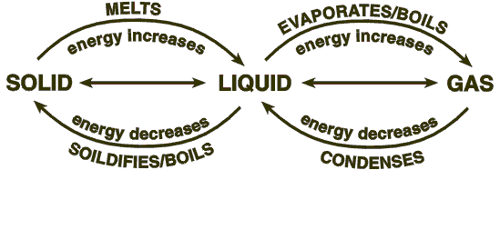
CHANGES IN STATE
Sublimation is a direct change from solid to gas, and deposition the reverse

Slide 3
States of matter
For solutions, volume is considered (1 liter = 1 dm³ = 1000 cm³)
  Expressed g dm⁻³ or mol dm⁻³
  How many grams of sodium hydroxide can be found in 3 liters of 5.00 mol dm⁻³?
  Solvent: the matter you’re dissolving in (often water)
  Solute: the matter being dissolved
Liquids are recorded in volume, density (mass/volume) is sometimes considered
Mass or volume may be used for gases
Gases are measured in dm³
  One mole of any gas will occupy the same volume at the same temp & pressure
  Note that temperature may be measured in degrees Celsius or Kelvin (273K = 0 °C 305K = 32°C)

