Slide 1
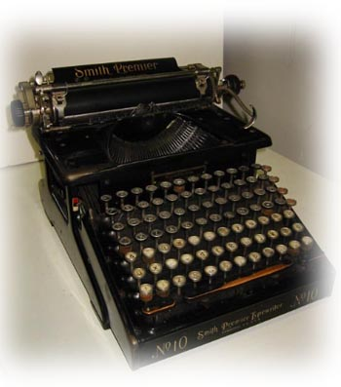
Burroughsin laskukone
Adding Machine is a class, to the mechanical calculator, which specializes in accounting calculations. United States oldest calculating machines were usually built to read in dollars and cents. Calculating machines were part of office equipment, until they were replaced by new kinds of dropped in 1970, and so on their own computers around the beginning of the 1985's. Parents calculators is rarely seen in American offices in the 2000s.
William Seward Burroughs received a patent for his laskukoneellensa 25 August, 1888. The grandson came up with the writer William S. Burroughs decline in machine upgrades. The Son, the Son was a collection of essays called calculator.

