Slide 1
Plastic in the ocean

Slide 2
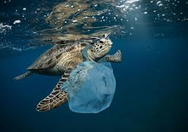
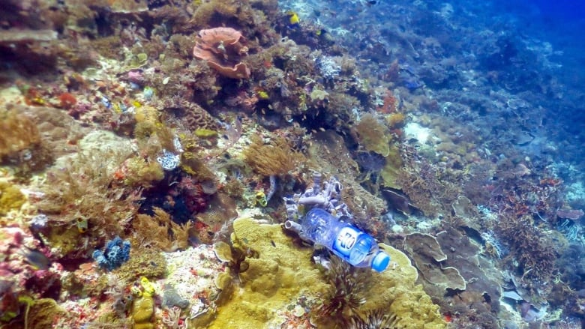
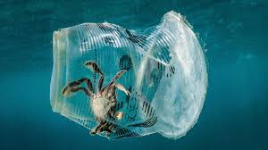
What is the issue?
Over years the demand for plastic drastically increased. Every year 8 million tons of plastic enters our oceans damaging marine life, which will eventually cause major problems with life on earth.
Our project is focusing on ways we can help stop this world issue.

Slide 3
How we feel
When we started the project we established why we feel it is important:
Worried about the future and future generations
Mad at how the government are doing nothing about it
Angry because some people ignore the effects that plastic pollution can have on animals and humans just because they don’t want to change their lifestyles
Concerned about our wildlife being destroyed
Scared because we don’t know what happens next

Slide 4
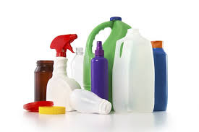
What ways do we most use plastic?
The use and production of plastic has drastically increased in recent years. There are many ways in which we use plastic:
There is a very large percentage of plastic used in the home. Food is commonly wrapped in PVC cling film, packaged in plastic tubs and stored in plastic bottles.
Trains, planes, automobiles and even ships all extensively use plastic.
A vast amount of plastic grocery bags are also being used even though better alternatives are available everywhere.

Slide 5
Types of plastic
PETE – Polyethylene Terephthalate
Is commonly used for fizzy drinks, water bottles and salad trays. PETE is widely recycled back into the manufacturing of items such as textiles, clothing, food and beverage containers and even carpet.
HDPE – High Density Polyethylene
Is used for milk bottles, bleach, detergents and some shampoo bottles. The main characteristics are:
Translucent
Fairly stiff and hard; can be scratched with a fingernail
Easily cut with smooth edges
Floats in water

Slide 6
Types of plastic
PVC – Polyvinyl Chloride and UPVC – Unplasticized Polyvinyl Chloride
There is only one difference between PVC and UPVC and that is that PVC contains BPA and phthalates, which are two plasticizers that make it more flexible. The “U” in UPVC stands for unplasticized because it doesn’t have these extra materials, it is often called rigid plastic. UPVC’s are:
Transparent unless pigment has been added
Stiff and hard
Easily cut out with smooth edges

Slide 7
Types of plastic
LDPE – Low Density Polyethylene
Is commonly used for bin liners, packaging film, squeezable bottles and carrier bags. These are the main characteristics:
Translucent
Fairly flexible, easily scratched
Easily cut with smooth edges
Floats in water

Slide 8
Types of plastic
PP – Polypropylene
Is used in the packaging of food and non-food containers, margarine tubs, microwaveable meal trays.
Translucent
Stiff, hard can be scratched by a fingernail
Easily cut but can have white cut marks
Floats in water

Slide 9
Types of plastic
PS – Polystyrene
Is most commonly known for its packaging protection uses especially electronic goods and toys whilst in transit. It is also used for packaging some foods such as hamburger boxes, egg cartons, and yoghurts. PS is not typically recycled.

Slide 10
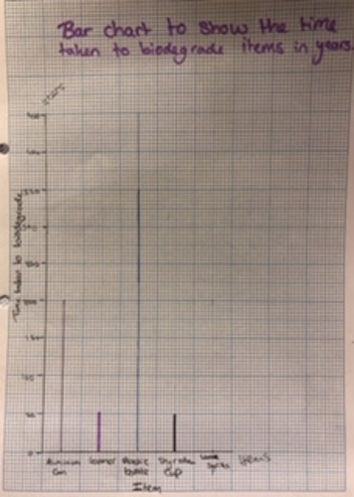
Item | Time taken to biodegrade (years)
Aluminium can | 200
Leather | 50
Plastic bottle | 450
Styrofoam cup | 50
Wool socks | 1

Slide 11
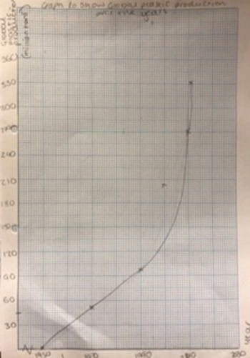
Year | Global plastic production (million tons)
1950 | 0.35
1970 | 50
1990 | 100
2000 | 200
2010 | 270
2016 | 335

Slide 12
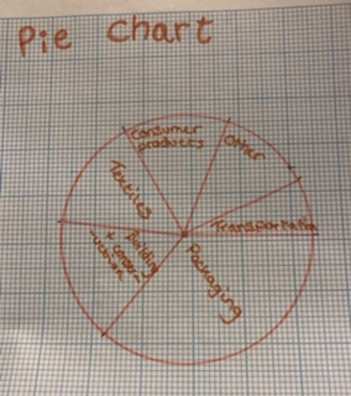
Use | Percentage of total plastic use
Packaging | 36
Building and construction | 16
Textiles | 15
Consumer products and electricals | 14
Transportation | 7
Other | 12

Slide 13
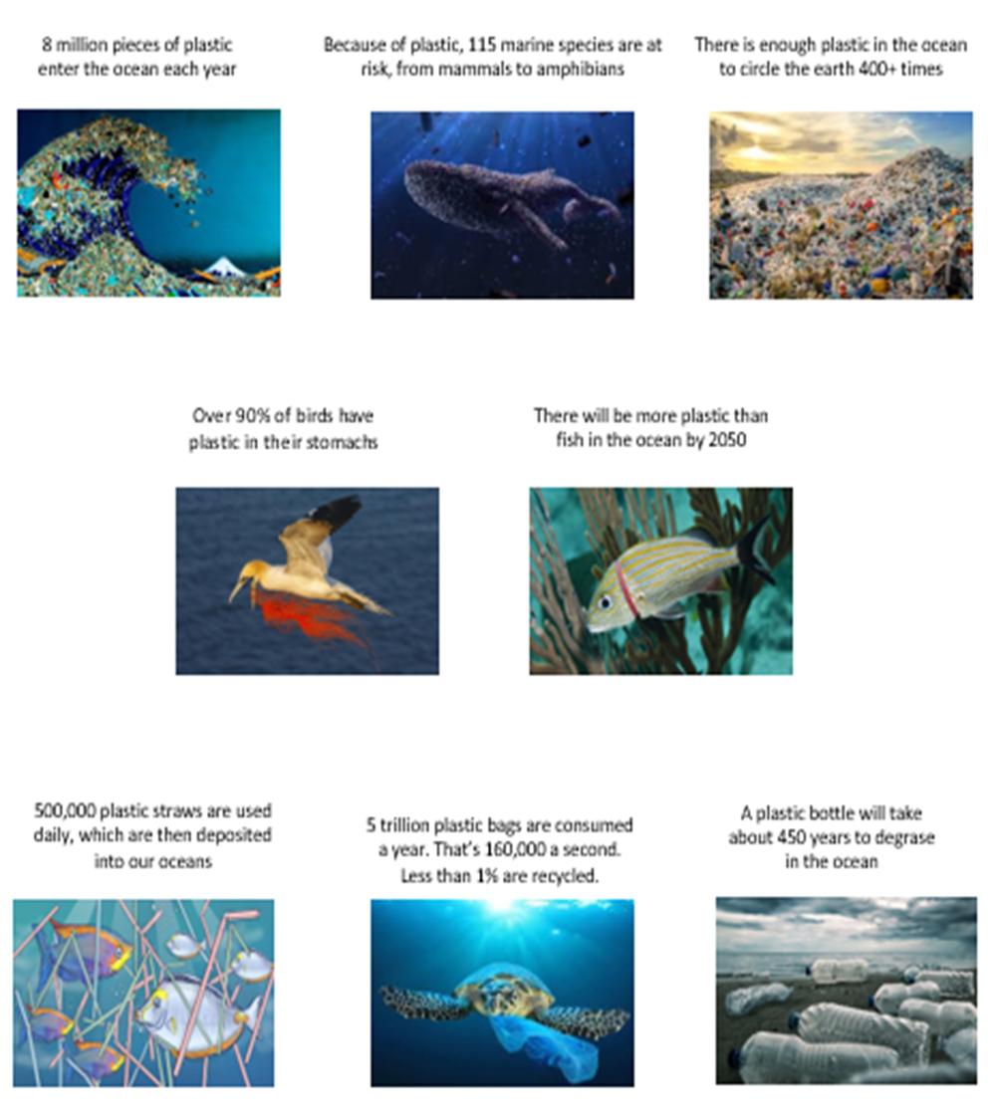
8 reasons to refuse single-use plastic

Slide 14
6 tips on reducing plastic
Video

Slide 15
Experiment

Slide 16
What is it and why?
As plastic bottles are the main contributor to plastic pollution we challenged ourselves to come up with a product that could act as a water bottle but wasn’t made out of plastic.
The reason we are doing this is because as our population increases as a vast rate the demand for single use plastic is also increasing and so a majority of this plastic finds its way into our beautiful oceans and is damaging our marine life. Not only does this plastic harm wildlife, plastic doesn’t biodegrade so it just breaks into smaller pieces of plastic called micro plastics. Micro plastics are then eaten by smaller fish as they think it is food, these smaller fish are then eaten by things further up the food chain, for example squid and sharks. Micro plastics also find their way into fish such as tuna and lots of the human population eat tuna causing us to have micro plastics in our stomach. We do not yet know how bad this could be for the human body.
The PowerPoint that we used to help us with our tasks pointed us in the direction of spherification.

Slide 17
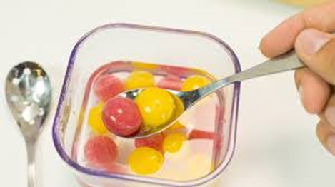
what is spherification?
Spherification is a culinary process that requires sodium alginate and calcium chloride to shape a liquid into squishy spheres. The way it works is that when the 2 chemicals come into contact they react and form a membrane around the liquid and so you are able to transport the liquid and have it whenever you desire. The membrane is also edible and so no waste is produced from this product.

Slide 18
what will we need?
To carry out this project we needed:
5g calcium lactate
500ml distilled water
2.5g sodium alginate
250ml fruit puree juice

Slide 19
How will we do it?
The method:
Firstly we needed to add the 5g of calcium lactate to the 500ml of water and blend until there were lots of air bubbles and all of the calcium lactate had dissolved. Then leave the bowl containing the calcium lactate and water to settle for an hour.
We then needed to blend our fresh fruit to get the puree juice. Once we had obtained this we needed to use a hand-held immersion blender to mix the sodium alginate into the puree. This process took a long time.
Using a teaspoon, scoop up the berry mixture and gently pour the mixture into the calcium bath and leave the bubble to “cook” for 1 minute in the bath, turning the bubble over several times halfway through the “cooking2 time.
Gently remove the “sphere” from the bath using a slotted spoon and transfer it into a clean water bath to rinse off any excess calcium on its surface. Remove and place into a second water bath to ensure all excess solution is removed.

Slide 20
Problems we encountered
We followed the instructions very carefully and when it came to placing our solutions in the calcium bath our membranes didn’t form and we couldn’t understand why. We kept replacing the calcium bath as it was very dirty from our failed attempts but that wasn’t the problem. We believed that the issue was the thickness of our sodium alginate puree so to solve this we watered it down and added more sodium alginate. After many more goes our experiment started to produce positive results so we were very happy. The only thing we would improve if we were to carry out this experiment again is the shapes of our spheres because they weren’t very round.

Slide 21
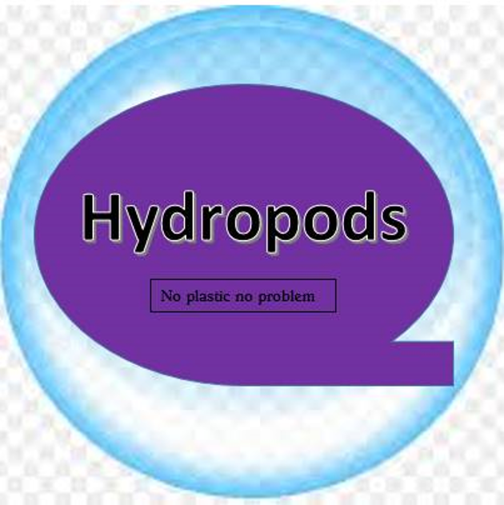
Branding
Who is our target audience?
Everyone!
How would we advertise?
Social media is a big platform, we could sponsor other campaigns also raising awareness about ocean plastic
Is there any competition?
At the moment there is no competition, however if there were to be a ban on plastic bottles we hope this idea will grow
How would we price them?
Our pricing would have to compete with bottled items but would also have to cover the cost of the making process

Slide 22
How would we package them?
Packaging solutions can be made from Notpla, a material made from seaweed and plants which disappear naturally within 4-6 weeks. Notpla is made from one of natures most renewables resource, brown seaweed.
Other ideas for storage once bought:
In water (so the bubbles don’t pop)
In reusable containers
Definitely should not store them with any sharp items such as knives as they could pop
In the fridge so they don’t expire if they are filled with juice and similar products

Slide 23
Conclusion
Overall we believe that the project as a whole went very well and the workshops we partook in really benefitted the group, we believe that the activity we enjoyed the most was the spherification as it was the most hands on task. The task gave us a chance to co-operate together and try something no one had done before. The tasks leading up to the spherification during the week were also very informative and gave the group lots of knowledge about plastics in the ocean and how we can cut down as well as influencing others to help cut down on plastic usage. We have learnt throughout the week that plastic pollution is a global issue and we have learnt how other countries are helping to fight the issue

Slide 24
Thank You

