Slide 1
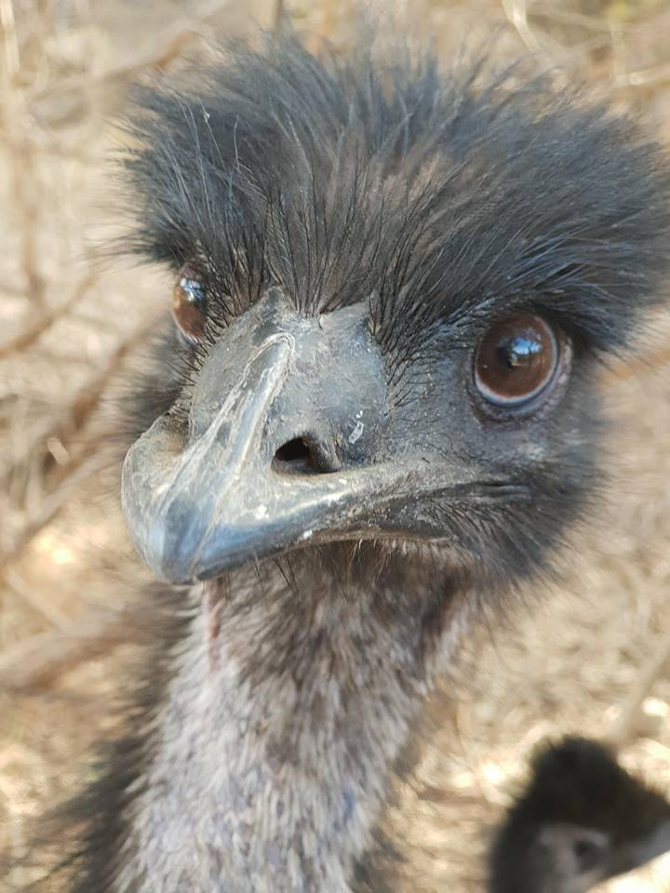
Emu War
Jere Määttänen

Slide 2
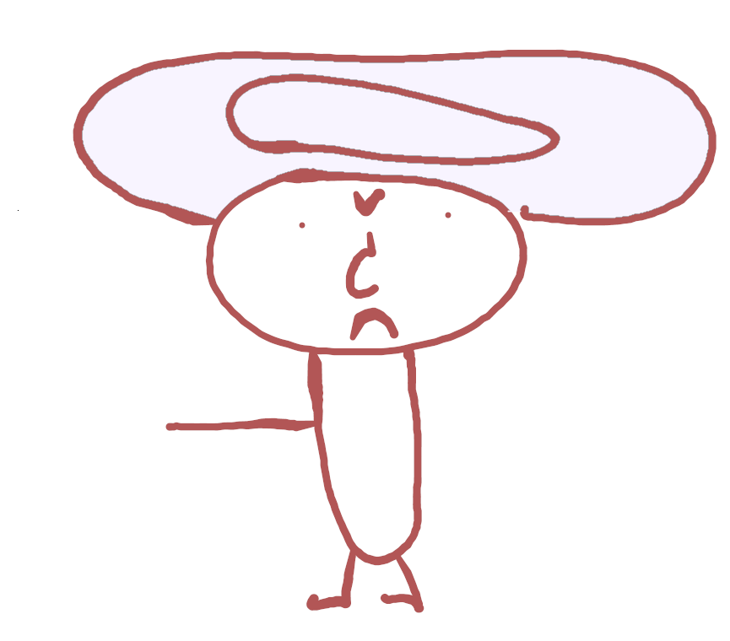
What is the ”Emu war”?
The Emu war is an Australian military operation which took place in 1932
It was between Australia and Emus
Australia declared war on emus because they kept eating all the crops

Slide 3
What caused the ”War”
It was really dry in Australia in 1932 so about 20 000 emus started eating crops off people’s plantations
People were getting mad because well.. they lost their food
The citizens of Australia wanted this madness to stop and asked the military if they could help to ”clear” the emus

Slide 4
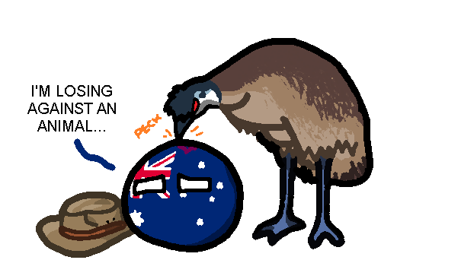
Surprising about the war
The first operations failed miserably
The guns weren’t working
Emus had an incredible tactic

Slide 5
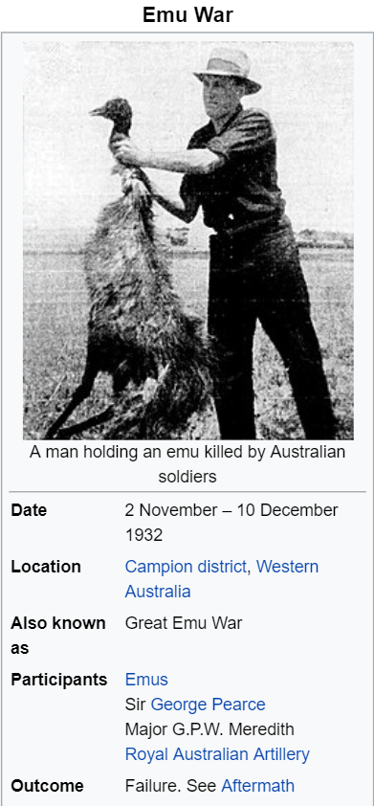
The outcome of the war
10 000 shots were fired
300 emus were killed
Emus won
yayay!

Slide 6
Sources
https://www.google.com/search?q=Emu&source=lnms&tbm=isch&sa=X&ved=0ahUKEwiJm723-avgAhU6QhUIHRHEBHMQ_AUIDigB&biw=1920&bih=938#imgrc=gD8uaXvD0VQFwM:
https://www.google.com/search?q=emu+wars&source=lnms&tbm=isch&sa=X&ved=0ahUKEwjUqIvszbXgAhWDJVAKHd_KBJgQ_AUIDigB&cshid=1549954339954521&biw=1920&bih=938#imgrc=6tLVT7TISvPApM:
https://fi.wikipedia.org/wiki/Emusota
https://en.wikipedia.org/wiki/Emu_War

