Slide 1
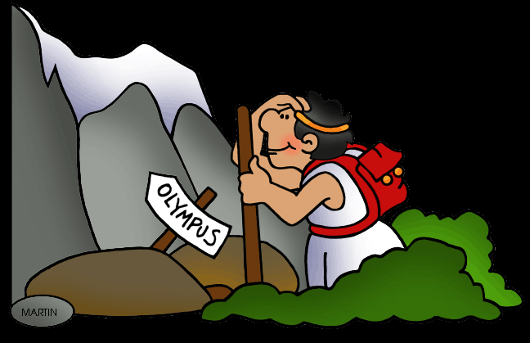

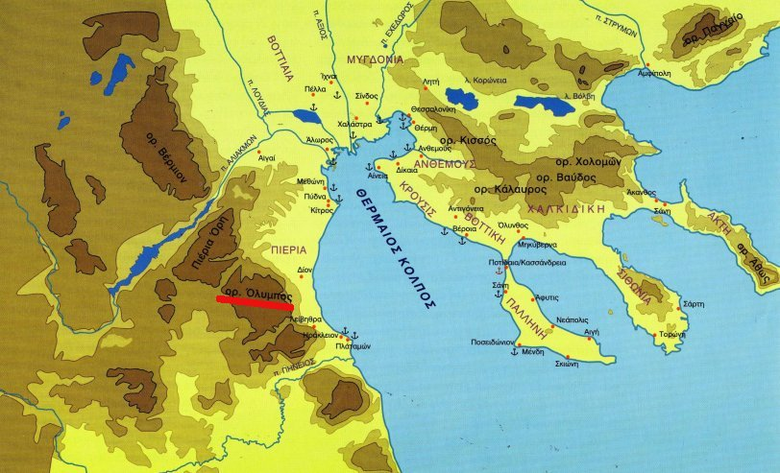

Slide 2
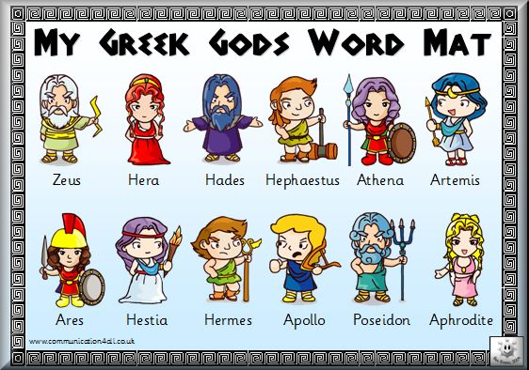
Greek Gods

Slide 3

1. ΔΙΑΣ (ΖΕΥΣ)
ZEUS was the King of the Gods and the god of the sky
lightning bolt, an eagle.

Slide 4
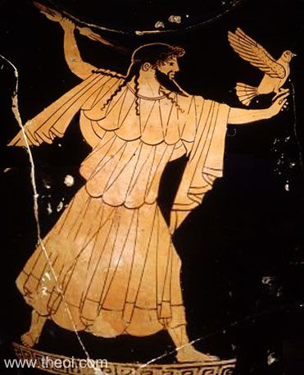

Slide 5
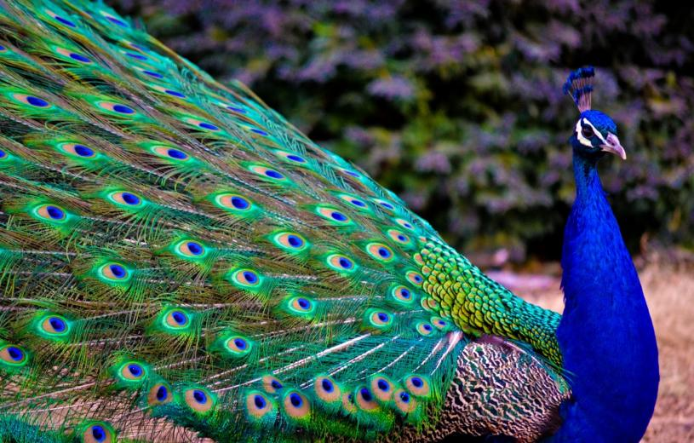
2. Ήρα
HERA was the Olympian queen of the gods, and the goddess of marriage, women, the sky and the stars of heaven.
peacock

Slide 6
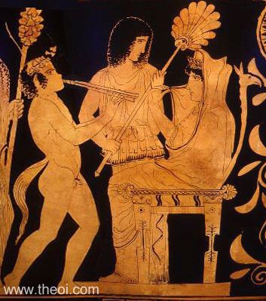

Slide 7
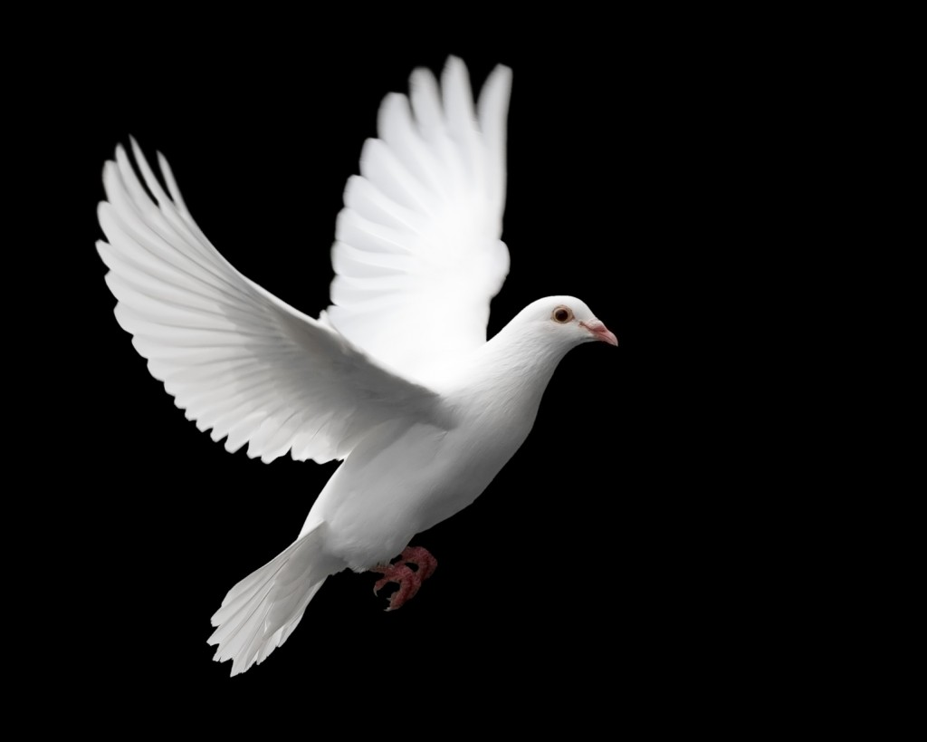
3. Αφροδίτη
APHRODITE was the Olympian goddess of love, beauty,
Dove, apple

Slide 8
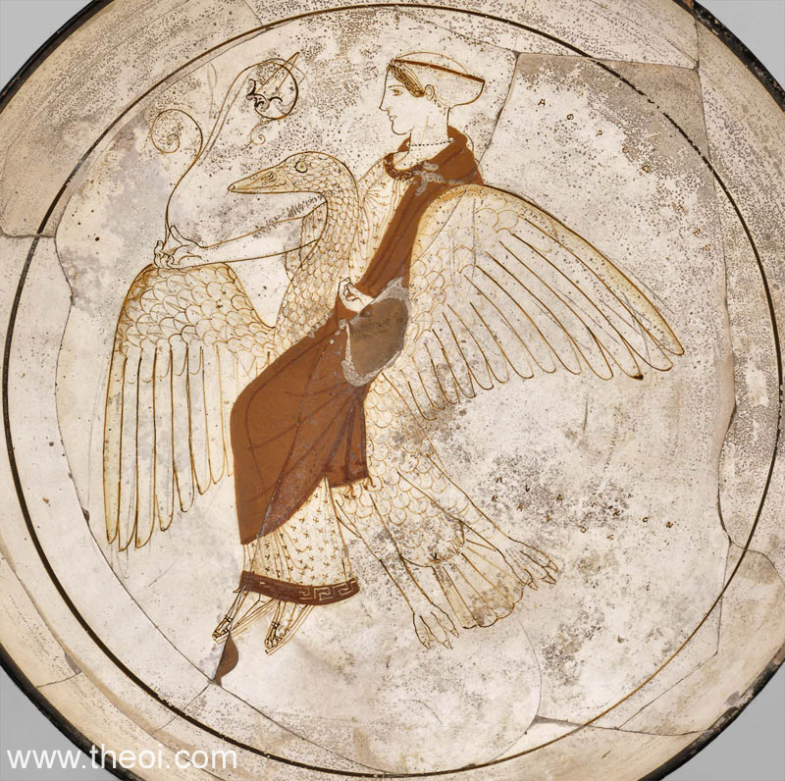

Slide 9
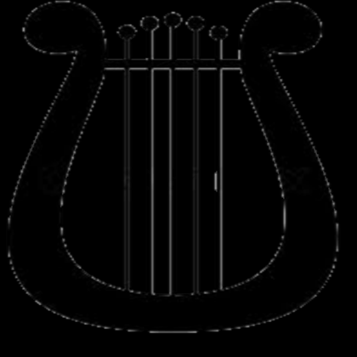
4. Απόλλωνας
APOLLON (Apollo) was the Olympian god of prophecy and oracles, music, song and poetry, archery, healing, plague and disease, and the protection of the young
Lyre

Slide 10
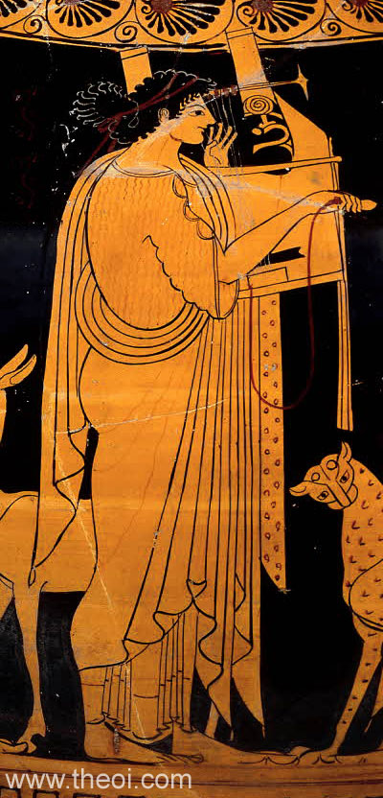

Slide 11

5. Άρης
ARES was the Olympian god of war, warrior armed for battle

Slide 12
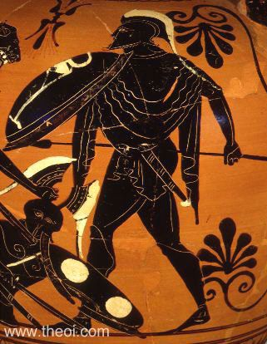

Slide 13

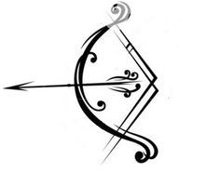
6. Άρτεμης
ARTEMIS was the Olympian goddess of hunting.

Slide 14
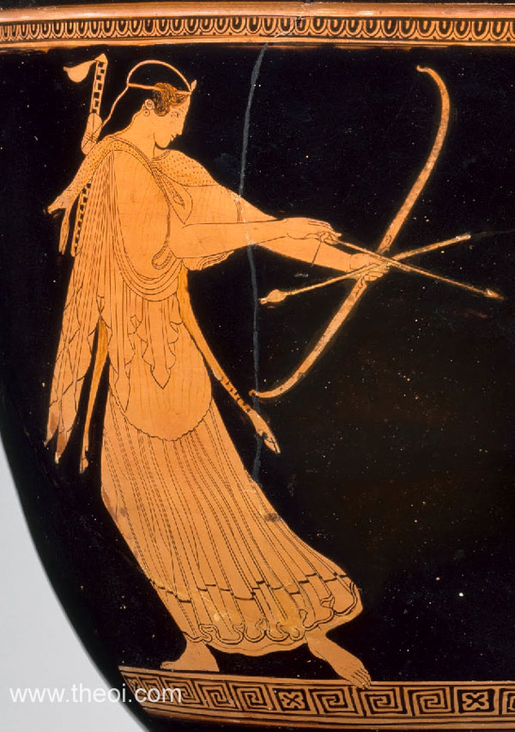

Slide 15

7. Aθηνά
ATHENE (Athena) was the Olympian goddess of wisdom
Owl

Slide 16
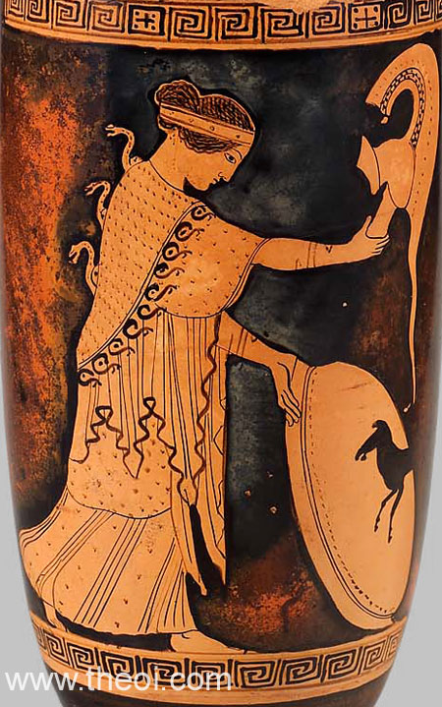

Slide 17
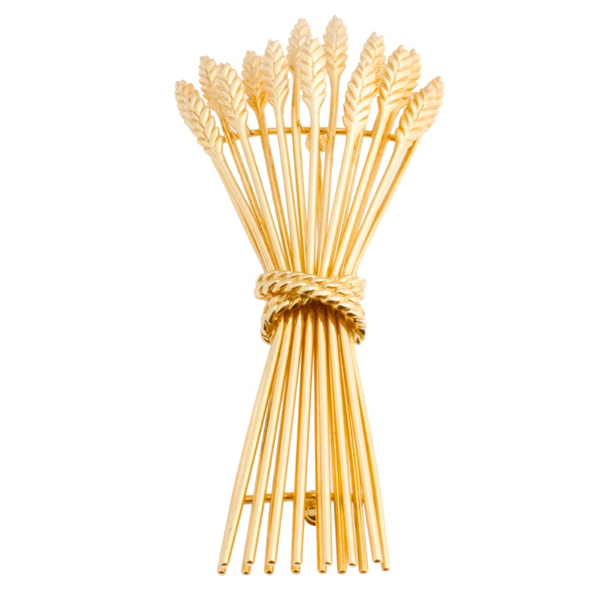
8. Δήμητρα
DEMETER was the Olympian goddess of agriculture.

Slide 18
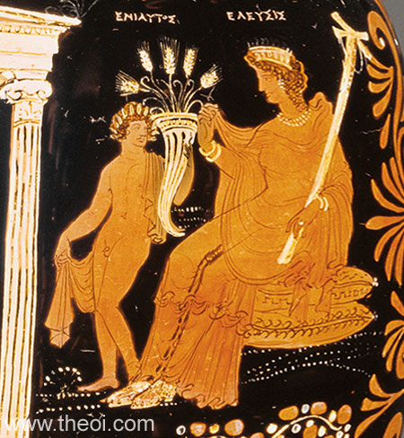

Slide 19
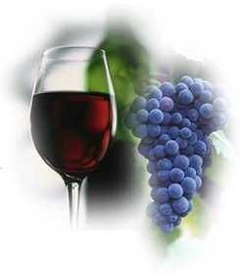
9. Διόνυσος
DIONYSOS (Dionysus) was the Olympian god of wine

Slide 20
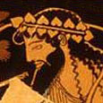

Slide 21
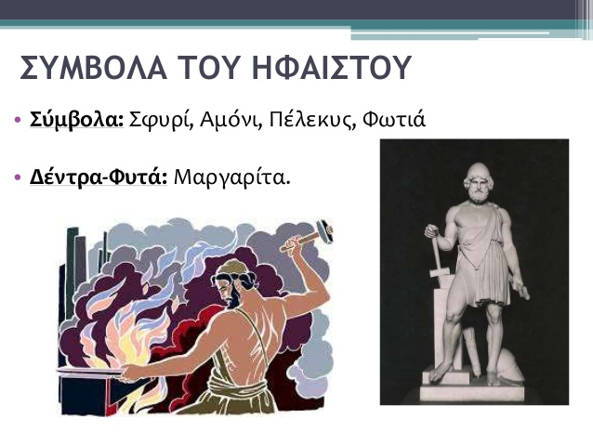

10. Ήφαιστος
HEPHAISTOS (Hephaestus) was the Olympian god of fire,
a hammer, fire

Slide 22
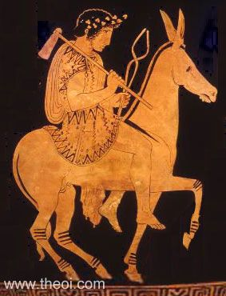

Slide 23
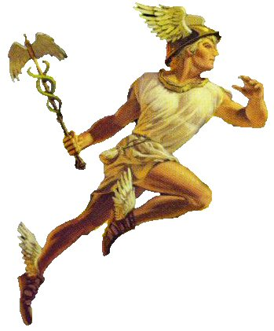
11. Ερμής
HERMES was the Olympian god of herds and flocks, travellers and hospitality.
winged boots and a herald's wand.

Slide 24
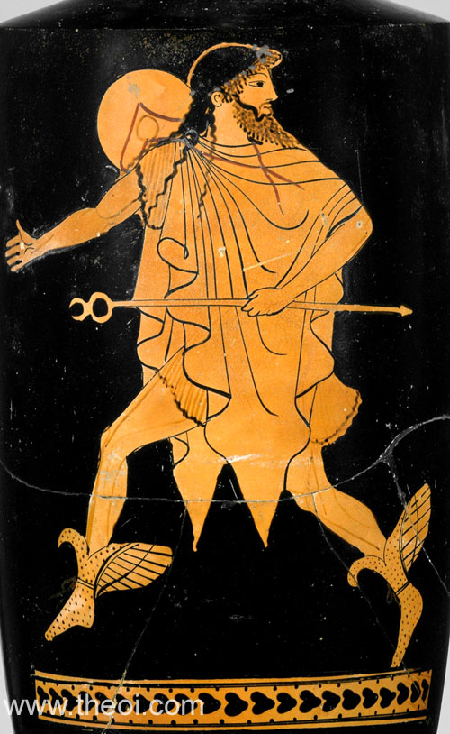

Slide 25
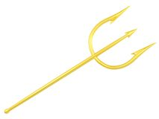
12. Ποσειδώνας
POSEIDON was the Olympian god of the sea
trident (a three-pronged fisherman's spear) and a dolphin

Slide 26
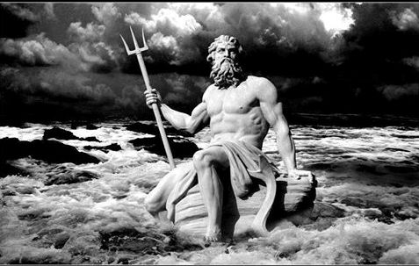

Slide 27

Kiitos

