Slide 1
THE NATURE OF KNOWLEDGE
TOK Jyväskylän Lyseon lukio

Slide 2

TASK
Review your definitions of knowledge in Teams
In your opinion, which definition is the best one?

Slide 3
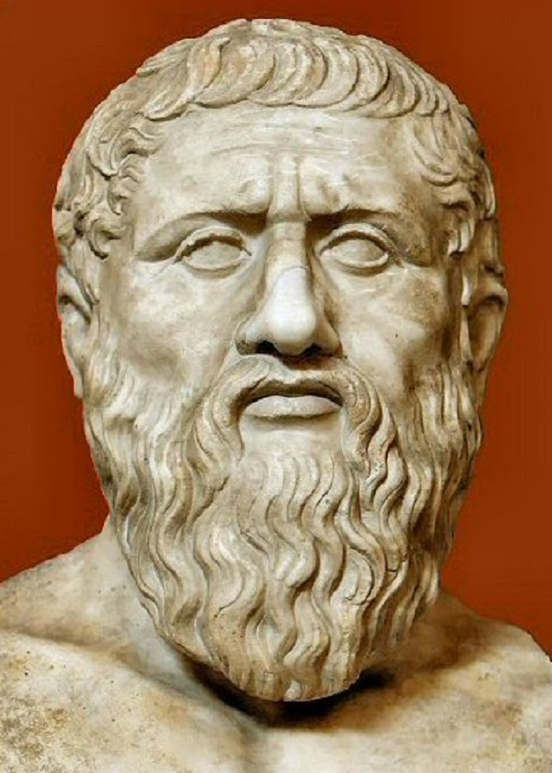
Classical Definition of Knowledge
KNOWLEDGE:
  JUSTIFIED
  TRUE
  BELIEF

Slide 4

Truth
The correspondence between a belief
and the reality
  E.g. the belief ”There is a university in Jyväskylä” is true, if there really is a university in Jyväskylä
Objective requirement of knowledge

Slide 5
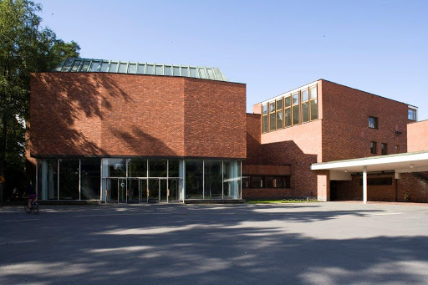
Truth
” ”

Slide 6
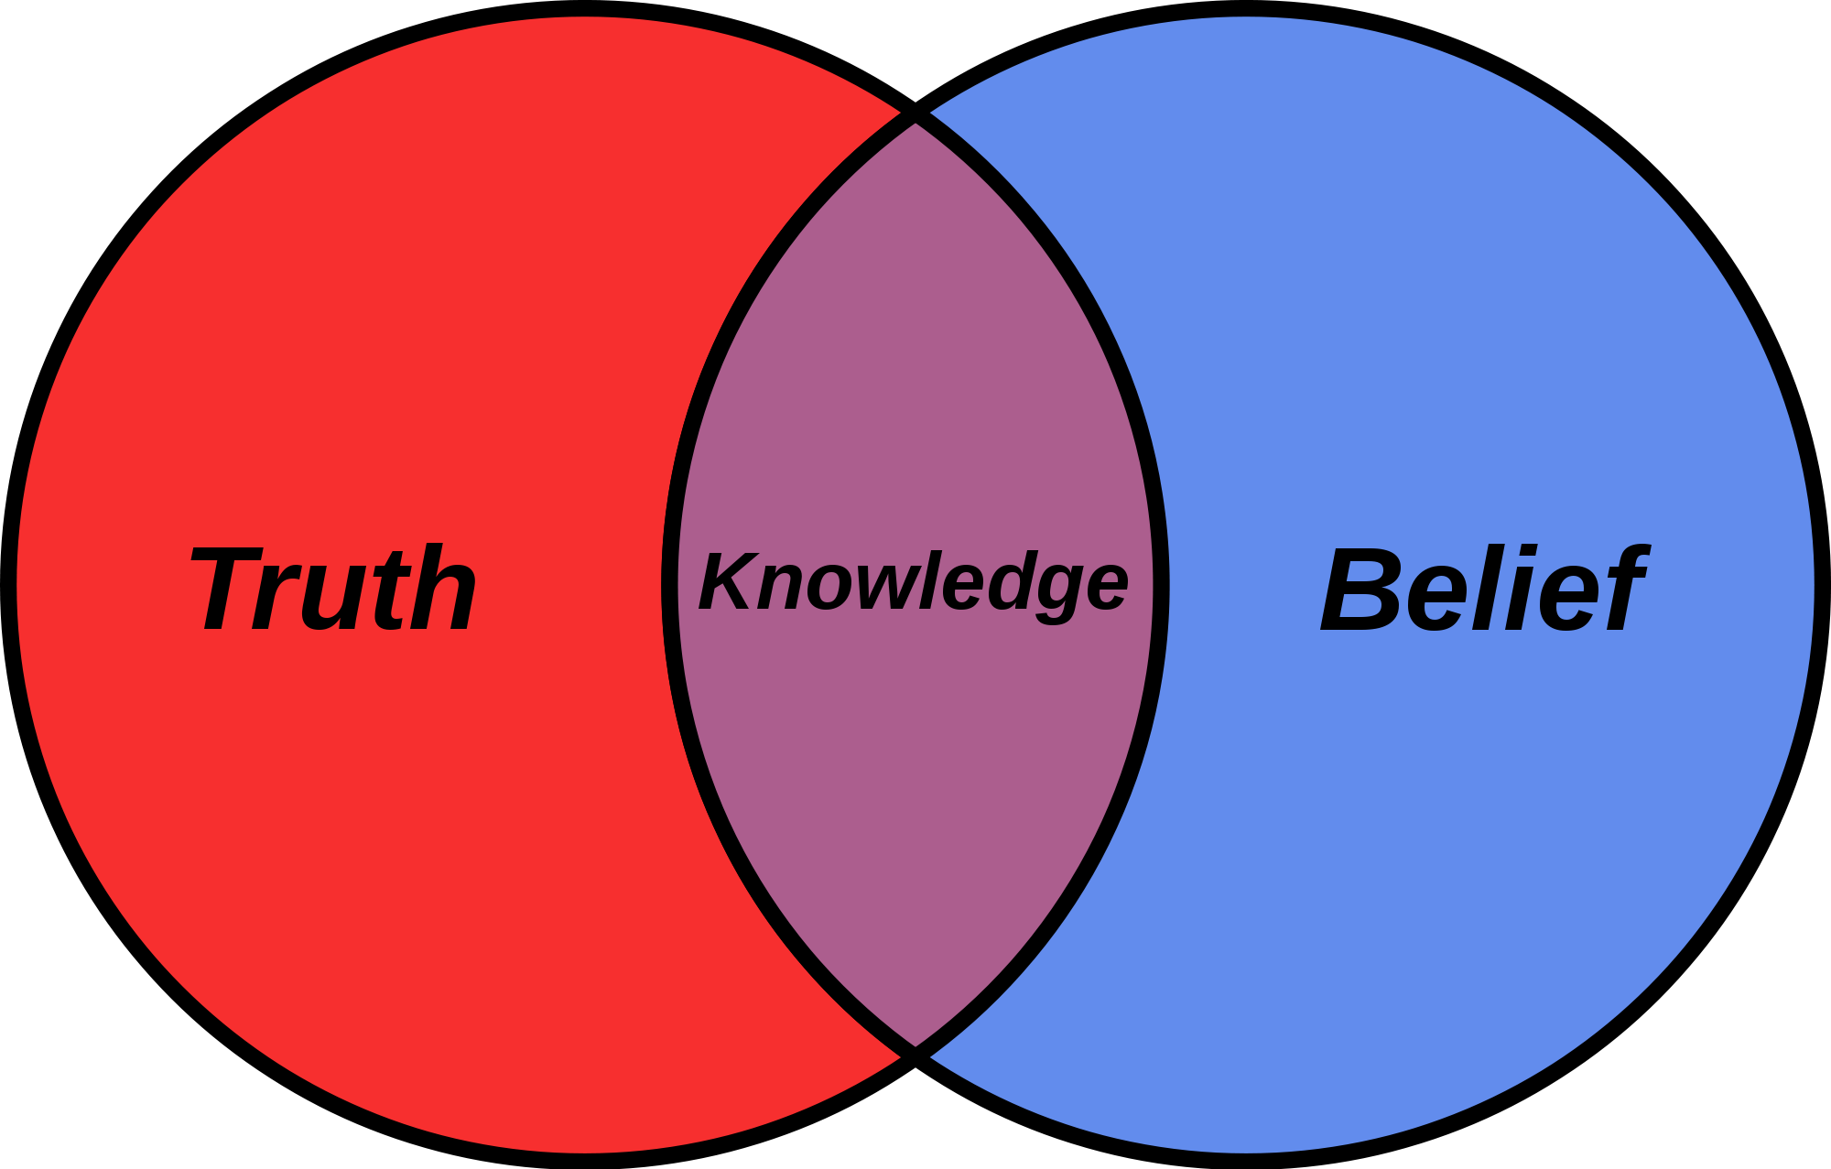
Belief
A psychological state in which a knower thinks something is the case
  The knower must understand what the belief is about
Subjective requirement of knowledge

Slide 7

Belief
” ”

Slide 8
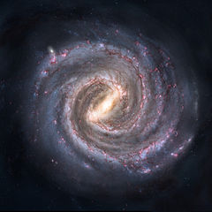
Belief
” ”
Knowledge requires a knower, someone who thinks something of something
If there is no subject of knowledge, there is no knowledge
  The reality just exists without a knower

Slide 9
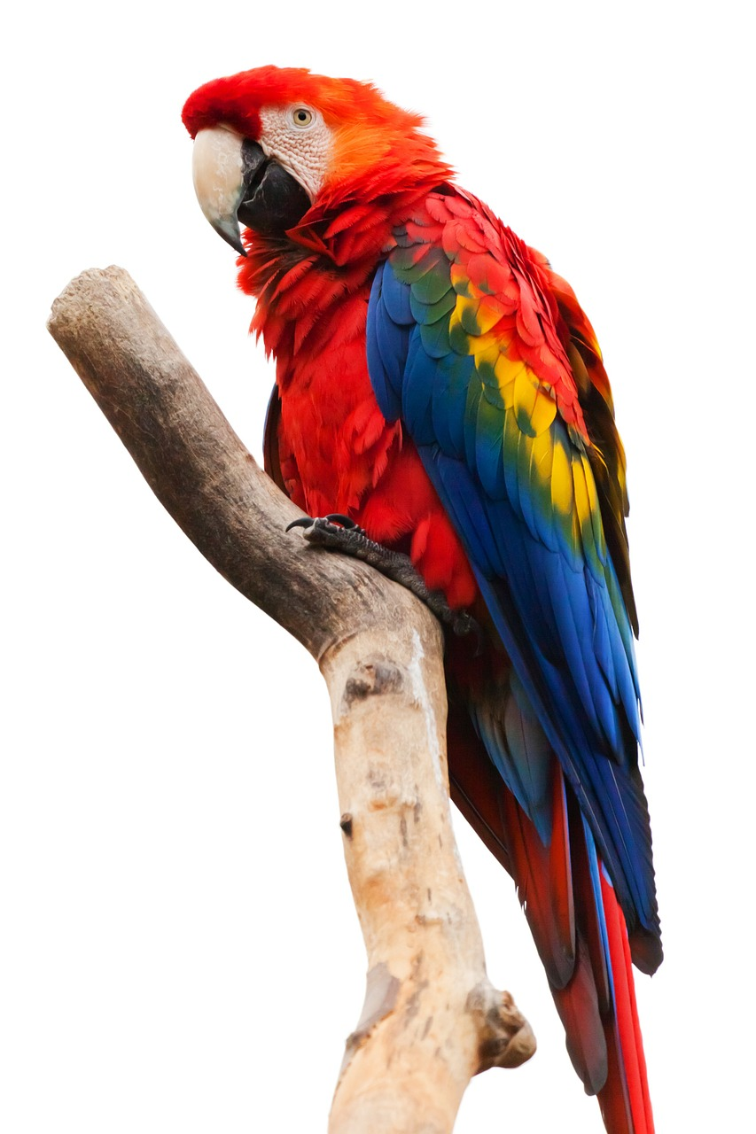
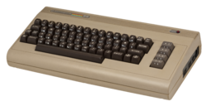
TASK
What kind of creatures can have beliefs?
  E.g. can animals be subjects of knowledge?
Will it ever make sense to say that a computer KNOWS something?
  Can a computer be a subject of knowledge?

Slide 10

Justification
The way how the knowers belief is pointed to be true
In order to be knowledge, beliefs should be supported with evidence

Slide 11
Justification
” ”
HOW do we
know this?

Slide 12
TASK
  Evidence
  Certainty
  Truth
  Interpretation
  Power
  Justification
  Explanation
  Objectivity
  Perspective
  Culture
  Values
  Responsibility
Engage in conversation with your small group
Try to find different ways to justify your beliefs!
  Your beliefs can be from any field of life or related to any subject imaginable
Try to apply the core concepts of TOK shown on the right

Slide 13
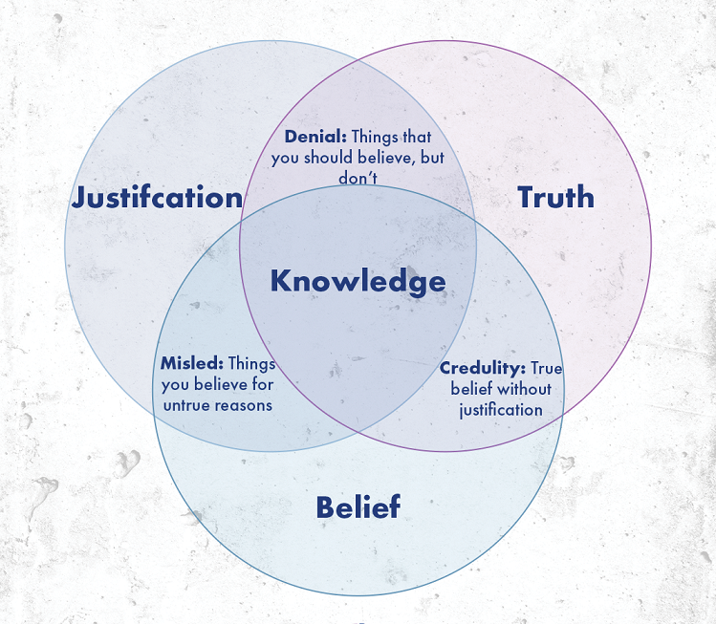
Classical Definition of Knowledge
We have knowledge when:
  something is true
  we believe it is true
  we have good reasons for believing it is true

Slide 14
TASK
Try to evaluate the classical definition of knowledge
  Can you spot any shortcomings in it?
  Should knowledge be approached differently in the modern world?

Slide 15
Modern Definition of Knowledge
Truth is considered more as a probability, NOT as a certainty, especially in sciences
The importance and means of justifications have become paramount
Knowledge should be accessible to anyone
  Everyone should be able to evaluate and assess knowledge and how it is justified
HOW do we know
something is the case?

Slide 16
Modern Definition of Knowledge
≈
” ”

Slide 17
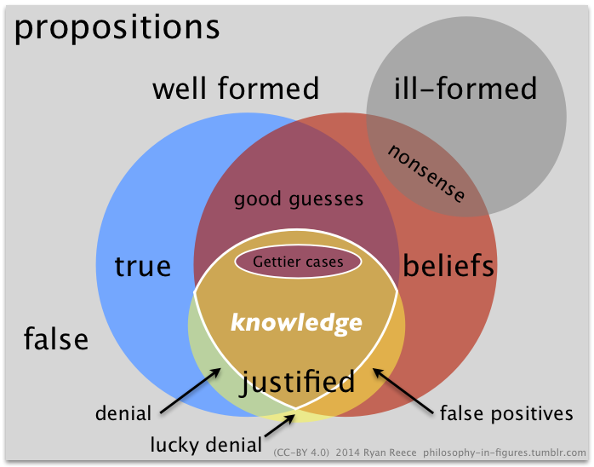
Modern Definition of Knowledge

Slide 18

TASK
Why are the criteria for what counts as a knowledge not obvious?

Slide 19

TASK
Think about the knowledge you have gained in your life
  How do the definitions of knowledge and the requirements of knowledge relate to the knowledge you hold?

Slide 20
Picture sources
Knowledge <http://www.stonecobra.com/knowledge-as-a-service-kaas-a-proposal/> Accessed 15th of August 2015.
Plato <https://antiikinhistoriajakulttuuri.com/2015/08/20/platonin-ja-aristoteleen-erilaiset-naiskuvat/> Accessed 27th March 2017.
Truth sign <http://www.thegospelcoalition.org/article/holding-fast-to-truth-in-a-doubting-age> Accessed 15th of August 2015.
The main building of Jyväskylä University <http://www.rky.fi/read/asp/r_kohde_det.aspx?KOHDE_ID=182> Accessed 31st of March 2020.
Truth and belief <https://en.wikipedia.org/wiki/Belief> Accessed 15th of August 2015.
Parrot <https://pixabay.com/fi/eläinten-ara-macao-nokka-lintu-84485/> Accessed 8th of March2017.
Commodore 64 <https://fi.wikipedia.org/wiki/Commodore_64> Accessed 15th of August 2015.
Milky way <https://en.m.wikipedia.org/wiki/File:Milky_Way_Galaxy.jpg> Accessed 12th of August 2021.
Evidence <http://janiczek.com/why-choose-us/evidence-based-investing/> Accessed 15th of August 2015.
Knowledge, justification, truth and belief Venn diagram <https://www.intelligentspeculation.com/blog/knowledge> Accessed 28th of March 2025
Venn diagram of the classical definition of knowledge <https://philosophy-in-figures.tumblr.com> Accessed 16th of April 2021.
Criteria <https://www.beger.com.au/buying-moving-house-checklist/> Accessed 31st of March 2020.
Chemistry bottles <https://sites.google.com/a/chsd117.org/cheek-chemistry/> Accessed 15th of August 2015.

