Slide 1
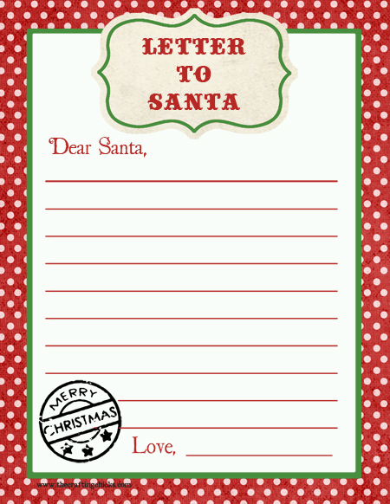
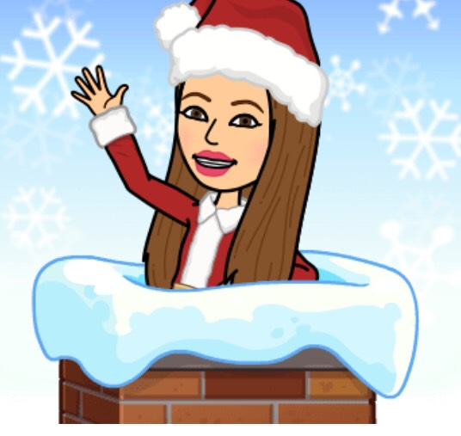

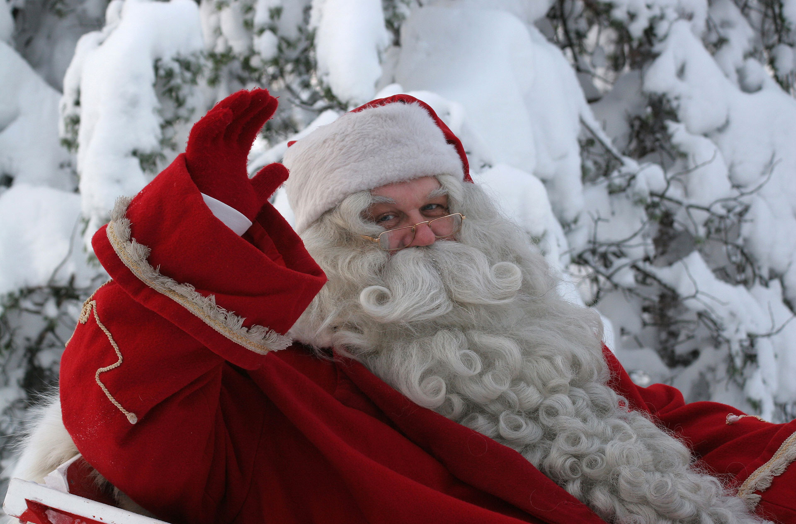
Santa can you hear me ?
I have been so good this year and all I want is love and peace for all the people in this world. I would also wish for warm hugs and happy moments with my friends , family and pupils.
I could also ask for some warm boots because here in Finland it is really cold for me!
PS: Cookies, milk and Christmas desserts will be waiting for you under the Christmas tree.
Katerina Eleftheriadi

Slide 2
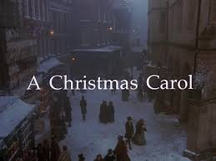

Slide 3
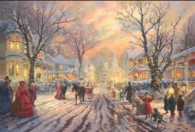
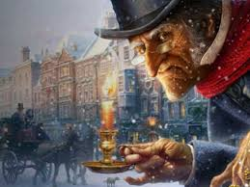
A Christmas Carol
Moi! I am Ebenezer Scrooge!
Do you know me?
I hate Christmas and I am a miserly mean man!
We could watch a short film about Scrooge’s story!
Are you ready?
https://www.youtube.com/watch?v=4SHROp-tls0

Slide 4
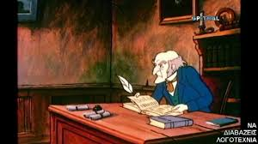
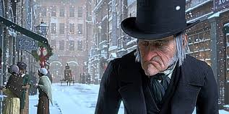
Ebenezer Scrooge is the main character of Charles Dickens' 1843 novel A Christmas Carol. He is a selfish and miserly old man who works at his office in London. Scrooge does not like to have fun and he is not kind, seeing it as a waste of time. That’s why he does not have friends. He hates Christmas (and the holiday season, in general). To him, "peace on Earth" and "Good will to all men" is like a knife to his heart (until his reformation at the end of the film). The character of Scrooge is partially inspired by Ralph Nickleby, a cruel moneylender in an earlier Dickens novel called Nicholas Nickleby.

Slide 5
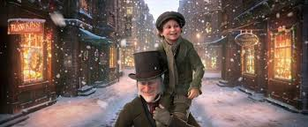
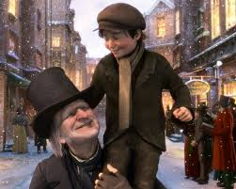
What happened at the end of the story?
Did Scrooge change his behavior?
Does he like Christmas right now?

Slide 6
Let’s play!!!

