Slide 1
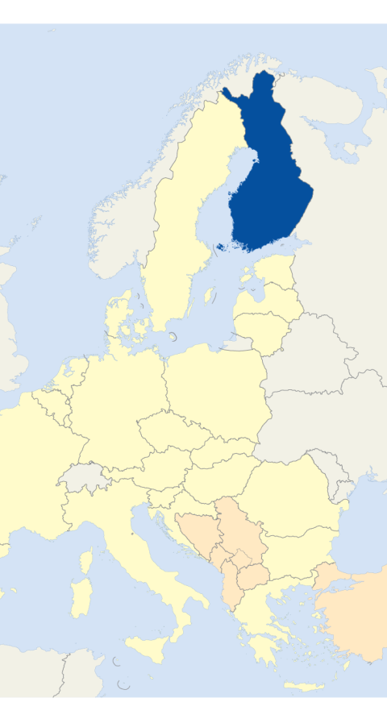
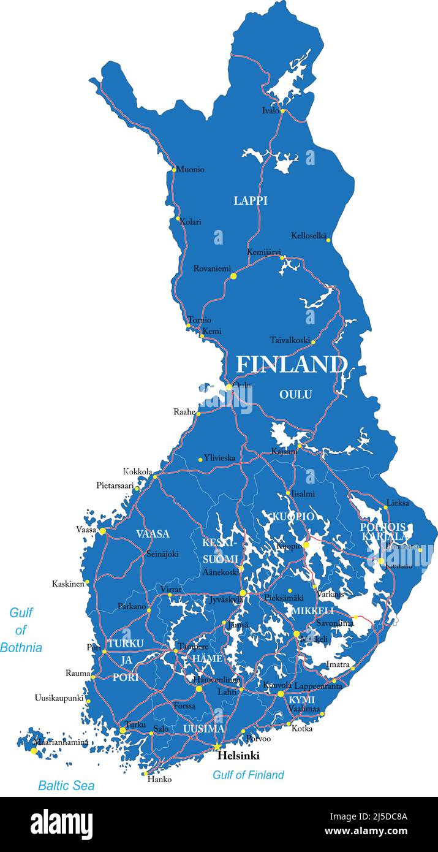

Palokka school is located in Jyväskylä in central Finland

Slide 2
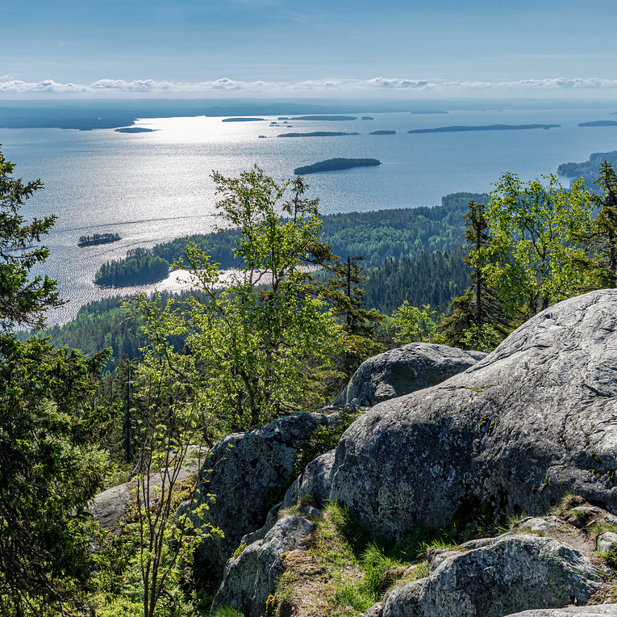
Things about Finland
We have short and mild summers and very cold winters
We are the happiest country in the world
Finns are quiet but honest people

Slide 3
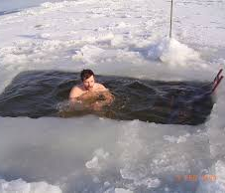
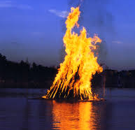
Culture
We have many lakes
Some of us start bonfires during a traditional midsummer party named "juhannus"
We swim in the winter
We swim in the summer
Sauna is a big part of the culture
We are also known for making Nokia (stronger than stone)

Slide 4
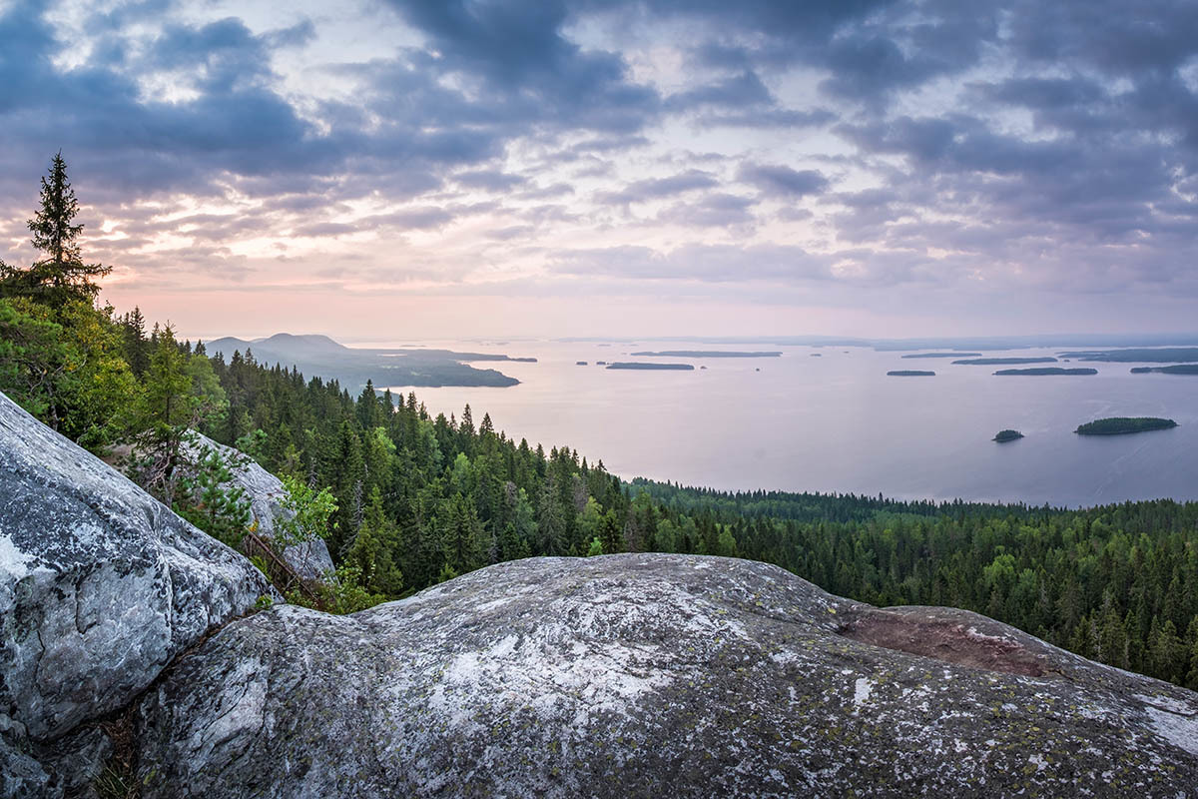
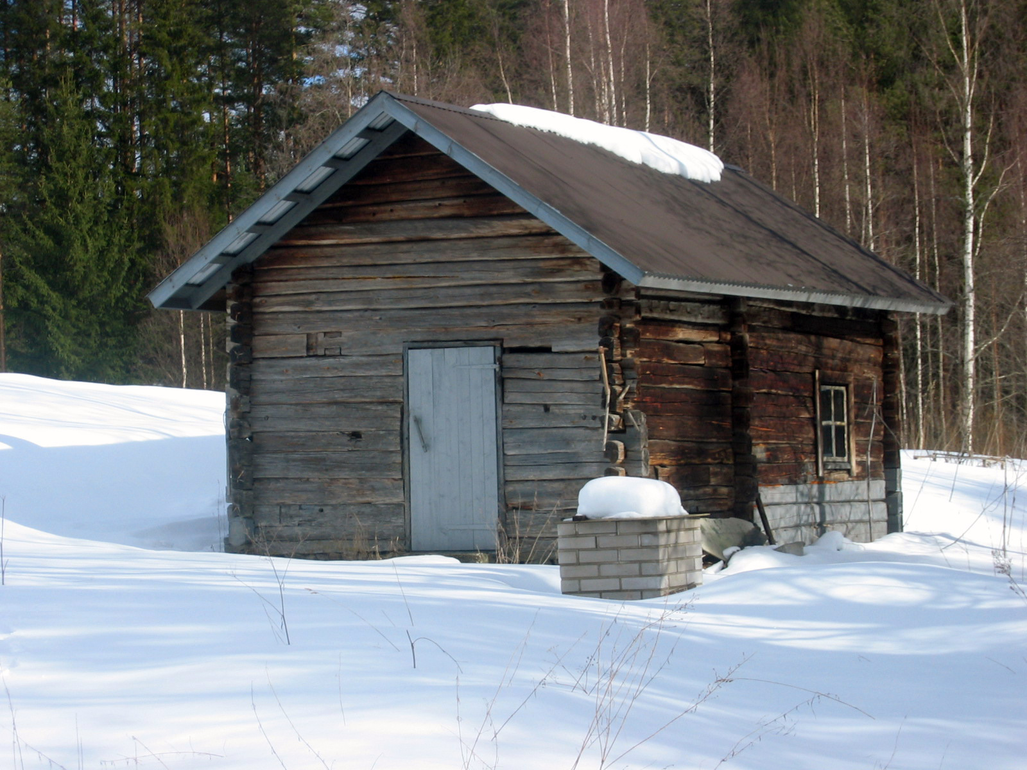
Culture
Finnish nature
In Finland there are a lot of forests and nature close by. Spending time in nature is really popular in all seasons.
In the summer Finnish people swim in lakes and many people go hiking in nature. In autumn it’s common to pick berries and mushrooms. In the winter people usually go skiing and in the spring we enjoy nature awakening.
Nature gives us a chance to relax and spend time peacefully.
Sauna
Going to sauna is a big part of Finnish culture. There are many saunas in Finland.
It helps our bodies to relax and the temperature helps the body to recover. It is easier to go to sleep after you have been in a sauna.

Slide 5
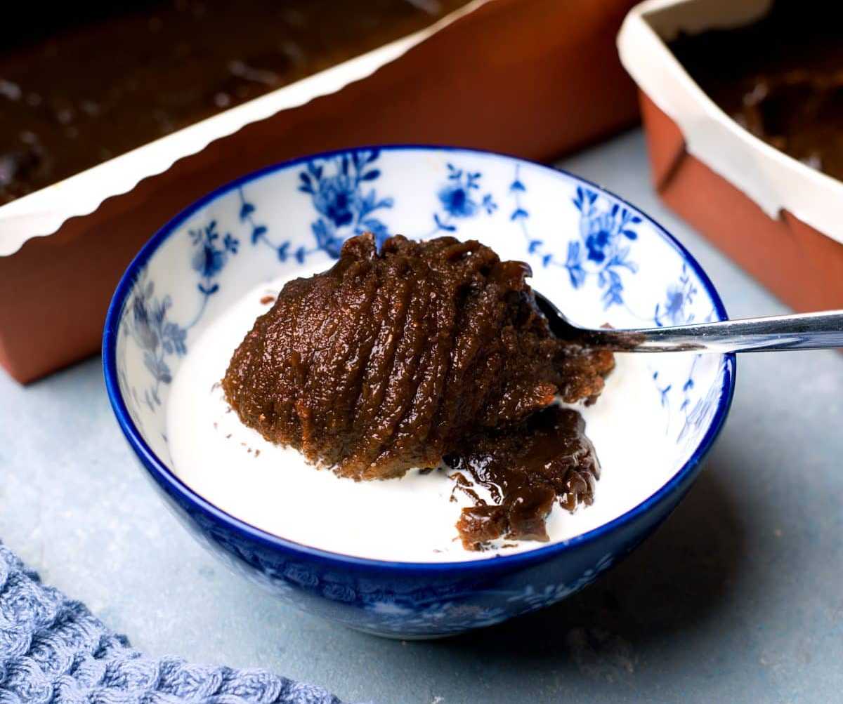
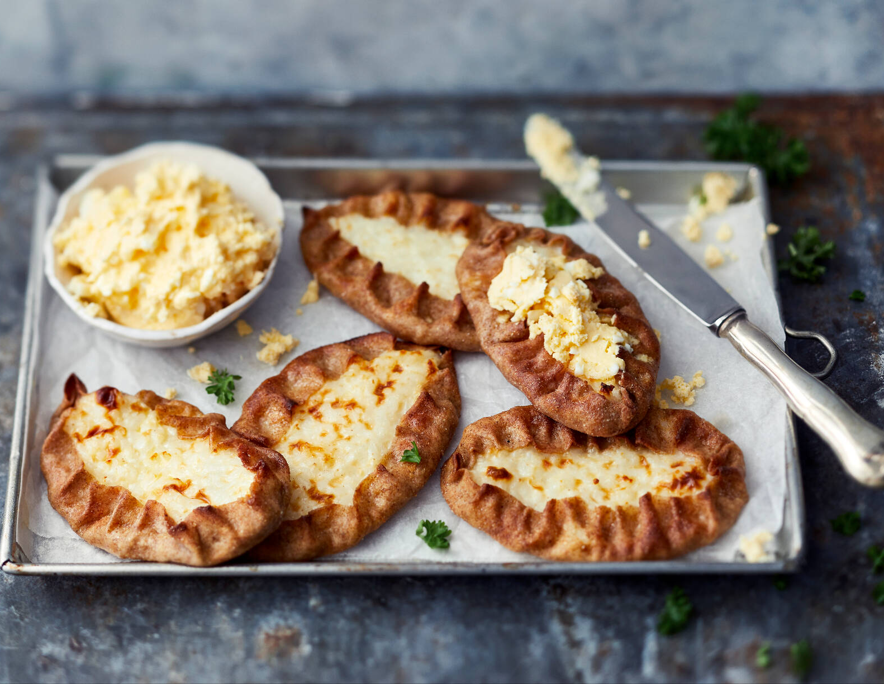
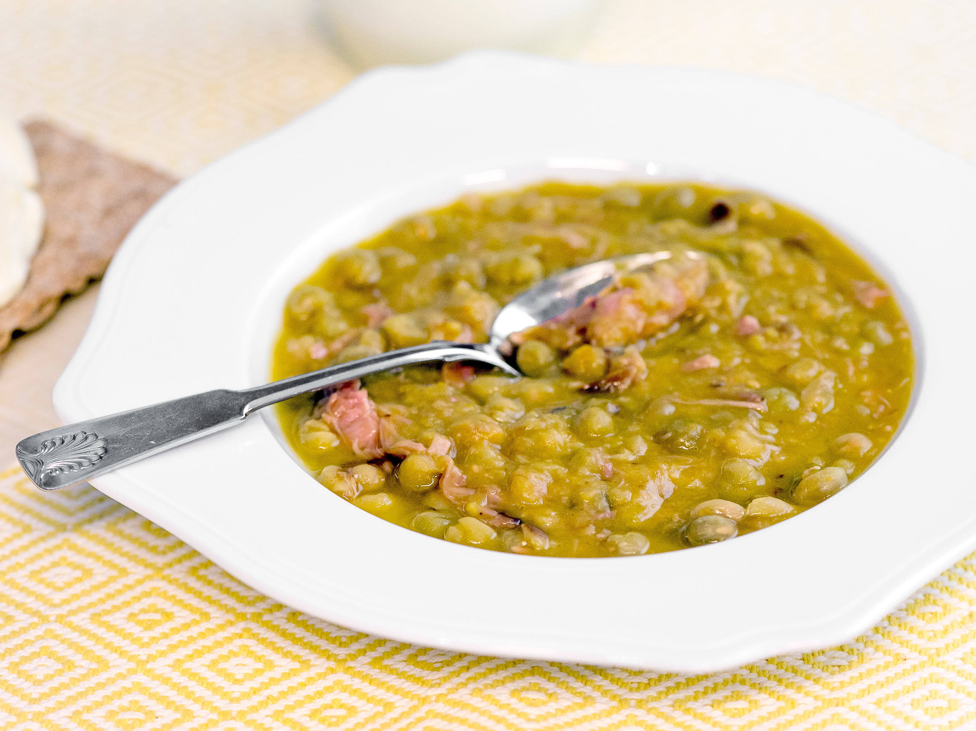
Traditional Finnish dishes
For example traditional Finnish dishes are:
Karjalanpiirakka is made of rye filled with rice porridge.
Hernekeitto is a thick soup made from dried peas and often added with pork.
Mämmi is Easter desert made of rye and flour. It' usually eaten with cream or milk and sugar.

Slide 6
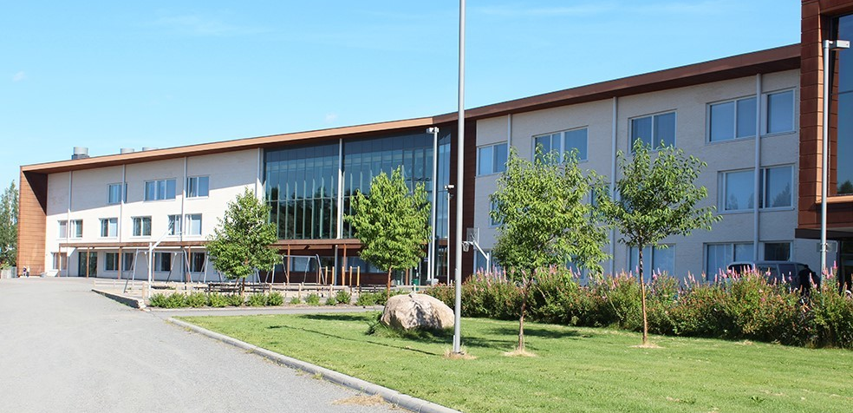
Welcome to Palokka School

Slide 7
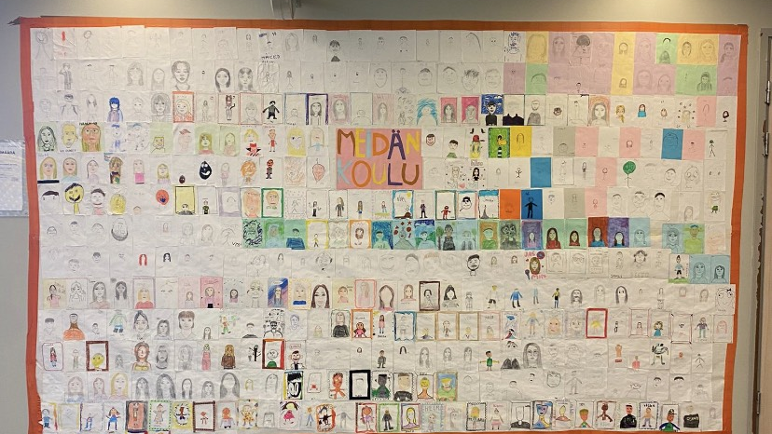
This is us
.

Slide 8
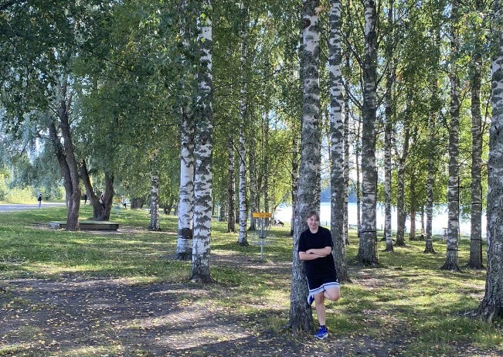
We have a forest and a lake
called Palokkajärvi near our school.
In winter, we go skiing
on the lake during PE lessons.
Sometimes we have PE lessons
in the forest.
Students in grades 1–6 also sometimes have science lessons there.

Slide 9
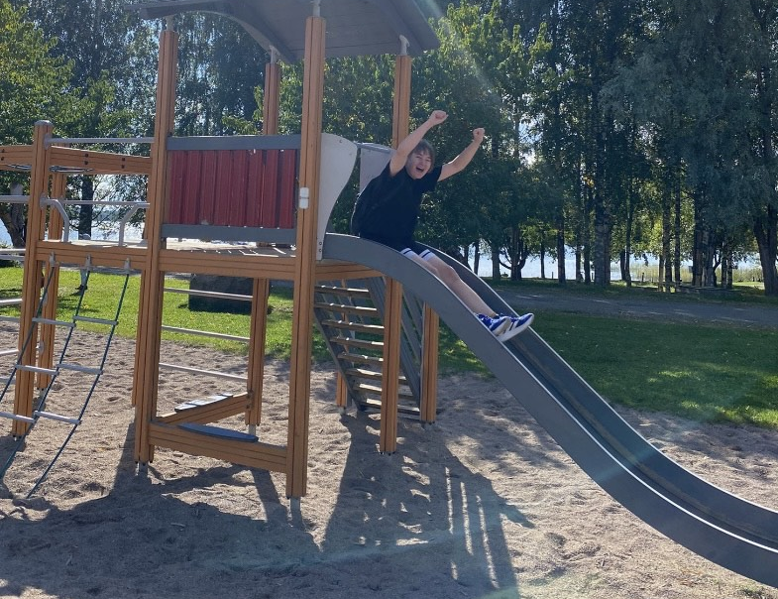
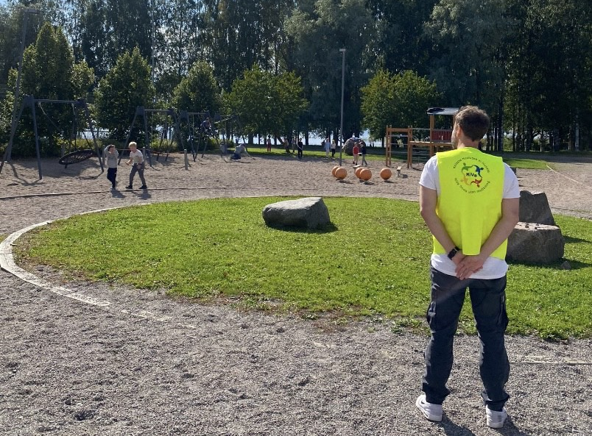
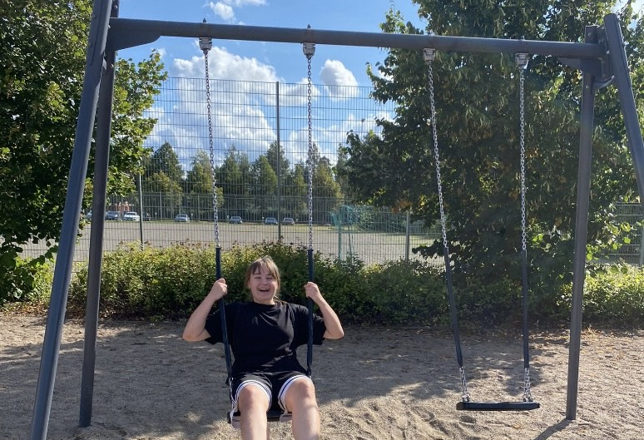
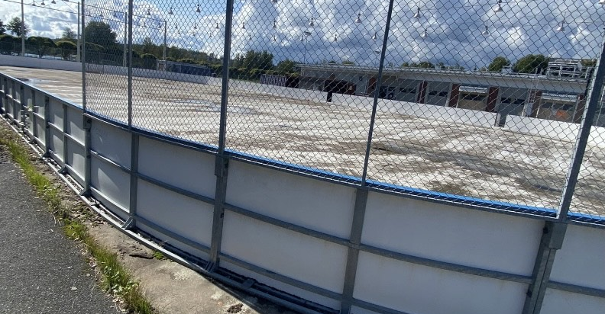
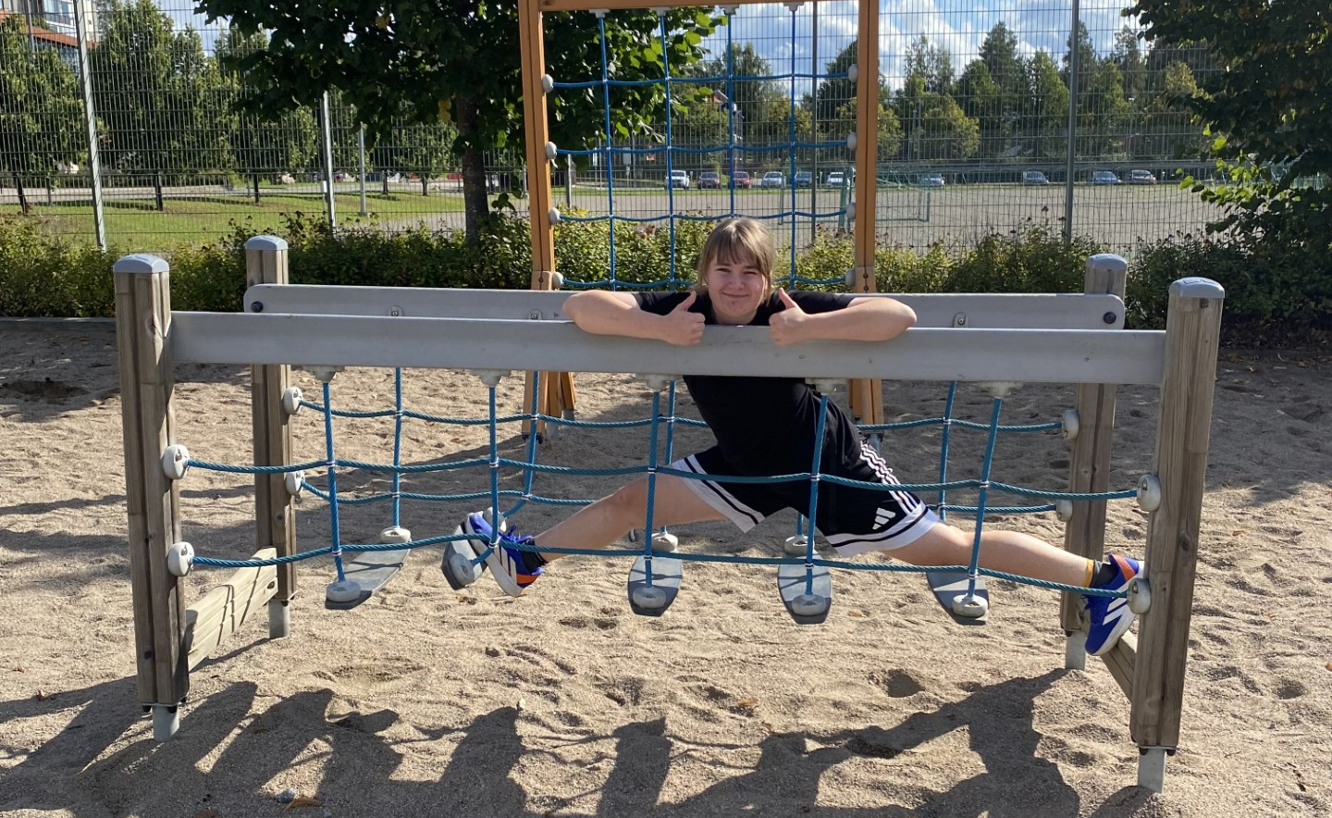
We have a playground in the school yard, where students in grades 1–6 play during school days.
We also have an ice rink where we skate in winter during our PE lessons.
There are always one or two adults supervising the students during recess.

Slide 10
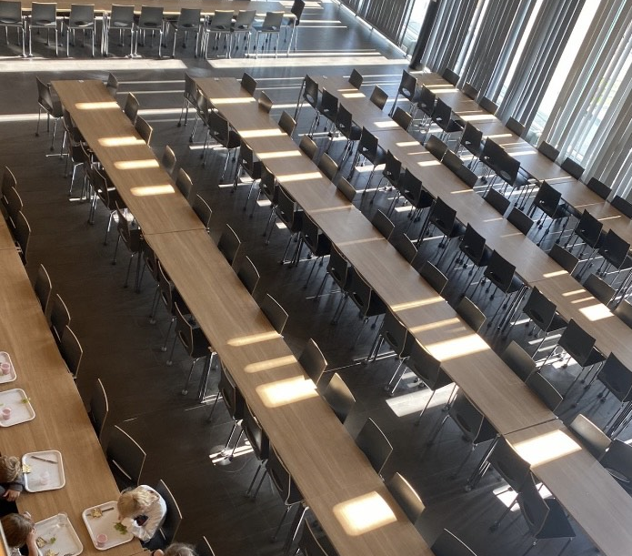
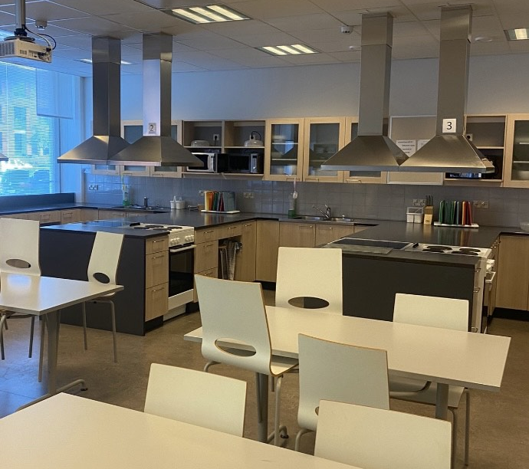
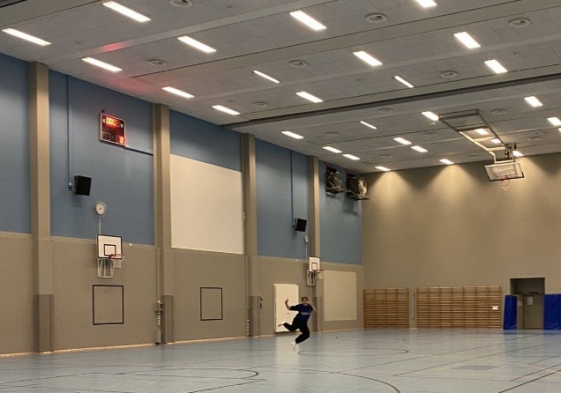
School building :D
We have a completely free lunch at school for all students. All the students eat in a huge cafeteria.
We have two kitchen classrooms for home economics and students cook food and bake there.
We have a massive gym for PE.

Slide 11
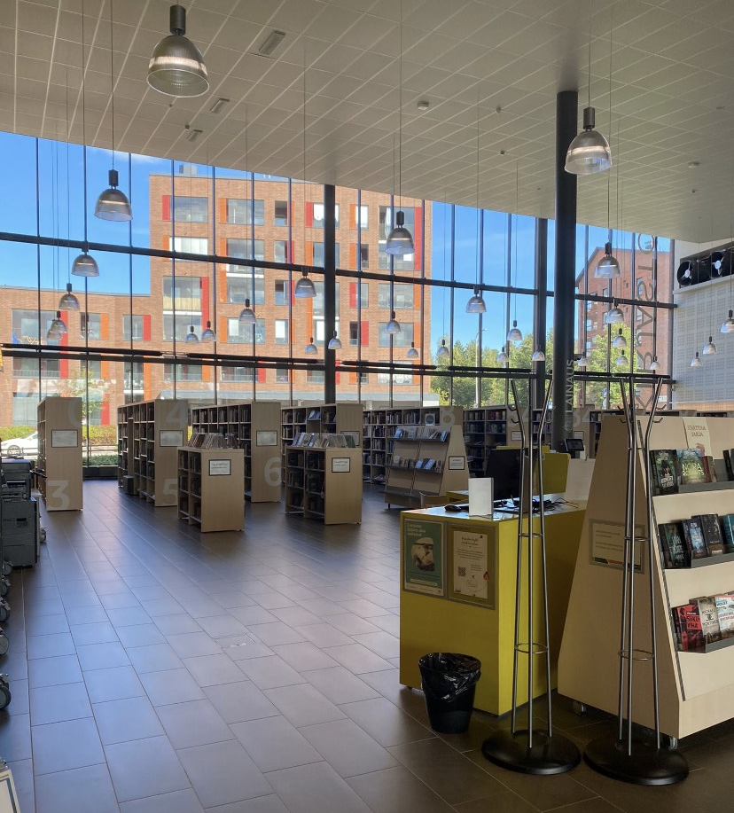
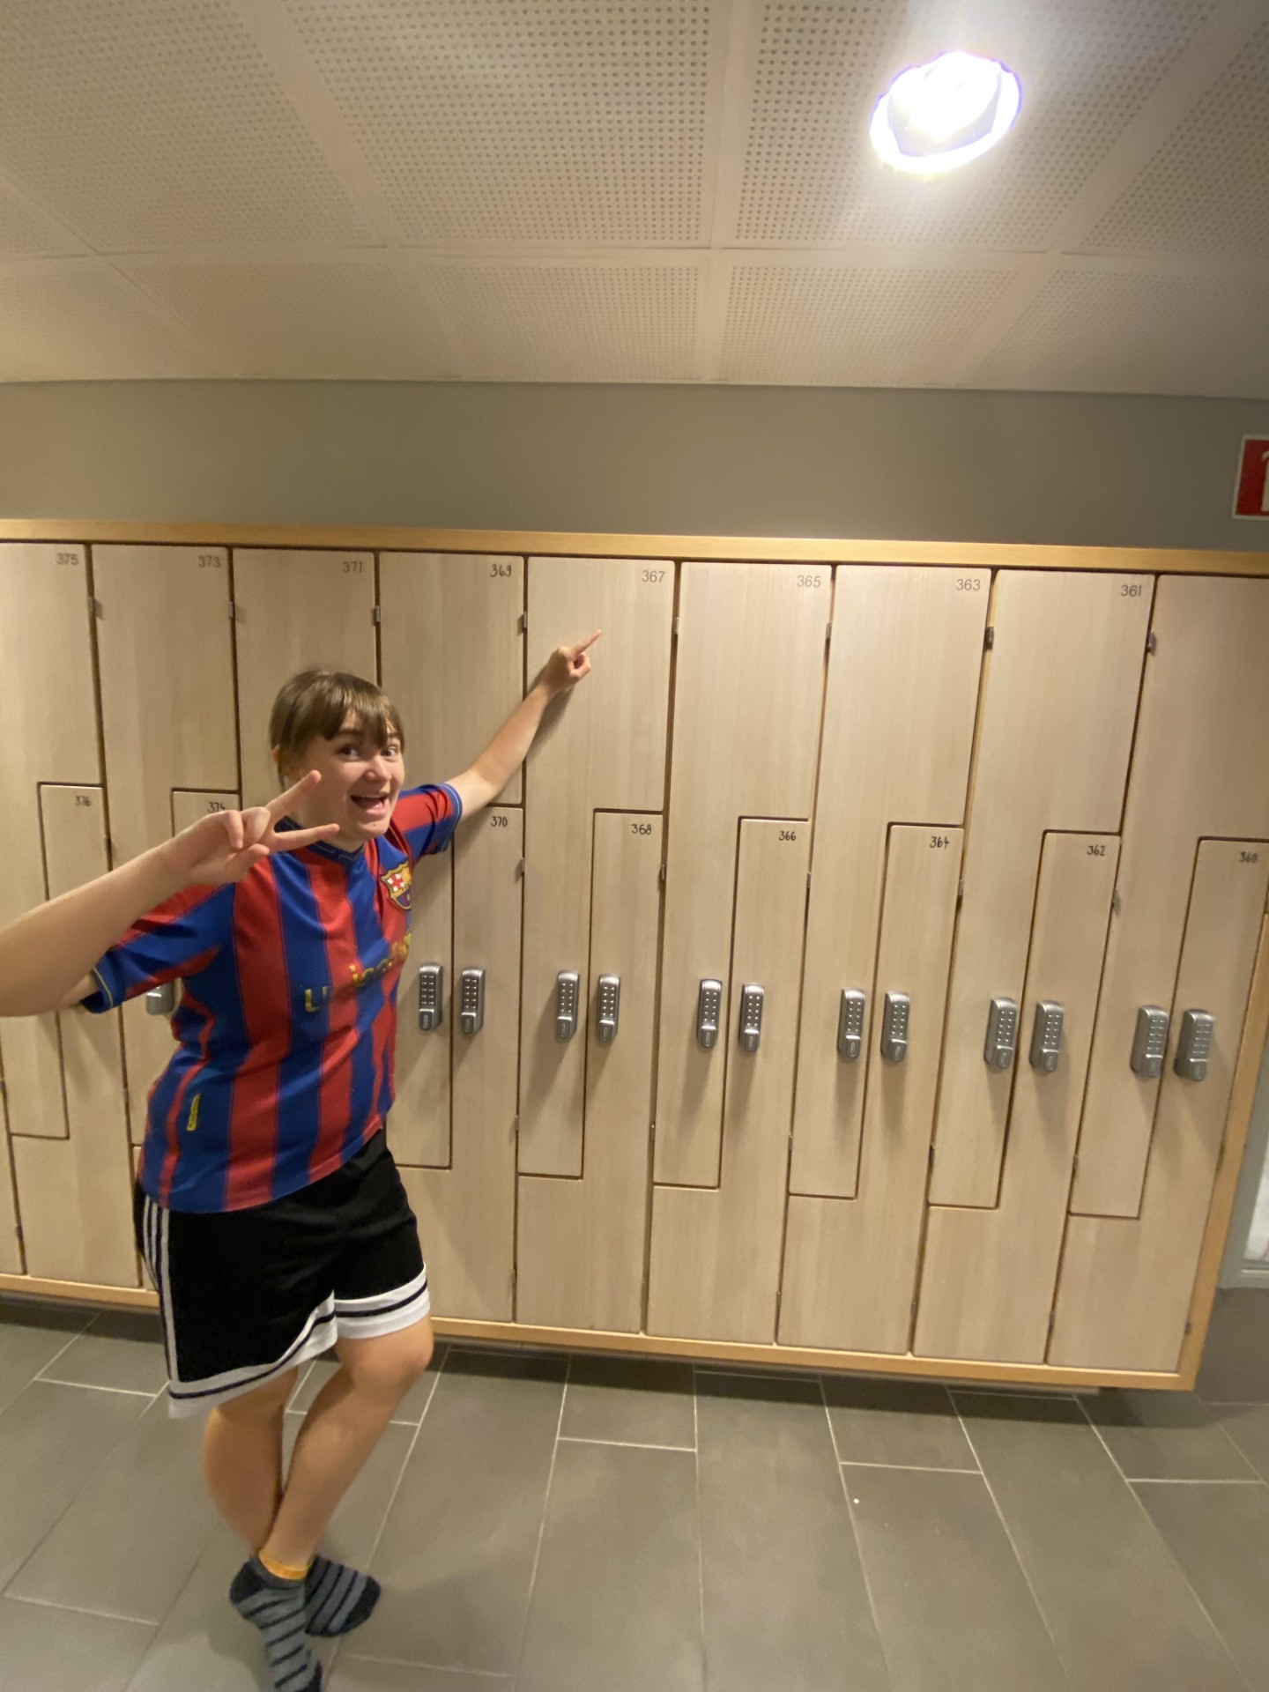
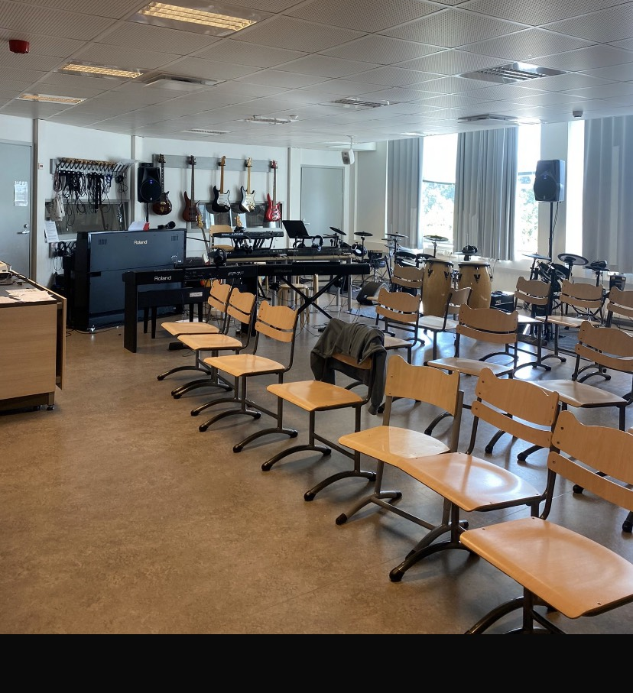
Other things we have
We have a cool library right next to our school. Sometimes students can go there during Finnish lessons and at recess.
We also have a music classroom where we learn to sing and play some instruments
Every student gets a personal locker to keep books and other personal stuff there.

Slide 12
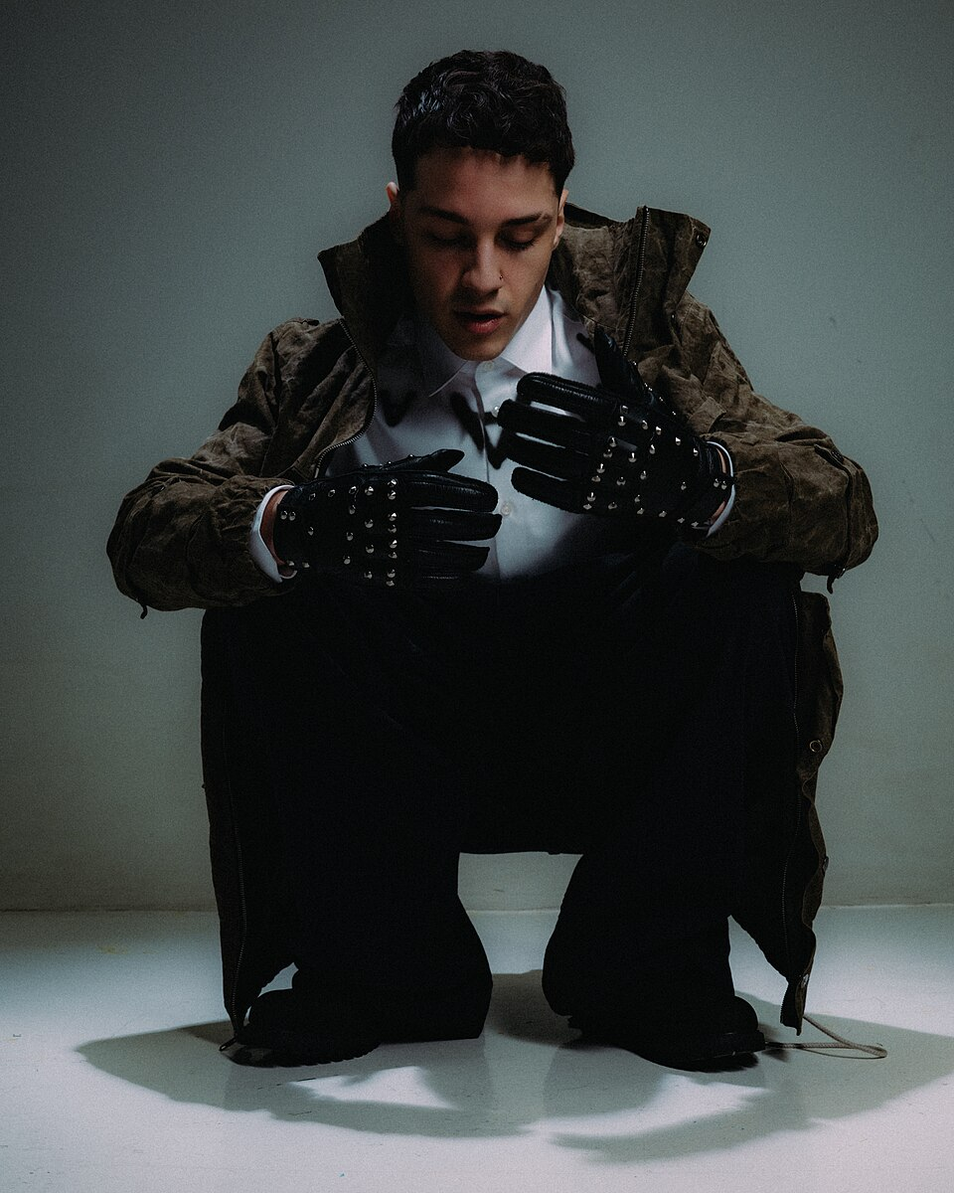
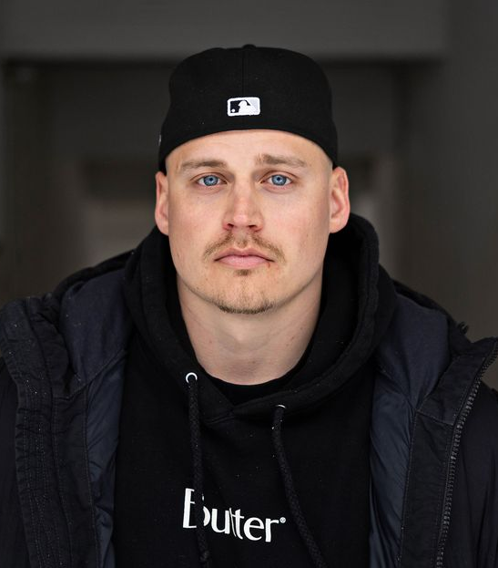
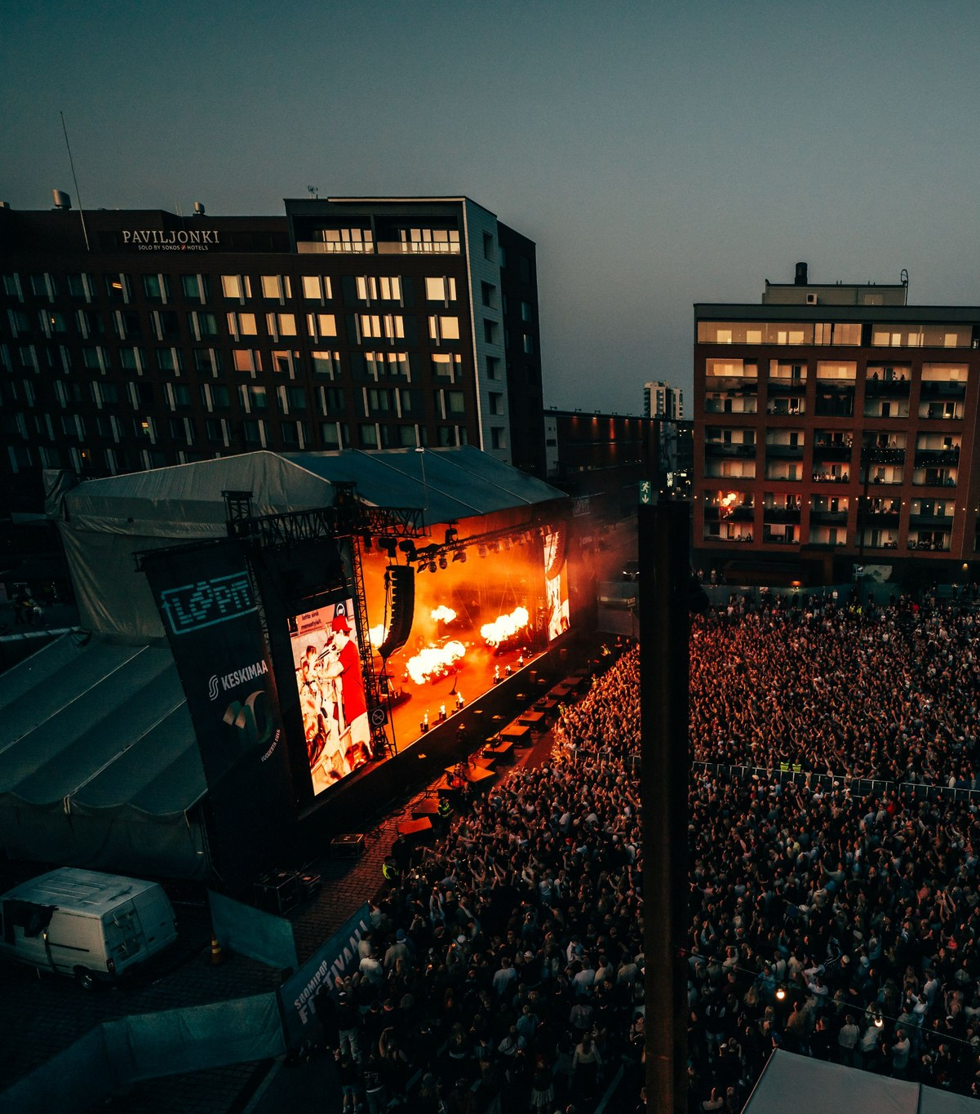
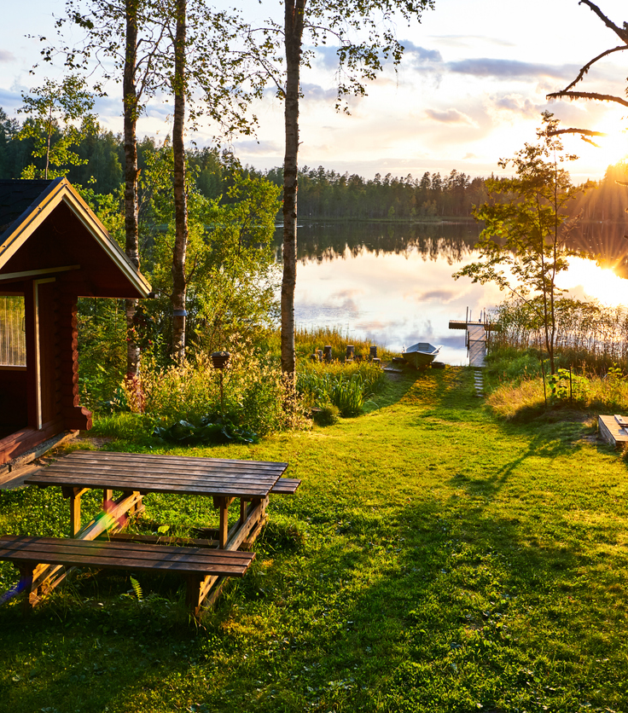
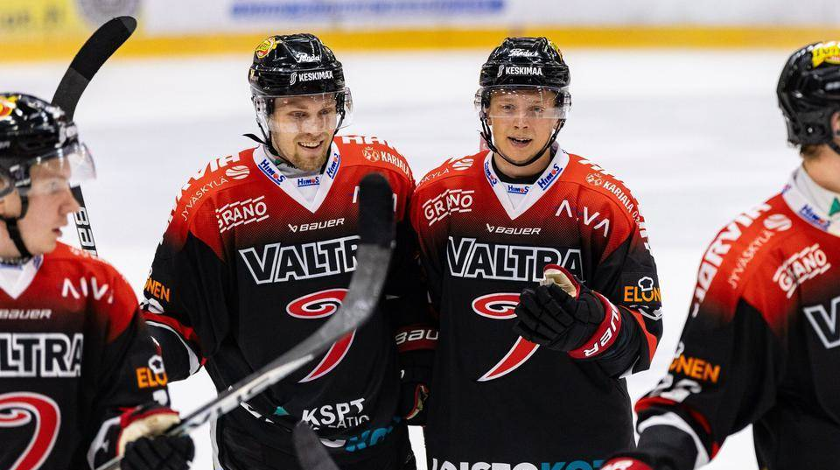
Freetime in Finland

Slide 13
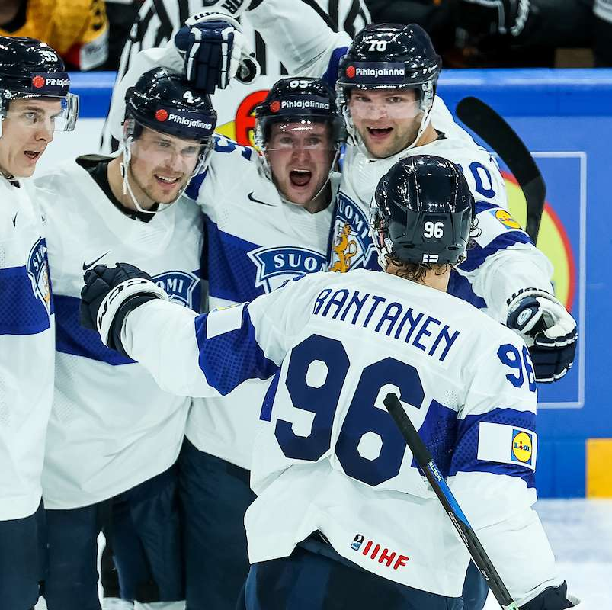
Finnish sports
Finnish national sport is Finnish baseball.
Finland´s top 3 most played sports are: football, ice hockey and floorball.
Different kind of acrobatic sports are also popular here, for example: cheerleading.
Fun fact! Finland is the current world champion in mens ice hockey and floorball!
Finnish people are also big in motorsport having one 16 world rally championships and 4 Formula 1 championships.

Slide 14
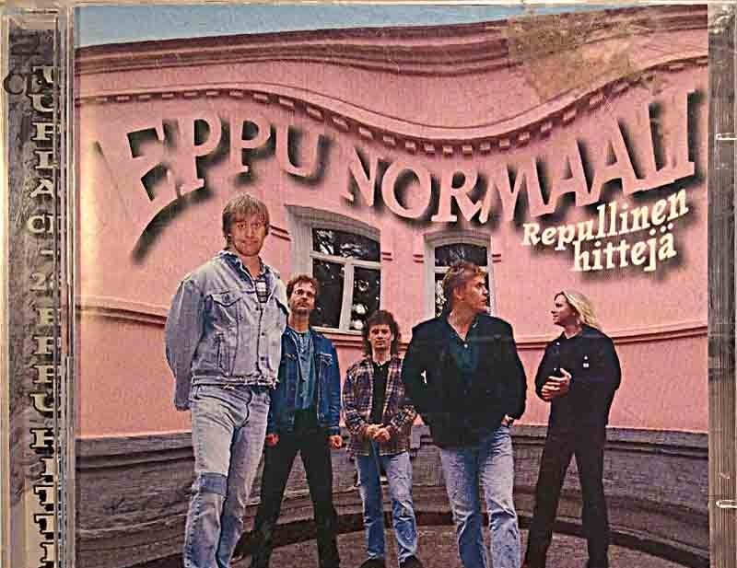
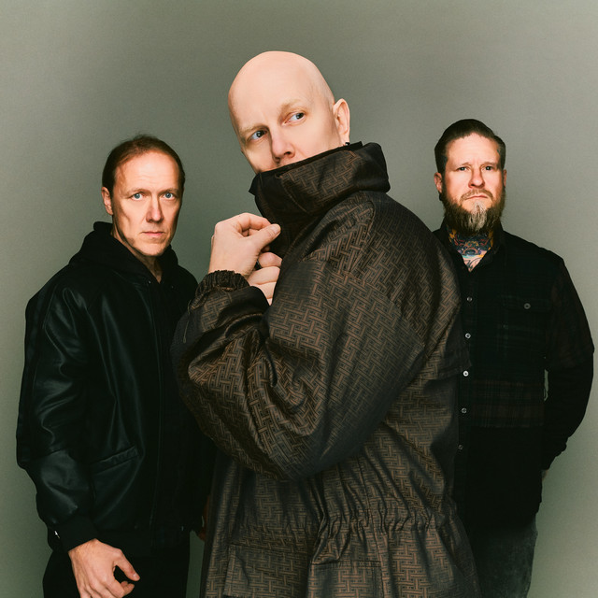
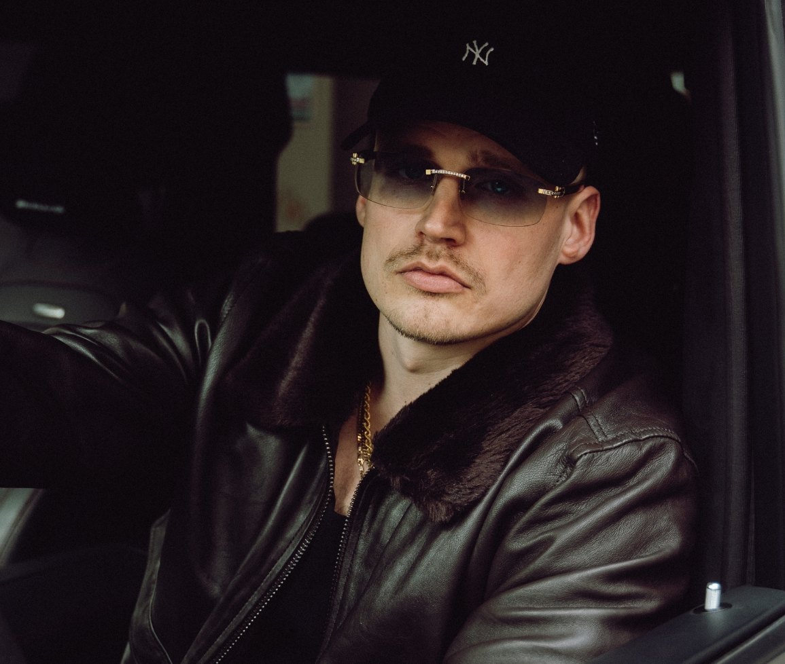
Music and gigs are a big part of young people life
Finland has a lot of great artists
For example, a good and popular rock band, Apulanta.
Eppu Normaali is super popular but recently retired Finnish artist.
Gettomasa is a popular rapper from Jyväskylä, whose music attracts mostly teenagers but also adults

Slide 15
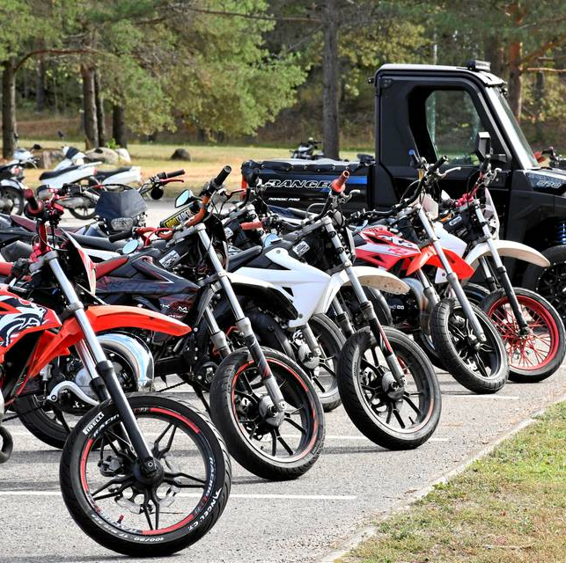
Finnish free time culture
A lot of finnish teens own a moped or an ATV.
You are able to get one once you turn 15.
A moped is a great form of transportation if u don't own a car yet.
The mopeds are often tuned and therefore strictly monitored by the police.

Slide 16
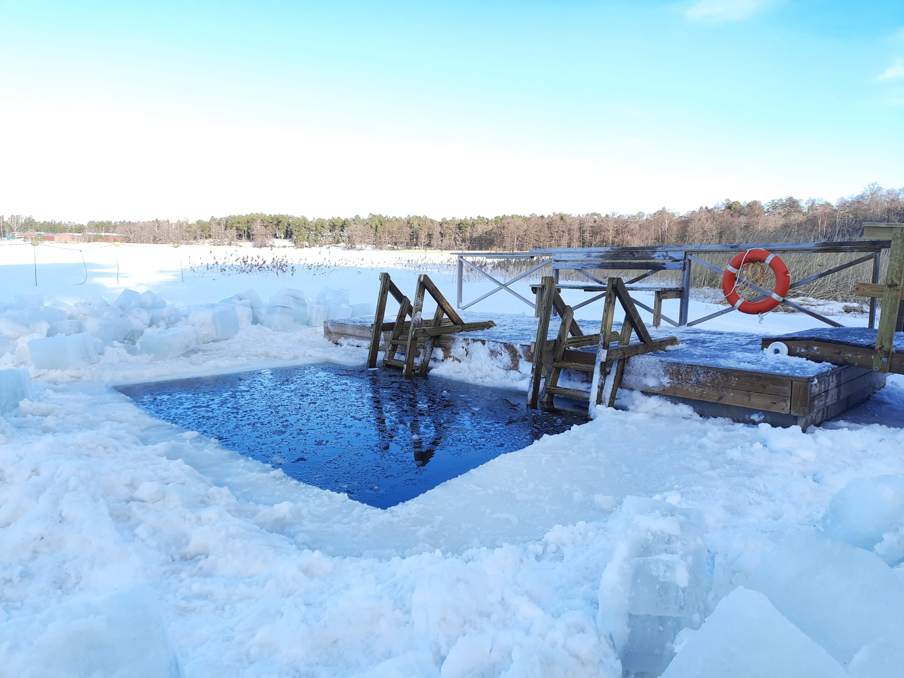
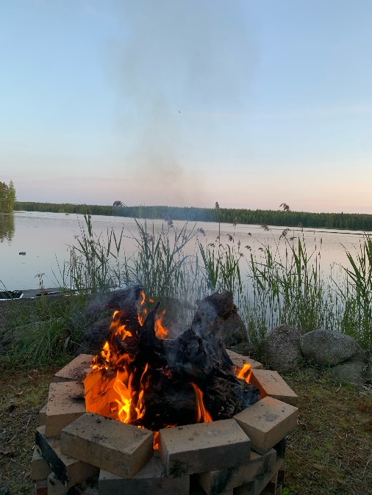
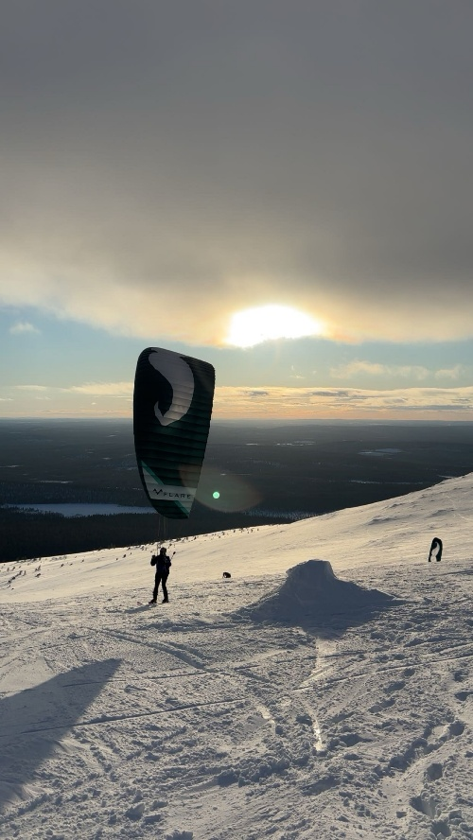
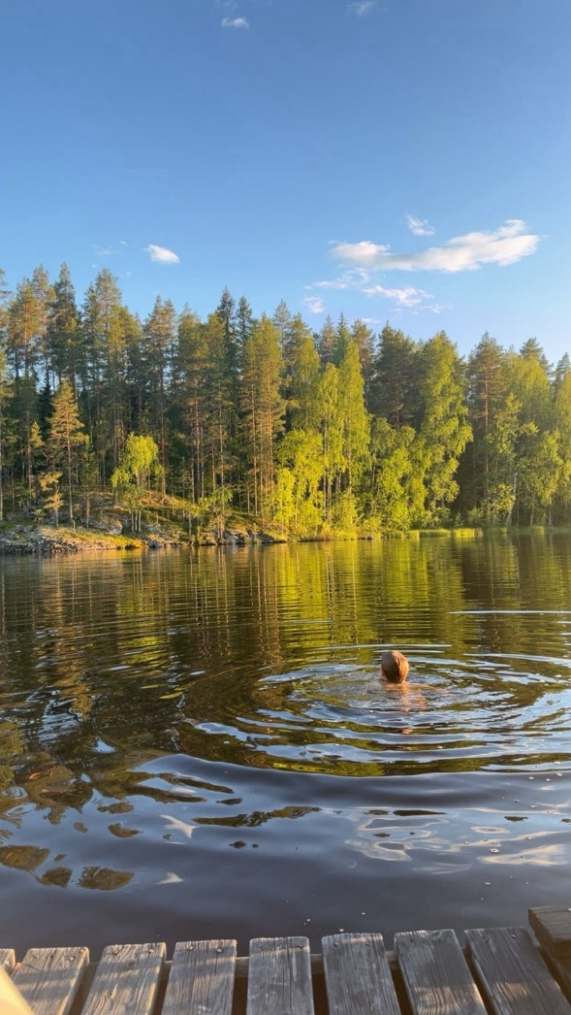
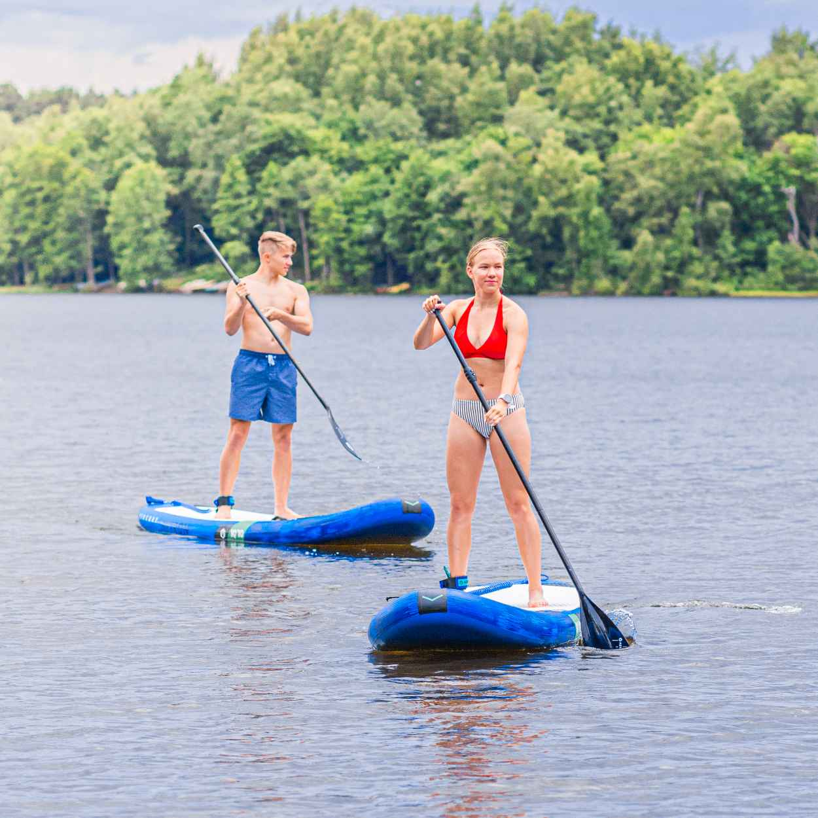
Seasonal activities
In winter we do skiing and ice swimming.
In summer people are at their cabins and do water activities like sup boarding.

Slide 17
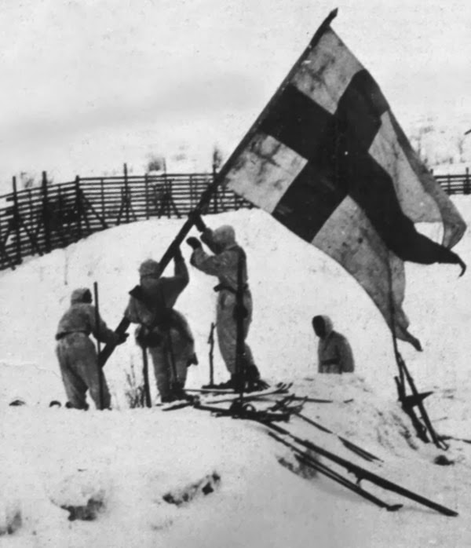
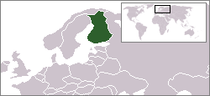
The most important events in Finnish history
• Finland was a part of Sweden for over 600 years before becoming an autonomous Grand Duchy within the Russian Empire
• (1906-1917): Finland became the first European nation to let women vote and stand for election.
• 1917 – Independence: Finland declared independence from Russia on 6 December 1917, which is now celebrated as Finland’s Independence Day.
•Finland’s "Sisu" Defiance (1939–1944): Against all odds, Finland defended its freedom from Soviet invasion during WWII. This legendary tactic was personified by Simo Häyhä, "The White Death," a sniper who survived brutal -40°C winters to become history's deadliest sniper.
•Modern Finland (1995–Present): Finland joined the European Union in 1995, fully connecting with the West. Even as a modern nation, it holds tight to its favorite tradition: 3.3 million saunas for 5.6 million people.

Slide 18
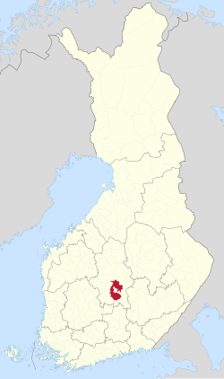
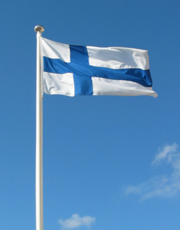
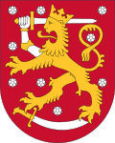
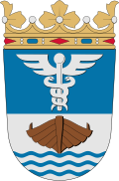
Finland and Jyväskylä
Finland is one of the Nordic countries. Finland is also the happiest country in the world.
There are 5,6 million people living in finland and the capital of Finland is Helsinki.
The official languages are Finnish and Swedish.
Finland is called the Land of a Thousand Lakes, and there are over 168,000 lakes here.
There are also many forests in Finland.
Examples of traditional Finnish dishes: Karelian pasty and black sausage.
Examples of traditional Finnish sweets: Fazer chocolate and cinnamon buns.
About 150,000 people live in Jyväskylä.
There is The World Rally Championship in Jyväskylä every year.
There are a lot of lakes in Jyväskylä.
There are many students in Jyväskylä.
Jyväskylä is located in Central Finland.
Jyväskylä is Finland's seventh-largest town.

