Slide 1
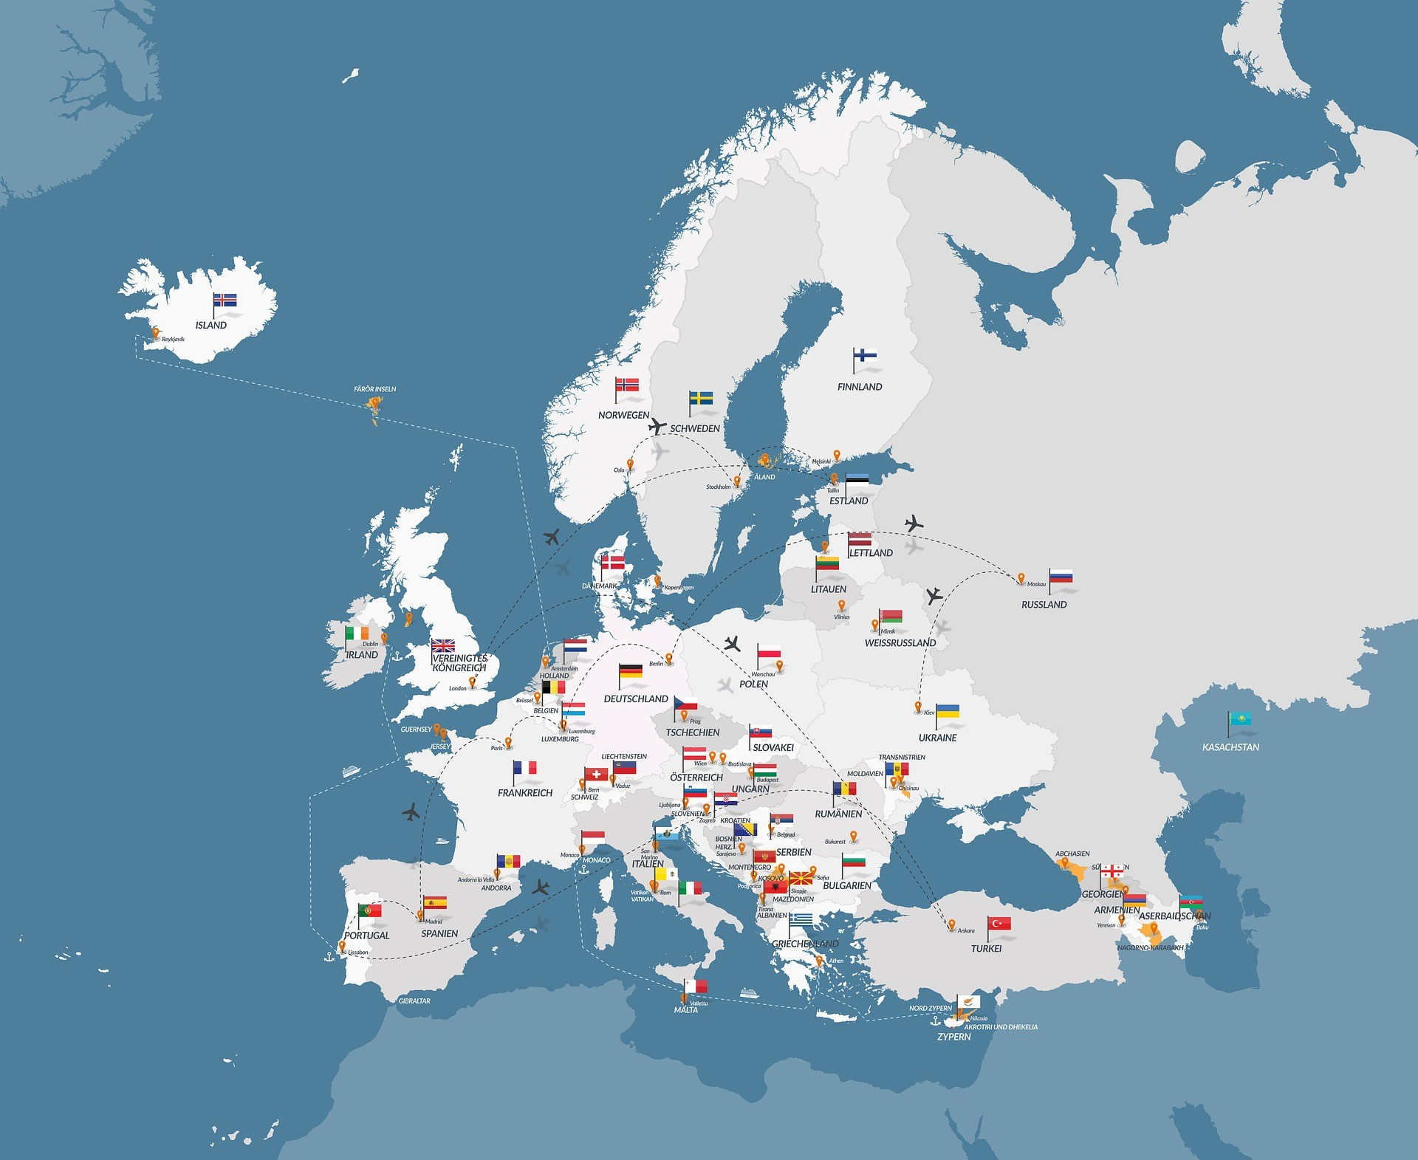
Suomi-Finland
Population: 5,6 million
(18 inhabitats per 1 km2)
-a lot of forests and lakes
-four seasons
-a lot of snow in winter (in Lapland)
-Santa Claus lives in Lapland
-a lot of mosquitoes in summer (in Lapland)
-temperature varies from +30 to -30 Celsius!

Slide 2
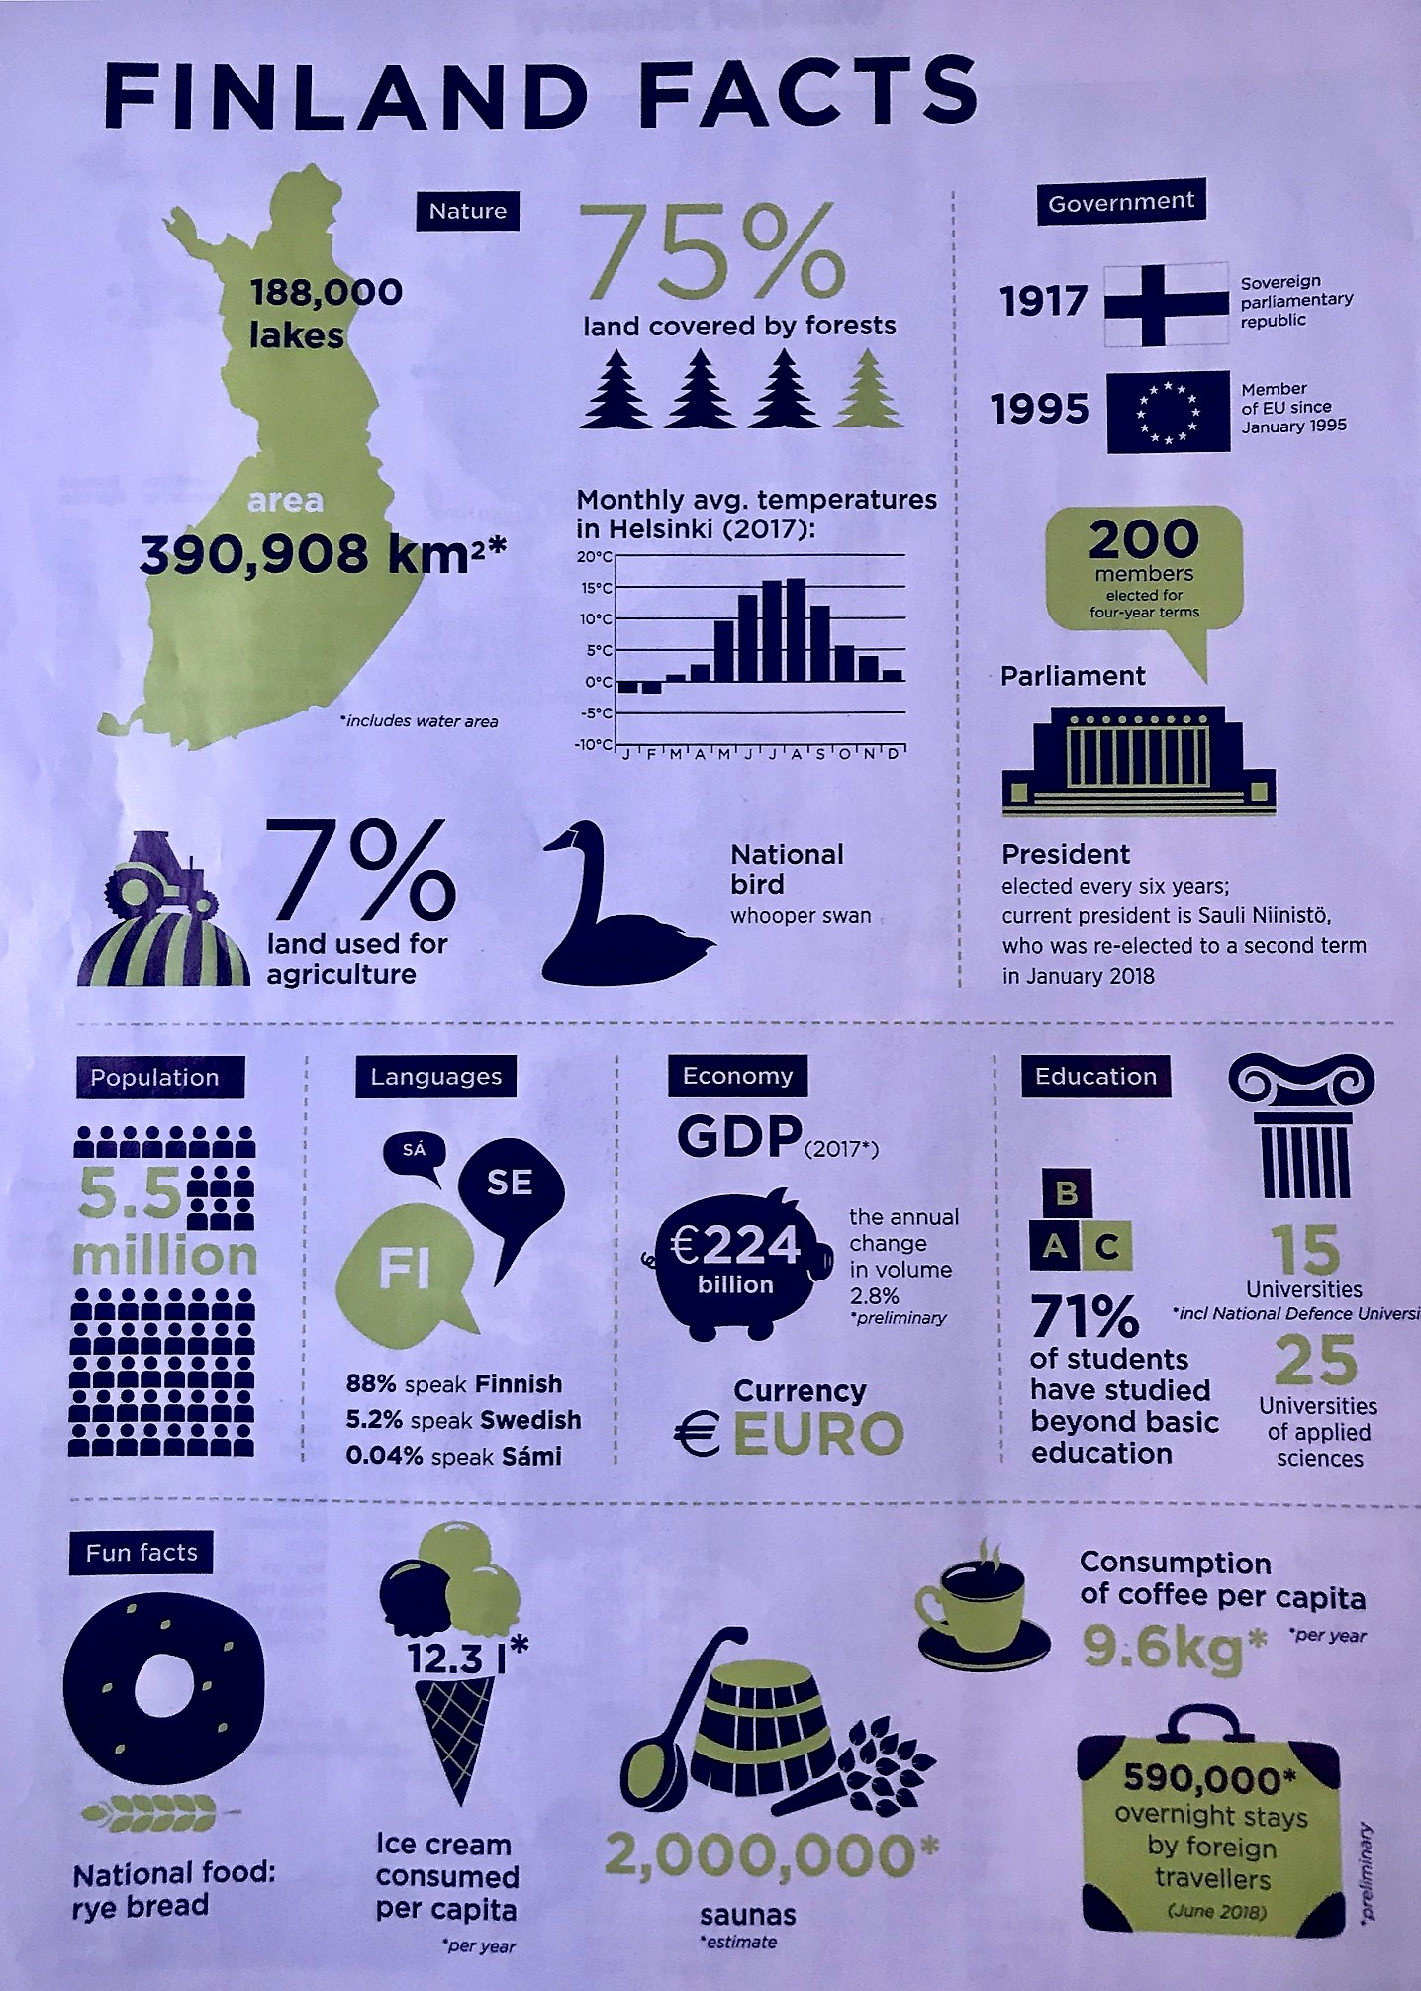
Finland Facts
We are highly educated.
We drink coffee and go to sauna
all day- all night long.
We like ice cream- a lot!

Slide 3
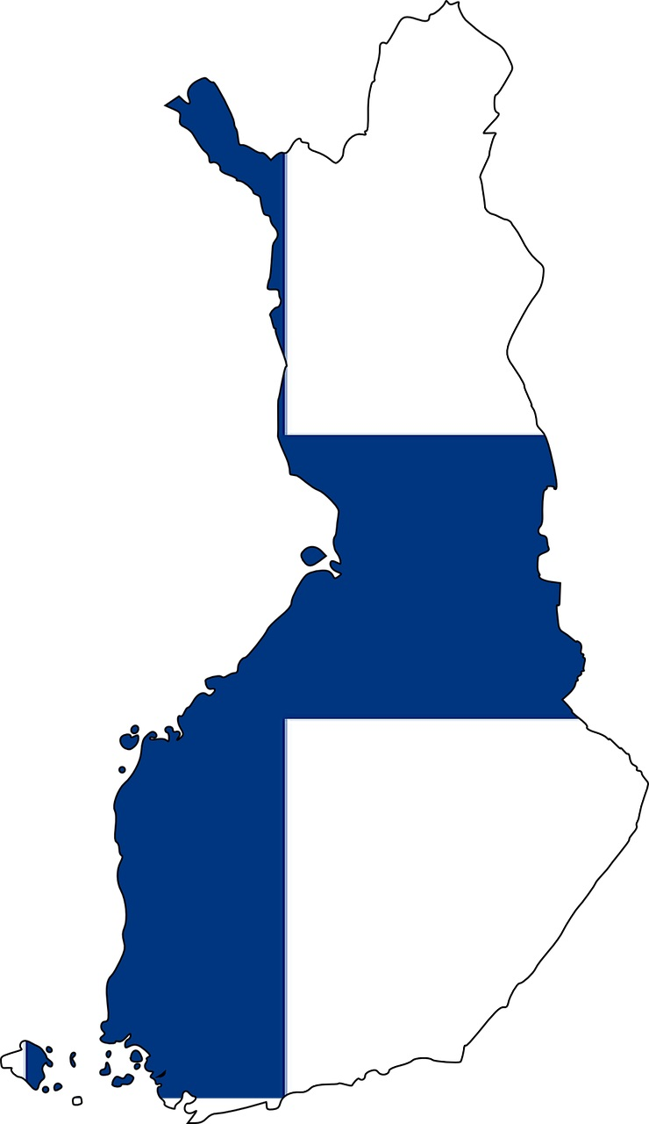
The World´s Happiest Country 2018-2023
World Happiness Report
We are so happy because we are going to live a long and healthy life.
Our GDP (gross domestic product) is high and we have social freedom, people are generous and we do not have corruption.
☺

Slide 4
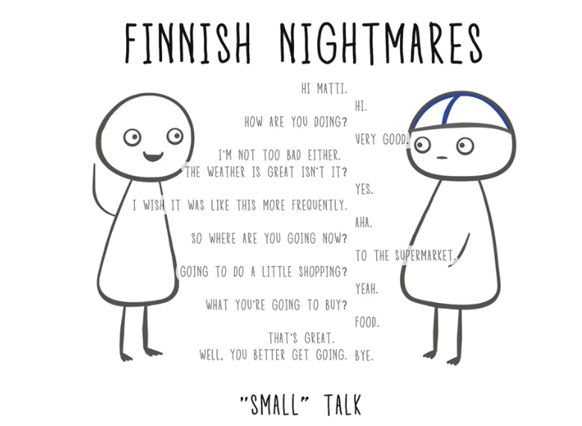
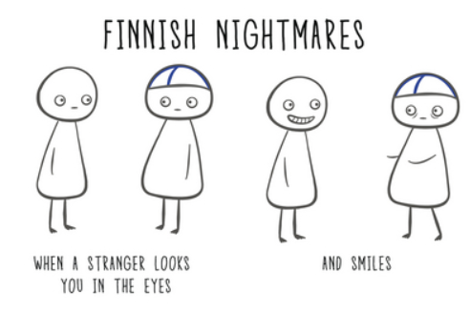
Finnish Nightmares

Slide 5
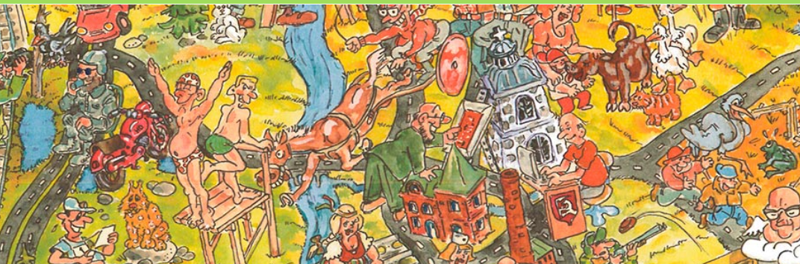
Orimattila- A Small and Vivid Town in Southern of Finland
16 000 inhabitats, 20 km from Lahti (famous for its winter sport events) and 90 km from Helsinki (the capital of Finland)

Slide 6
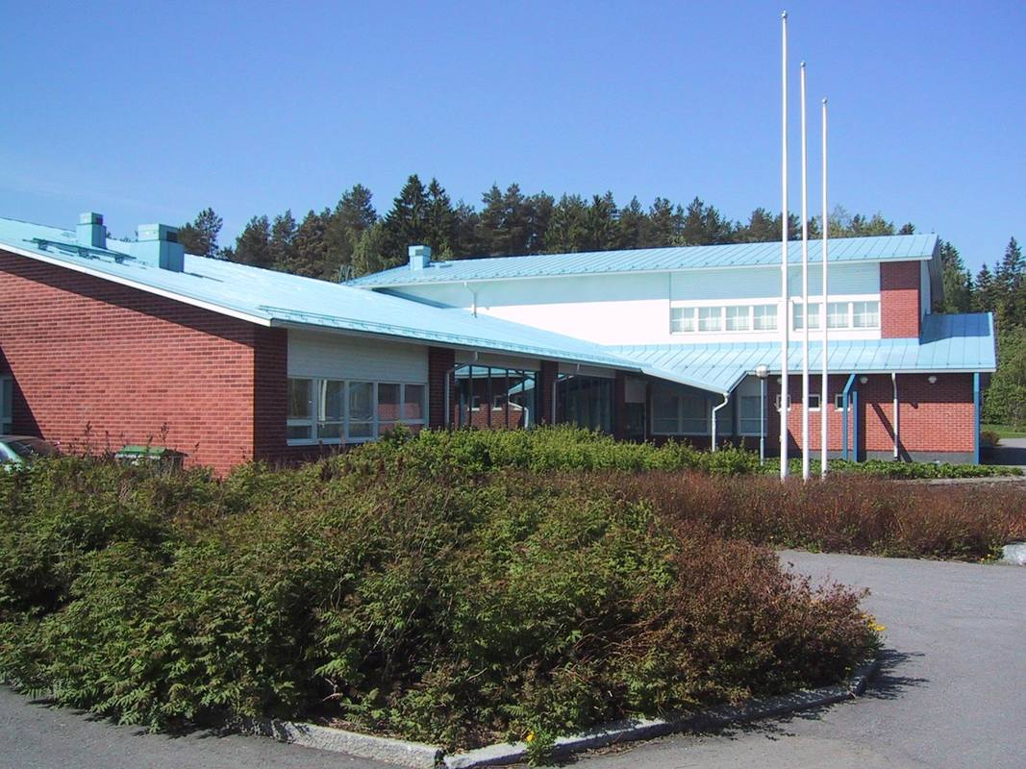
Myllylä Primary School
260 pupils- grades 1st to 6th
(age from 7 to 13 years old)
pre-school unit (6 years old)
3 special education classes
18 teachers, 9 classroom assistants
School nurse, school psygologist, school social worker
Cleaning and cooking staff

Slide 7
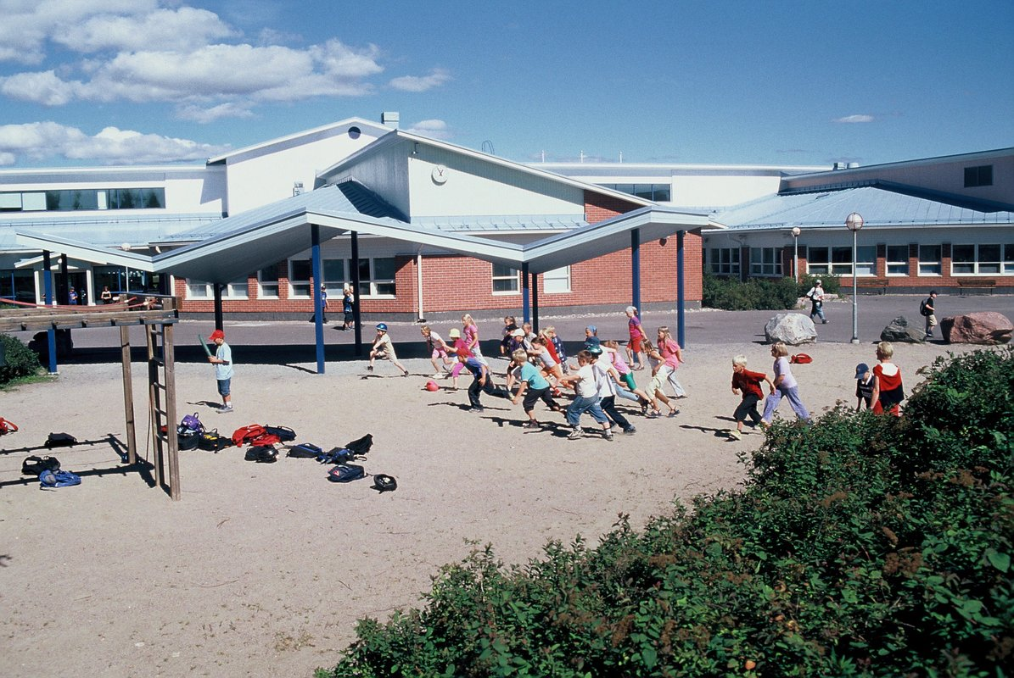
A chance for every learner
Comenius / Erasmus+ projects since 1998
Erasmus Accrediated 2021 among the first schools in Finland
Every Day Learning
The theme of accrediation is wellbeing for both pupils’ and school staff’s.
Student centered learning, education for international understanding and developing language skills are main goals too.

Slide 8
Finland, Orimattila, Myllylä, Education
Happiness from Finland
Video 1.35 min
Myllylän koulun video
Orimattila
Video 1.03 min
Education in Finland
Video 2.35 min

Slide 9
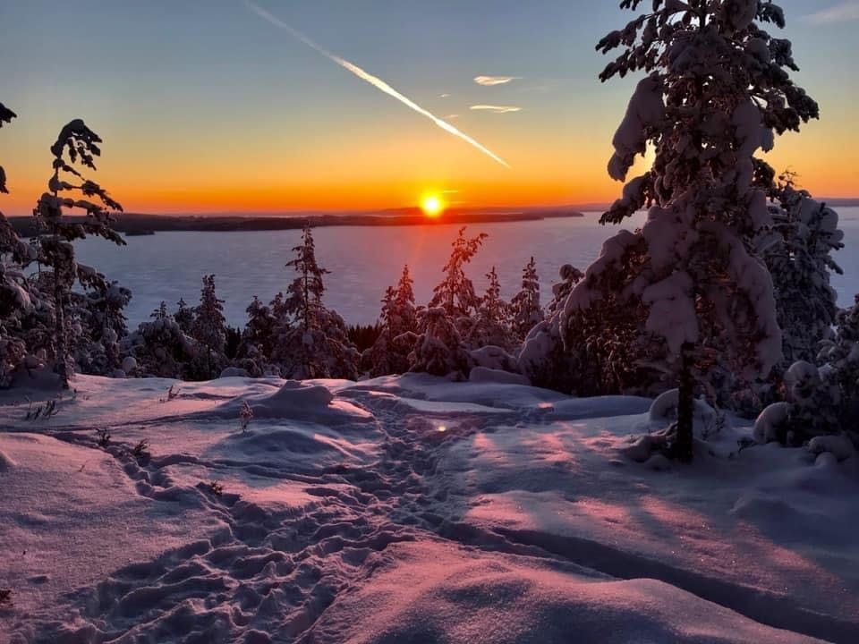
Welcome to Myllylä School, Orimattila, Finland!
Contact:
Co-ordinators
Maarit Rajamäki-Kivi
maarit.rajamaki@orimattila.fi
Marjut Koukkula
marjut.koukkula@orimattila.fi

