Slide 1
5.2.2 SCHEMA THEORY
IB Psychology LAJM

Slide 2
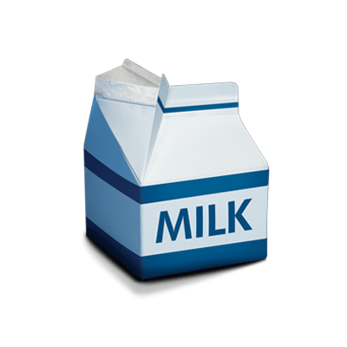
REVIEW
What were meant by schemas?
What could be examples of different schemas?
How do schemas influence our behaviour?

Slide 3
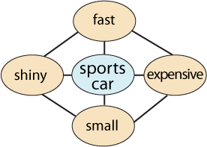
5.2.2 Schema Theory
Cognitive schemas
Mental representations
Patterns of knowledge

Slide 4
5.2.2 Schema Theory
ENVIRONMENT
CYCLE OF PERCEPTION
SELECTS
TARGETS
CHANGES
SCHEMA
PERCEPTION
DIRECTS

Slide 5
5.2.2 Schema Theory
THREE MAIN STAGES IN MEMORY PROCESSES
ENCODING
STORAGE
RETRIEVAL
SCHEMA PROCESSING CAN INFLUENCE MEMORY AT ALL STAGES

Slide 6
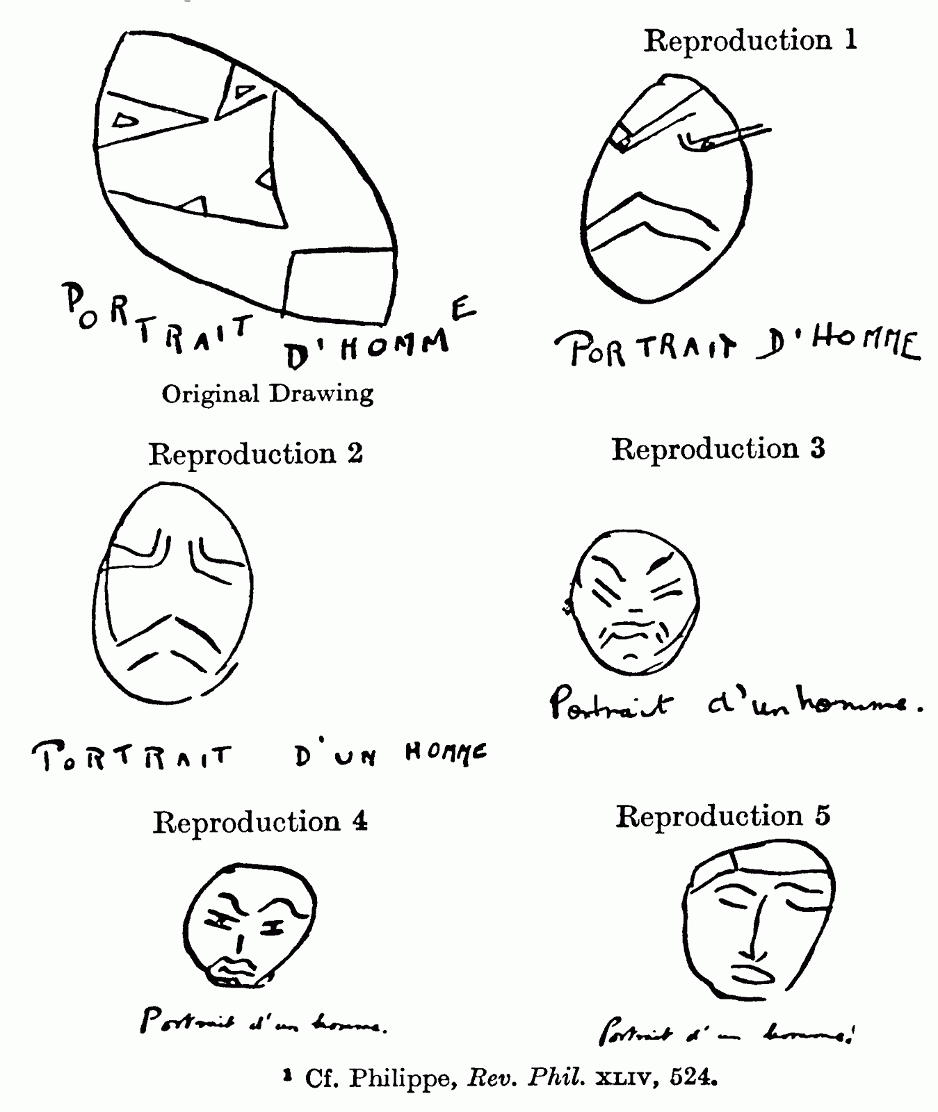
5.2.2 Schema Theory
Bartlett (1932)
Studied the reliability of memory with serial reproduction of Native American legend “The War of Ghosts”

Slide 7
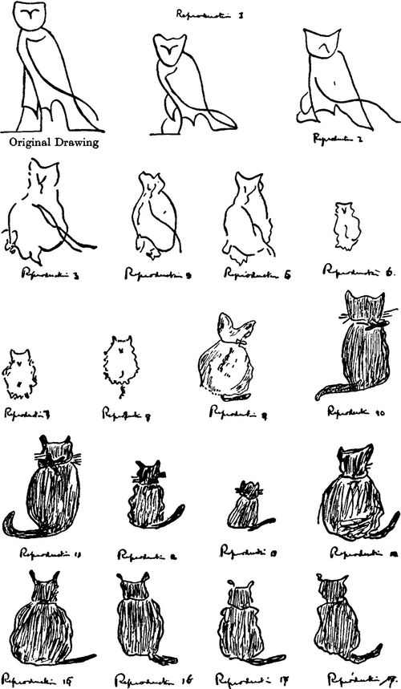
5.2.2 Schema Theory
Effort after meaning
Attempt to match unfamiliar ideas into a familiar framework

Slide 8
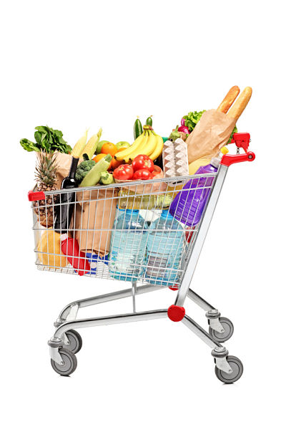
5.2.2 Schema Theory
Social schemas
Schemas about groups of people
E.g. stereotypes
Scripts
Schemas about sequences or events
E.g. grocery shopping

Slide 9
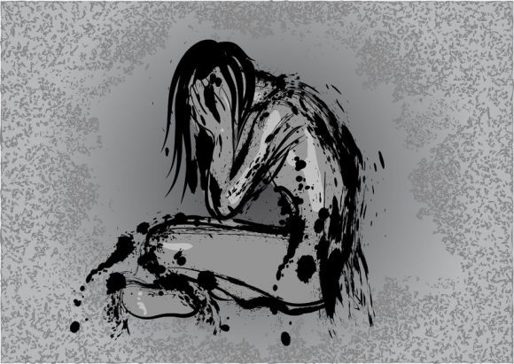
5.2.2 Schema Theory
Self-schemas
Schemas about ourselves
”I wish I was different”
”People don’t notice me”
”No matter how hard I try I will fail for sure”

Slide 10
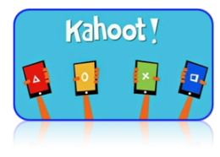
TASK
Teacher will divide the class in two groups
Both groups will given a stimulus material
Both groups will do a Kahoot! separately

Slide 11
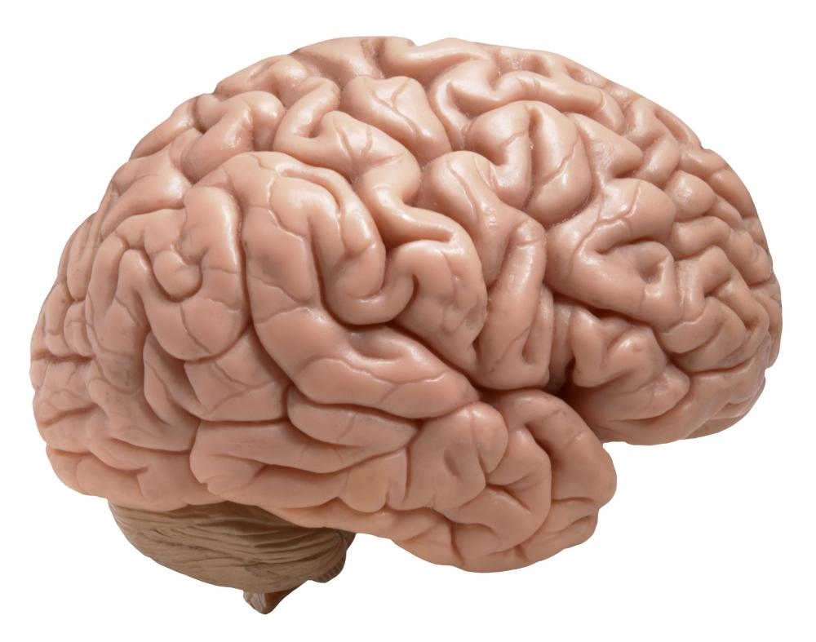

5.2.2 Schema Theory
TOP-DOWN PROCESSING
BOTTOM-UP PROCESSING

Slide 12
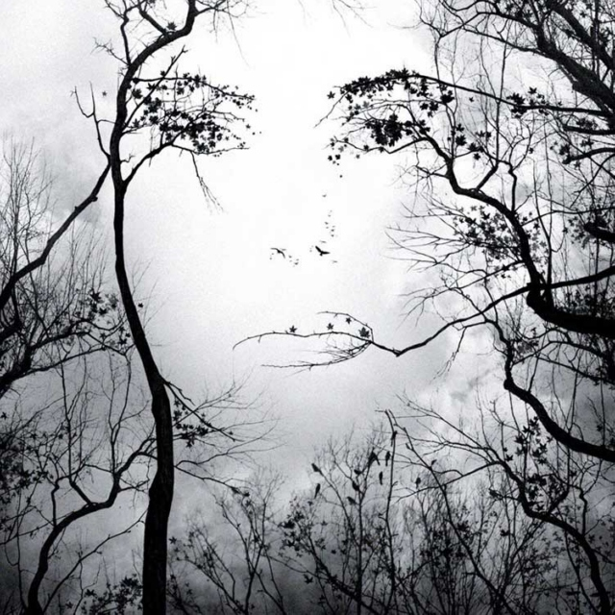
5.2.2 Schema Theory
Pattern recognition
Matching the current sensory input to schemas in memory

Slide 13
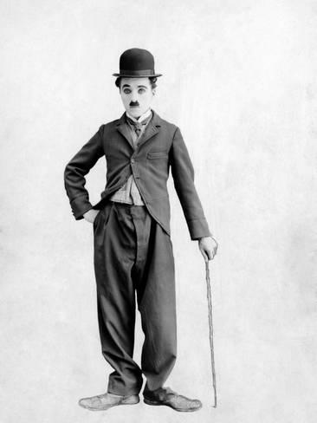
TASK
Watch the following video clip experience pattern recognition in action

Slide 14
TASK
Read the teacher’s supplementary material on schema theory
Make short notes, amend the ones you already have on schema theory
What new did you learn from the material?
Watch this eduactional video on Piaget’s schemas
What new did you learn from the video?
Watch this short documentary on Woolworth’s fire in 1979
How can you apply schema theory here?

Slide 15

5.2.2 Schema Theory
Theory of reconstructive memory
Memory is an active process
Memory is NOT exact, it is distorted by existing schemas

Slide 16
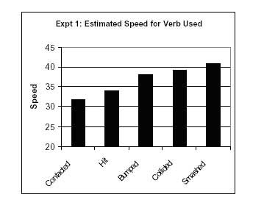
TASK
Watch the instructional video about Loftus and Palmer (1974) study
Focus on the gist of the study; what is the most important conclusion

Slide 17
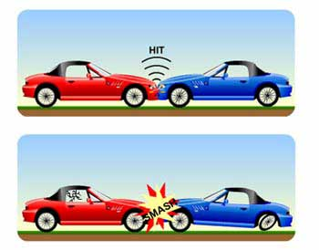
5.2.2 Schema Theory
Loftus and Palmer suggested that the findings could be interpreted in two ways
Response bias: the verb biases the response to a higher estimate
Memory change: the verb causes an actual change in the memory

Slide 18
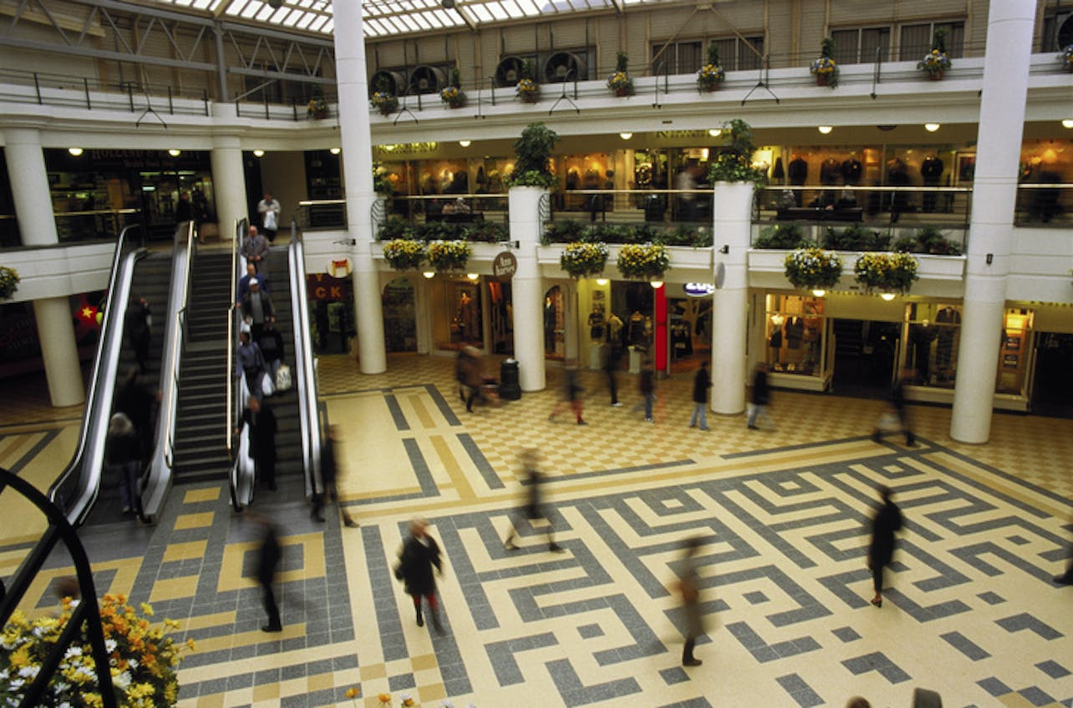
TASK
Read ”Memories and external factors” from Kognity 5.2.2 and Loftus and Palmer (1974), Paterson and Kemp (2006) and Loftus and Pickrell (1995) from Kognity 5.2.11
How do external factors influence our memories?

Slide 19
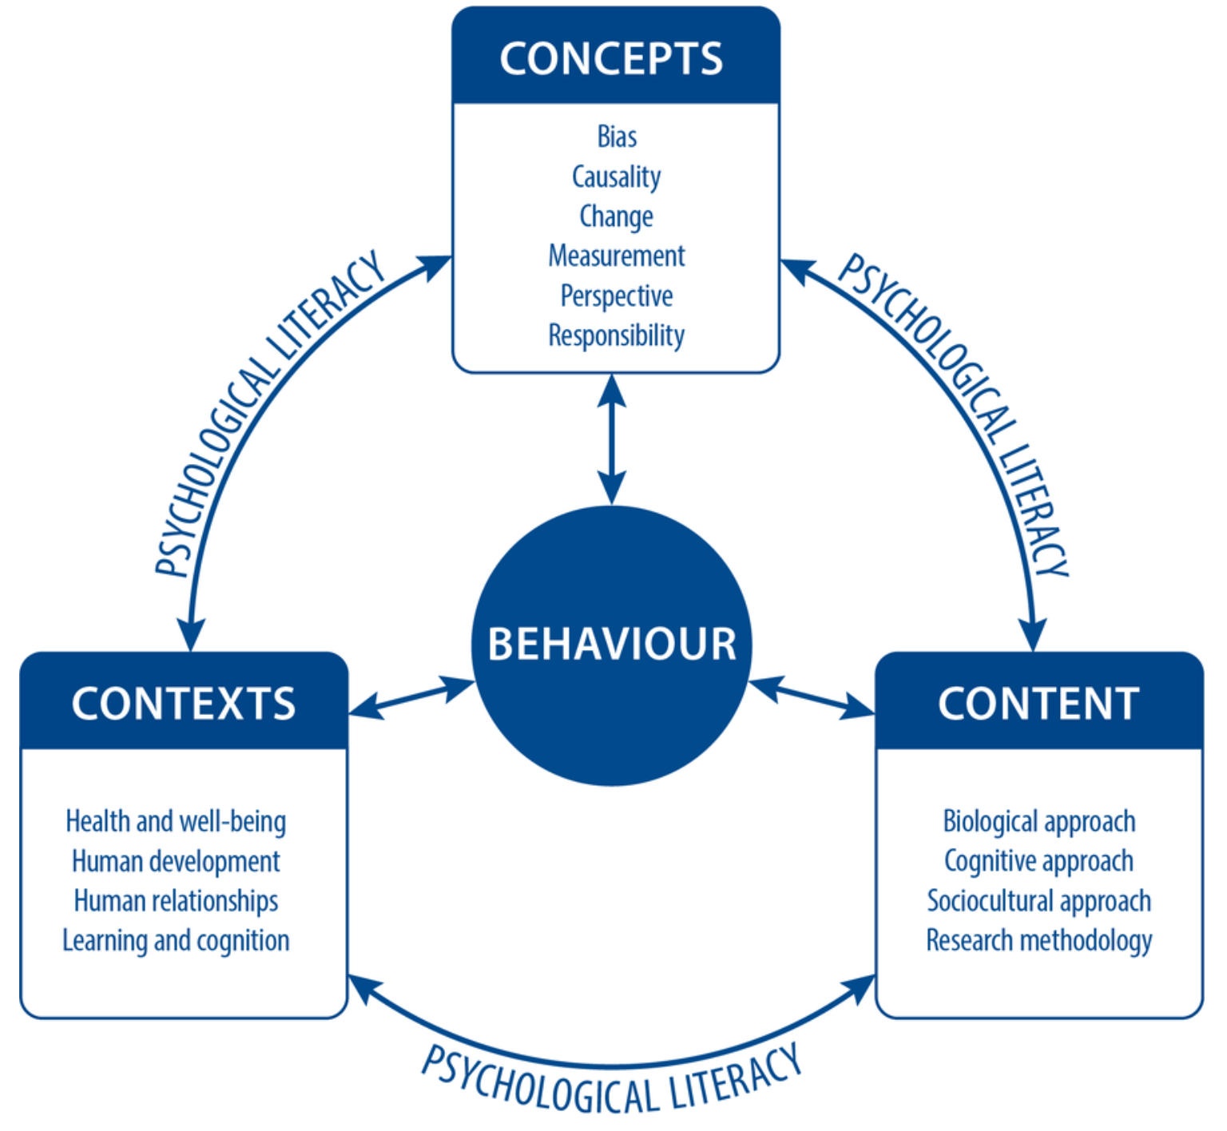
TASK
How do bias and responsibility connect with the research you have just studied?
How can you apply these concepts and schema theory in real-life?
Find examples

Slide 20
TASK
How does change relate to schema theory?
What is changings when schemas are changing?
How does this change influence our behaviour?

Slide 21
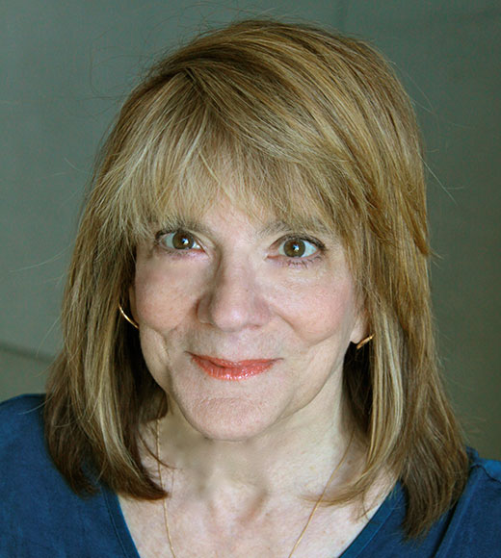
TASK
Watch Elizabeth Loftus TED-talk “How reliable is our memory?”

Slide 22

TASK
What are the pros and the cons of schemas?
How do they facilitate and/or complicate the way we process information and guide our behaviour?
What are the strengths and limitations of schema theory?
Do a TEACUP analysis

Slide 23
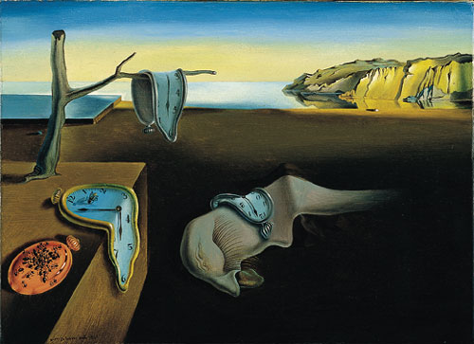
TASK
Is human memory reliable?
On what basis it is?
On what basis it is not?
Can you trust your memory?

Slide 24
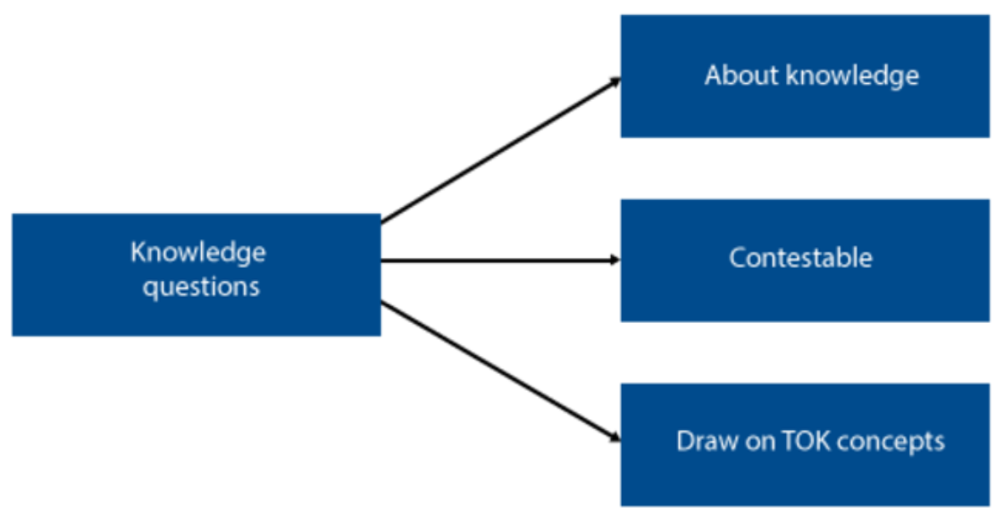
TOK-LINK
How do the following KQs relate to the contents we just covered?
What features of knowledge have an impact on its reliability?
What constraints are there on the pursuit of knowledge?
To what extent is certainty attainable?
DISCUSS AND EXPLORE THESE KNOWLEDGE QUESTIONS

Slide 25
Sources
Crane, J. & Hannibal, J. (2009). Psychology Course Companion. Oxford: Oxford University Press.
Gray, P. & Bjorklund, D. (2014). Psychology (7th edition). New York: Worth Publishers.
Kognity
Popov, A., Parker, L. & Seath, D. (2017). IB Psychology Course Companion (2nd Edition). Oxford: Oxford University Press.

Slide 26
Picture sources
Milk carton <http://www.smallworlds.com/forum/archive/index.php/t-1274171.html> Accessed 23rd of November 2017.
Schema of sport cars <http://mercercognitivepsychology.pbworks.com/w/page/61207282/Schemas> Accessed 11th of November 2015.
Bartlett serial reproduction figures 1 <http://www.psychsummaries.com/2011/11/bartlett-1932-and-war-of-ghosts.html> Accessed 27th of November 2017.
Bartlett serial reproduction figures 2 <http://psycnet.apa.org/fulltext/2014-16777-001.html> Accessed 27th of November 2017.
Groceries <https://www.groceryshoppingbusiness.com/hello-world/> Accessed 6th of November 2018.
Depression <https://www.docsopinion.com/2018/02/25/depression-symptoms/> Accessed 6th of November 2018.
Kahoot! <http://www.psi-solutions.org/kahoot-it/> Accessed 24th of January 2016.
Brain <http://cliparting.com/free-brain-clipart-4926/> Accessed 23rd of November 2017.
Eye drawing <http://www.clipartpanda.com/clipart_images/blue-eye-clip-art-image-1399516> Accessed 23rd of November 2017.
Face in trees <https://8tracks.com/theperksofbeingme/confusing-thoughts-on-a-chilly-afternoon> Accessed 27th of November 2017.
Chaplin <http://www.allposters.fi/-sp/Charlie-Chaplin-1925-posters_i5099494_.htm> Accessed 6th of November 2018.

Slide 27
Picture sources
Memory wheel head <http://exclusive.multibriefs.com/content/working-memory-in-english-language-development> Accessed 24th of November 2015.
Loftus & Palmer 1 & 2 <https://www.simplypsychology.org/loftus-palmer.html> Accessed 27th of November 2017.
Mall picture from Kognity 5.2.2
IB Psychology syllabus from the 2025 Guide
Elizabeth Loftus <http://www.law.uci.edu/faculty/full-time/loftus/> Accessed 30th of November 2017.
Information <http://www.aiim.org> Accessed 23rd of November 2017.
Dali <https://fi.wikipedia.org/wiki/Muiston_pysyvyys> Accessed 25th of November 2015.

