Slide 1




Career Counseling and Guidance programs among Finnish VALA partners
1.11.2012
Nordic Network meeting, Reykjavik

Slide 2
Educational programs among Finnish VALA partners
 | University of Eastern Finland | University of Jyväskylä | JAMK University of Applied Sciences | Education and Development Center Salmia
Degree Programme (300 credits) | X (annual intake 20 students) |  |  | no academic programs - customer service training program for employment consultants and psychologist (9 ect) - short courses - development projects e.g. courses of guidance and counseling for adults with partners 5 ect and 30 ect (2009 – 2012)
Master’s Degree Programme (120 credits) | X (annual intake 10 students) | X (annual intake 20 students )
Qualification studies (60 credits) | X (2011-2013 40+40 students) | X (intake 20 students) (2011 – 2013 40 + 40 students) | X

Slide 3
Degree Programmes

Slide 4
The mission
Our mission is to establish a learning environment that creates counsellors, teachers and researchers
who are able to support individuals and communities in their life course designing in a responsible and creative manner
who are able to face and analyse the challenges and opportunities of the changing society, differentiating contexts and developing educational organisations and are able to act in order to create new opportunities
who as professionals adopt ethical standards, research-based and critical reflection, and enhance social inclusion, equal opportunities and social equity

Slide 5
Target groups
a) students who have completed upper secondary school and passed matriculation examinations
b) students with Bachelor’s degree or degree in polytechnics with grades in educational sciences or on in a related field
c) teachers and other actors with master’s degree and teacher qualifications d) university students with pedagogical studies who can choose career counselling studies as their minor subject.

Slide 6
Guiding principles
Guidance and counselling expertise: integrated into the individual’s life course (life-long guidance and counselling)
Guidance and counselling: multidisciplinary science which has its scientific foundations in psychology (counselling psychology), educational sciences, sociology and philosophy
Contexts of counselling : Schools and various educational institutions play an important role. Career counselling has its applications in a variety of fields of adult guidance and counselling: personnel training, vocational training, professional development, planning of career changes and career paths, organizational development and change, and occupational health and well-being.

Slide 7
Core processes
the society, educational systems and working life: contexts of counselling
life course and development in social and cultural context
theories and approaches of counselling
theories of educational sciences , psychology and sociology, philosophy
scientific research and research practices, development of research-based professional methods
counselling as a professional practice: interaction and communication, counselling processes and methods, inter-professional cooperation and networking
teaching, pedagogy and didactics.

Slide 8
Counselling processes and methods are among the main foci
Counselling Process and Conversation
Virtual Guidance and Counselling
Classroom and Group Counselling
Small Group Counselling
Guidance and Counselling as Psychosocial Support
Supervision and Consultation

Slide 9
Qualification Studies

Slide 10
STUDY COUNSELLOR EDUCATION
A post-graduate programme aimed at qualified teachers wishing to specialise in the field of study counselling and guidance. The programme comprises 60 ECTS credits and is organised in Finnish as multi-mode education during three semesters.
The education provides a comprehensive qualification for study counselling in the various forms of education, depending on prior education. The objectives and implementation are based on the rapidly changing needs of working life and of the operating environment.

Slide 11
IMPLEMENTATION OF THE STUDIES
Blended-model, studying on a part-time basis, the programme will last for 1.5 years and consist of three contact sessions per semester (2-3 days/session), online courses, small group- and independent studies.

Slide 12
Content of the studies
The programme intends to build a comprehensive and inclusive understanding of the field of study counselling and guidance.
Orientation to Study Counselling
Networking in Counselling
Developing Counselling
Guiding Diverse Learners
Counselling in Various Stages of Life
Theoretical Approaches to Counselling
International Study Counselling
Counselling Practise

Slide 13
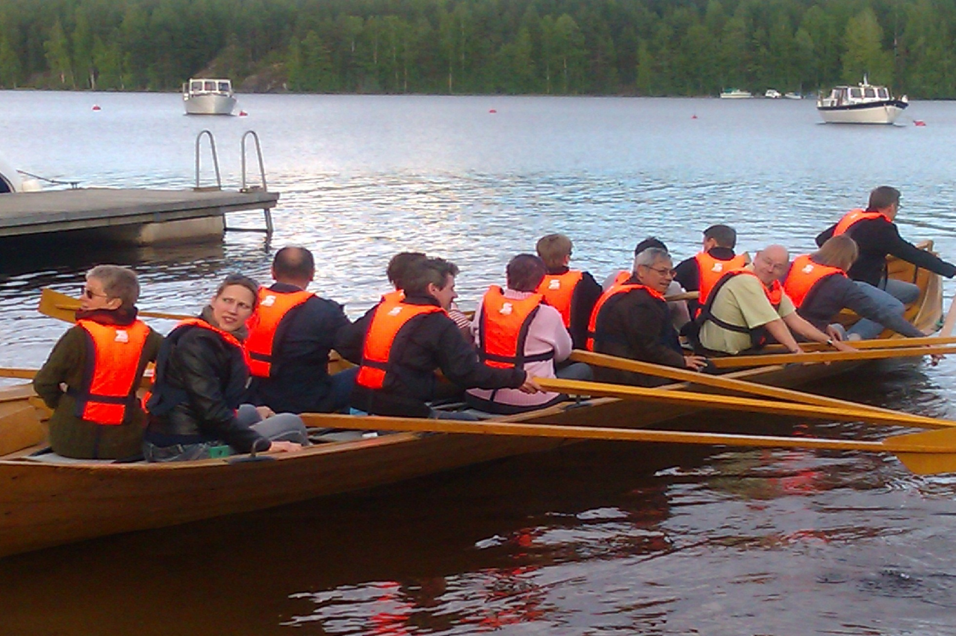

Slide 14
BASIC ELEMENTS
All the elements of study counsellor education are interlinked with regard to content and time, and are completed with summarising assignments.
The various stages of the education may be rather individual and include a personal focus, because students’ backgrounds, competences, and expectations vary considerably.

Slide 15
BASIC ELEMENTS
Our Study Counsellor Education programme includes a more comprehensive interpretation of the large-scale expertise of study counsellors. It also seeks to develop each student’s work and operating environment on a practical level.
This implies the aim of becoming deeply aware of one’s own philosophy of counselling and guidance. These objectives are reached through thematic entities.
The content and proceeding of the themes are based on students’ growth into the profession through research on their own work

Slide 16
In-house training of staff within PES

Slide 17

Annual program
Local training
Employment and
economy
development
offices
Customer service training program
for employment consultants and psychologists
Professional program
for consultants
Professional program
for psychologists
Centres for
Economic
Development,
Transport and the
Environment
Courses on different areas of expertise
Unemployment
benefits
Legislation
Public labour
services
Basics of
business
Counselling
methods
Current
interests etc.
ESF projects
-Guidance and
counselling
(TE-ERKKERI and
Laituri)
Management training
Program for Specialist
vocational qualification
in management
Program for
Immediate
managers
Courses on
current interests

Slide 18
An example of longer training programmes:the customer service training program
for employment consultants and vocational psychologists, group size 25, participants come from all over the country
Lasts about one year and includes for example: strategies and values of adiministration, Finnish educational system, links between education and labour politics, different information sources and tools to analyze the fenomenons of labour markets, laws and concrete tasks of each officials, communication skills, tools for developing one´s own work and how to create constructive discussion at work
5 contact periods (3 days) and assignments to be done at work between the periods

Slide 19
After one year training progamme divides for two parts:
The program for employment consultants focuses the customers they meet and services they provide. Three contact periods that focuses the roles ande interpersonal skills in customer service, guidance and counselling methods, serving the jobseeker and serving the employer.Each student has to videotape an appointment with the customer. Tapes are viewed and analysed in small groups.
The program for vocational psychologists also consists of three periods (of four or three days). The students analyze their own professional identity and personality in customer service. They learn counselling theories and methods, skills and tests (personality, interest and ability tests) and to give statements and reviews. Also the psychologists videotape an appointment ja give and receive feedback of it.

Slide 20
Some examples of shorter courses:
Current interests and changes in politics
Guidance and counselling methods
(basic courses and also courses for more advanced counsellors and psychogists, for example sociodynamic counselling, solution-focused counselling, motivational interviewing, multicultural counselling etc )
Internet and CC services
Different customer segments and theír services
Ethics and values at work
Customer groups: youth, immignrants, vocational rehabilitation
Entrepreneurship
Unemployment benefits
Summer courses on well-being
***

Slide 21
Jukka Lerkkanen
jukka.lerkkanen@jamk.fi
Merja Niemi-Pynttäri
merja.niemi-pynttari@salmia.fi
Marjatta Vanhalakka- Ruoho
marjatta.vanhalakka-ruoho@uef.fi
Jaana Kettunen
jaana.h.kettunen@jyu.fi

