Slide 1
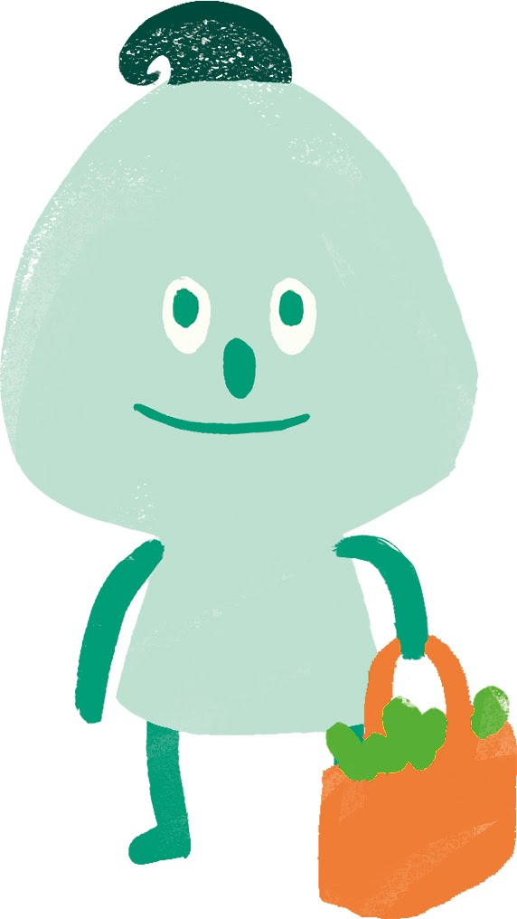


Mankola Comprehensive school
The greenhouse yearcalender

Slide 2
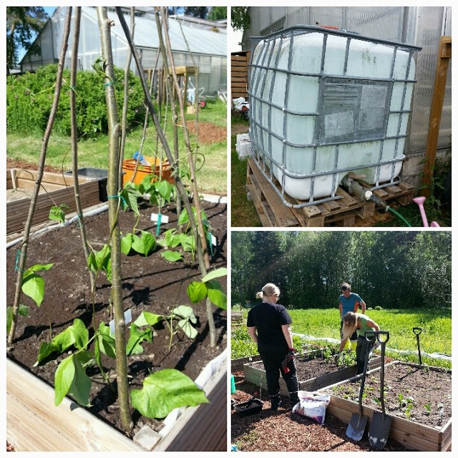
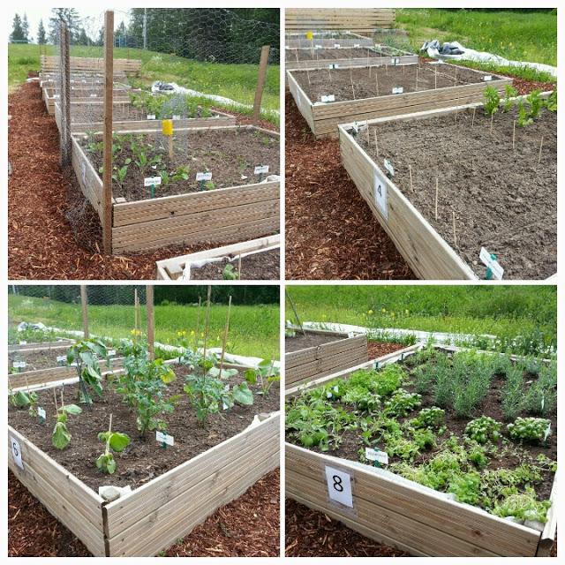
June and july
JAMK, Jyväskylä University of Applied Sciences and its students of sustainable gastronomy and their teacher Minna Junttila take care of the garden. Help provided by JAO Jyväskylä College
Taking care of the birds and watering the wintergarden, Teacher Pekka Männistö and the staff of the afterschool services

Slide 3
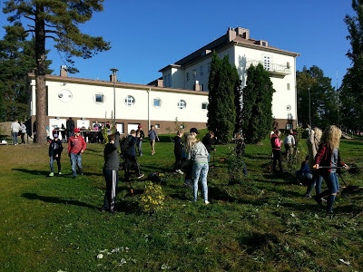
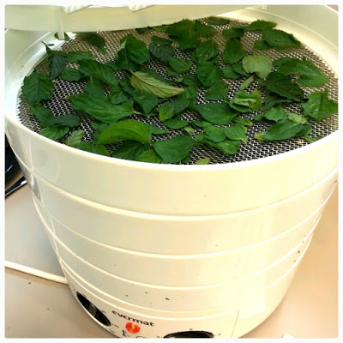
Auqust
Planting the last herbs
Cleaning the birdcages and changing the bedding
Cutting and raking the meadow outside the greenhouse
Cleaning the plantpots
General arranging in and out the greenhouse
Harvesting the garden
Drying and packing the herbs
Documenting the activities (videos, texts, interviews etc.)
Planning the annual school themeday Makosa
Starting the nature club, teacher Pekkä Männistö and Sanna Penttinen

Slide 4
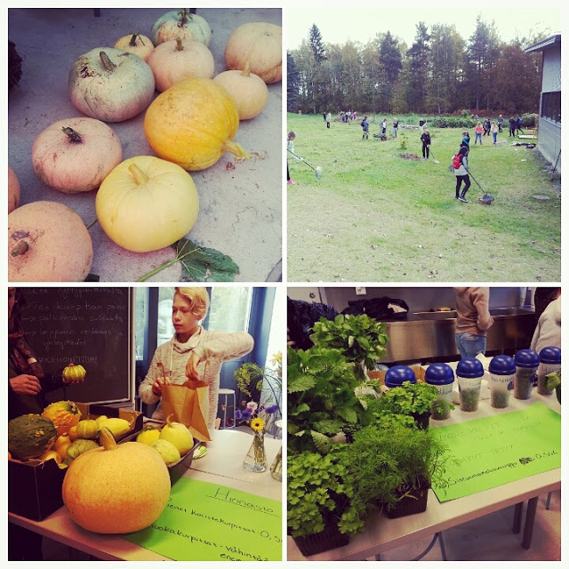
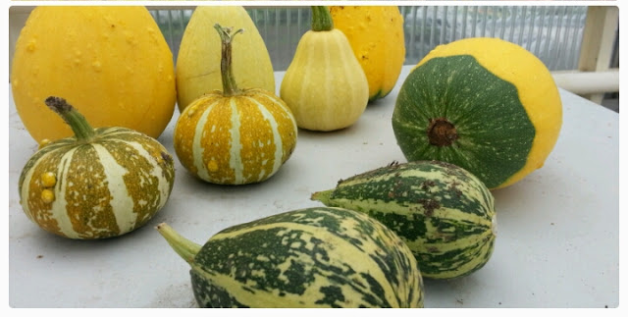
September
* Harvesting pumpkins
* The school themeday Makosa
Taking care of the compost
Washing the sapling growing space with a pressure washer
General maintenance
Collecting material for christmas decorations
Projectwork with Lithuania, The Sapling Academy

Slide 5
october
* Handicrafts, planning and realizing crafts, integration of subjects and pupils of different study years
* Projectwork with Lithuania

Slide 6
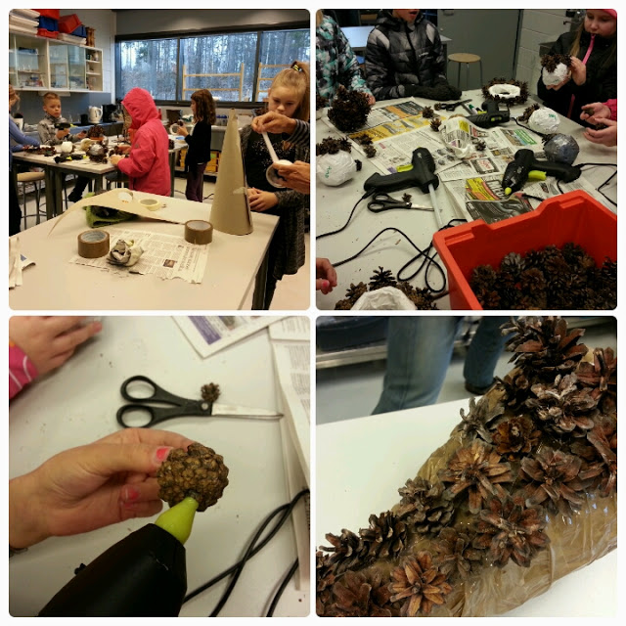
November
Crafts, christmas decorations
Finishing the Yearcalender

Slide 7
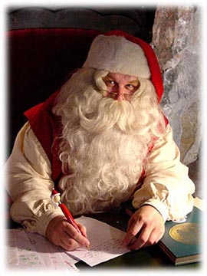
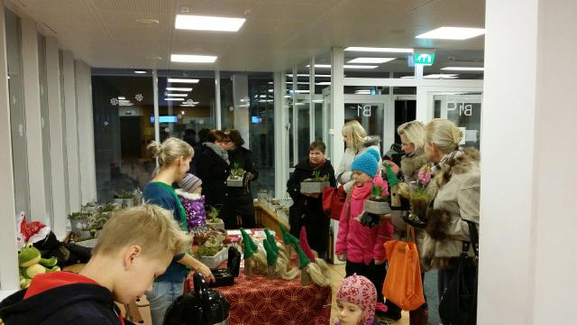
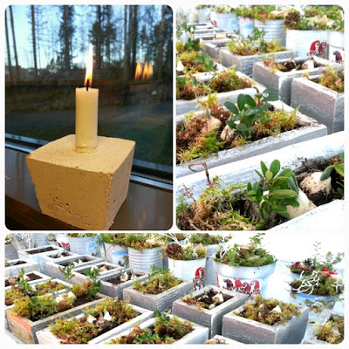
December
The annual christmas fair, planning, marketing and bookkeeping
Young entrepreneur fair
Project work with Lithuania
The end of the project with The center for economic development, transport and the environment

Slide 8
January
Maintening the contemporary cooperation with different partners
Planning the planting for the spring and ordering of the seeds

Slide 9
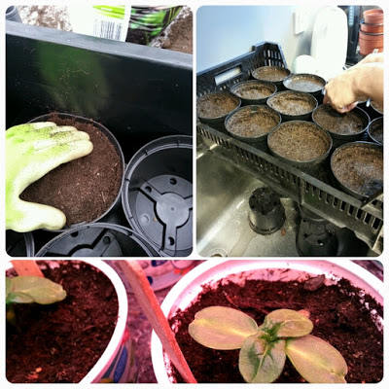
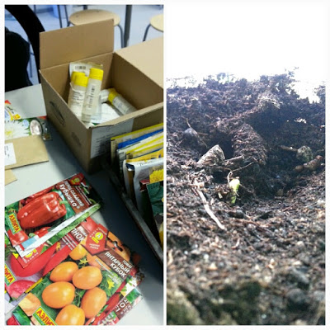
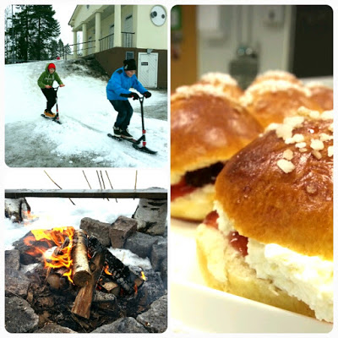
Febuary
* Planting, training the plants, taking care of the plants
* Shrovetide event at the greenhouse
* Projectwork with Lithuania

Slide 10
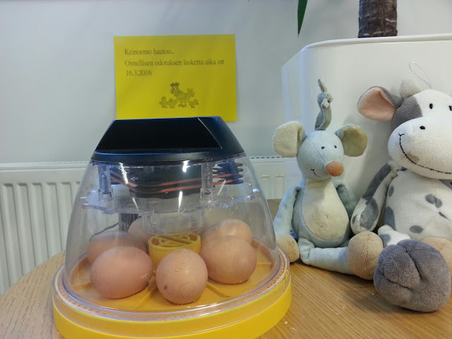
March
Taking care of the plants, planting them into pots
Incubation of eggs for chickens
Projectwork with Lithuania

Slide 11

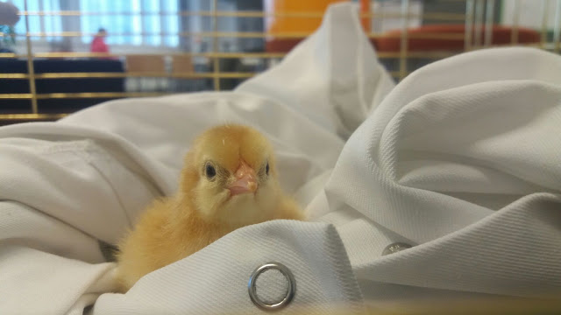
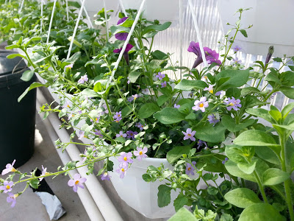
April
Icubation of eggs in the Easter week
Planning the outside garden (JAMK, JAO)University of applied sciences and Jyväskylä college
Pregrowing and maintenance of plants for the outside garden
Project visit from Lithuania

Slide 12
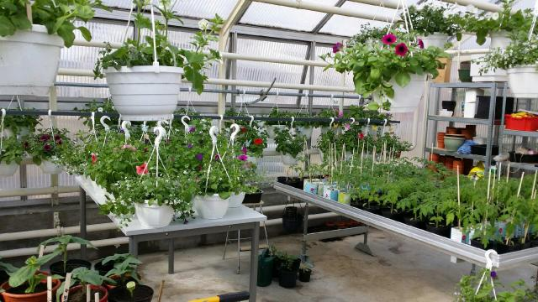
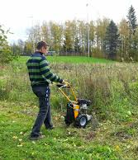
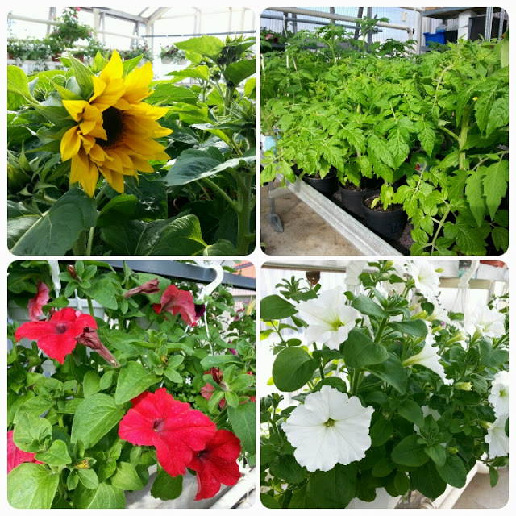
May
Planning the marketing and selling the plants and flowers
Advertising, selling training for the selling of plants
Bookkeeping
cutting and raking the meadow
Cleaning and maintenance of the greenhouse and its surroundings

Slide 13

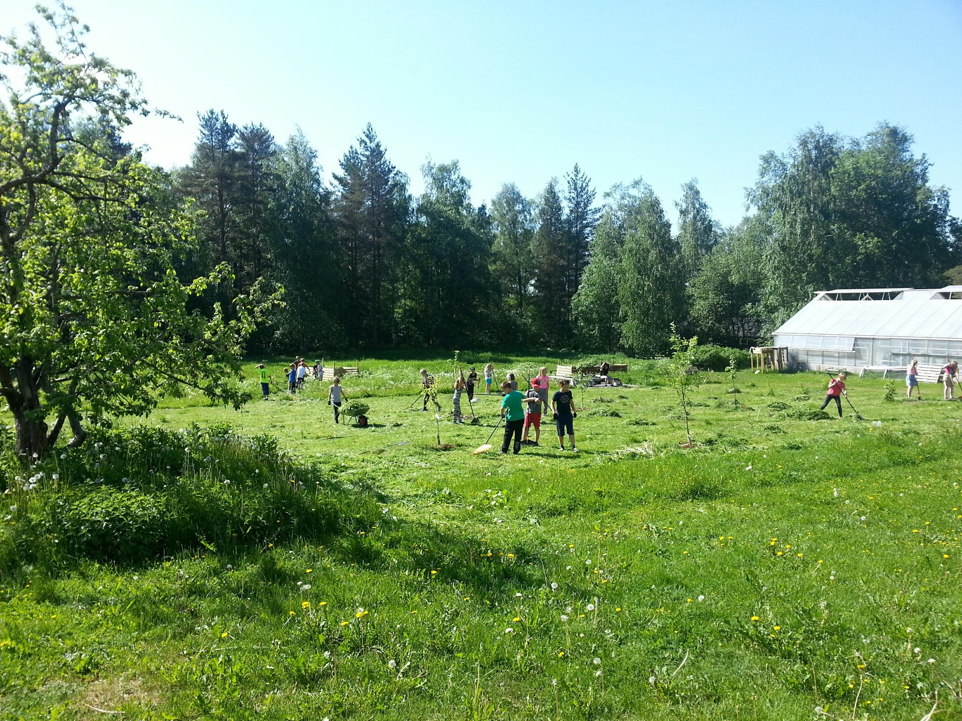
Made by: Atte Uusitalo
References:
http://mankolankasvihuone.blogspot.fi/
http://www.best-things-in-hungary.com/hungarian-christmas-recipes.html

