Slide 1
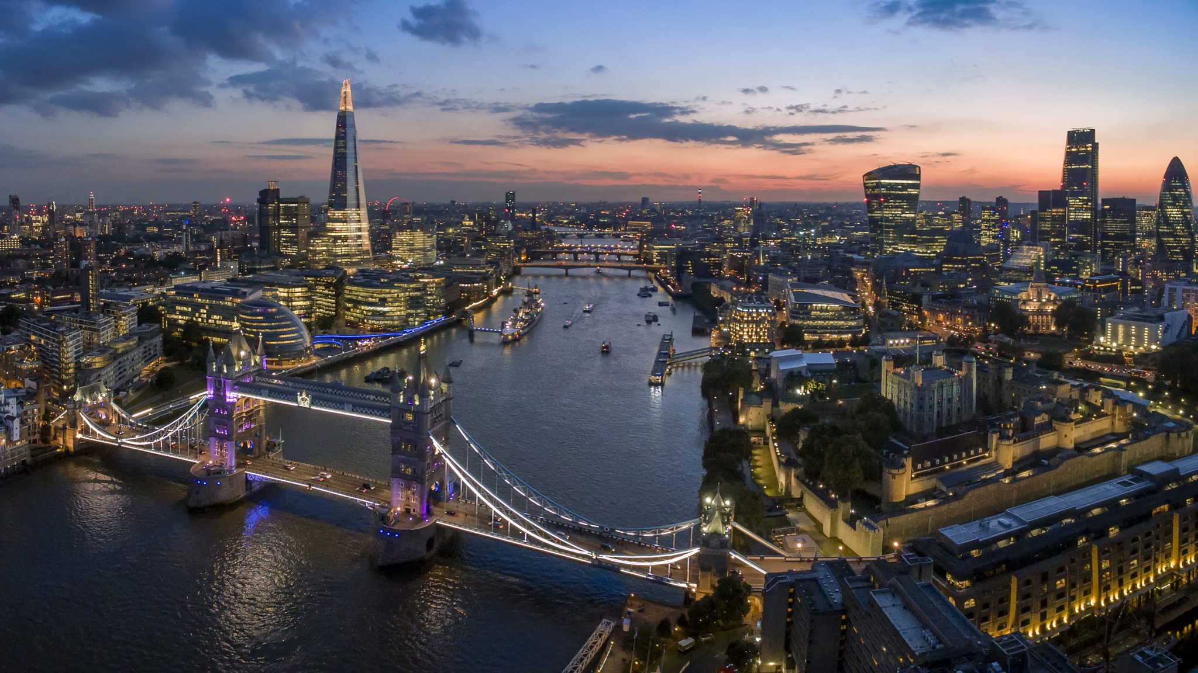
Famous people in London

Slide 2
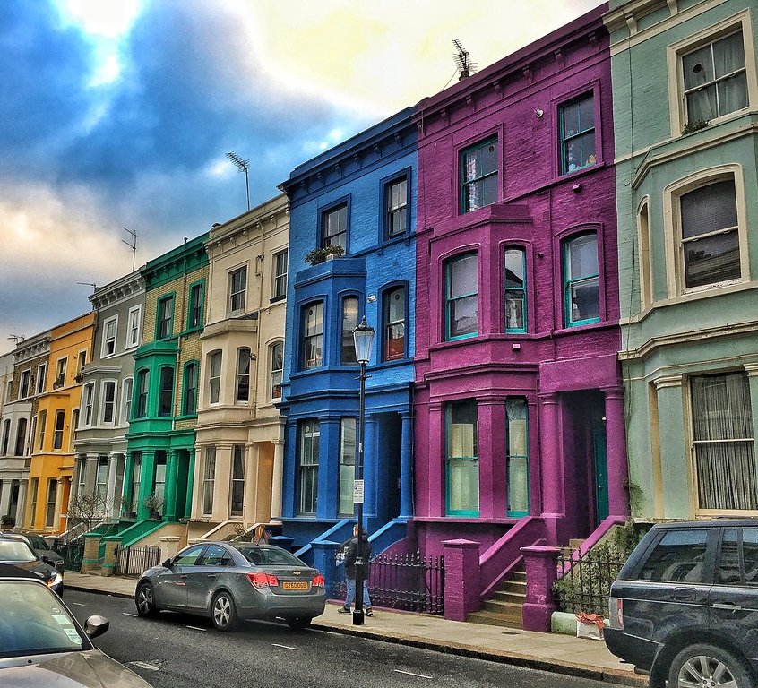
Notting Hill
Richard Branson, the founder of Virgin group
Famous pop-singer Robbie Williams
Fashion designer Stella McCartney

Slide 3
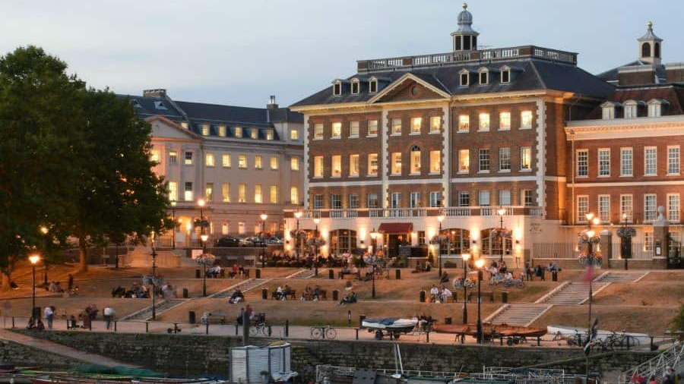
Richmond
Rock musician Mick Jagger
Actor Brad Pitt
Actress Sandra Bullock

Slide 4
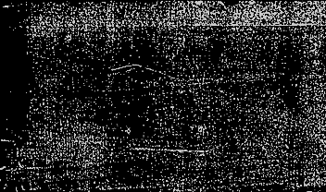
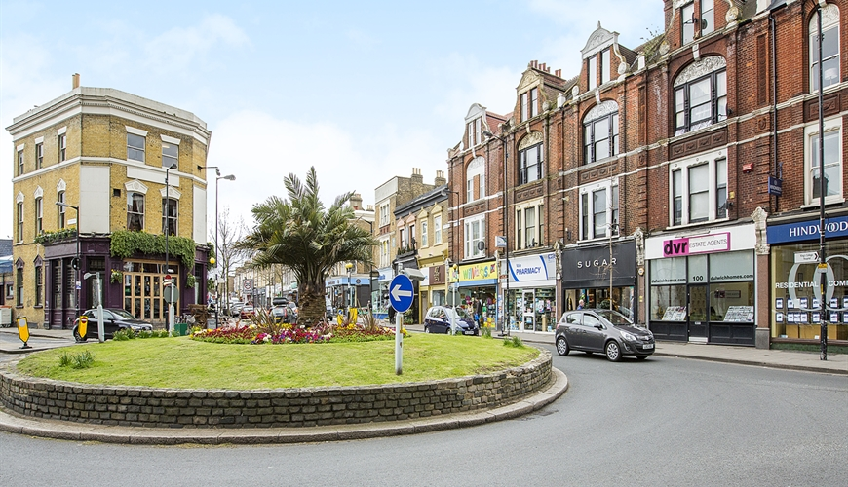
East Dulwich
Actor Tom Cruise has lived here
Actor James Nasbitt
Actor and comedian Steve Frost

Slide 5
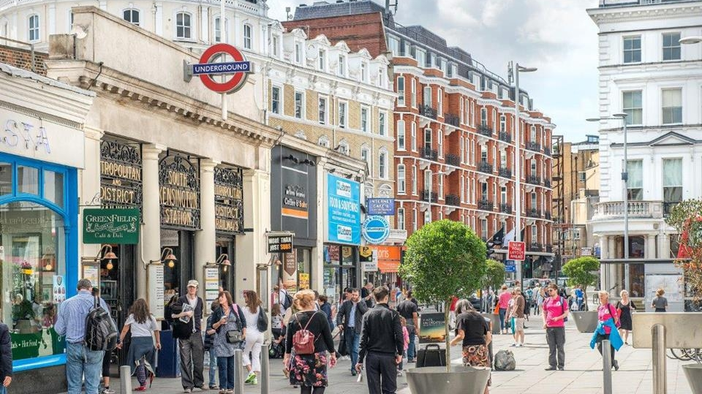
Kensington & Chelsea
Business magnate and former chief executive of the Formula One Group Bernie Ecclestone
Footballer David Beckham and his wife Victoria
Singer Kylie Minogue

Slide 6
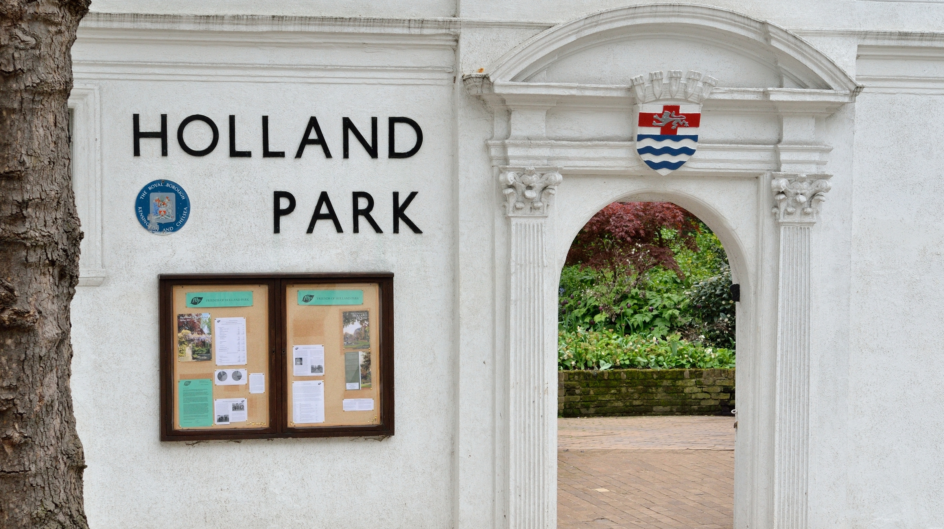
Holland Park
Singer Elton John
Television music and talent show judge, businessman, television producer and entrepreneur Simon Cowell
English broadcaster and natural historian Sir David Attenborough
Fashion designer Stefano Gabbana

