Slide 1
Konditionaalit
New Insights
Module 2 Grammar

Slide 2
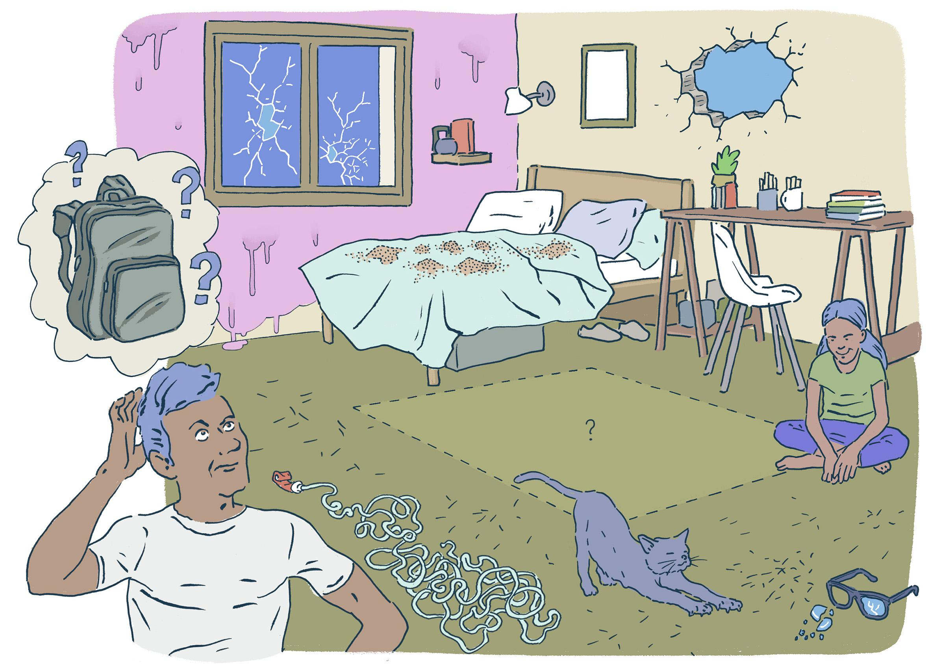
What would you do if your room looked like this?
Say at least 10 things that you would do.

Slide 3
Read the note and find the different ways of saying the Finnish -isi in English.
Dear Marsha
I would be happy if you apologized to me. Actually, if you bought me flowers to say sorry, it might be nice. You could even buy me something more meaningful. I think your friends wouldn’t make stupid jokes about me if you didn’t encourage them. If I didn’t love you, I would be walking away right now and not writing this note. Should I give you another chance or not? Not sure. I have feelings, too.
Derek

Slide 4
Read the note and find the different ways of saying the Finnish -isi in English.
Dear Marsha
I would be happy if you apologized to me. Actually, if you bought me flowers to say sorry, it might be nice. You could even buy me something more meaningful. I think your friends wouldn’t make stupid jokes about me if you didn’t encourage them. If I didn’t love you, I would be walking away right now and not writing this note. Should I give you another chance or not? Not sure. I have feelings, too.
Derek

Slide 5
Konditionaali päälauseissa
Suomen -isi:
would -isi
could voisi, osaisi
should pitäisi
might saattaisi
Apuverbejä seuraa pääverbin perusmuoto.
Should = ought to, mutta ought to on nykyään harvinainen.

Slide 6
Konditionaali ehtovirkkeissä
I would be happy if you apologized to me.
I think your friends wouldn’t make stupid jokes about me
if you didn’t encourage them.
Päälauseessa on would + pääverbin perusmuoto
ja sivulauseessa (if-lause) imperfekti.

Slide 7
Practise.
1. Miksi et voisi tulla kanssani sinne?
Why couldn’t you come with me there?
2. Juhlat saattaisivat päättyä myöhään.
The party might finish late.
3. Jos tulisit kanssani, minun ei tarvitsisi pelätä pimeää.
If you came with me, I wouldn’t have to be afraid of the dark.
4. Olisitko sankarini, jos mörköjä tulisi vastaan?
Would you be my hero if bogeymen/spooks met us?

Slide 8
Practise.
5. Milloin meidän pitäisi lähteä?
When should we leave?
6. Jos lähtisimme ajoissa, juhlat olisivat vielä parhaimmillaan.
If we left early, the party would still be at its best.
7. Jos et olisi niin kova juhlija, minun ei tarvitsisi tulla joka paikkaan mukaan.
If you weren’t such a party animal, I wouldn’t have to come with you everywhere.
8. Saattaisin rentoutua enemmän, jos jäisimme kotiin.
I might relax more if we stayed at home.

Slide 9
Menneen ajan konditionaali - Muodostus
I wouldn’t have gone there
if I had known about the problems.
If Mike had believed me,
he would have made a fortune.
Kerrottaessa mitä aiemmin olisi tapahtunut / olisi tehty, käytetään menneen ajan konditionaalia.
would have done olisi …
could have done olisi voinut/osannut
should have done olisi pitänyt
might have done olisi saattanut
Sivulauseessa on pluskvamperfekti.

Slide 10
Practise.
1. Minun olisi pitänyt lähteä matkalle viime kesänä.
I should have gone on a trip last summer.
2. Meidän ei olisi pitänyt valittaa.
We shouldn’t have complained.
3. Tämä suunnitelma olisi kuulostanut hullulta, jollen olisi keskittynyt sanomaasi paremmin.
  This plan would have sounded crazy if I hadn’t focused / unless I had focused on your message better.

Slide 11
Practise.
4. Olisitko muistuttanut minua kokeesta, jos olisit muistanut sen itse?
Would you have reminded me of the exam if you had remembered it yourself?
5. Olisimme saattaneet juhlia koko yön, ellei seuraava päivä olisi ollut työpäivä.
We might have partied all night if the following day hadn’t been / unless the following day had been a work day.
6. Jos olisin haastanut sinut uusintaotteluun, olisitko yrittänyt enemmän?
If I had challenged you to a rematch, would you have tried harder?

