Slide 1
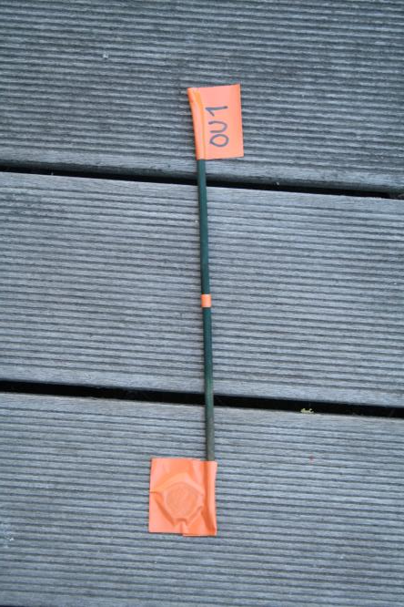
Temperature loggers 1/2: what are they?
Temperature loggers are a combination of thermometers and dataloggers. They record the temperature at preprogrammed intervals ( in our case, every 4 hours), and save the data on an integrated microchip. This way we can monitor the soil temperatures at our sampling sites for the duration of the experiment. At the end of the experiment (in May), the data will be transferred to a computer and analyzed.
Identification flag (and string)
Support stick (wooden, to avoid heat conduction). Enables also finding the logger!
Temperature logger, about the size of a button. In this photo the logger is only wrapped in tape
”Old model logger package”

Slide 2
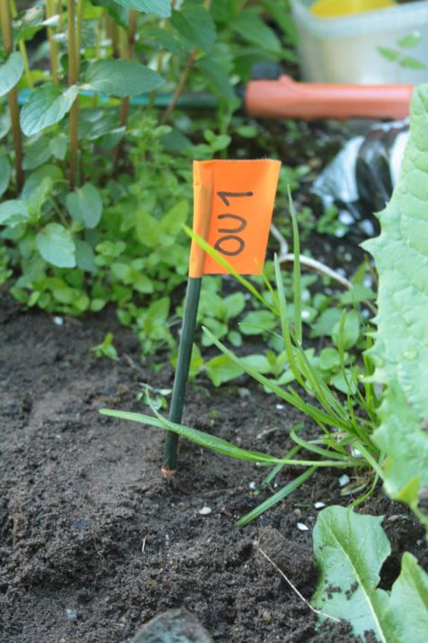
Temperature loggers 2/2: how to use them?
The height of the bag plus tape pack is approximately 10 cm. Bury the logger in the ground so that the top of the tape is NOT visible (see the picture on the right for reference)
OU1
In the ”new and improved logger package” the temperature logger is packed in a small plastic bag, and wrapped in protective tape, with which it is also fastened to the stick (The picture above to demonstrate the structure). This is what we sent to the schools. THESE LOGGERS ARE READY TO USE AS SUCH. JUST BURY IN THE GROUND AS SHOWN ABOVE

